Slide 1
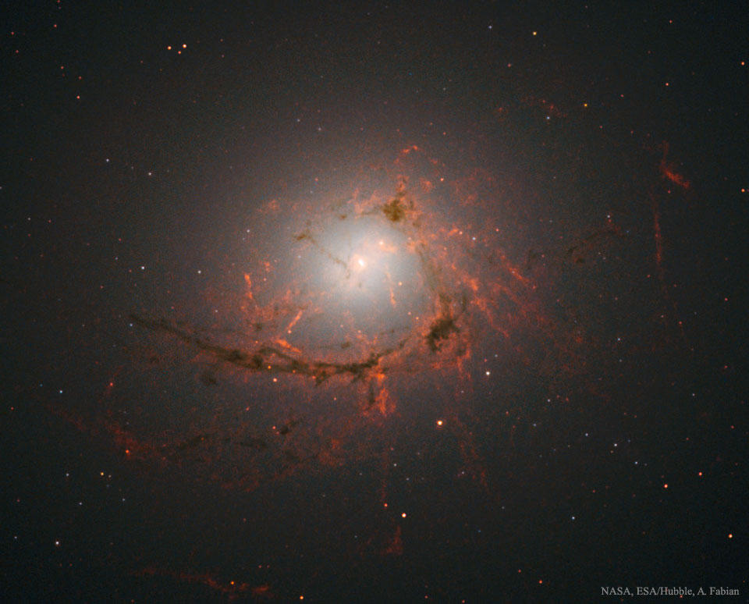
Hidden Cooling Flows
In
Clusters of Galaxies
Andy Fabian IoA Cambridge UK
with Jeremy Sanders, Ciro Pinto, Brian McNamara,
Gary Ferland and Stephen Walker
I:MNRAS 515 3336; II:MNRAS 521 1794; III MN in press, arXiv2306.11077

Slide 2
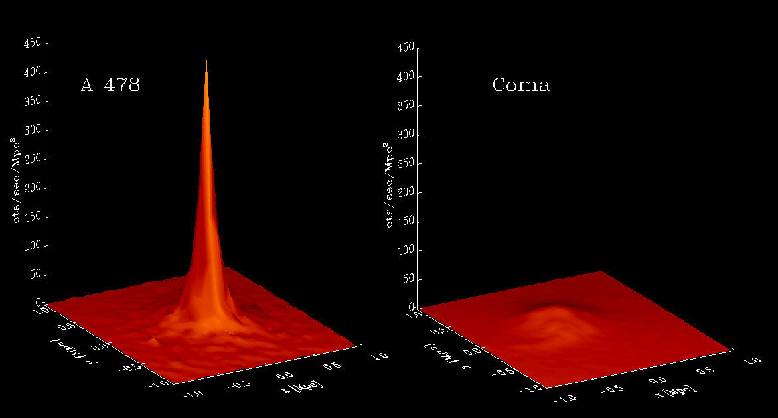
X-ray surface brightness of typical clusters of galaxies
Cool Core Non Cool Core

Slide 3
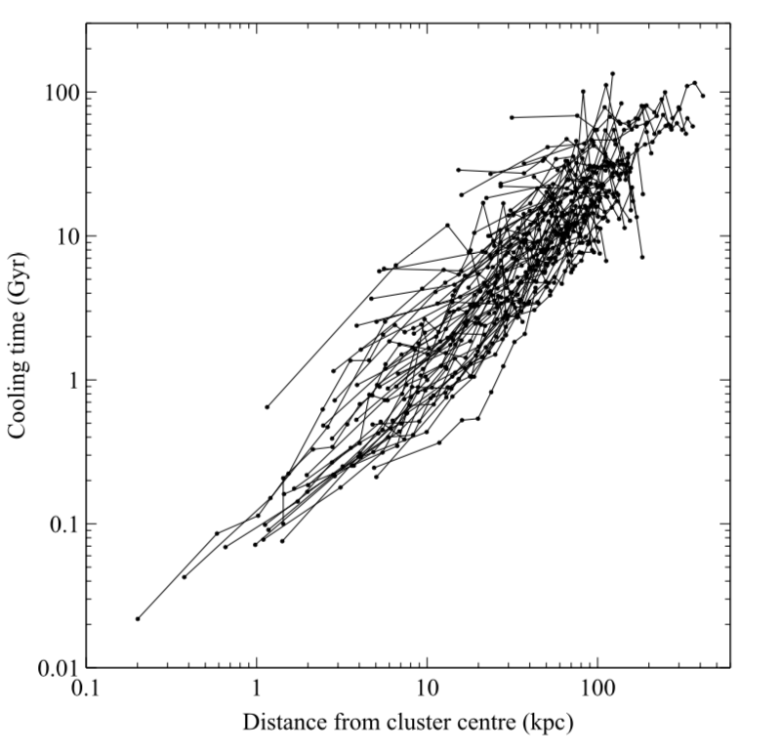
Radiative
cooling time
of hot gas
in 66 clusters
(Gyr)
10⁹ yr
10⁸ yr
Panagoulia+14; see also Hogan+17, Babyk+18
Radius (kpc)

Slide 4
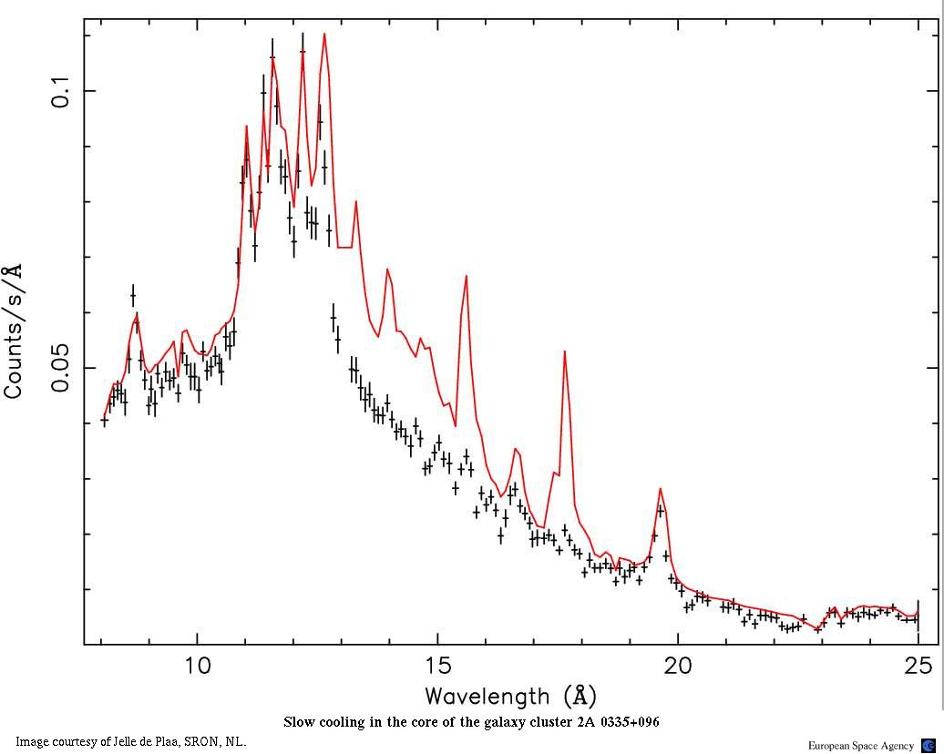
Lack of cool X-ray emitting gas
Spectra imply less than 10% of cooling rates expected from luminosity profiles
Typically temperature goes down to 1/2 to 1/3
of outer temperature
Fe XVII lines (indicating
gas at kT~0.5 keV)‏
missing
2A 0335+096
XMM RGS SPECTRUM

Slide 5
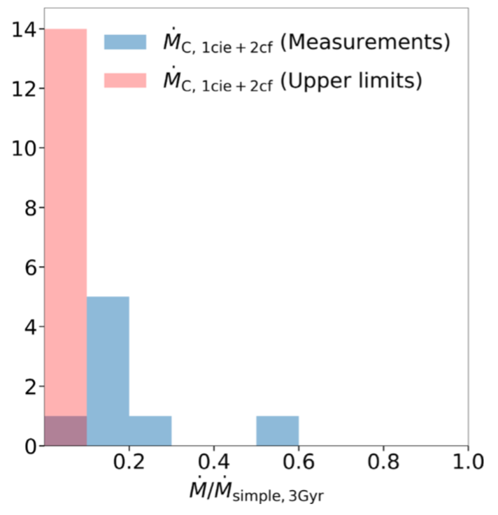
XMM RGS Spectroscopy
.
Liu+19
Little obvious cooling in RGS spectra of cool cores
Mdot_{simple}= M_{gas}(<r)/t_{cool} within radius r where t_{cool}=3Gyr

Slide 6
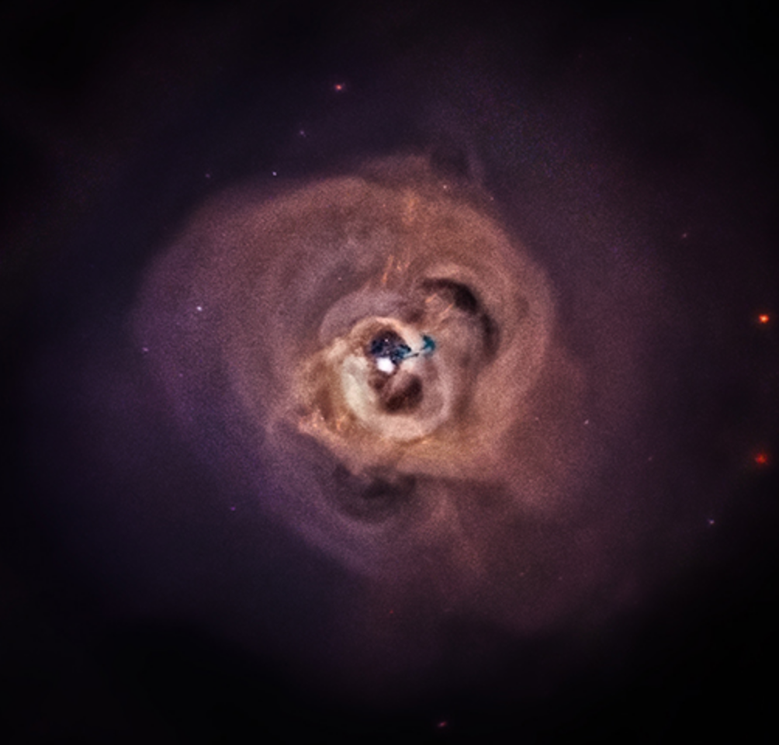
Weak shock
Filaments
Inner cavities
Outer cavities
Perseus Cluster A426 NGC1275

Slide 7
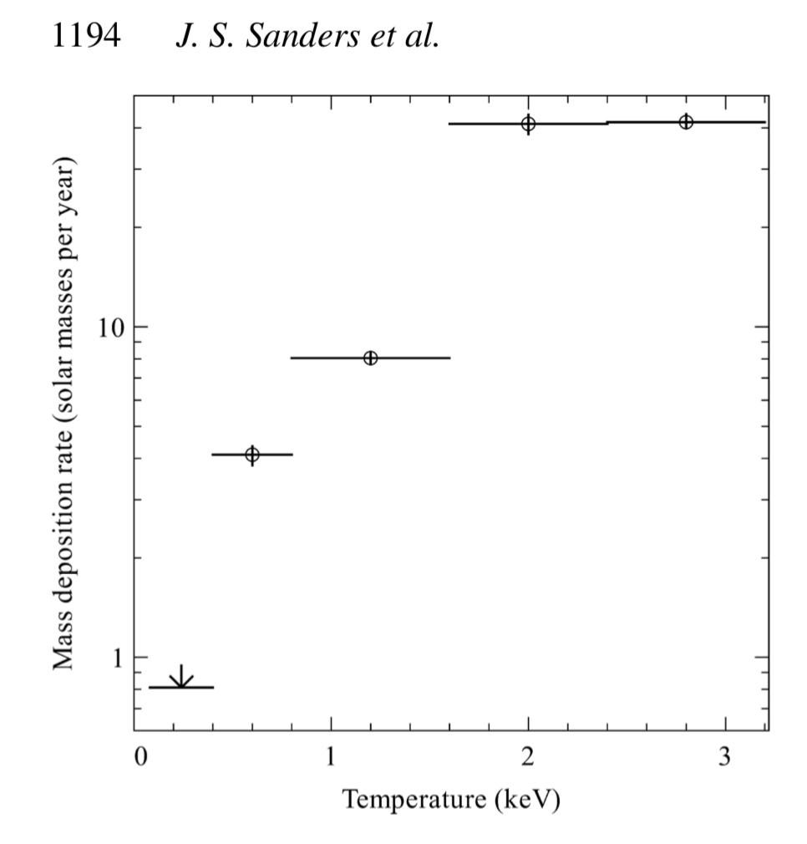
08 Centaurus
Mass
Cooling
Rate

Slide 8
AGN feedback in clusters and groups
appears continuous and gentle
Reduction of Mdot at small radii and
below 1 keV seems like fine tuning?

Slide 9
08 Centaurus
Mass
Cooling
Rate
Can complete decline in Mdot
be explained by photoelectric
absorption of the soft X-rays by cold gas?

Slide 10
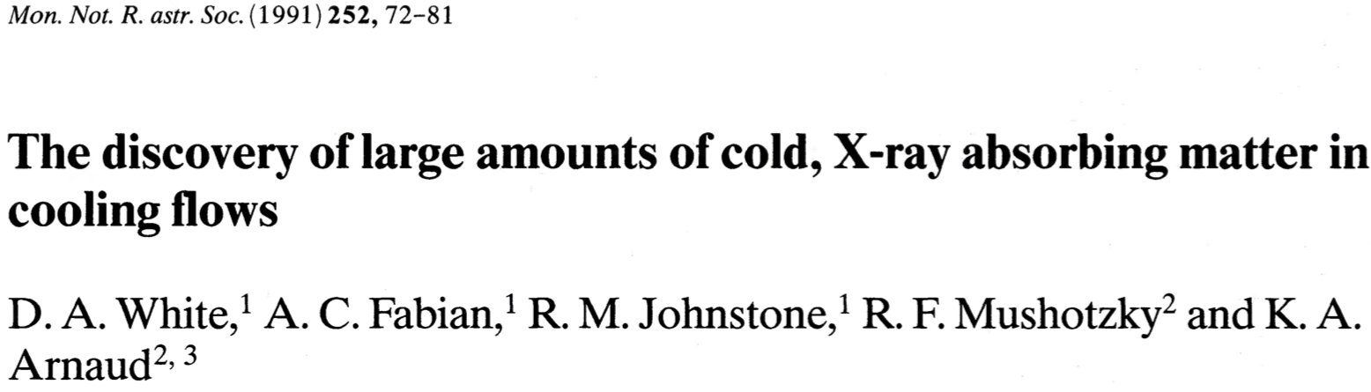
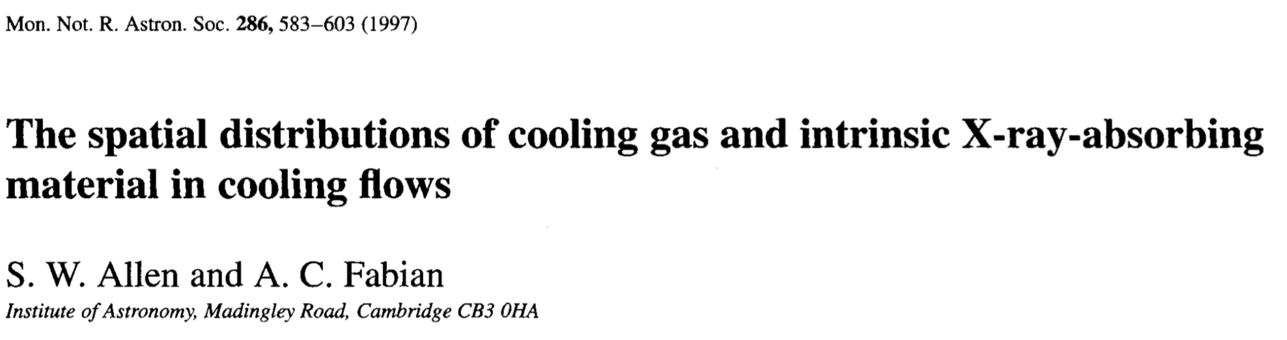
1991
1997

Slide 11
Hidden Cooling Flows?
Cold gas occupying same region as gas emitting soft X-rays
Need to (re)consider absorption of soft X-rays by cold gas
Use multilayer intrinsic absorption model first used on ROSAT PSPC data by Allen&Fabian97
Energy from gas cooling below 1 keV ultimately emitted by dust and gas in FIR +UVOIR

Slide 12
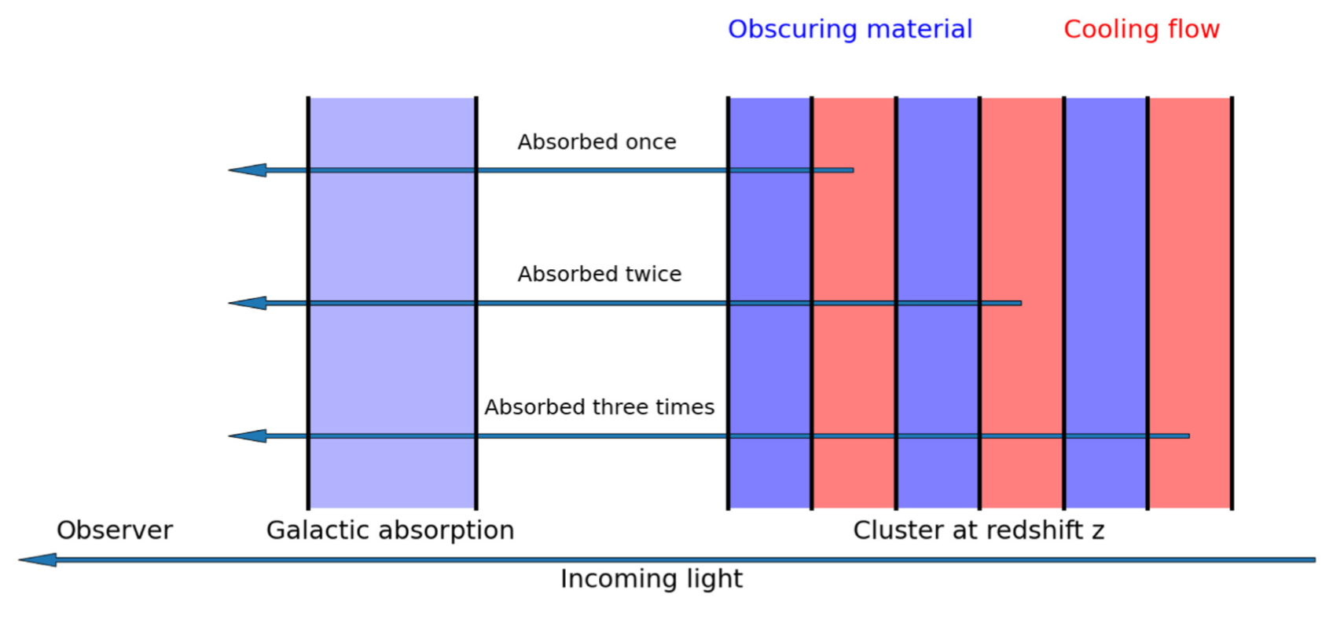
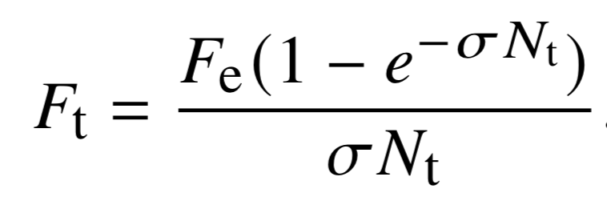
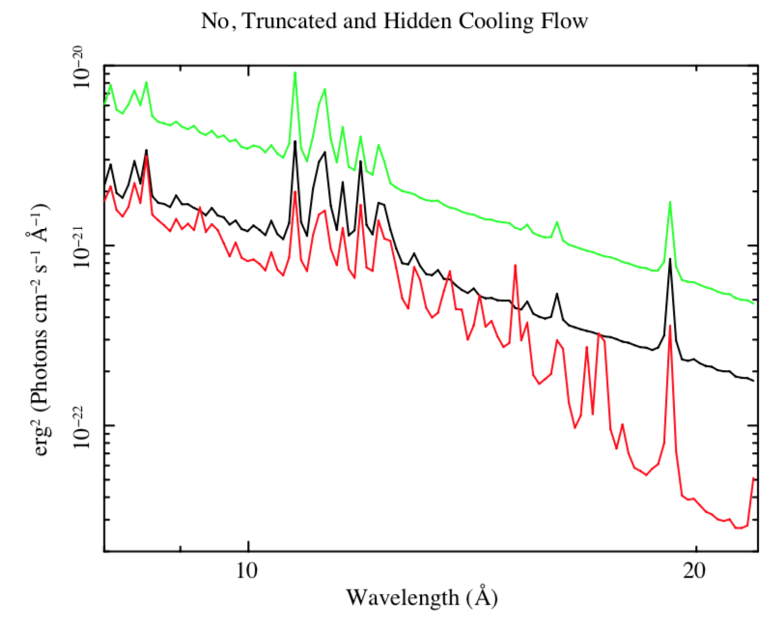
N_{t}
Crawford & Fabian 1992
Allen & Fabian 97 ROSAT
Allen 00 ASCA
Liu, Fabian+22 XMM
Also Werner+13, Walker+15

Slide 13
Centaurus
.
M~15
10²² cm⁻²
Perseus
.
M~80
HCFI Fabian+22a

Slide 14
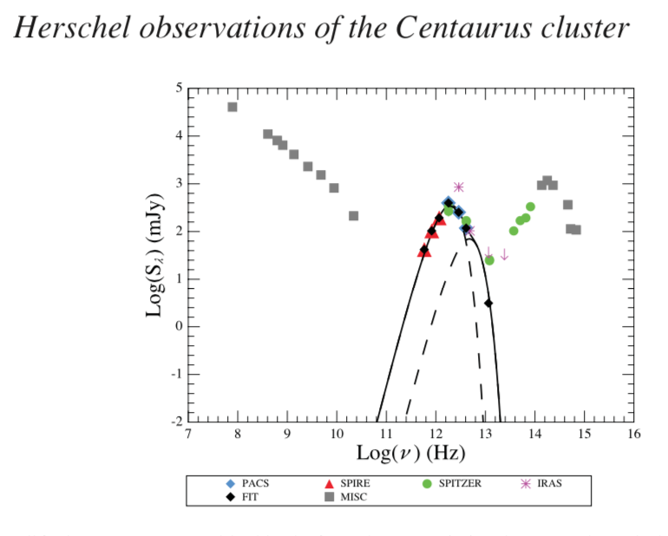
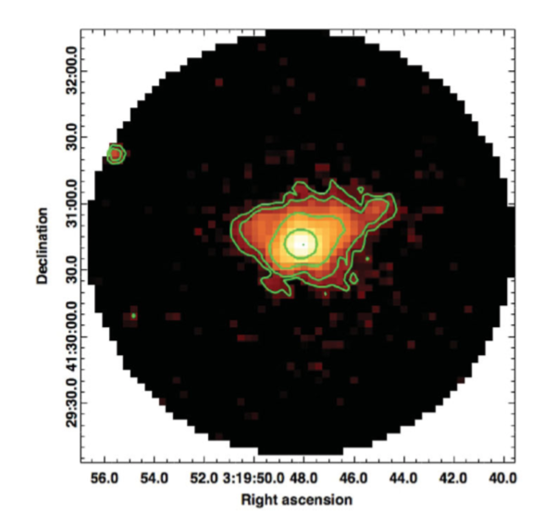
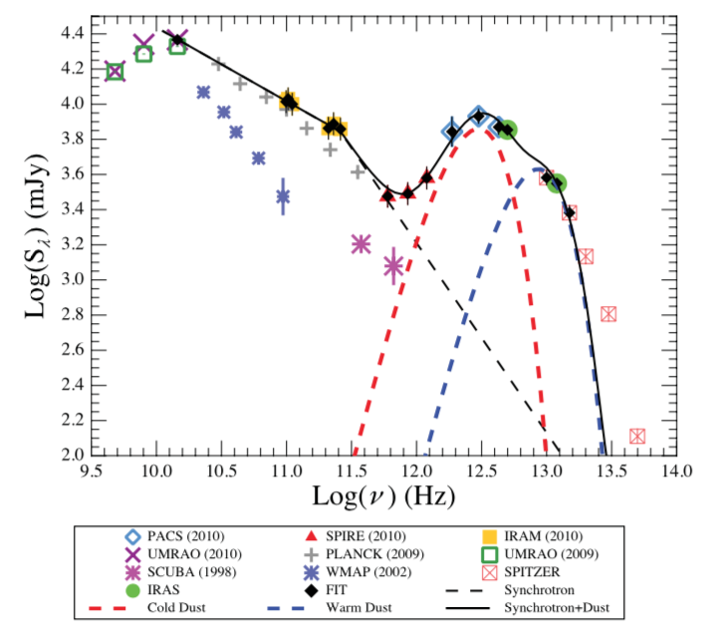
Far Infrared Mittal+11,12
Perseus

Slide 15
Will too much gas accumulate?
Maybe (In 1 Gyr, ~10¹⁰Msun in Cen, ~10¹¹ in Per)
What is too much?
There is a lot of cold gas observed in many CC (10⁸-10¹¹Msun)
Speculate: perhaps there is more in the form of ultracold clouds (<5K?)
Bubble shocks destroy clouds and drag gas outward, regulating total central cooled gas mass
Low mass star formation? High gas pressure lowers Jeans mass: Jura 1977; Fabian+82; Ferland+94… Bottom-heavy IMF van Dokkum+10, Oldham+Auger18 (M87)

Slide 16
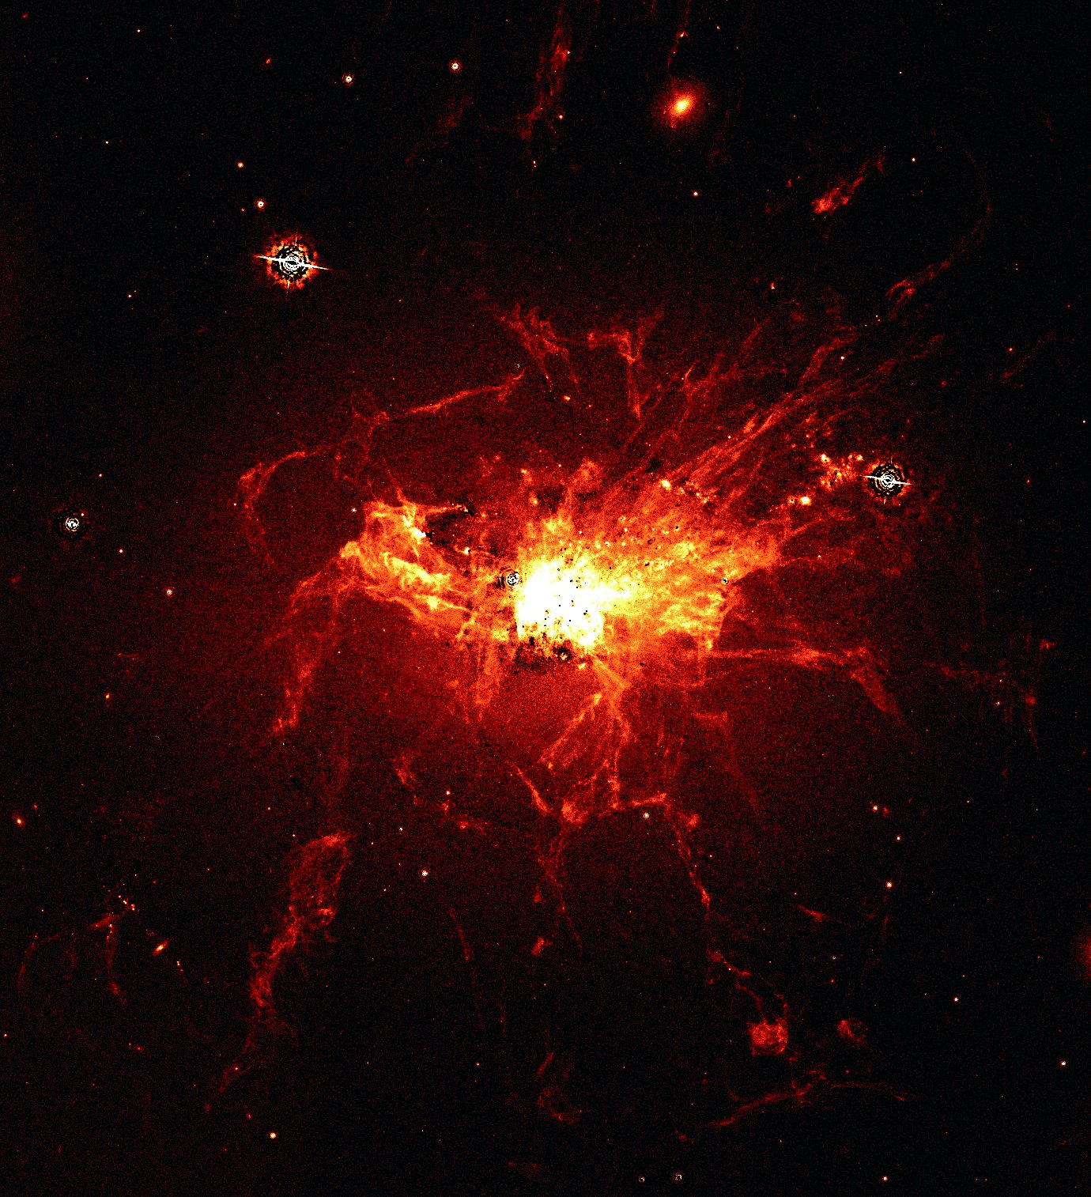

H$α$band
HST
Fabian+08

Slide 17
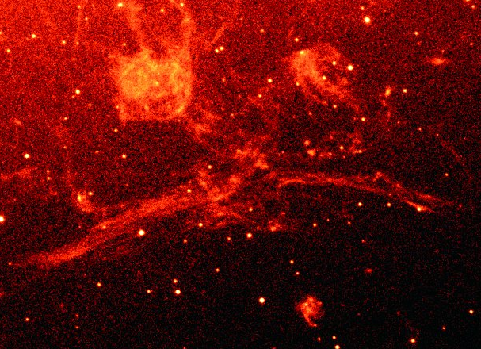
Optical spectrum of these filaments is unlike anything in the Galaxy,
except Crab. Due to energetic particles (Ferland+08/9)
or irradiation by absorbed soft X-ray spectrum (Polles+21).

Slide 18
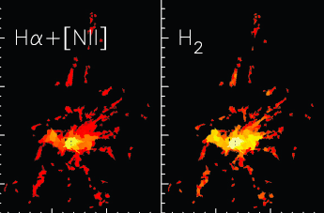
Lim+12

Slide 19
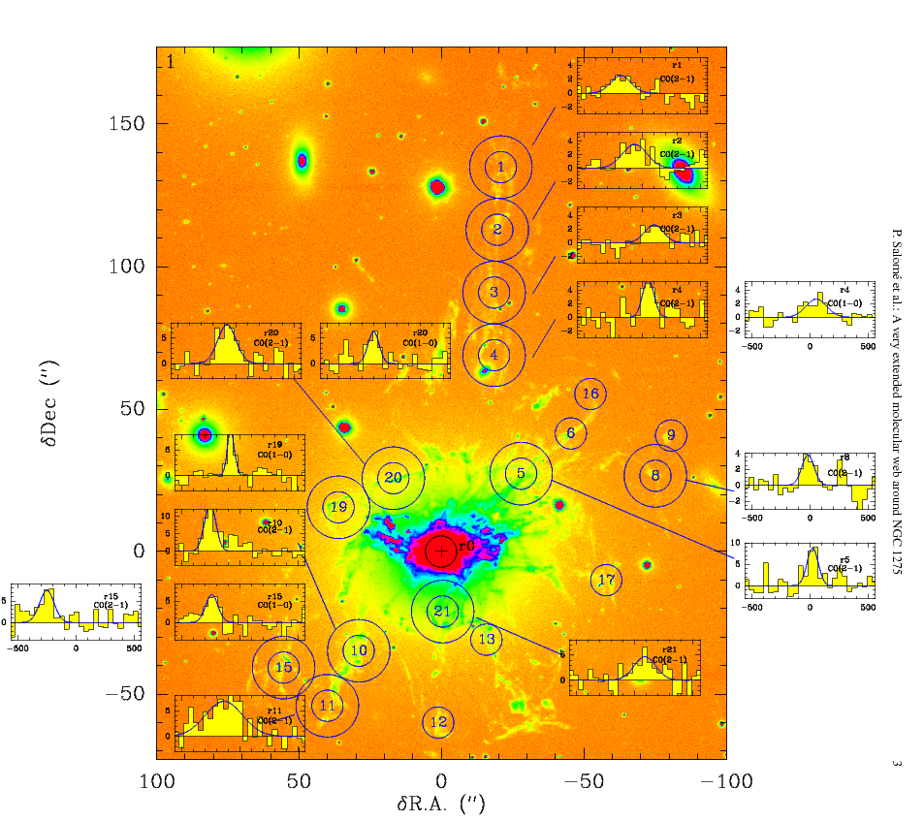
CO from IRAM
5x10¹⁰ M_{sun}
cold gas
Salome+06,10

Slide 20
Cooling time
Emission
30 yr
How cold can clouds go?
3K?
G Ferland

Slide 21
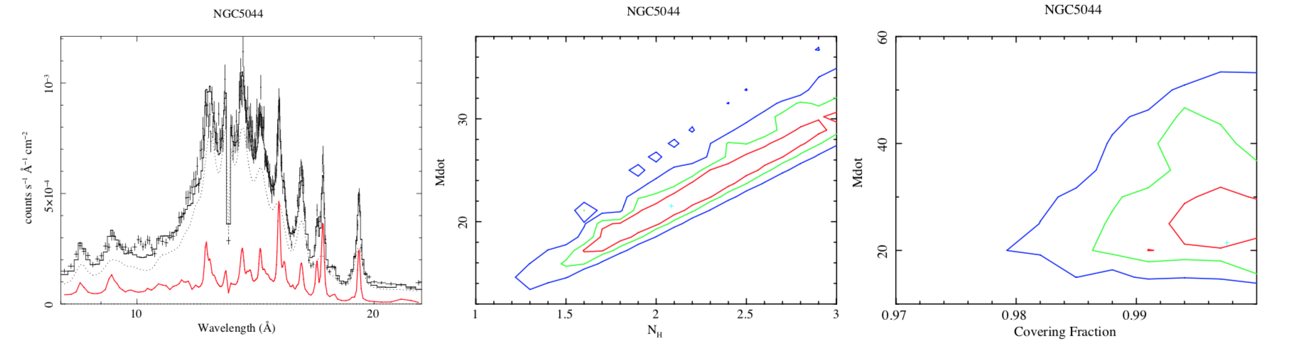
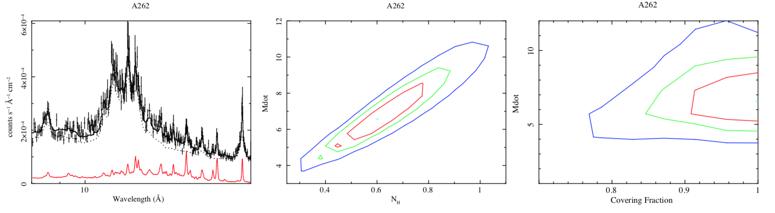
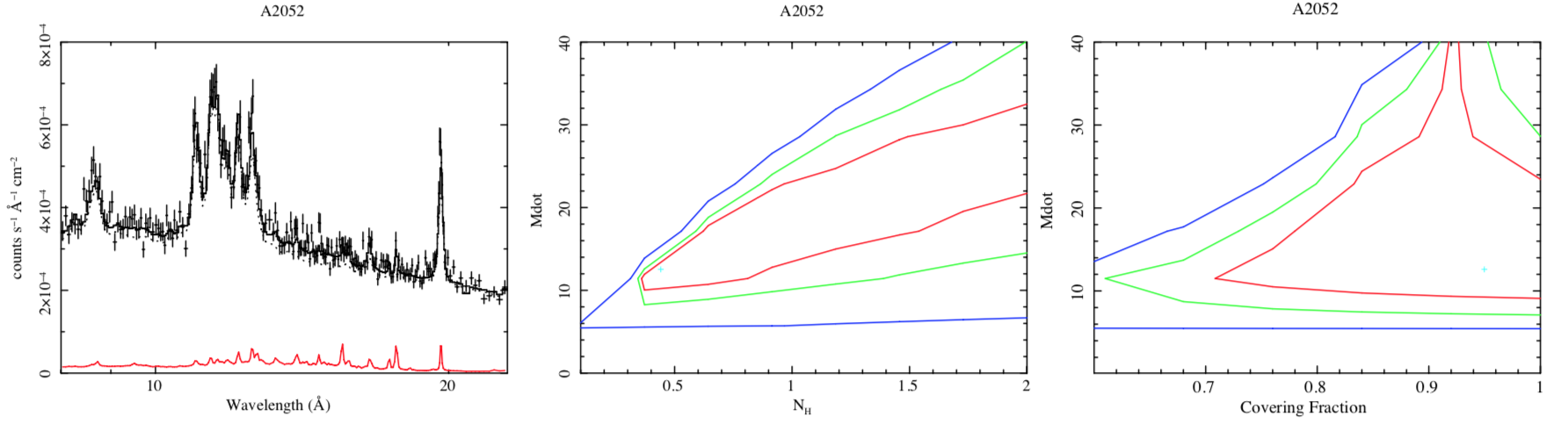
Group N5044
Mdot
N_{H}
Covering fraction
A262
Hidden Cooling Flows are common
A2052

Slide 22
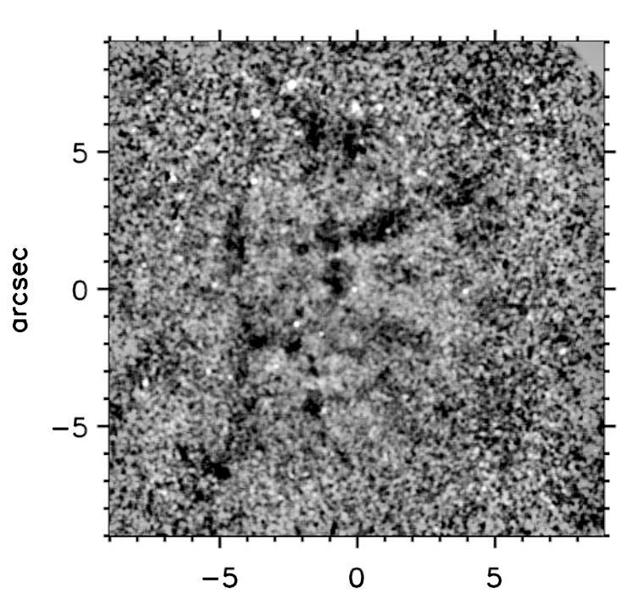
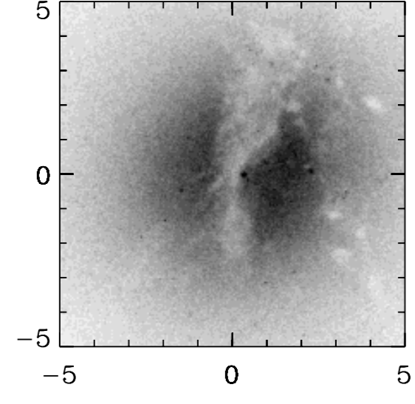
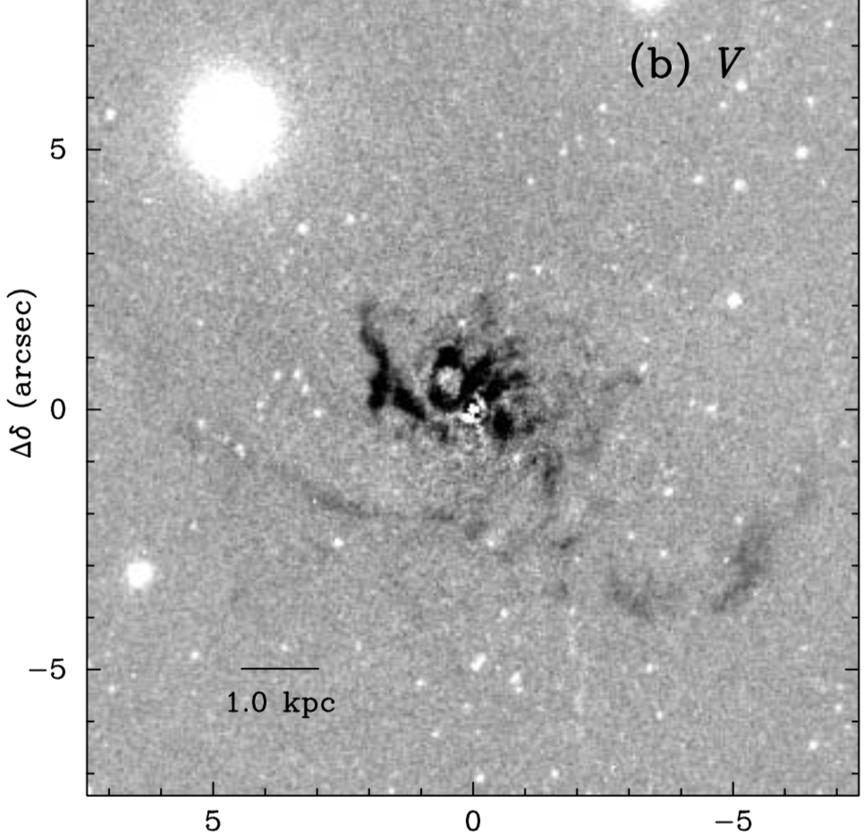
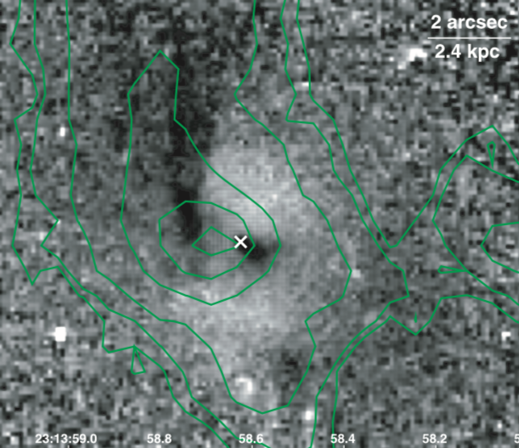
A262
NGC5044
HST images of cores
note patchy extinction
SERSIC 159
A2052

Slide 23
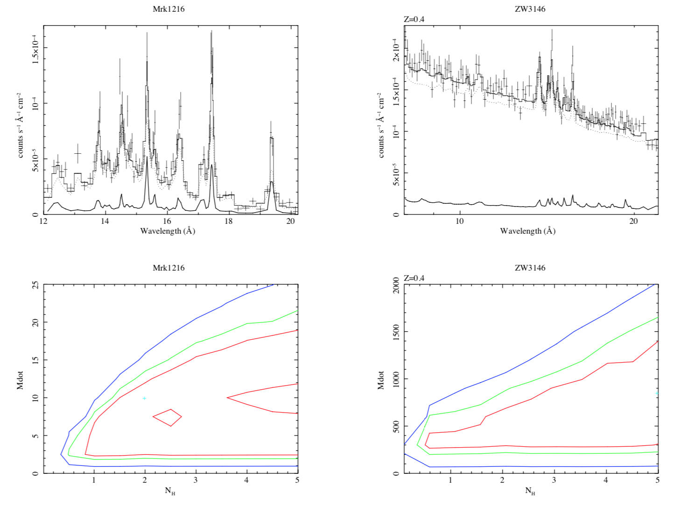
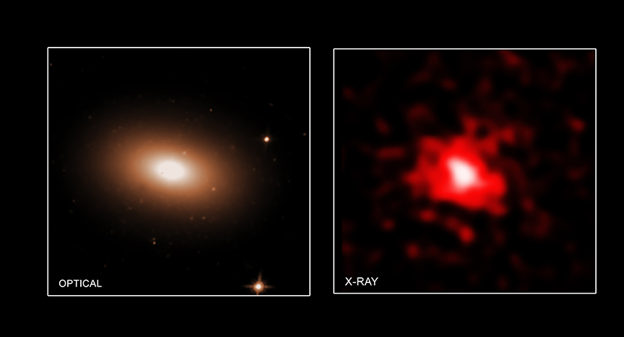
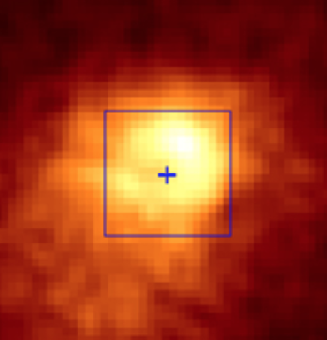
Fabian+23b

Slide 24
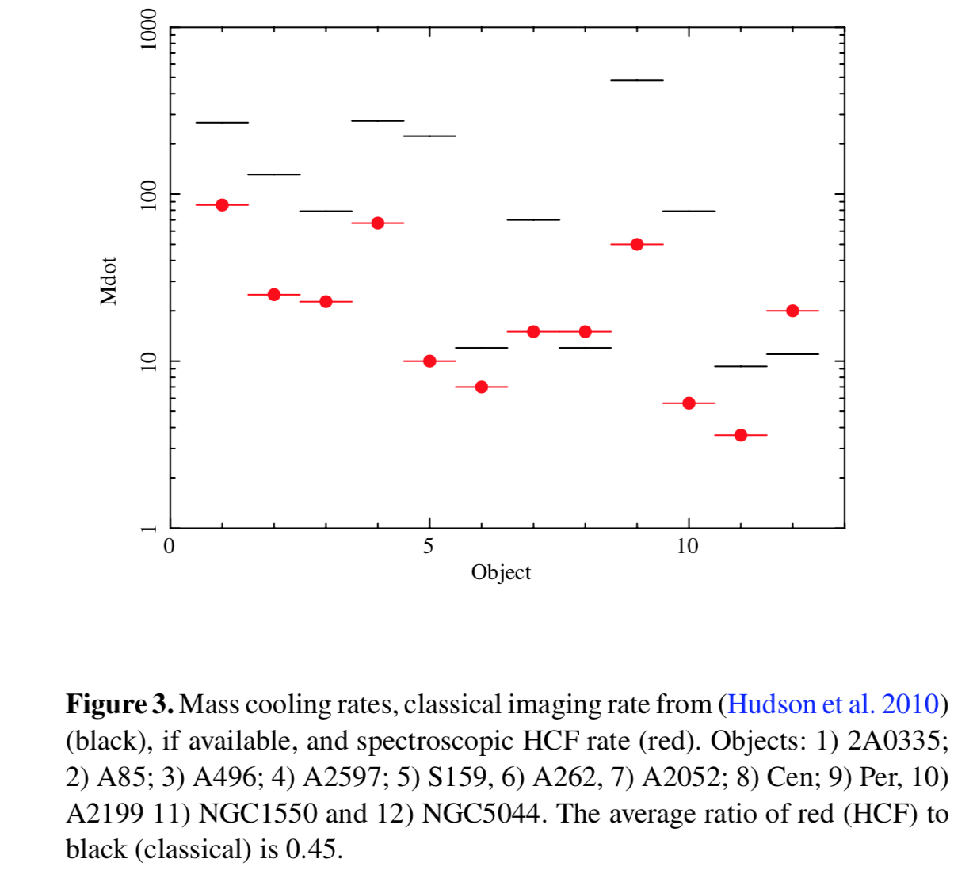
Black –
Classical
Red –
HCF

Slide 25
Growth of Central Black Hole
How much accretes into central black hole?
Gravitational torques act on substellar objects collapsed from very cold clouds, then swallowed whole, i.e invisibly.
Explain why so many of most massive BH are at the centres of clusters?
Like Holm 15A in A85 of 4x10¹⁰M_{sun} (Mehrgan+19)

Slide 26
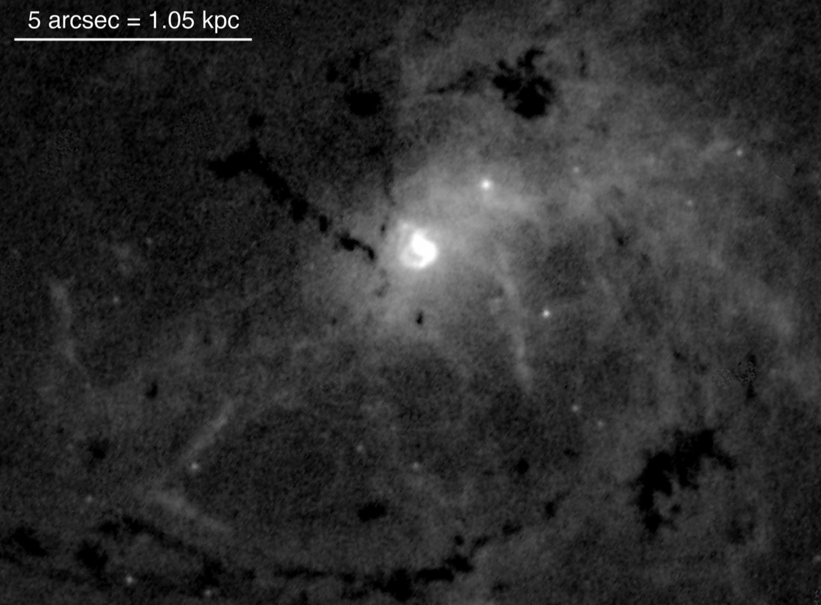
Centaurus in optical

Slide 27
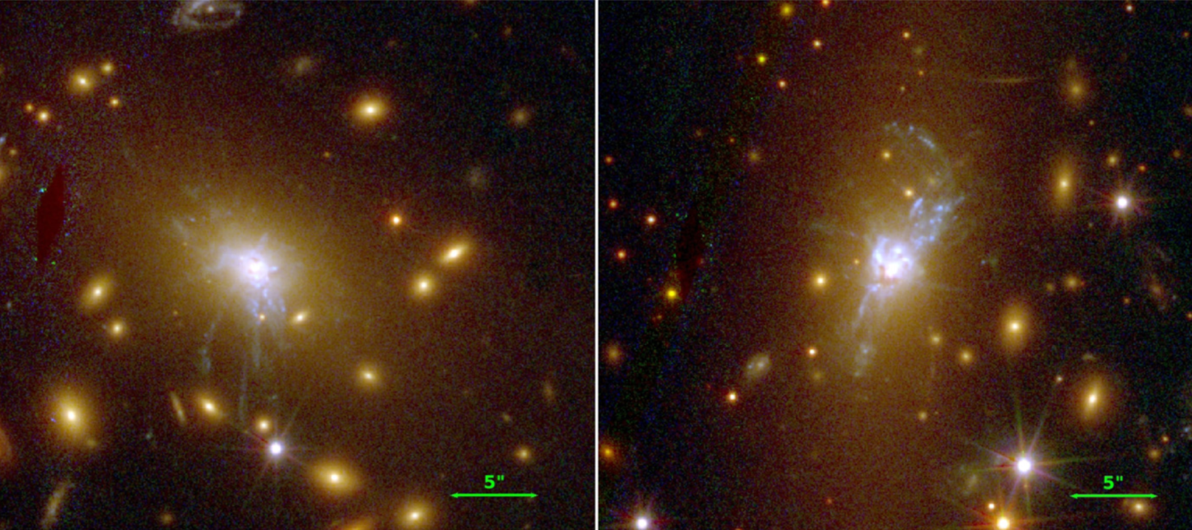
25kpc
RXJ1532 z=0.35 RXJ1931 z=0.36

Slide 28
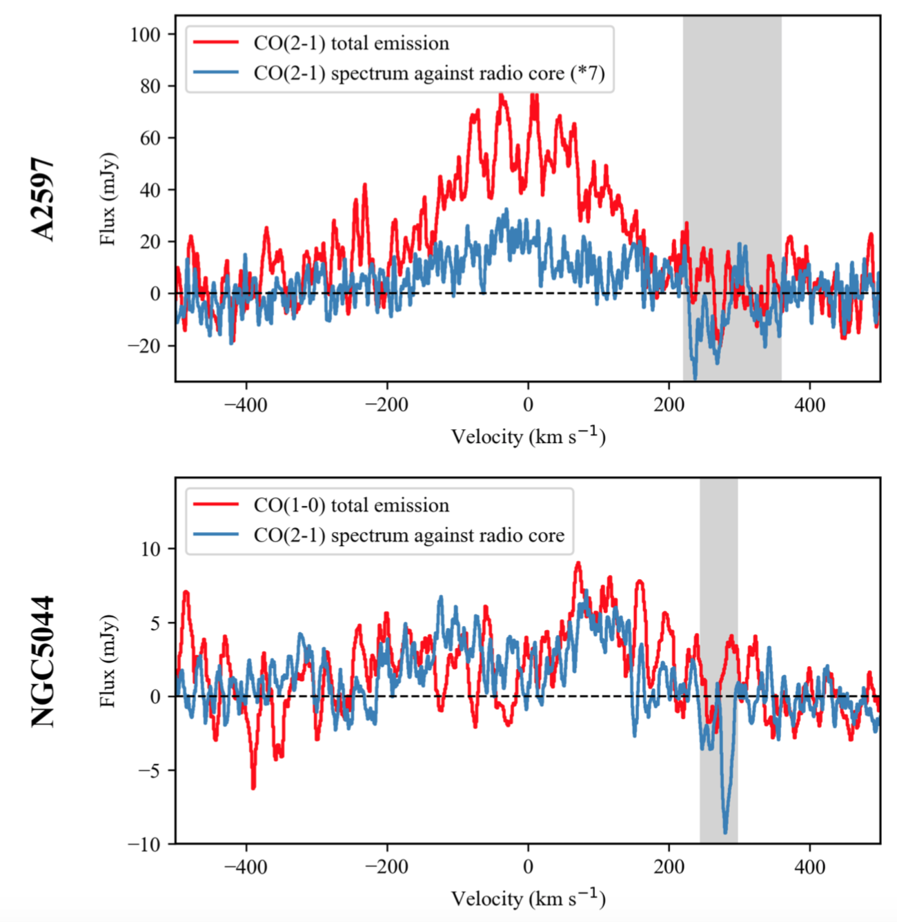
Absorption of nucleus by cold clouds
Blueshifted absorption
seen in some cool cores
(Rose+23).
Many cool core nuclei either intrinsically weak or absorbed in X-rays
(Hlavacek-Larrondo+11).

Slide 29
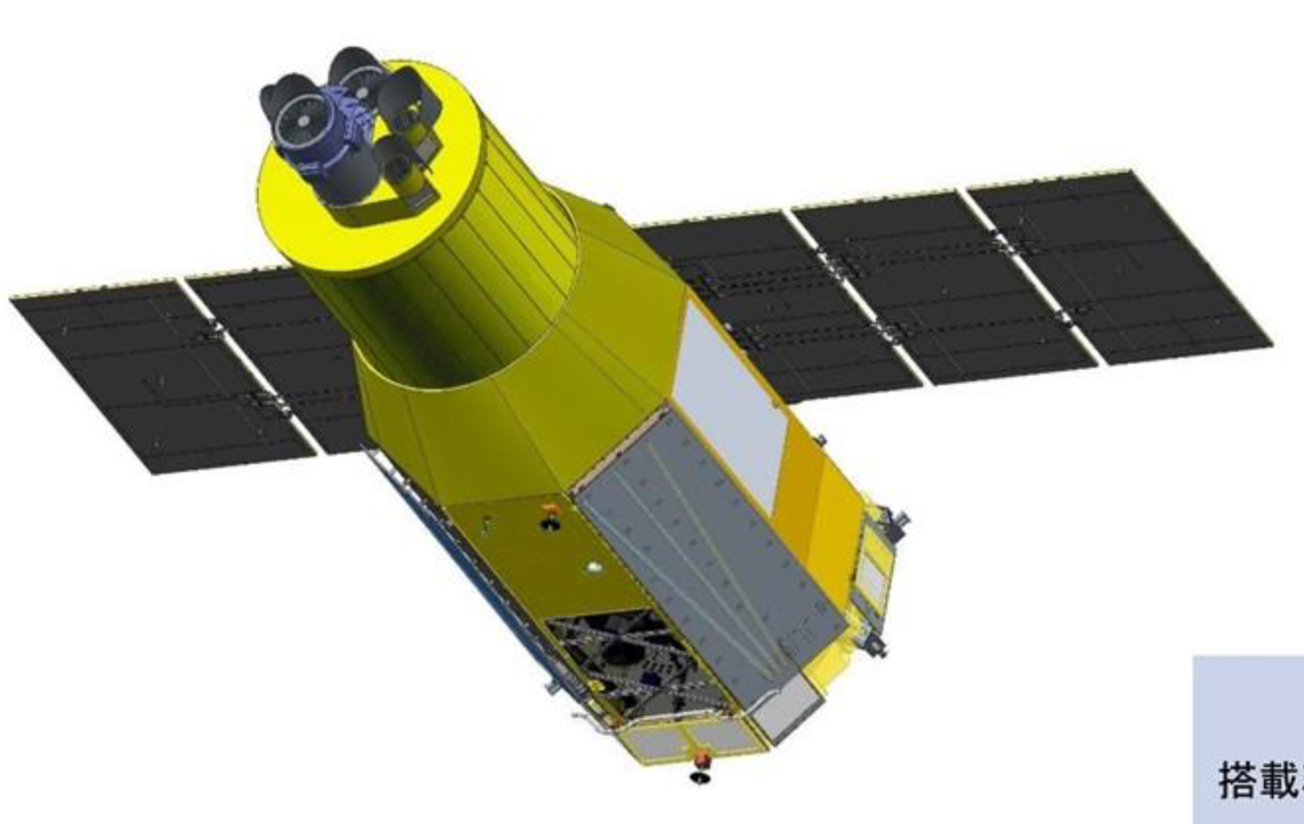
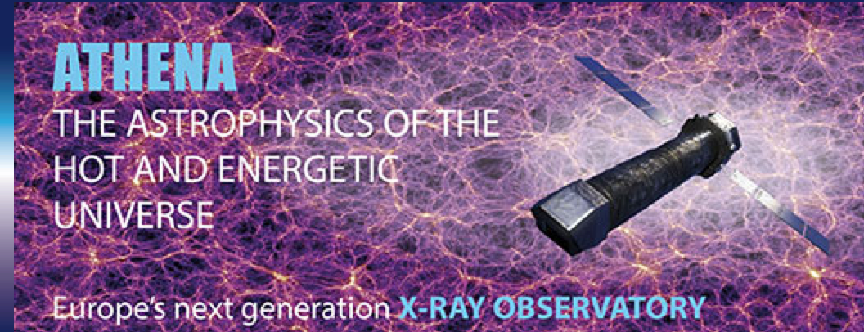
Future is XRISM (launch 2023) then

Slide 30
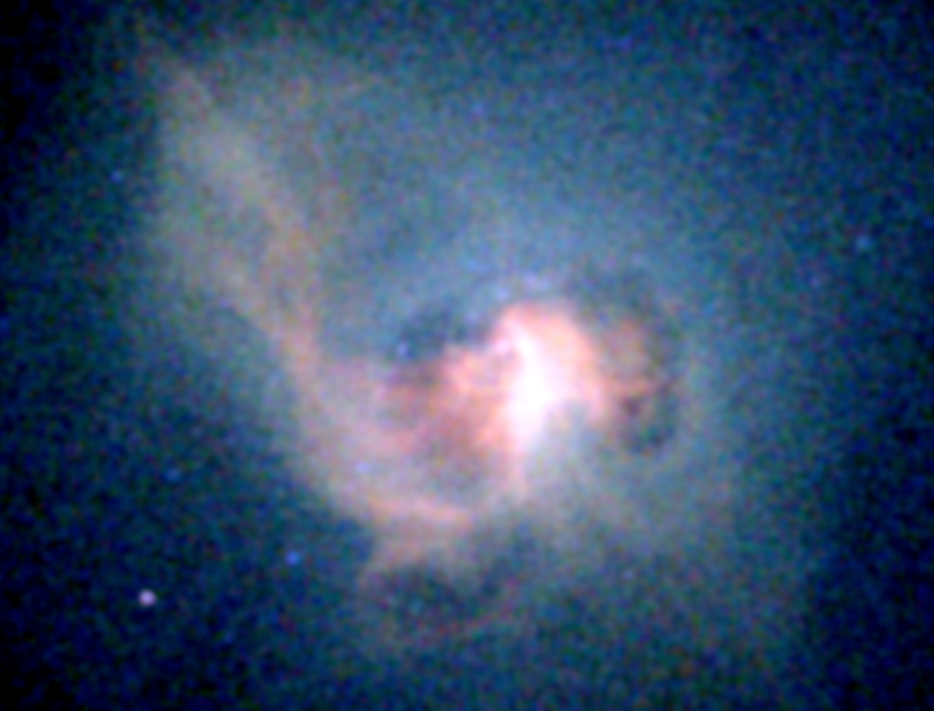

AXIS will spatially resolve the soft X-ray emission from the HCF
Centaurus in X-rays
Centaurus

Slide 31
Summary
ICM is cooling below 10 million K, hidden by intrinsic absorption
Mass cooling rates several times > unabsorbed estimates
Most of absorbed energy emerges in FIR
Ultracold clouds exist? Implications for low mass star/brown dwarf formation?
Inner few kpc of cool cores v complex and multiphase
Large range of densities and sizes challenges numerical simulations (most assume region is optically thin)
Some substellar objects may be swallowed whole by central BH
All models and interpretation require cold absorption!

Slide 33
Centaurus

Slide 34
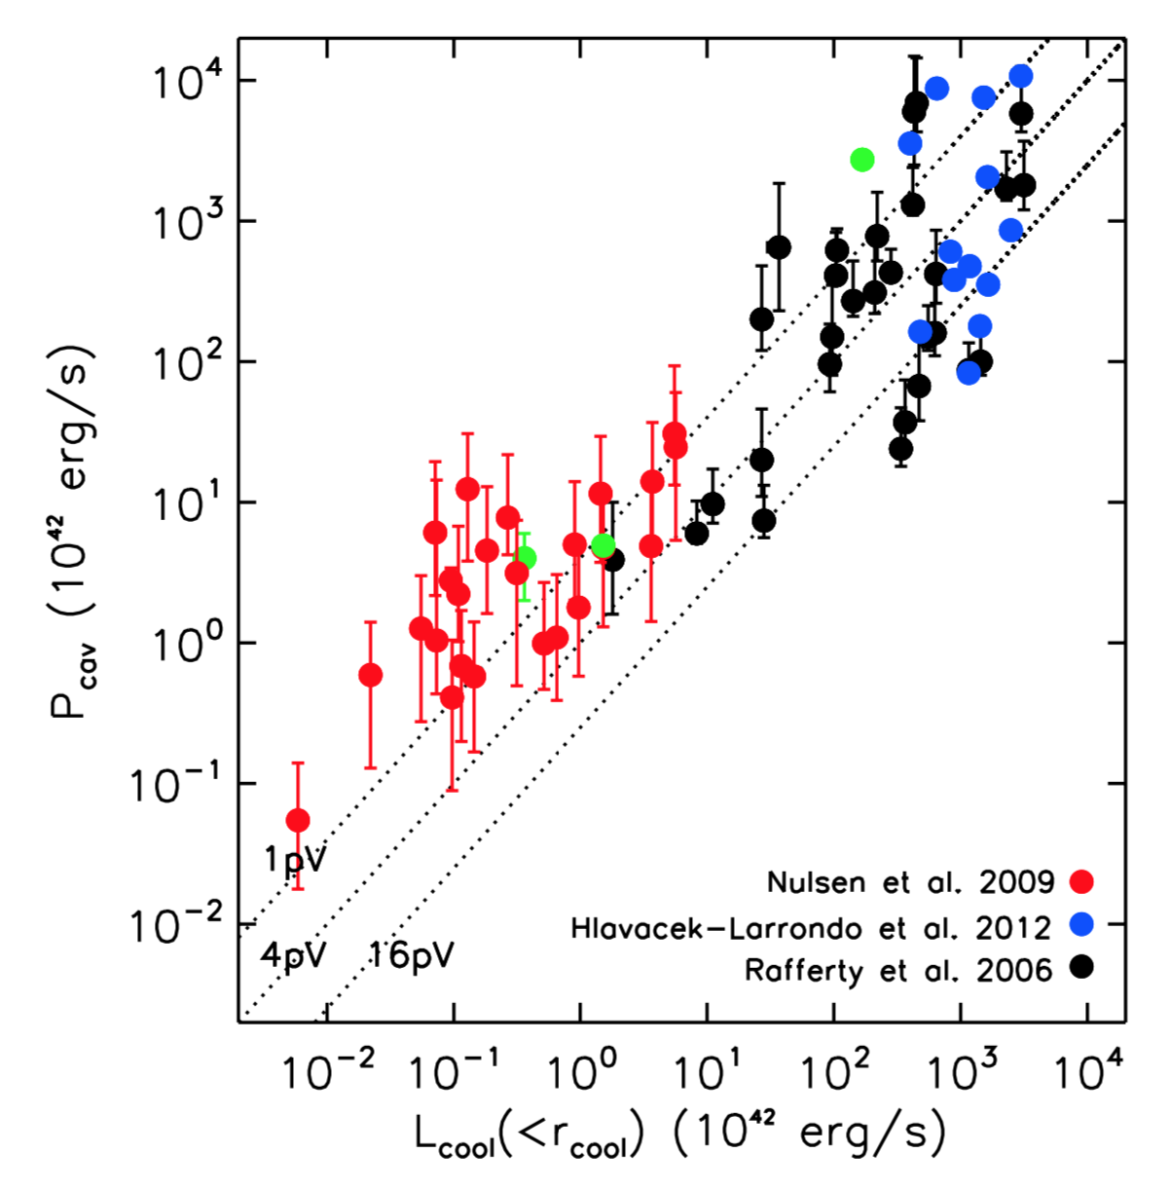
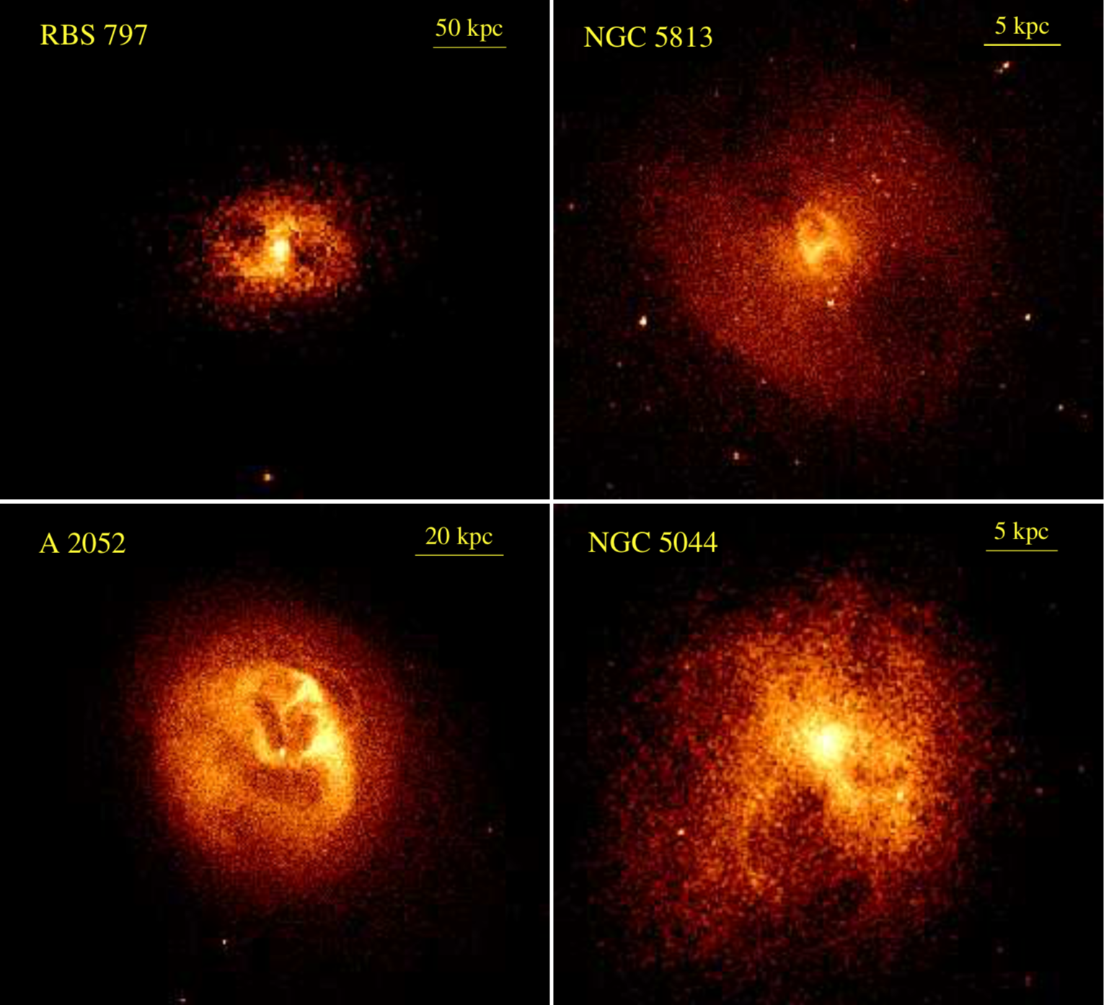
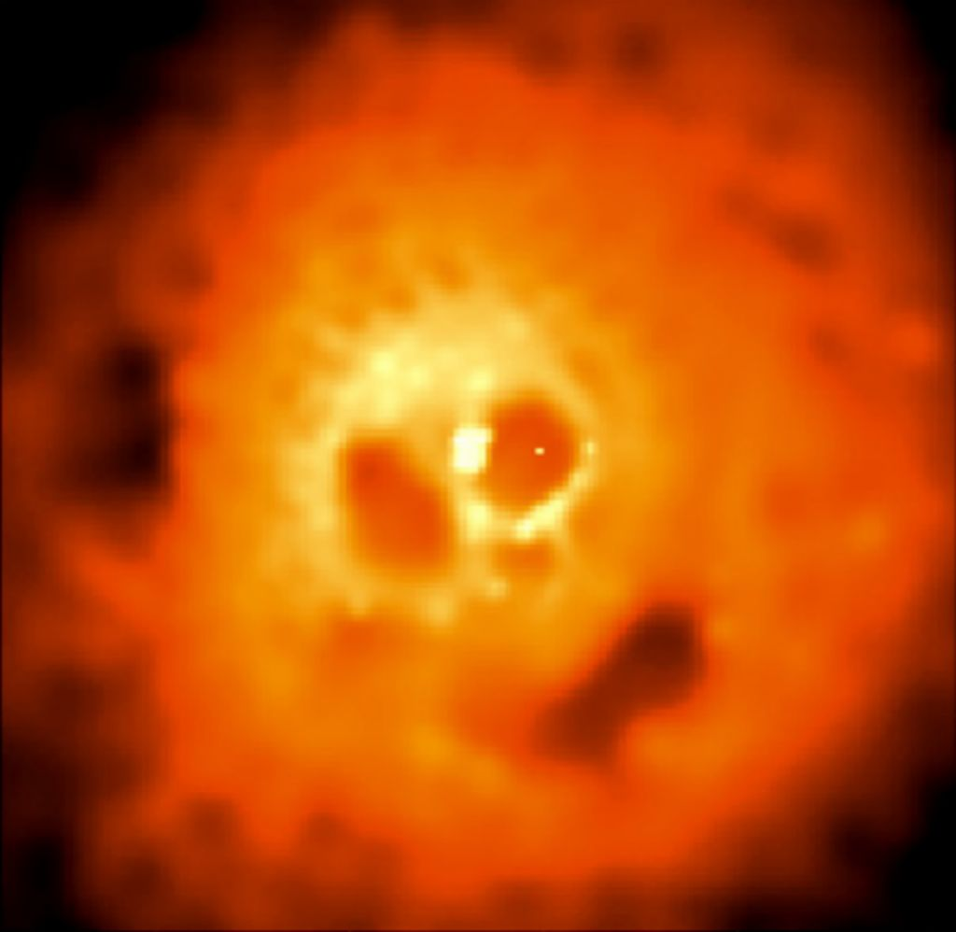
Much of cooling
in core balanced
by heating via bubbles?
AGN Feedback
REVIEWS in
Fabian12; McNamara&Nulsen12

Slide 35
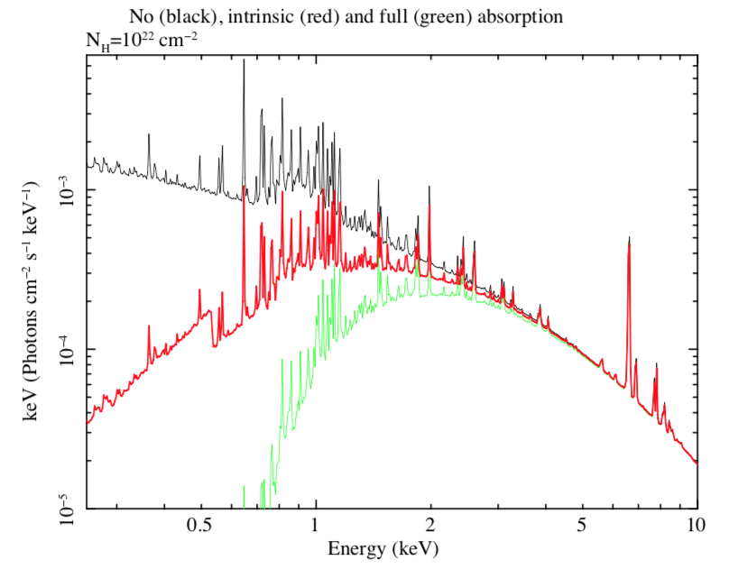

Slide 36
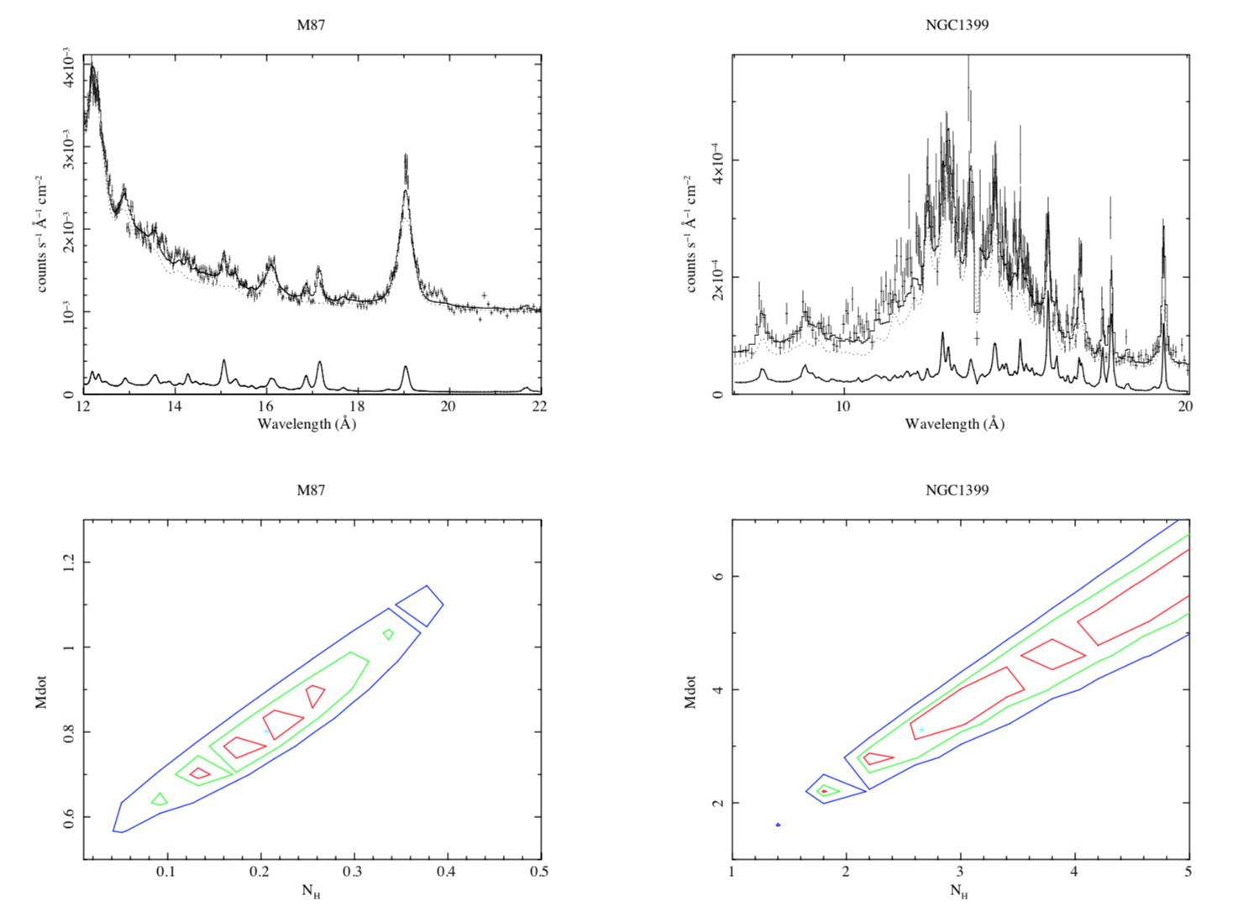
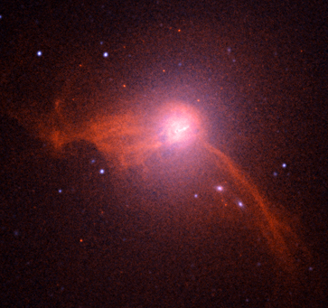
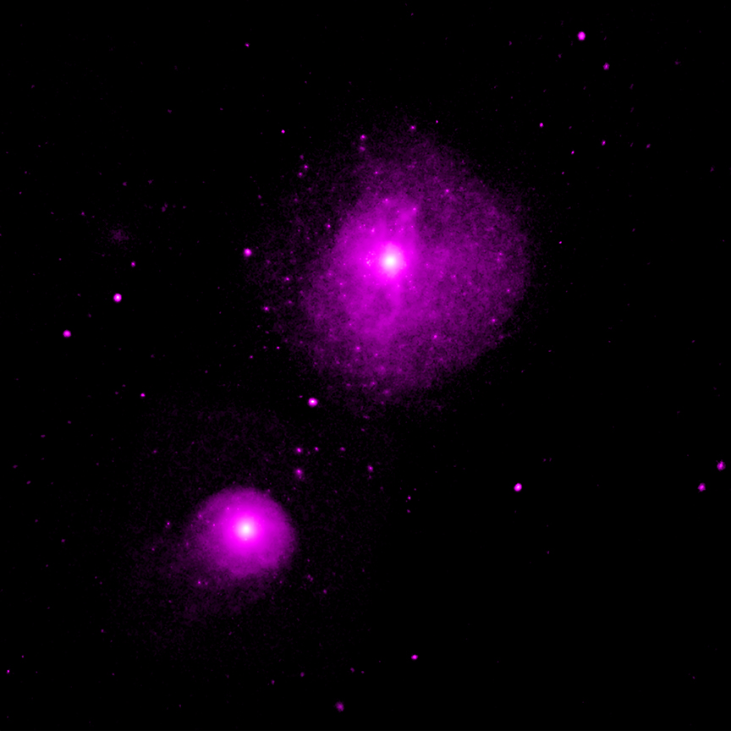

Slide 37
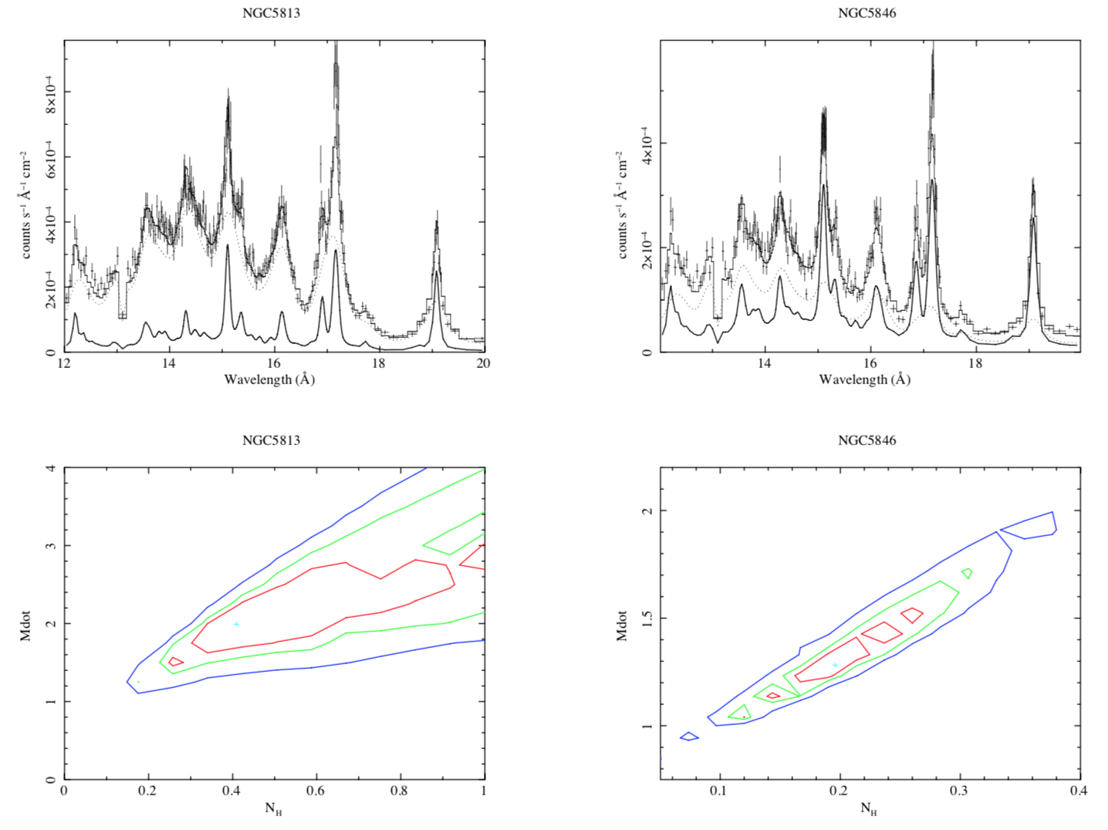
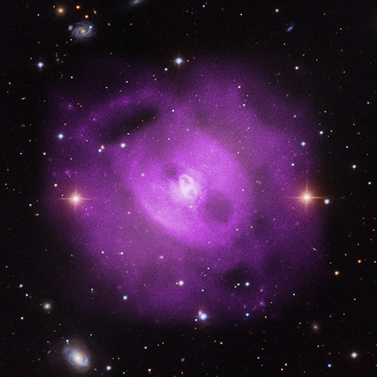
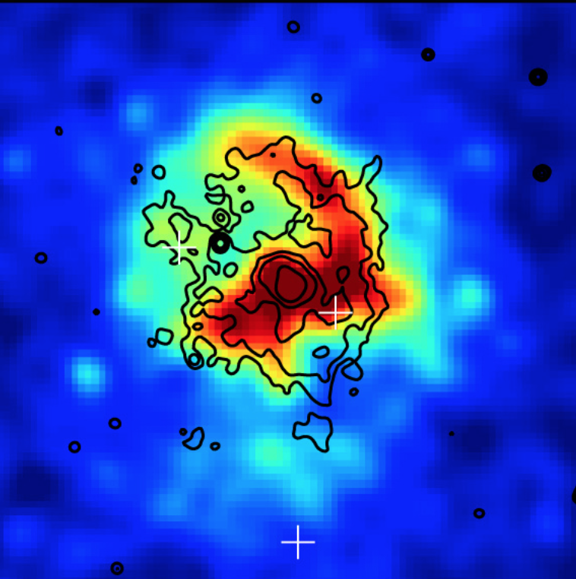

Slide 38
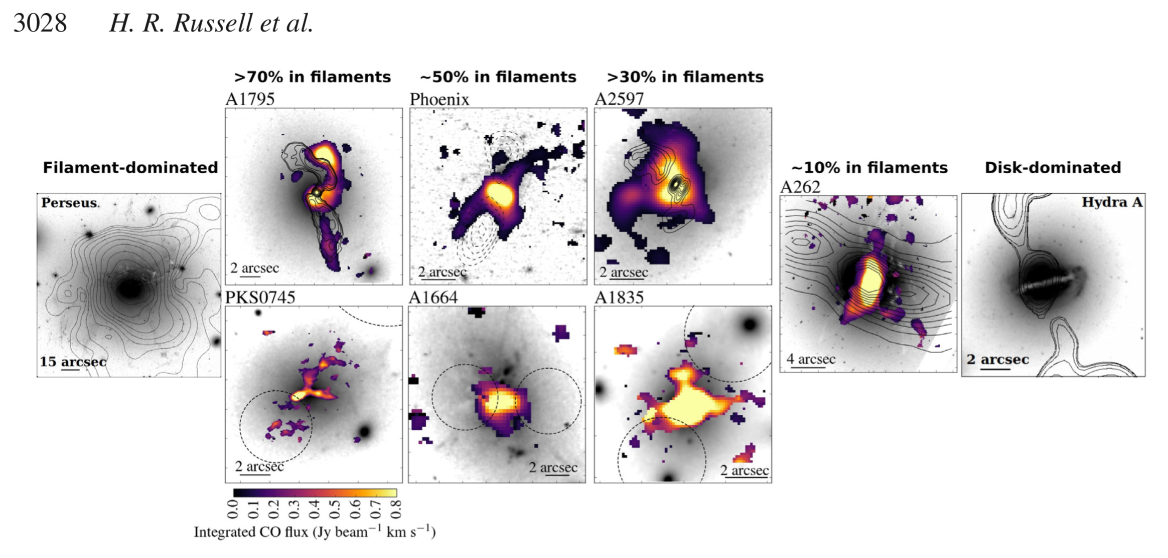
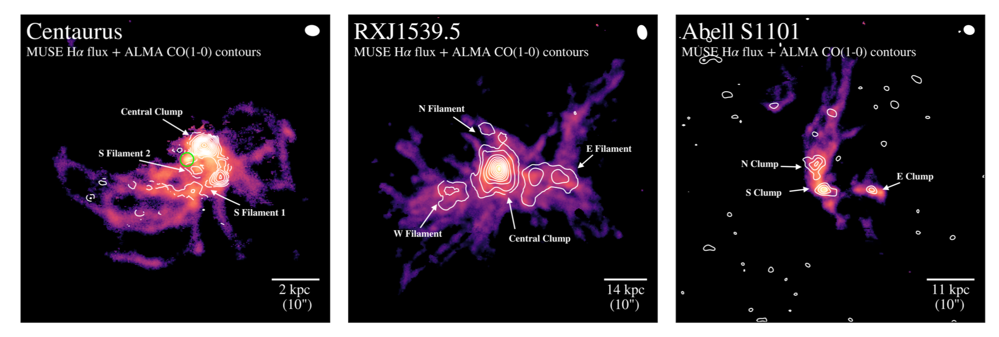
19
Olivares+19

Slide 39
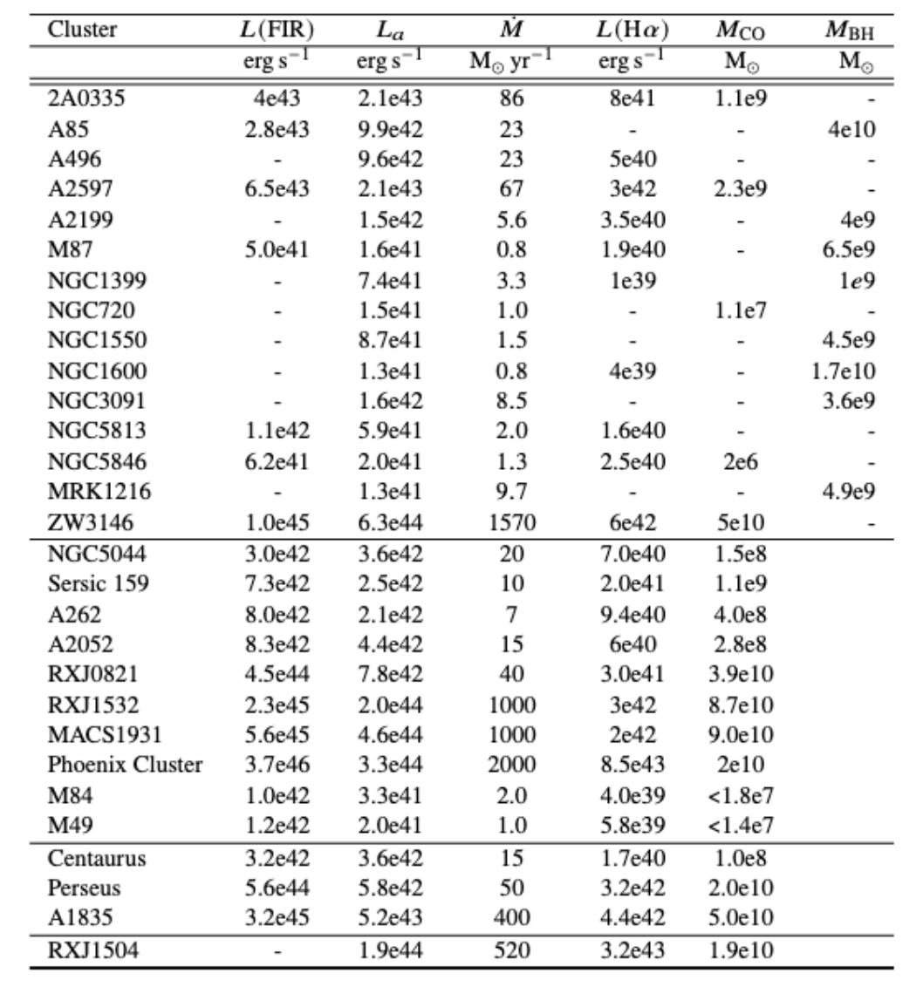
L_{a} is absorbed luminosity

Slide 40
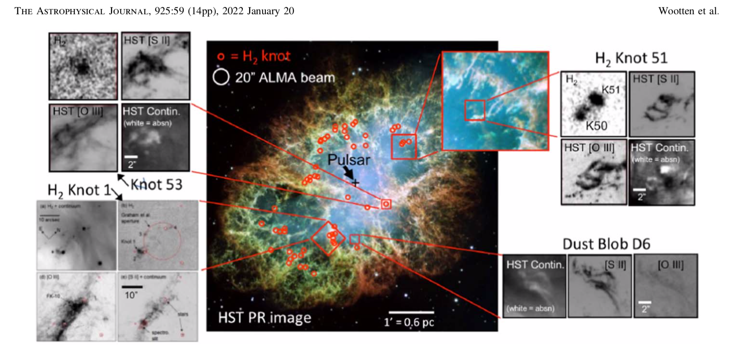

Crab Nebula
Pressure nT=10^{6.5} cm⁻³ K
Similar to cool cores

Slide 41

kT
Centaurus cluster
Chandra X-ray
Sanders+16
Z
Centaurus

