Slide 1
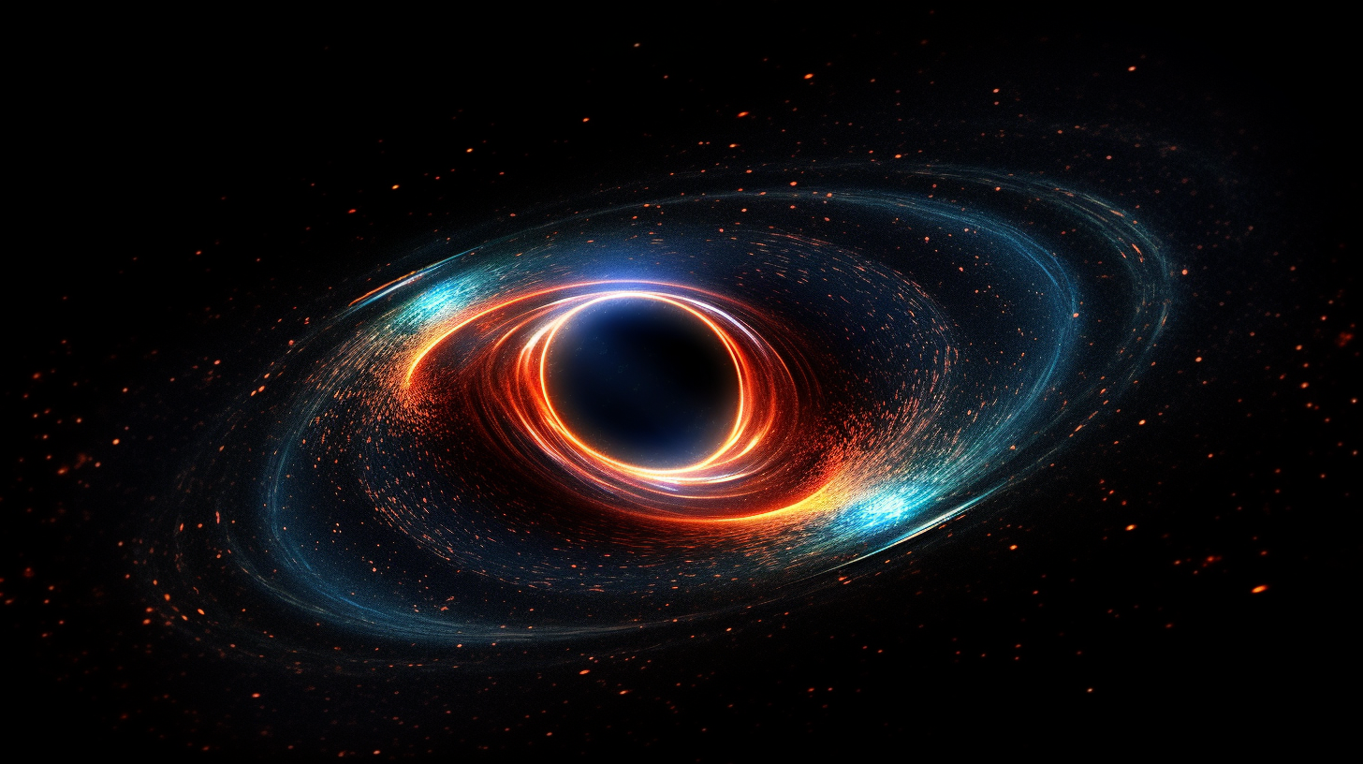
The Transient Slim Disk of the Changing-look
Active Galactic Nucleus 1ES 1927+654
Ruancun Li liruancun@pku.edu.cn
Advisor: L. C.Ho
Collaborators: C. Ricci, E. Kara, B. Trakhtenbrot
Kavli Institute for Astronomy and Astrophysis (KIAA)
Department of Astronomy, Peking University
June 25 2023
See details：
Li, Ho, Ricci et al. (2022 ApJ, 933 70)
Li, Ricci, Ho et al. (2023a, ApJ, in preparation)
Li, Ho, Ricci et al. (2023b, ApJ, in preparation)
Notes:
Greetings, everyone. I am Ruancun Li, and I am delighted to have the opportunity to present my research on the transient slim disk of the Changing-Look AGN 1ES 1927+654. I am currently a fourth-year PhD student at KIAA, working under the guidance of Luis. This project was a collaborative effort, involving Claudio, Erin, and Benny.

Slide 2
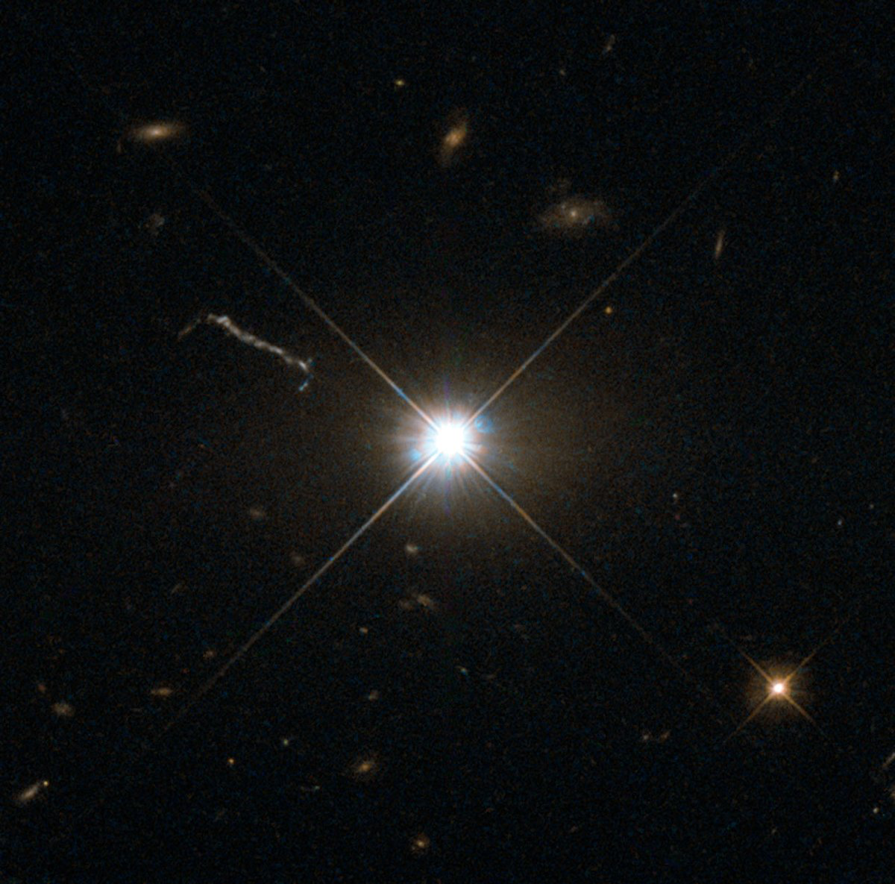
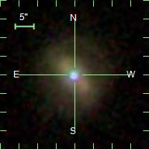
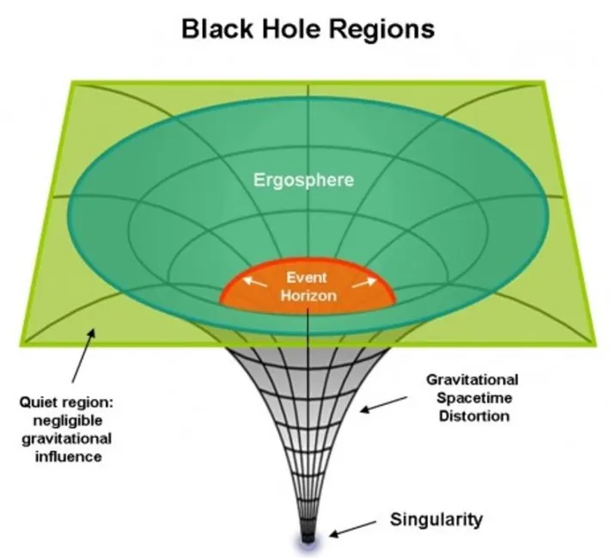
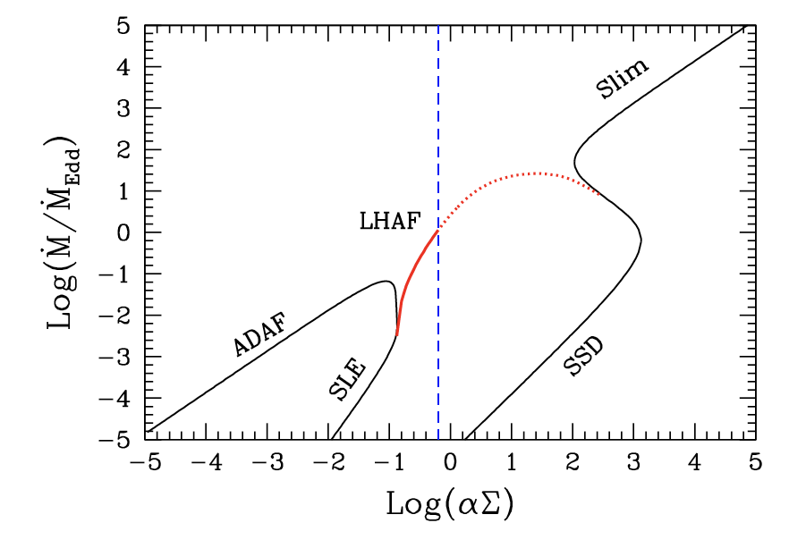
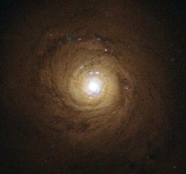
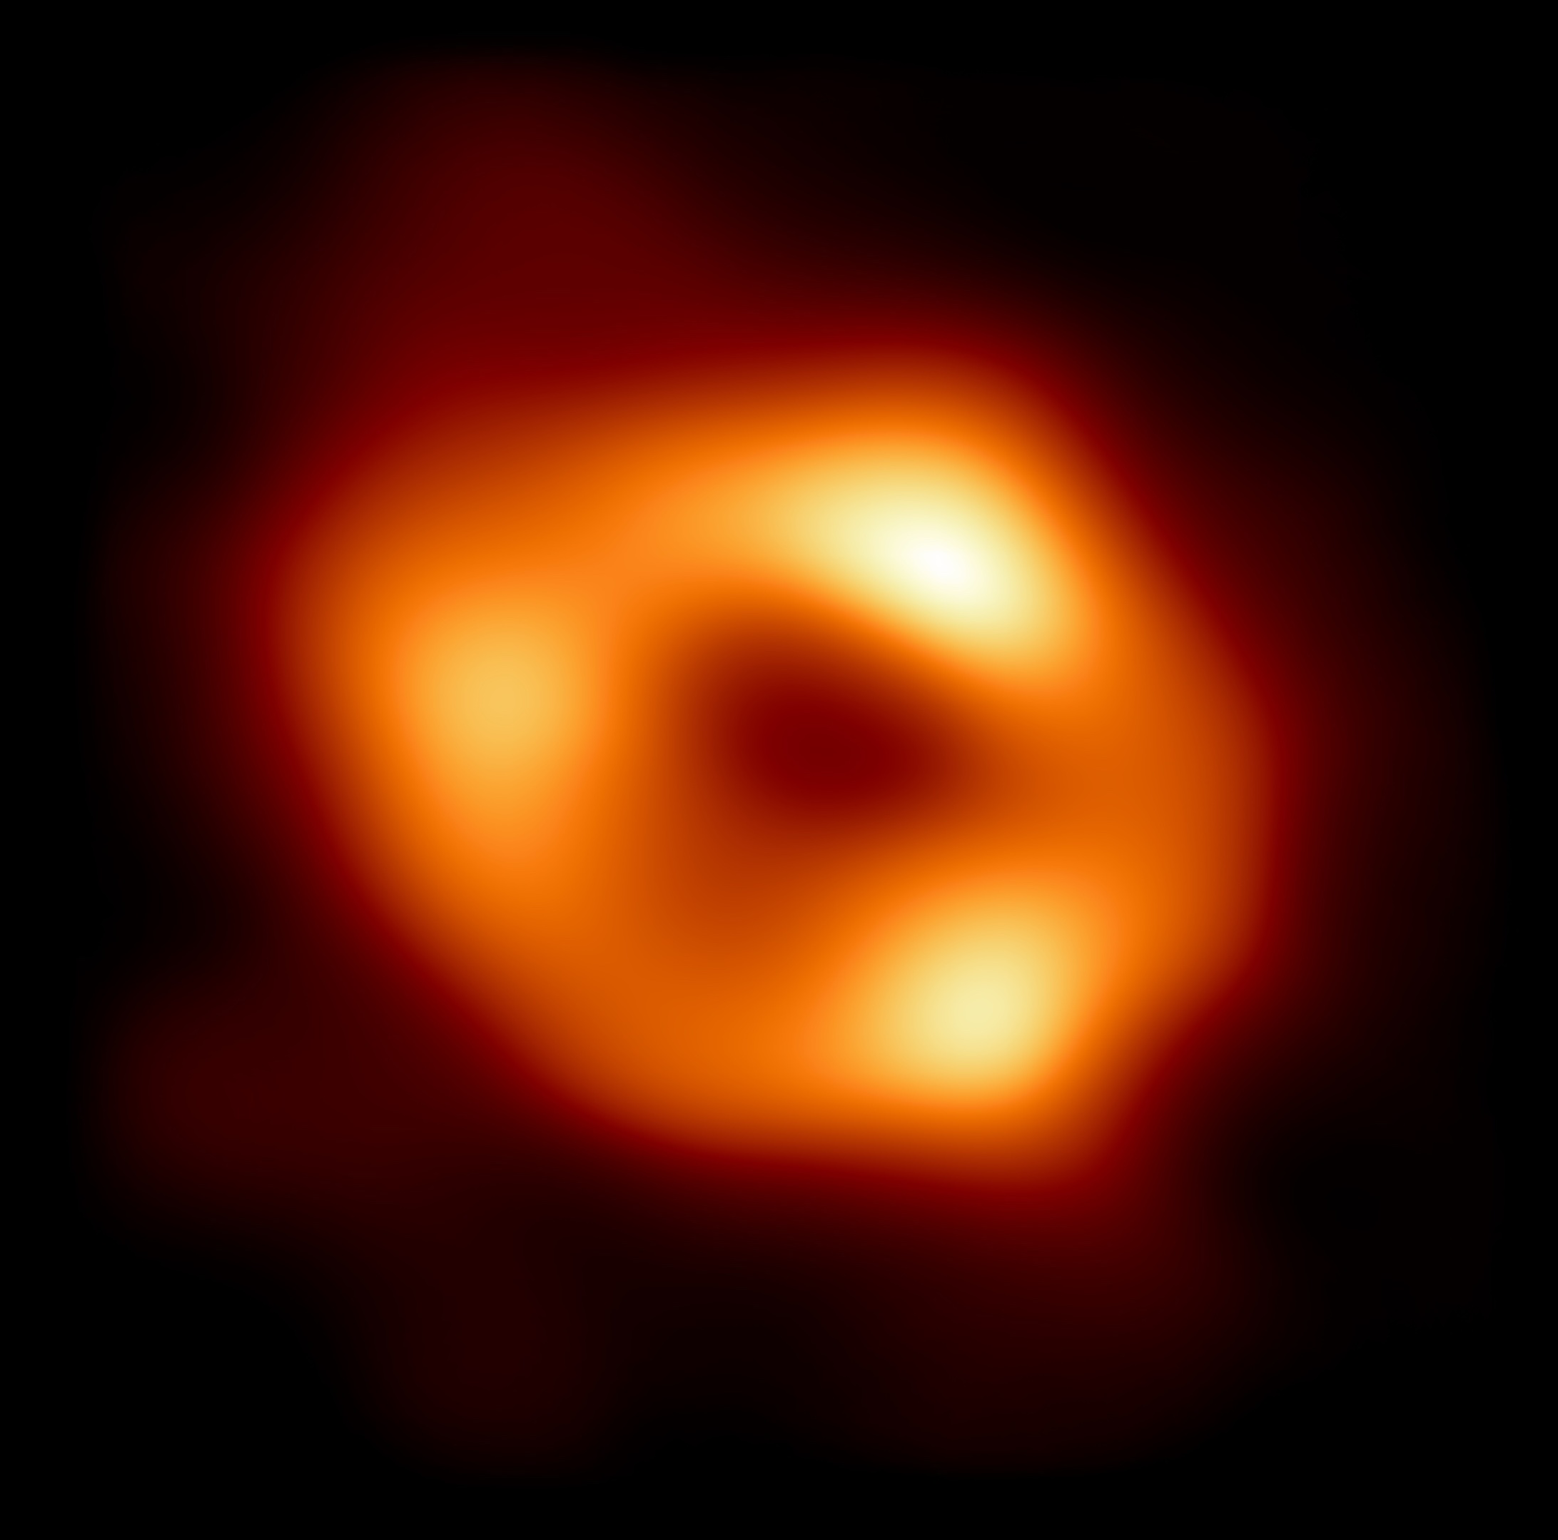
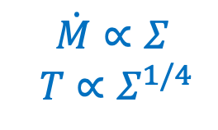
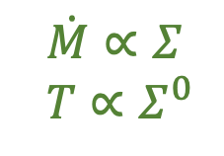
Accretion Disk
?
Wheeler 1960s
$\dot{M}∝Σ$
$$T∝Σ^{1/4}$$
Schmidt 1963
Lynden Bell + 1972
Shakura & Sunyeav 1973
Novikov & Thorne 1973
$\dot{M}∝Σ$
$$T∝Σ^{0}$$
Abramowicz + 1988
Narayan & Yi 1994
Review by Yuan & Narayan 2014
Notes:
The genesis of accretion disk theory traces back to the time of John Wheeler, who populated the concept of black holes as actual astronomical object, rather than merely mathematical solutions derived from GR. Following Martin Schmidt's groundbreaking discovery of the first quasar, a consensus was reached among astronomers that only supermassive black holes (SMBH) could account for such energy-intensive sources. Later on, Lynden Bell et al. embarked on the development of black hole accretion disk theory. The theoretical solutions differ significantly depending on the mdot of the black hole. For low mdot, the solution can be found in the ADAF model proposed by Narayan & Yi . Observational evidence, such as that provided by Sgr A* in our own Milky Way, aligns well with this model, exhibiting an mdot of approximately 10^-6. However, as mdot increases to about 0.1, like in the case of NGC 5548, the disk becomes thin and optically thick, conforming to the Shakura & Sunyaev (SS) and Novikov & Thorne models. If the accretion rate is exceptionally high, the disk thickens once again, leading to the slim disk solution by Abramowicz, which posits a distinct temperature-surface density (T-Sigma) relation than the thin disk. A number of nearby AGN, such as Mrk 142, fall within this regime, though solid evidence for the existence of slim accretion disks remains elusive. It's interestoing to note, mathematically, a transitional solution branch exists between thin disks and slim disks

Slide 3
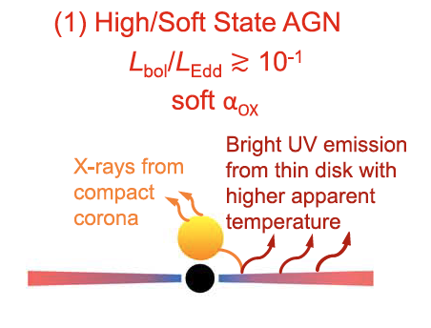
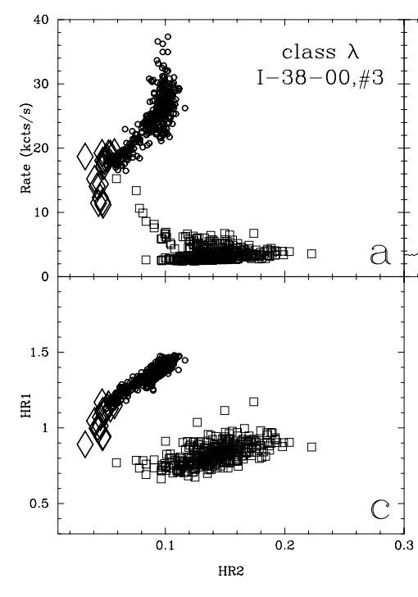
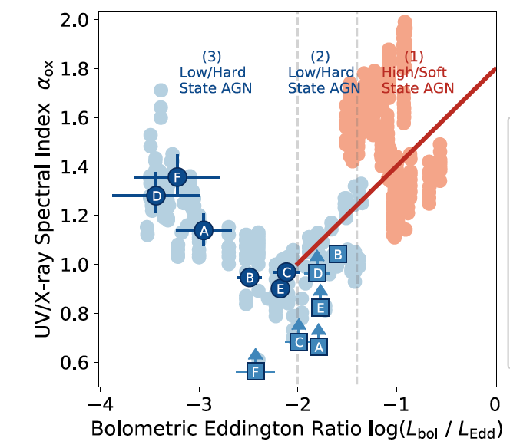
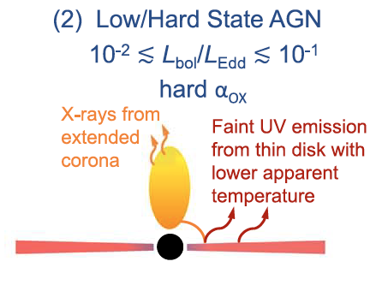
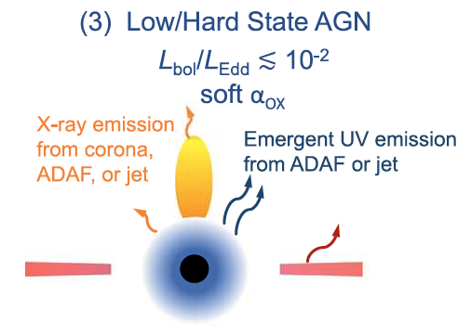
Disk state transtion in Changing-look AGN
BH binary
GRS 1915+105, Belloni + 2000
Ruan + 2019
Notes:
Disk state transitions are a well-known phenomenon in black hole binaries. For example, GRS 1915+105 oscillates between two distinct regimes, soft and hard states, as illustrated in this luminosity color plot. Ruan et al. analogized this to a set of CLAGN, which show the appearance and disappearance of broad emission lines. They identified these CLAGN at the transition points of these black hole binaries. The physical interpretation they proposed involves the transformation of the disk from an ADAF to a thin disk, enhancing UV radiation in the soft state with increasing mdot, or alternatively, by a hot ADAF or jet in the hard state.
Watarai 2003

Slide 4
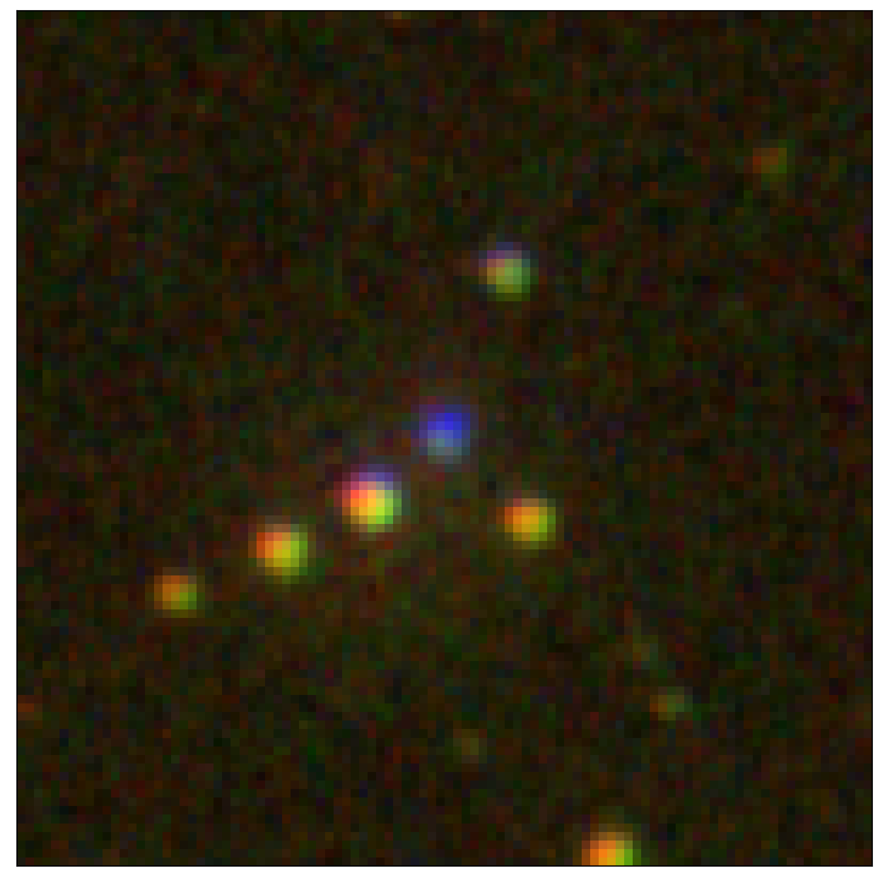
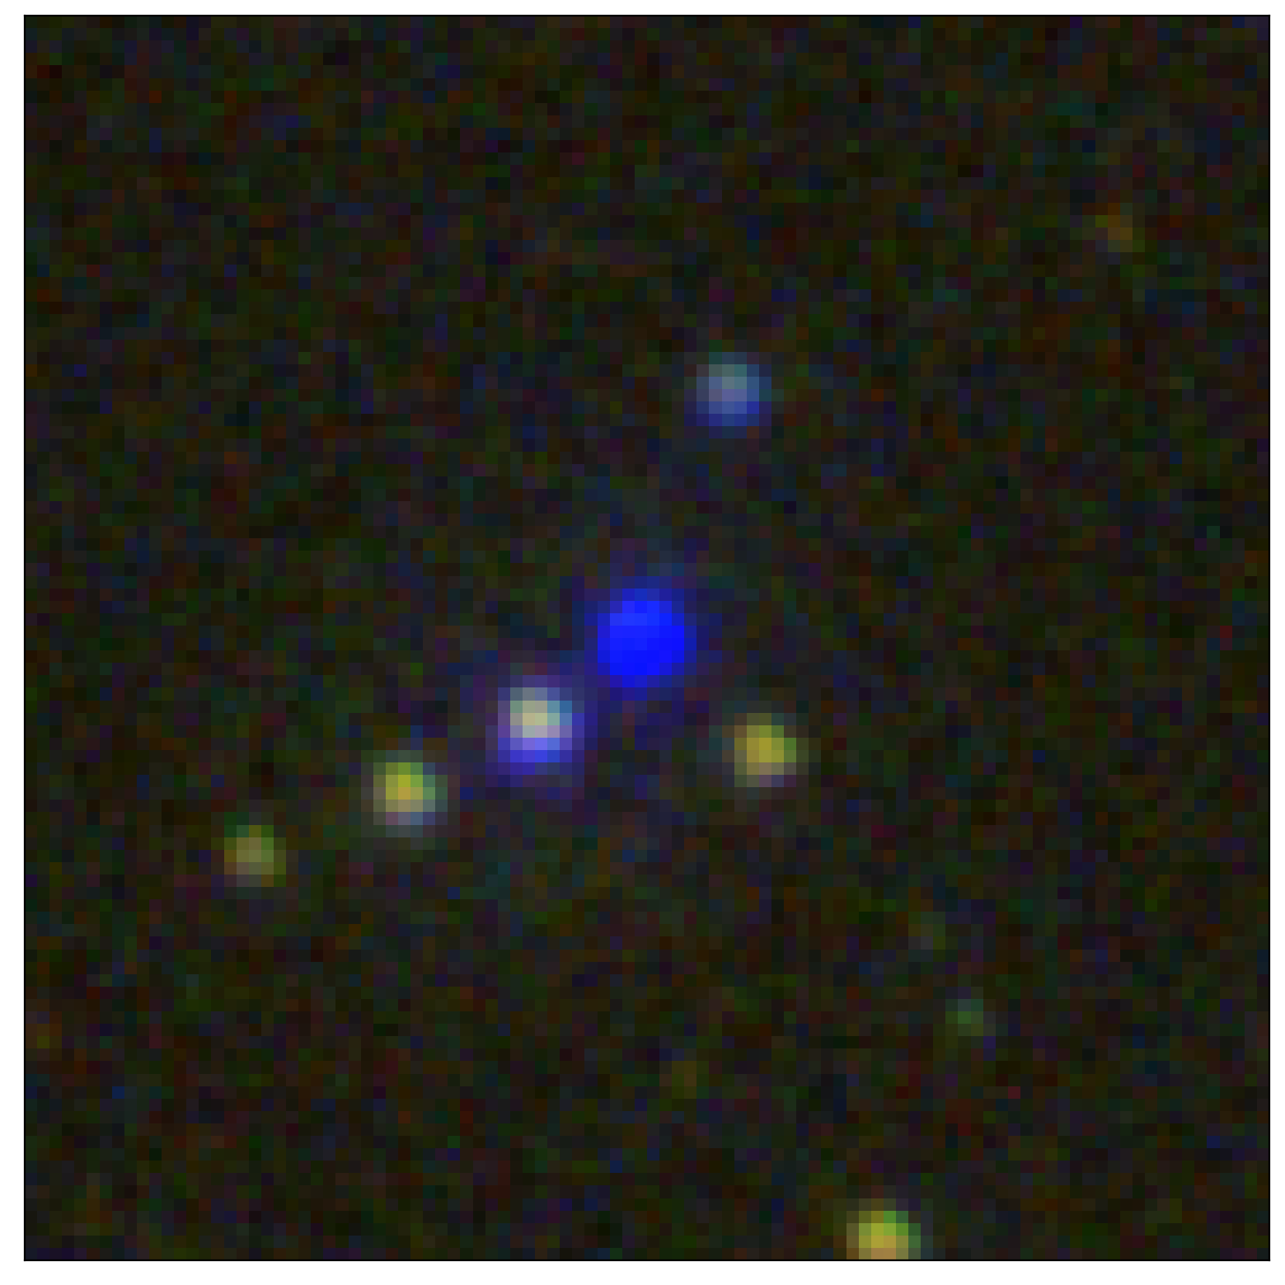
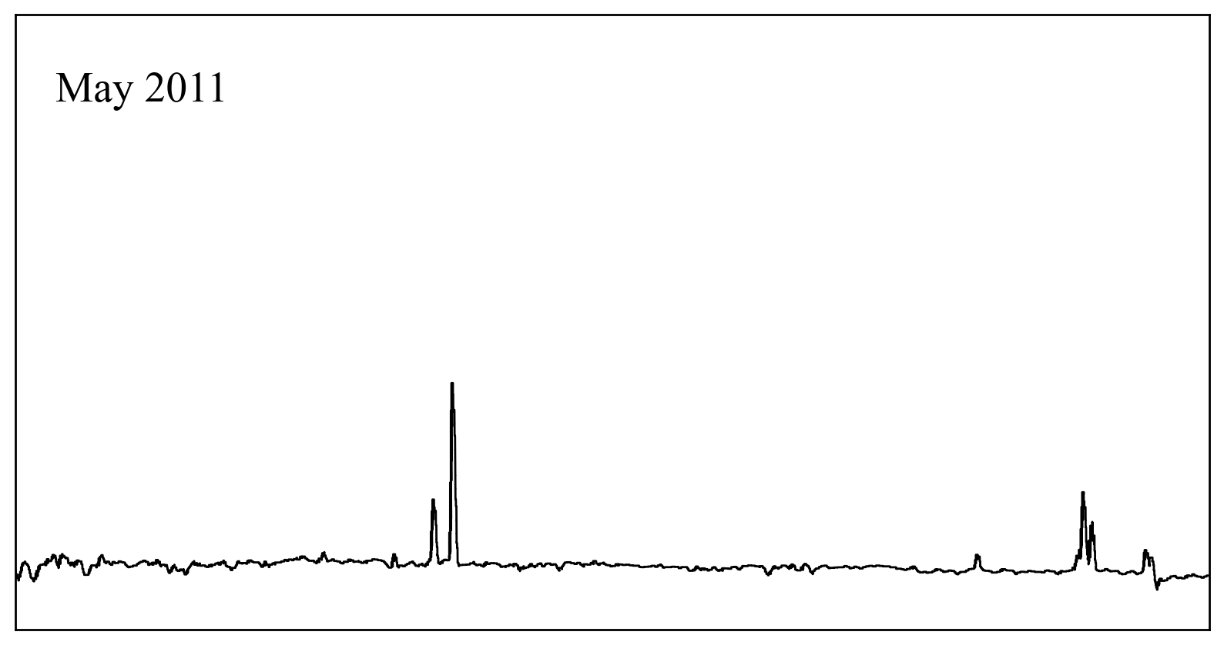
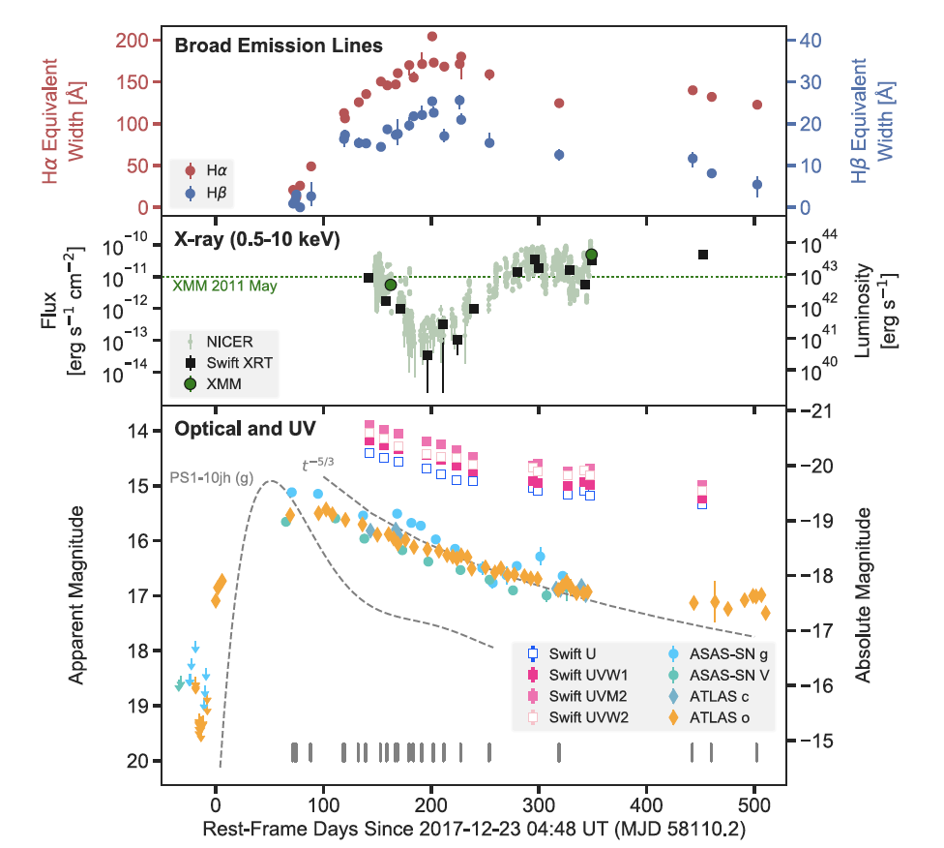
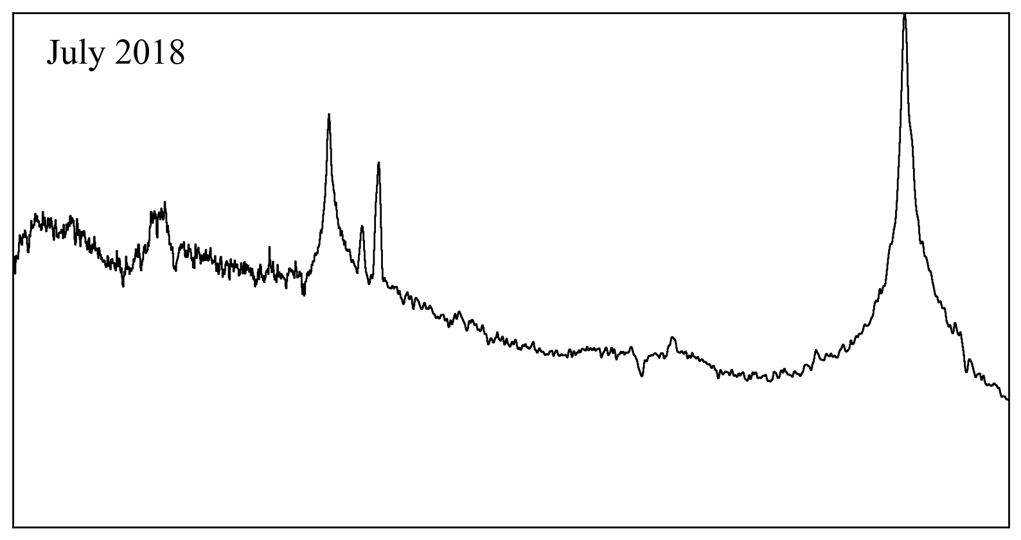
1ES 1927+654
Outburst 12/2017
Type 2 -> Type 1
Notes:
1ES, surrounded by several G or K foreground stars, has been spectroscopically confirmed as a true type 2 AGN. At the end of 2017, it exhibited a 5 magnitude increase in flux, transforming both its image and spectra to resemble a quasar. We conducted a comprehensive three-year photometric and spectroscopic follow-up

Slide 5
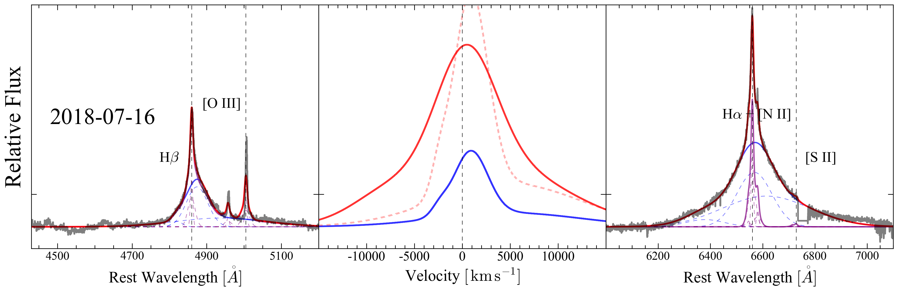
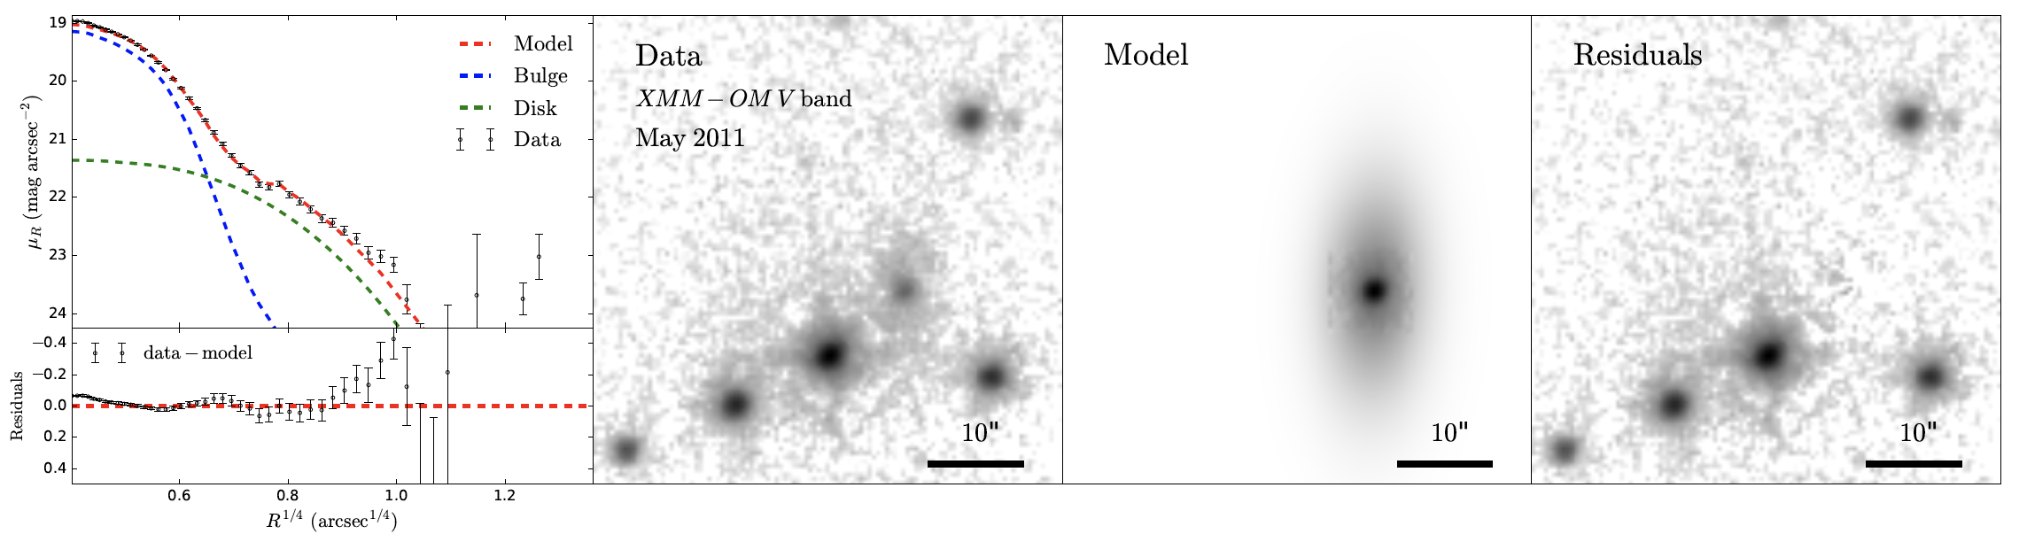
1ES 1927+654
34 optical spectra
14 Swift XRT+UVOT
7 XMM + NuSTAR
830 NICER
Trakhtenbrot + 2019, Li + 2022
Notes:
encompassing 34 optical spectra, 14 Swift XRT+UVOT observations, and 7 XMM+Nustar observations. These 21 observations provided broad-band and simultaneous data. In addition, we obtained over 800 X-ray data alone observations from NICER. By performing detailed spectral and image decompositions, we derived both photometric and broad-line light curves. Notably, we discovered that 1) the timescale of broad emission line emergence was about 100 days after the optical outburst, 2) the X-ray did not trace the optical, dimming after 200 days, and 3) the optical light curve did not align with TDE predictions, presenting a shallower index of approximately 1.1.

Slide 6
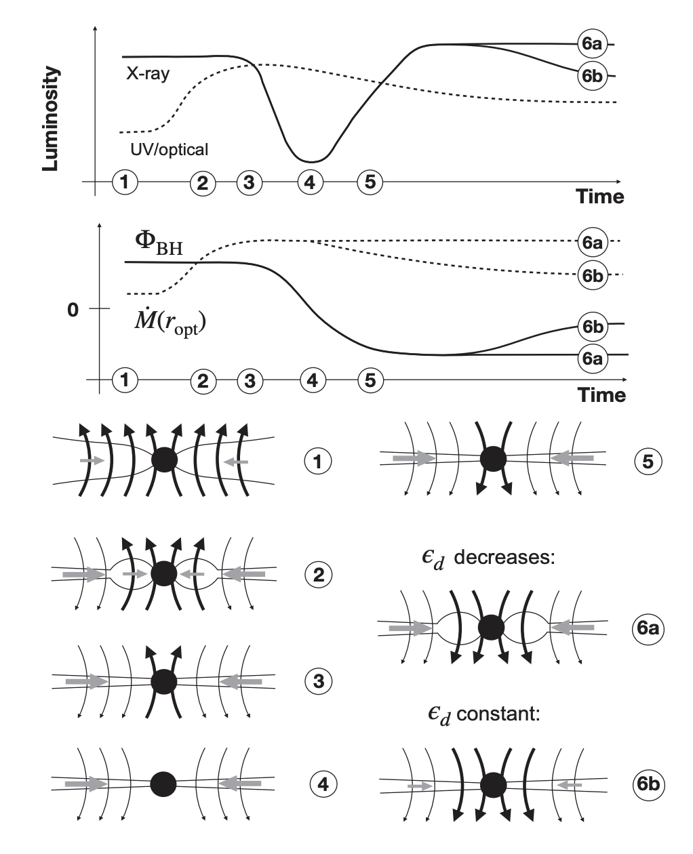
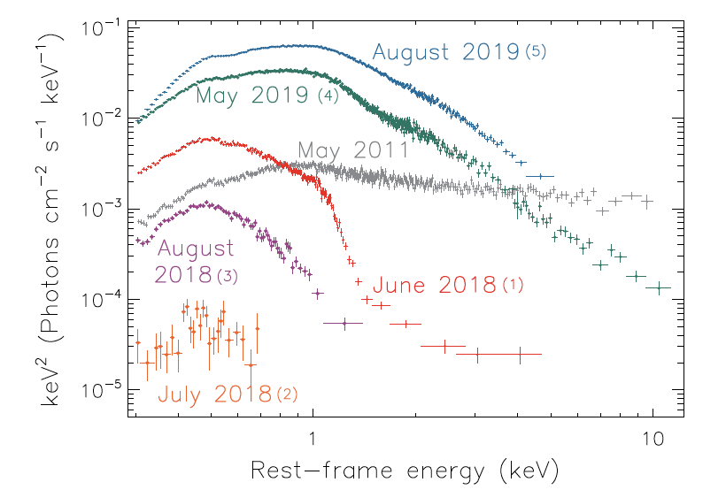
Picture1 Flux inversion
Scepi + 2021, Laha + 2022
Ricci + 2020
Notes:
A flux inversion picture has been proposed to account for the unusual X-ray light curve. In that case the optical outburst would be triggered by an advection event. However, the additional material accreted during this process carried a magnetic flux opposing the direction of the original corona. This conflict would temporarily disrupt the energy source of the corona. This theory seems to explain the light curves satisfactorily, but the spectral shape also underwent significant changes, affecting the power-law index, hardness ratio, and the strength of the soft X-ray excess.

Slide 7
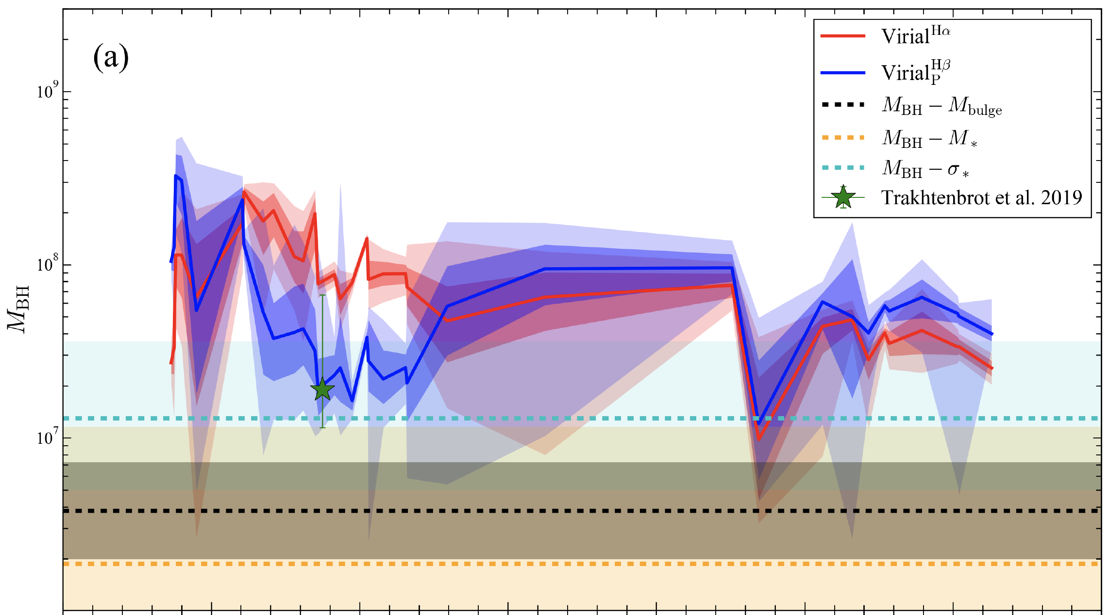
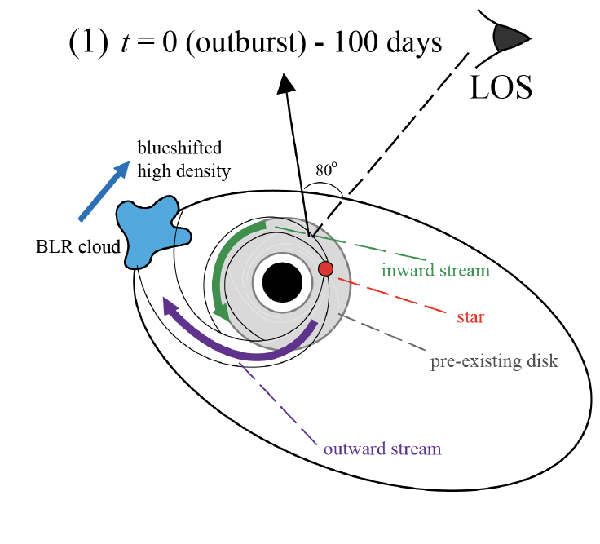
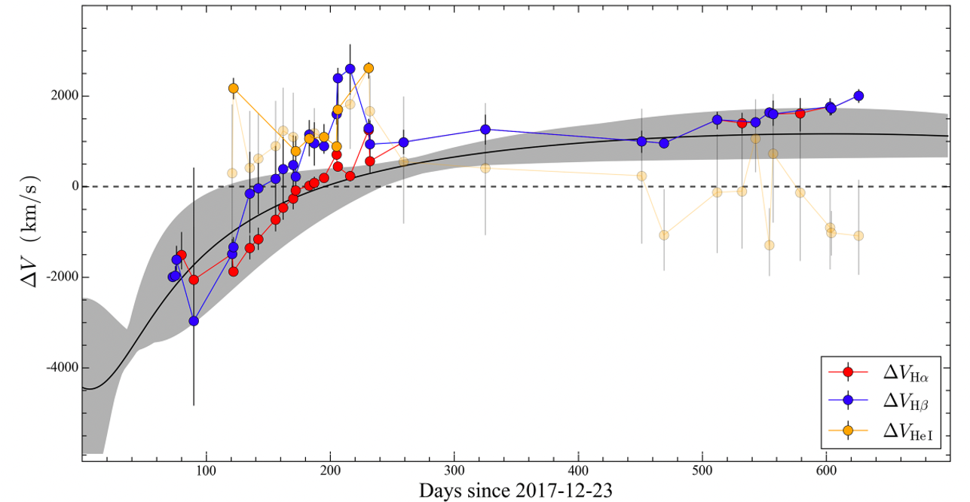
Picture2 TDE on AGN
8500 Rg
Li + 2022
Notes:
Not only the X-ray spectral profile, the optical broad emission lines also exhibited a changing profile. This figure illustrates the evolution of the virial estimation of black hole mass based on both H-alpha (red) and H-beta (blue) lines. The variation exceeds 1 dex, suggesting the broad line region is not in virialized. Interestingly, the velocity shift of the broad lines aligns with a eccentric Keplerian orbit, supporting a second scenario: a TDE caught by an AGN with a pre-existing disk. The BLR was, therefore, newly formed from the outward stream of the disrupted star.

Slide 8
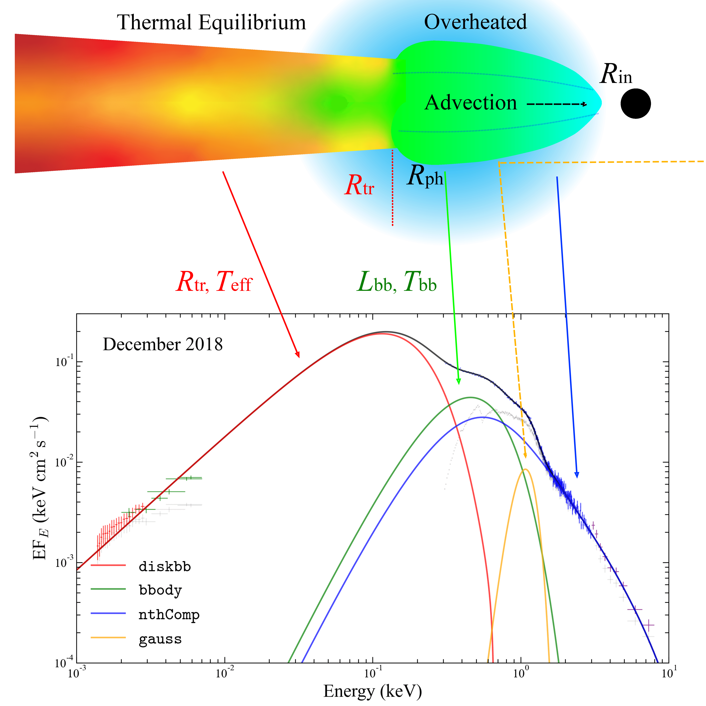
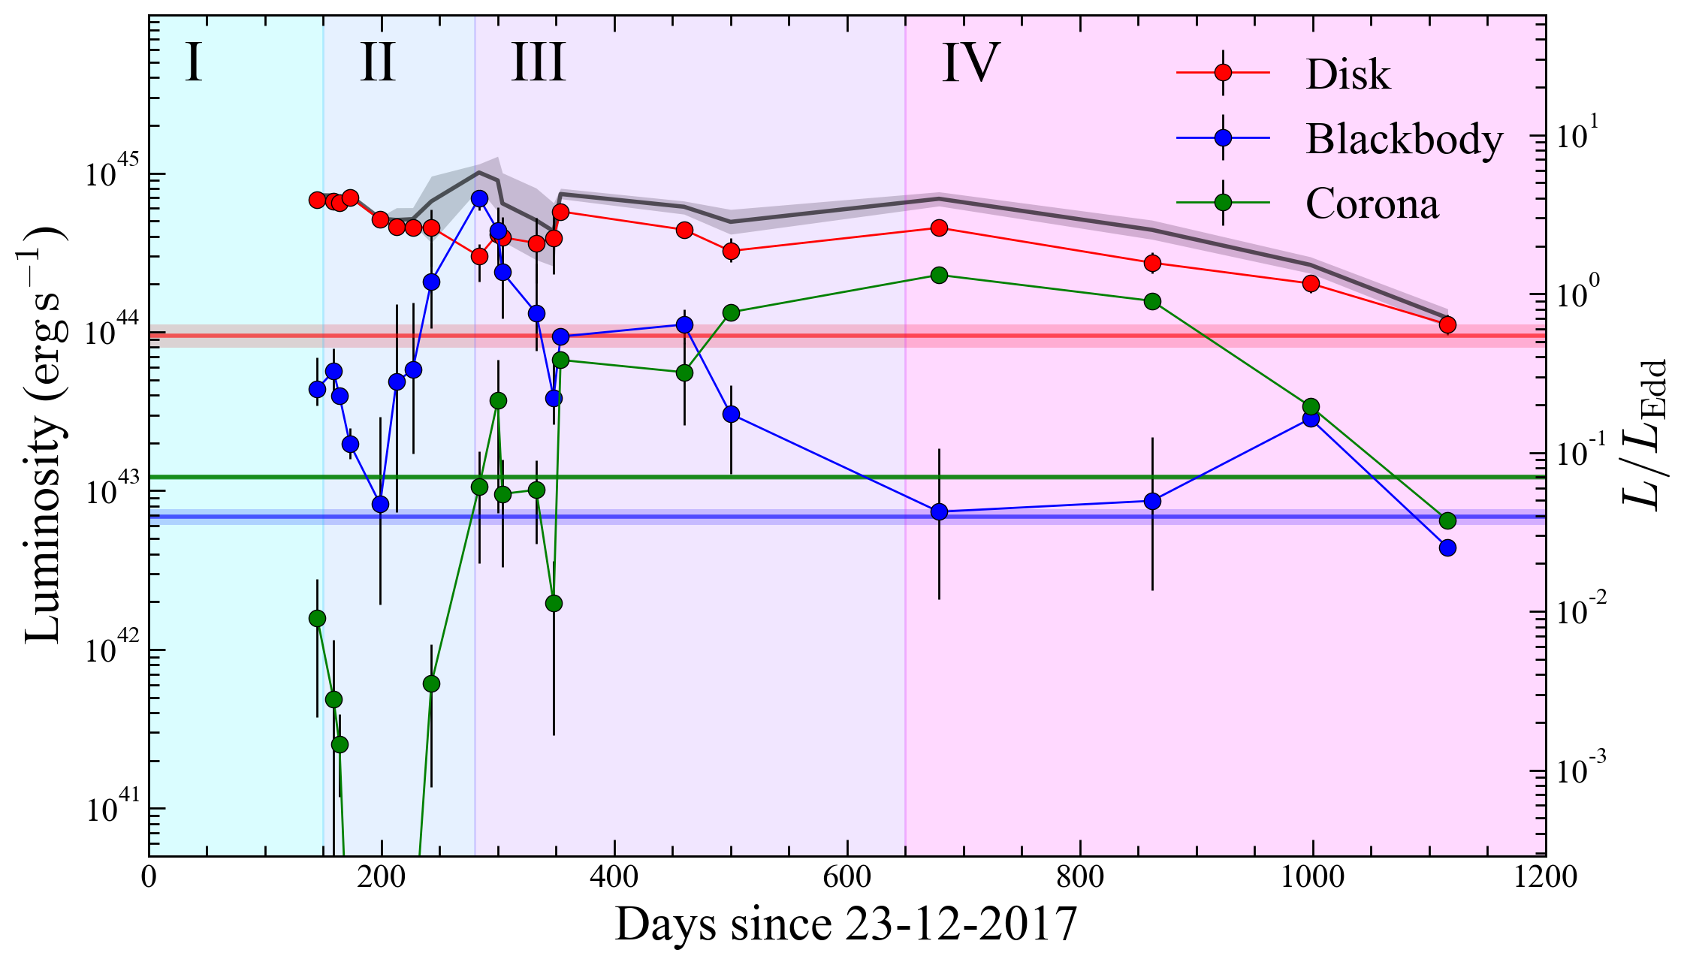
Bolometric SED
~100 days after optical outburst
2017-12-23
Li + 2023a, in prep
Notes:
To distinguish between the two scenarios, we performed a broad-band SED decomposition to study the evolution of different physical components. The simultaneous SED range started from 8000 Angstroms, incorporating data from the optical spectrum, UV photometric points (using XMMOM), and XMM-EPIC soft and Nustar hard X-rays. We adopted a three-component model, consisting of a multi-color black body representing the outer thermalized disk, a black body component for the soft X-ray excess, and a Comptonization component for the hard X-ray. We could derive the inner radius or truncation radius, electron temperature, and photon index from this model. The light curves of the components is shown here, where horizontal lines mark the pre-outburst values, whose evolution can be summarized as the 4 stages: in stage 2, we found BB also follows the corona, the thermal disk went through a small decrease. In stage 3, BB decrease dramatically, while the corona become more and more brighter, even 10 times than the pre-outburst. In stage 4, all the 3 components come back to the original ones.

Slide 9
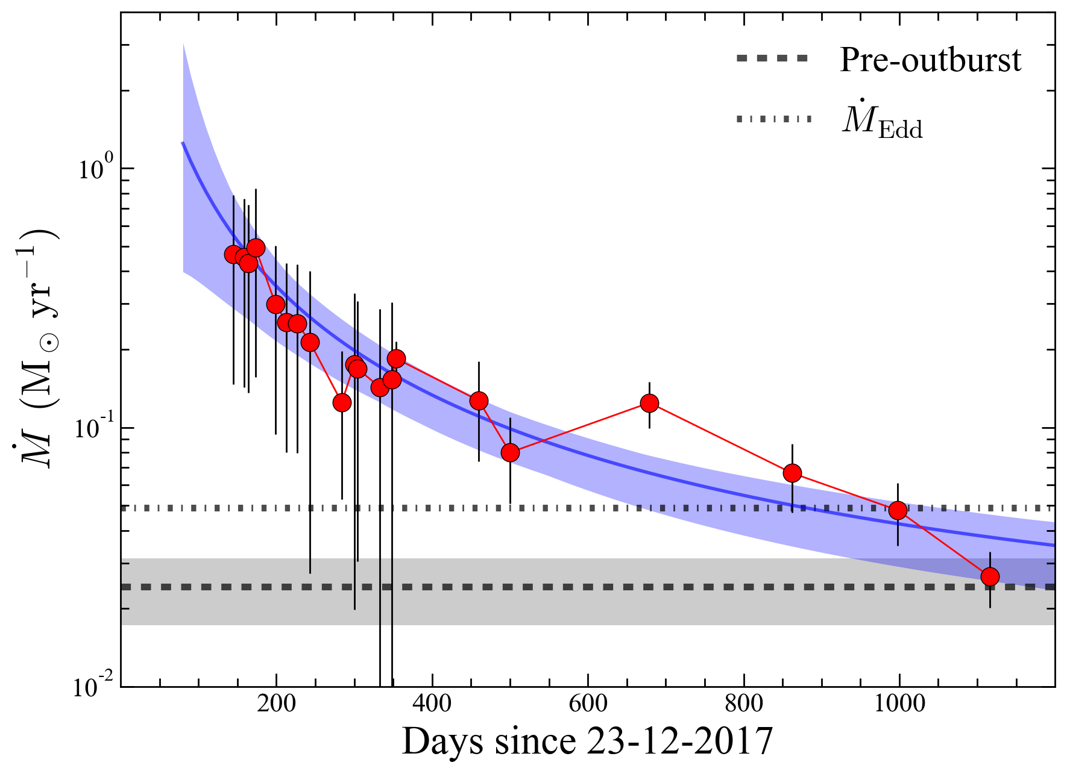



Accretion rate
Super-Eddington Accretion
$$γ=1.53±0.10$$
0.55$M_{⨀}$ accreted mass
Support TDE picture
Radius is consistent with BLR size
Li + 2023b, in prep
Notes:
Drawing upon the SED output, we solved the hydrodynamic equation locally at the truncation radius to derive the evolution of mdot, as shown in this figure. Modeling the slope of the mdot change yielded 1.53, roughly aligning with the TDE mass fallback rate, except for being lower around 250 days and higher around 700 days. The integrated mass was about 0.55 solar masses, indicating that it might have been a 1.1 solar mass star that was disrupted. Notably, the most bound radius we calculated aligned with the BLR size inferred from the broad line profile evolution.

Slide 10
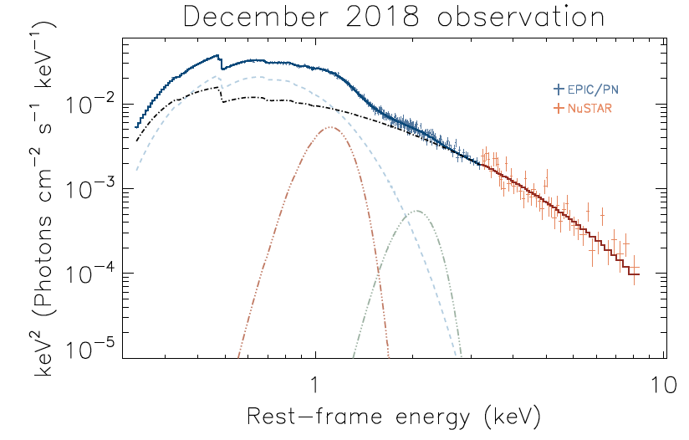
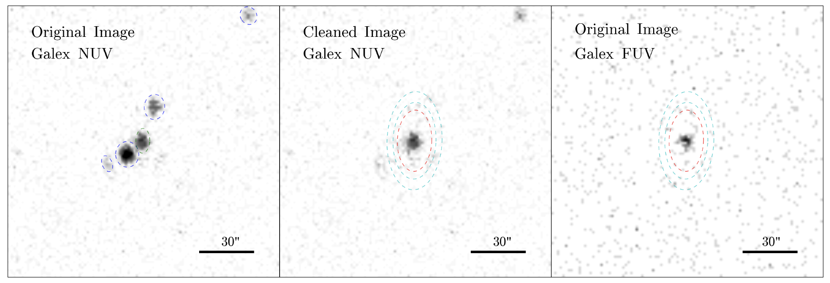
Mysteries
1. Was 1ES a real Type 2 before?
2. What happened at ~ 200 days?
3. What is the broad 1 keV feature?
Ricci + 2021, Li + 2023a, in prep
Notes:
Our work lends support to the TDE scenario; however, there remain several mysteries. Before the outburst, the FUV flux was three times higher than that of the host. Was 1ES truly a type 2 AGN beforehand? What happened around the 200-day, that made the three components behave differently, unlike other TDEs? X-ray spectra modeling also revealed a significant broad 1keV feature, but its origin remains unclear.

Slide 11
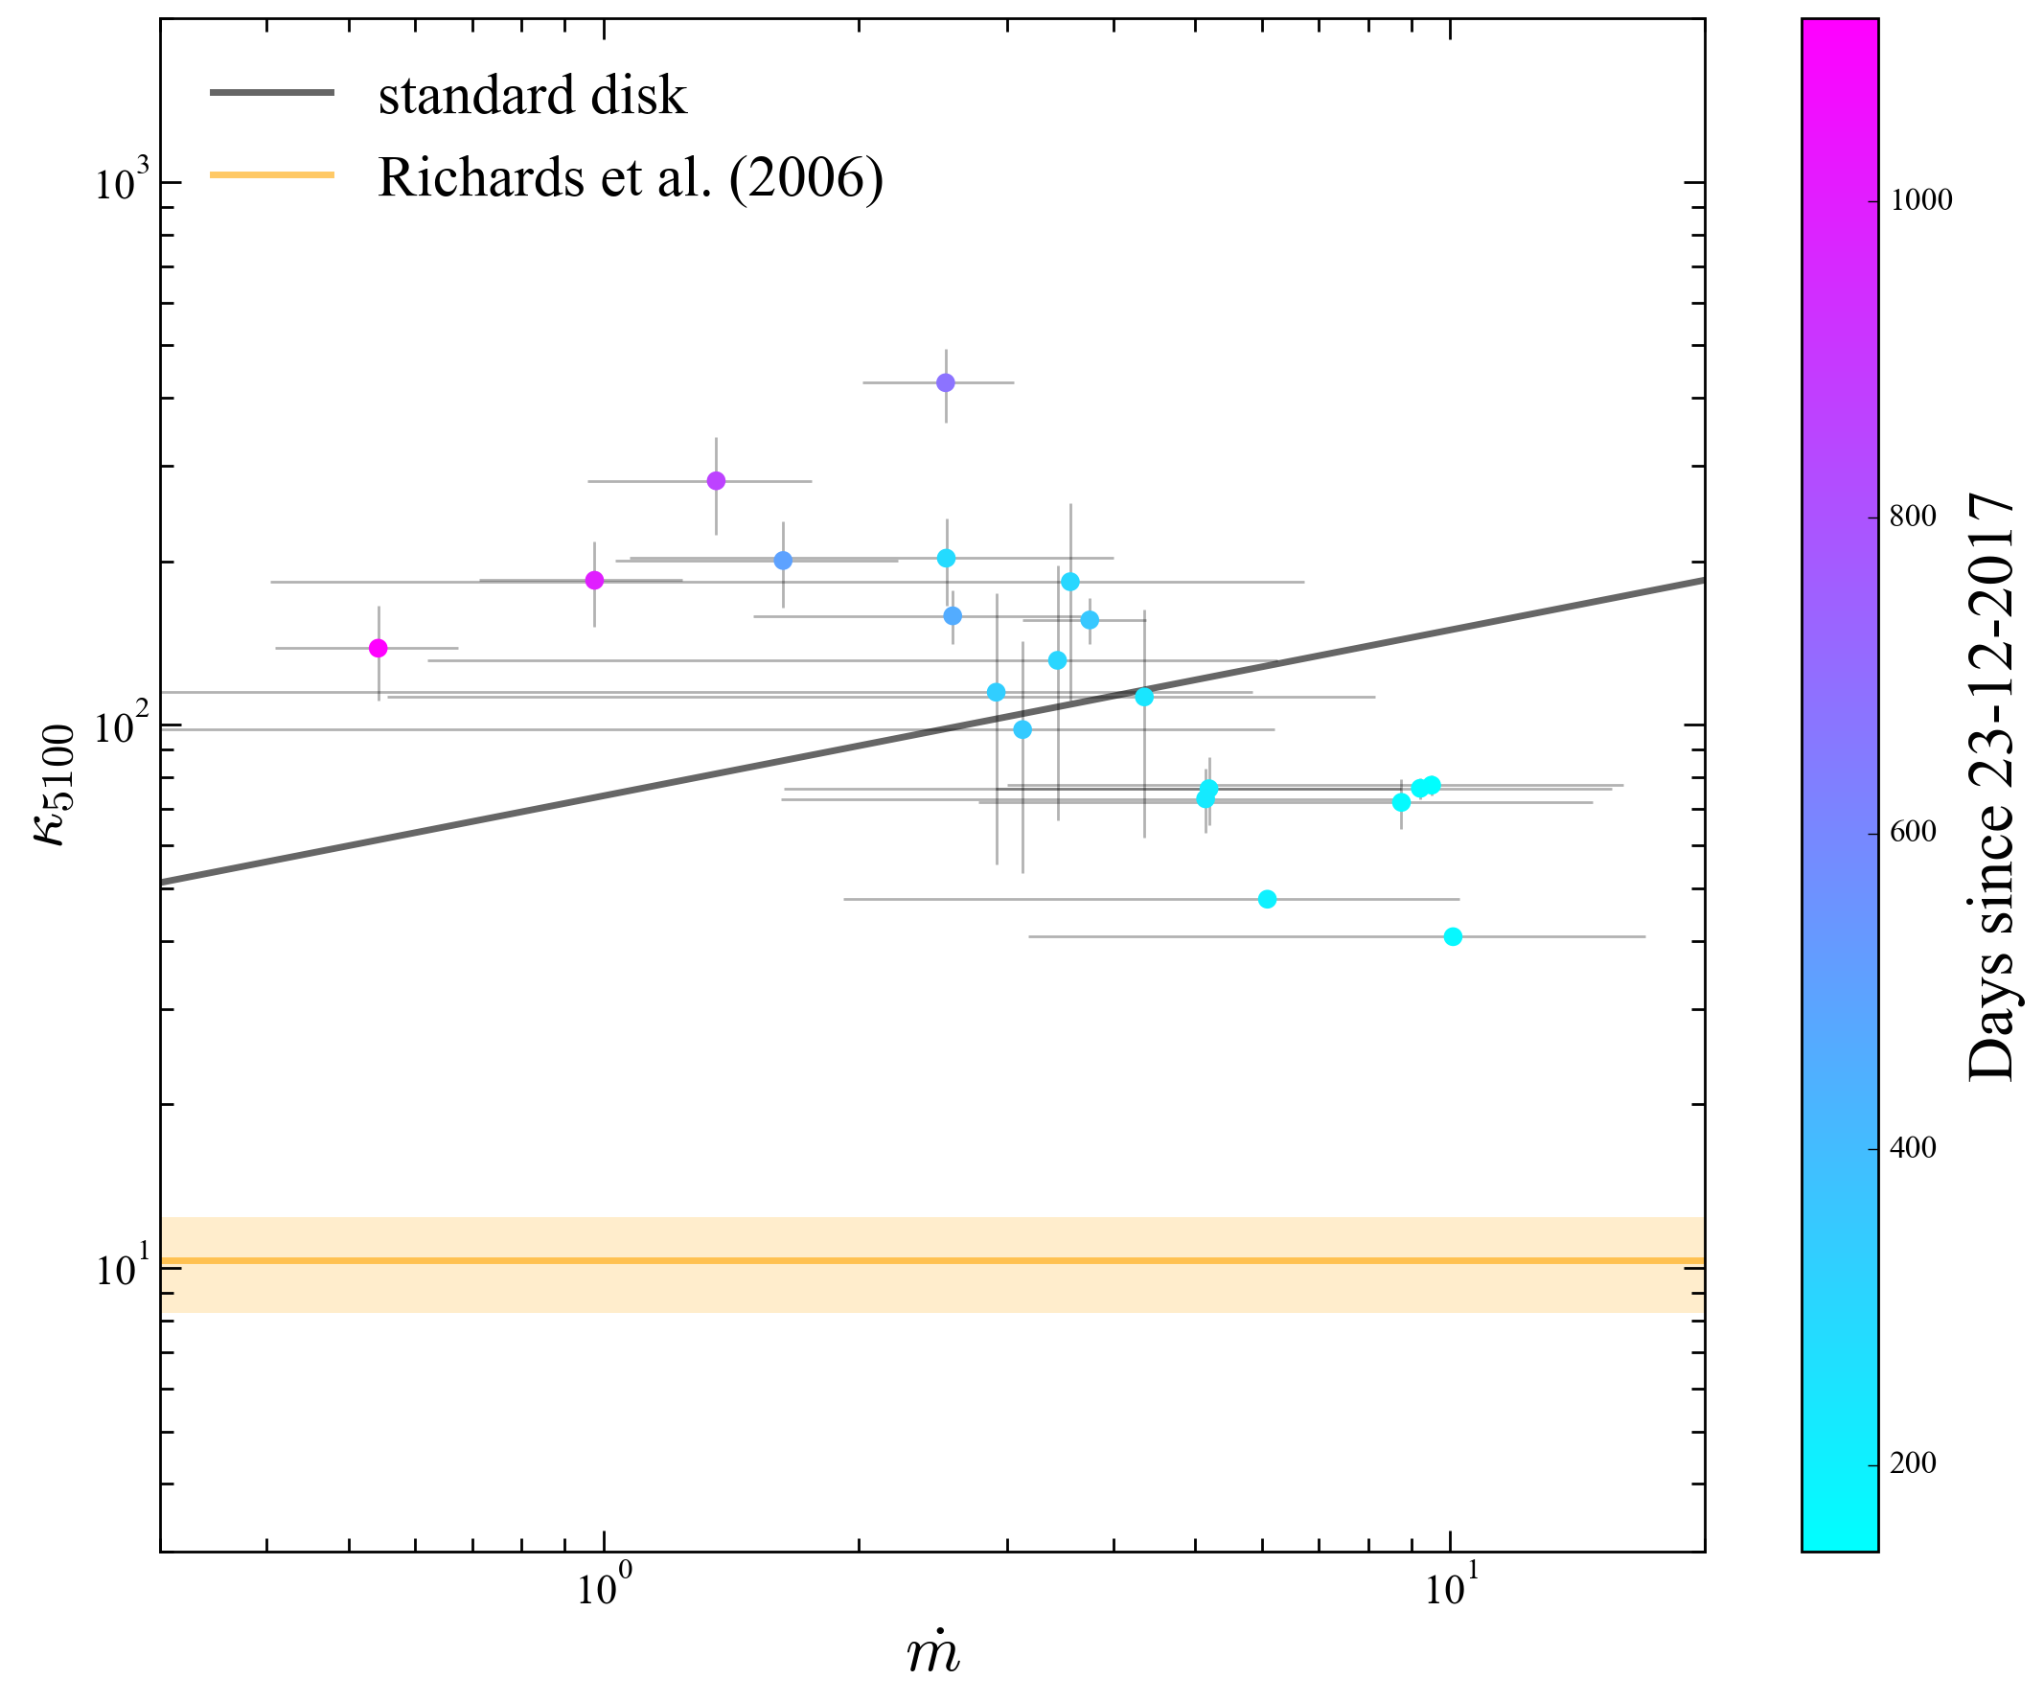
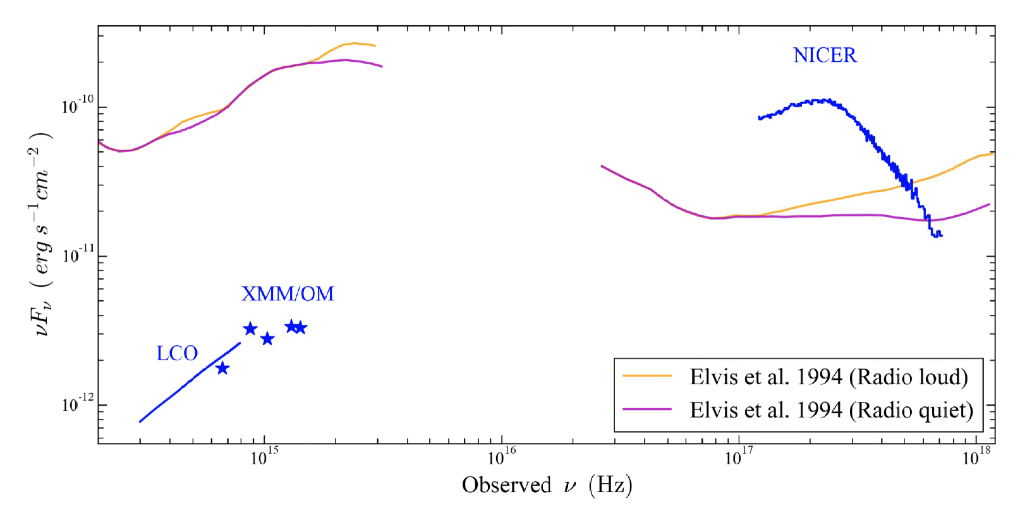
The disk dominated SED
Ricci + 2020, Li + 2023a, in prep
Notes:
Let's first discuss the SED of 1ES. Although its optical spectra resemble those of a quasar, the broad-band color significantly differs when compared to composite quasar spectra, skewing much bluer. The optical bolometric correction, kappa5000 is about 100, ten times that of Type 1s. Intriguingly, this value aligns with the thin disk model discussed in the introduction. However, the bluer when birghter, for thin disk, only manifested in the later epochs of 1ES; during earlier epochs, it was bluer when fainter.

Slide 12
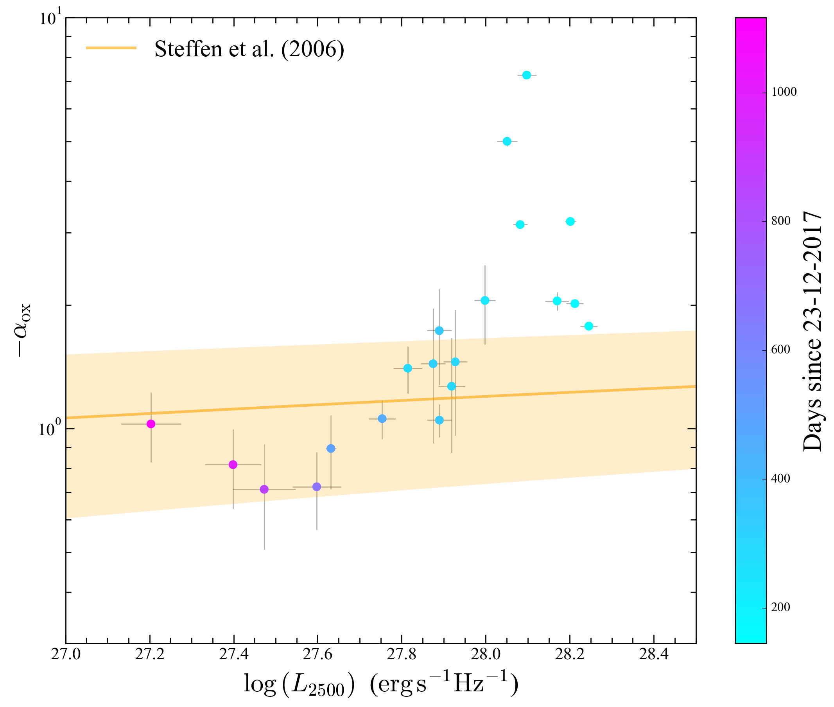
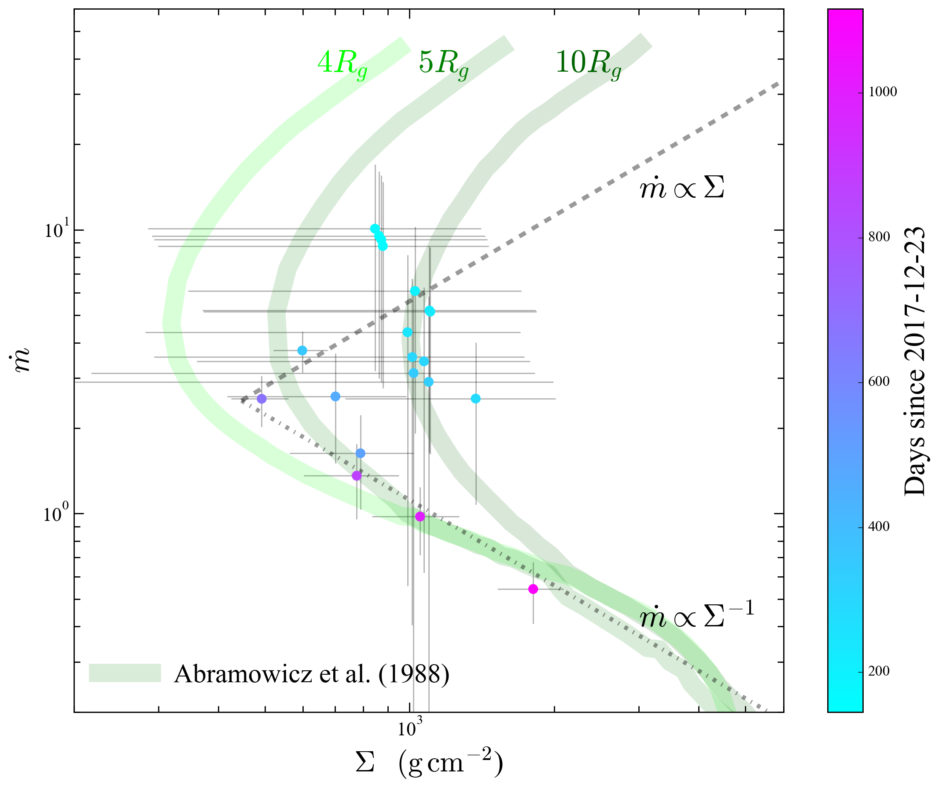
The transient slim disk
Li + 2023a,b, in prep
Notes:
The two-branch evolution also appeared in the optical/X-ray slope: bluer when fainter earlier, and redder when fainter later. To remind you, a slim disk is actually redder than a thin disk due to a flatter effective temperature. Therefore, we inspected the surface density at the truncation radius, and although not clear because we could not trace a fixed radius, the mdot-sigma relation seemed to align with the two branches proposed for the slim to thin disk transition by Abramowicz. The results first explains the kappa5000 evolution: it was red as a slim disk initially, became blue when transitioning to a thin disk, and finally became redder as the mass accretion rate decreased. To explain the alpha_OX physically,

Slide 13
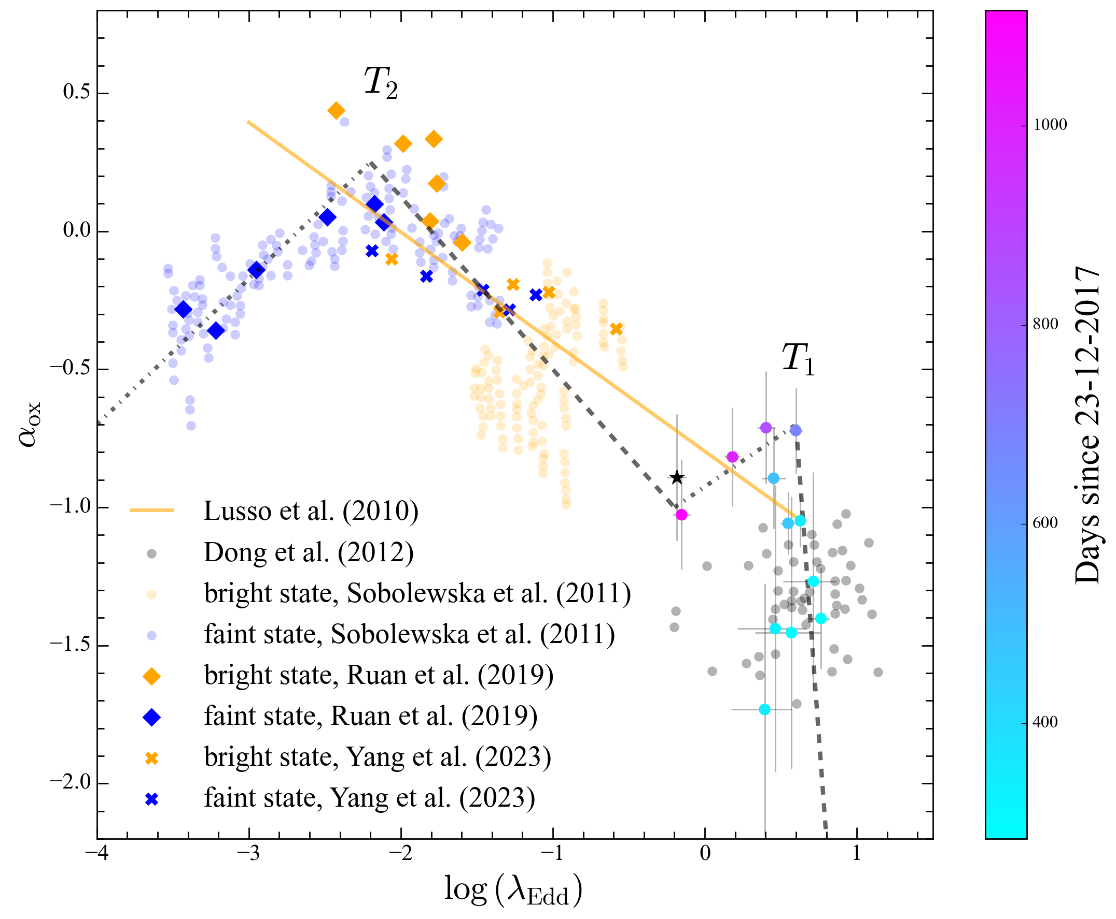
Observed state-transition plot
Yuan & Narayan 2014
Li + 2023a, in prep
Notes:
This finding is intriguing because it allows us now, to transform the theoretical S-curve, where both axes are unobservable, into this color luminosity plot. The S-curve now appears as shown. Here is the quasar main sequence, and here is a small sample of highly accreting Intermediate Mass Black Holes. For the first time, 1ES provides a bridge that transforms from the slim disk to the standard disk.

Slide 14
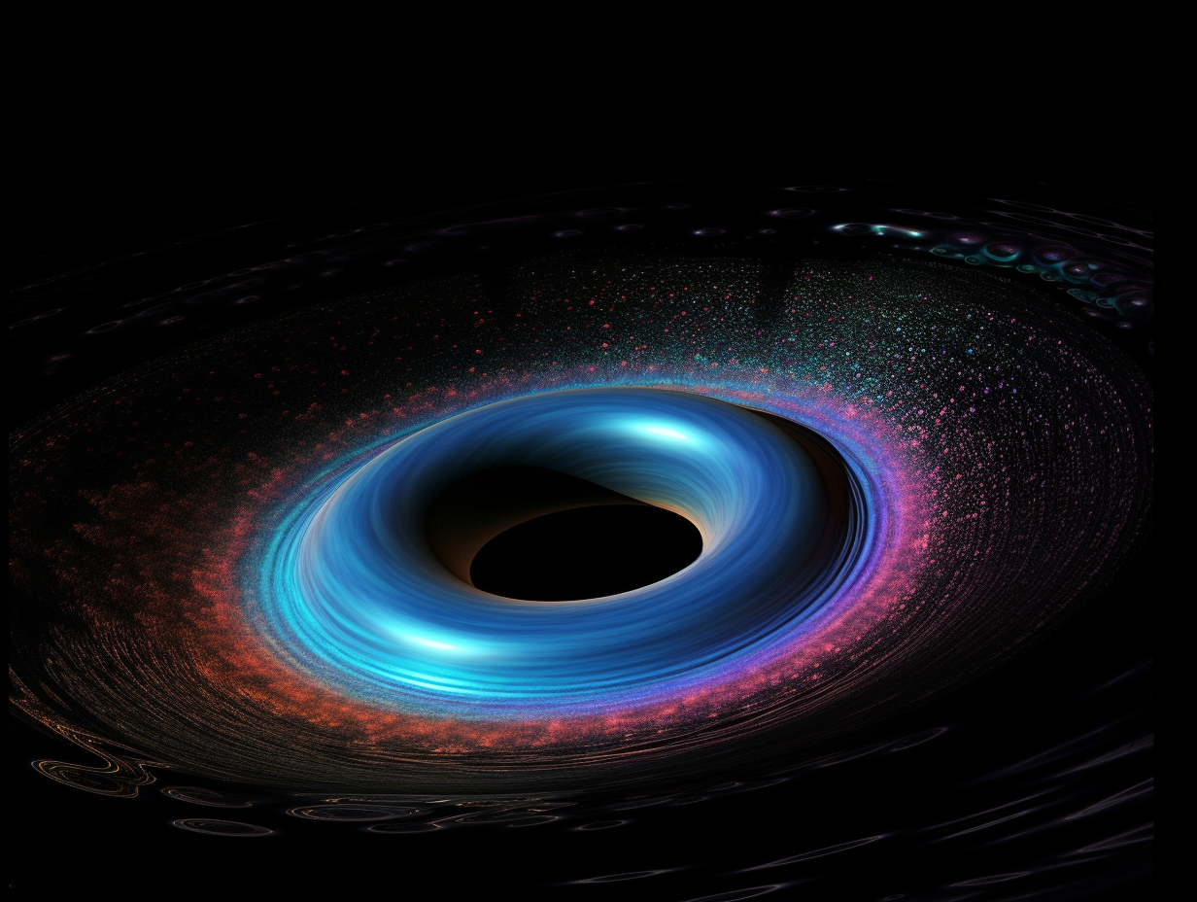
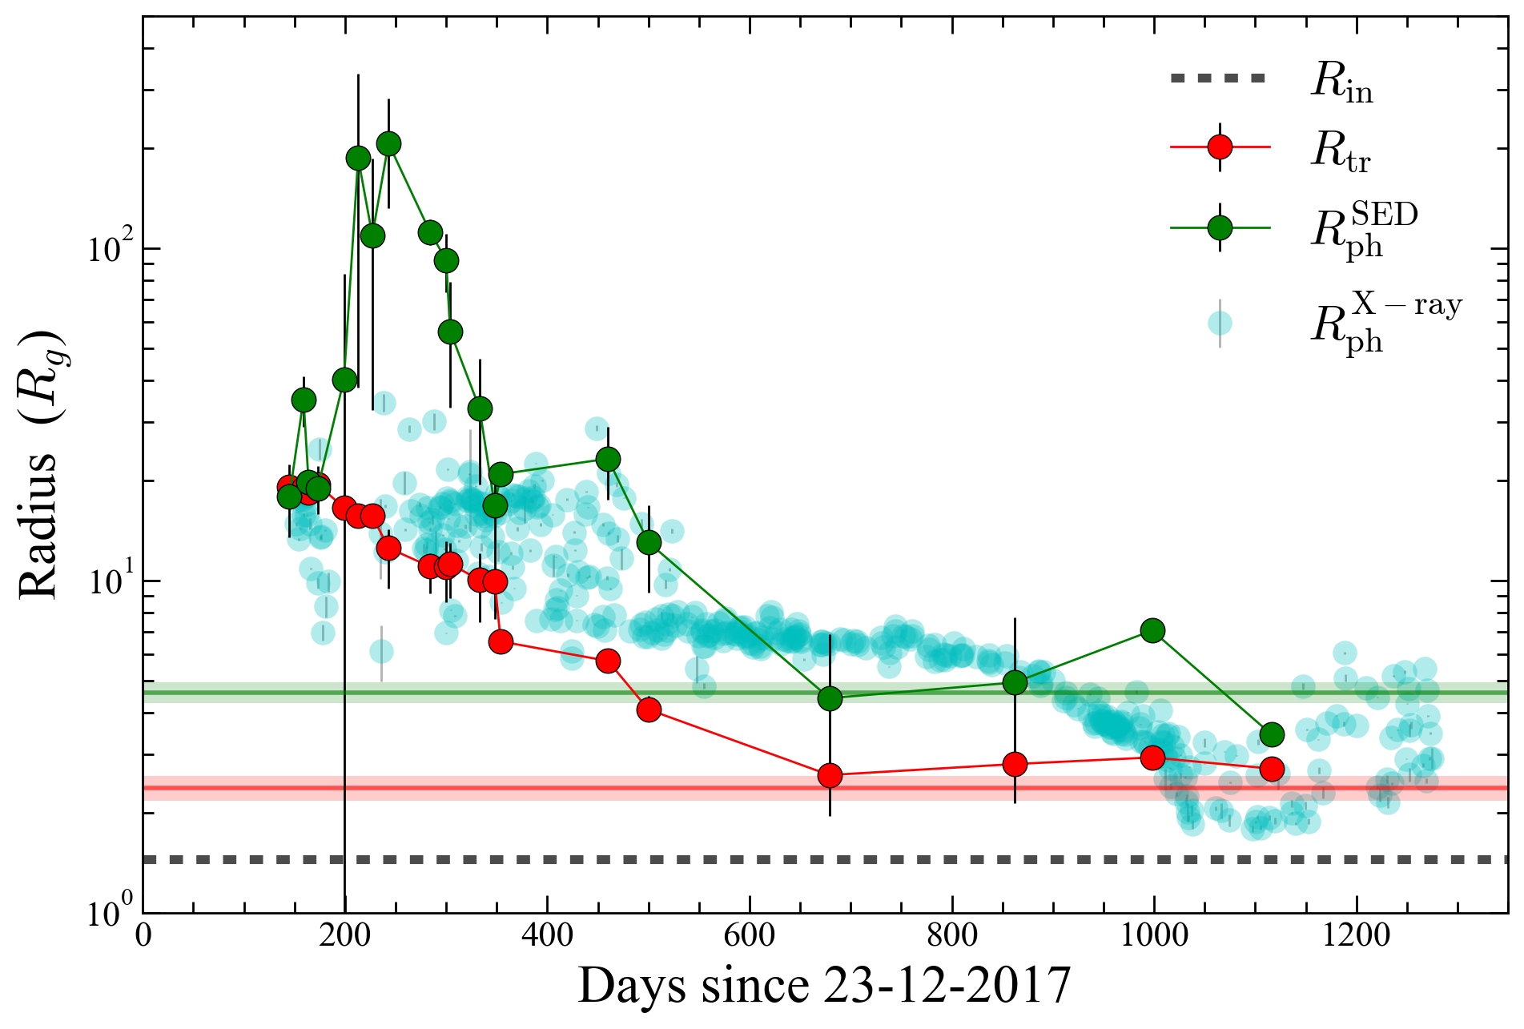
Evolution of the slim disk
Li + 2023b, in prep
Notes:
Now I will have delivered the message that the slim accretion disk, a theoretical solution for more than 30 years, indeed exists. We can study the detailed picture of disk phase transition with these characterizations: the red one represents the truncation radius, initially large at about 20 gravitational radii. As time passed, the truncation radius decreased monotonically down to near the ISCO, and the SED, changes from a slim disk dominated, to a thin disk dominated. Since the slim disk was puffed up, the photosphere size (the green line) was larger than the truncation radius, especially around 200 days, when the photosphere size became exceedingly large.

Slide 15
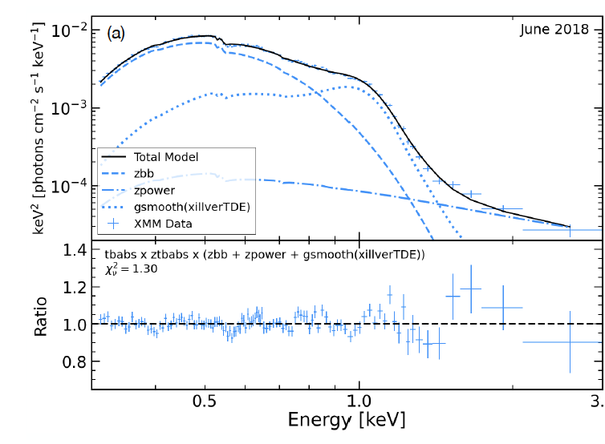
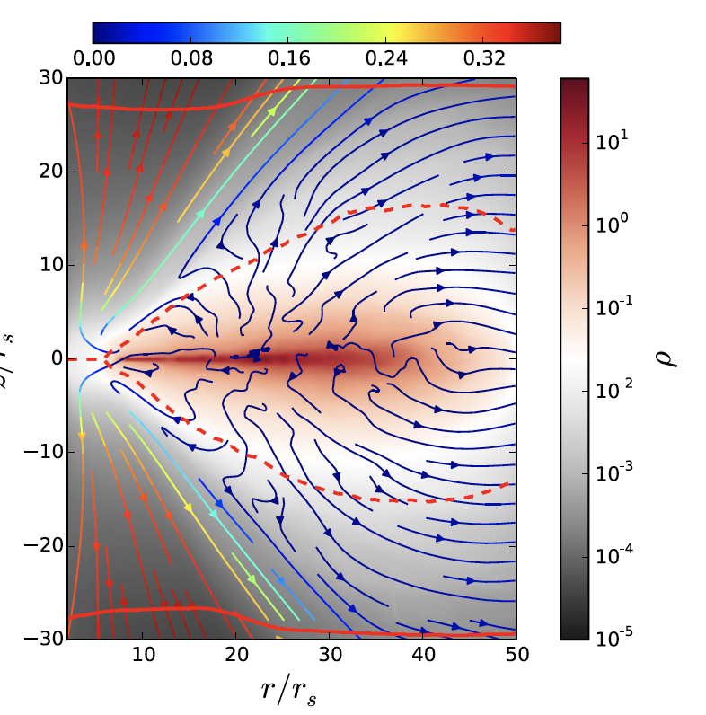
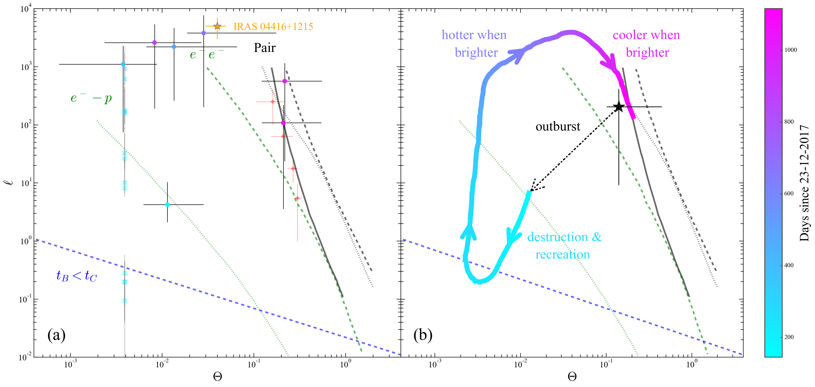
Optical thick outflow at 200 day
Reflection
Masterson + 2022
Blandford-Payne mechanism ?
Blandford & Payne 1982
Cooling
Jiang + 2014
Notes:
A reasonable hypothesis is that at this epoch, an optically thick outflow was launched, as typically seen in 3D, super-Eddington, RMHD simulations. Three interesting properties of 1ES can be attributed to this optically thick outflow. First, Masterson et al. have shown that the 1 keV feature can be produced by an ultra-fast, thick reflector. Secondly, the corona traced this trajectory in the Theta-l plot. Right after the optical outburst, luminosity decreased around 200 days, touching the line where bremsstrahlung cooling dominates. This is very likely because the outflow significantly increased the gas density in the corona, cooling down the corona efficiently. Now both the 3 mysteries seem to have solutions. Last but not least, thirdly, the outflow would carry away mass, causing the mass accretion rate to decrease quickly at first. Based on the Blandford-Payne mechanism, it would also carry away angular momentum, leading to a slight increase in the mass accretion rate after a certain viscous time scale.

Slide 16
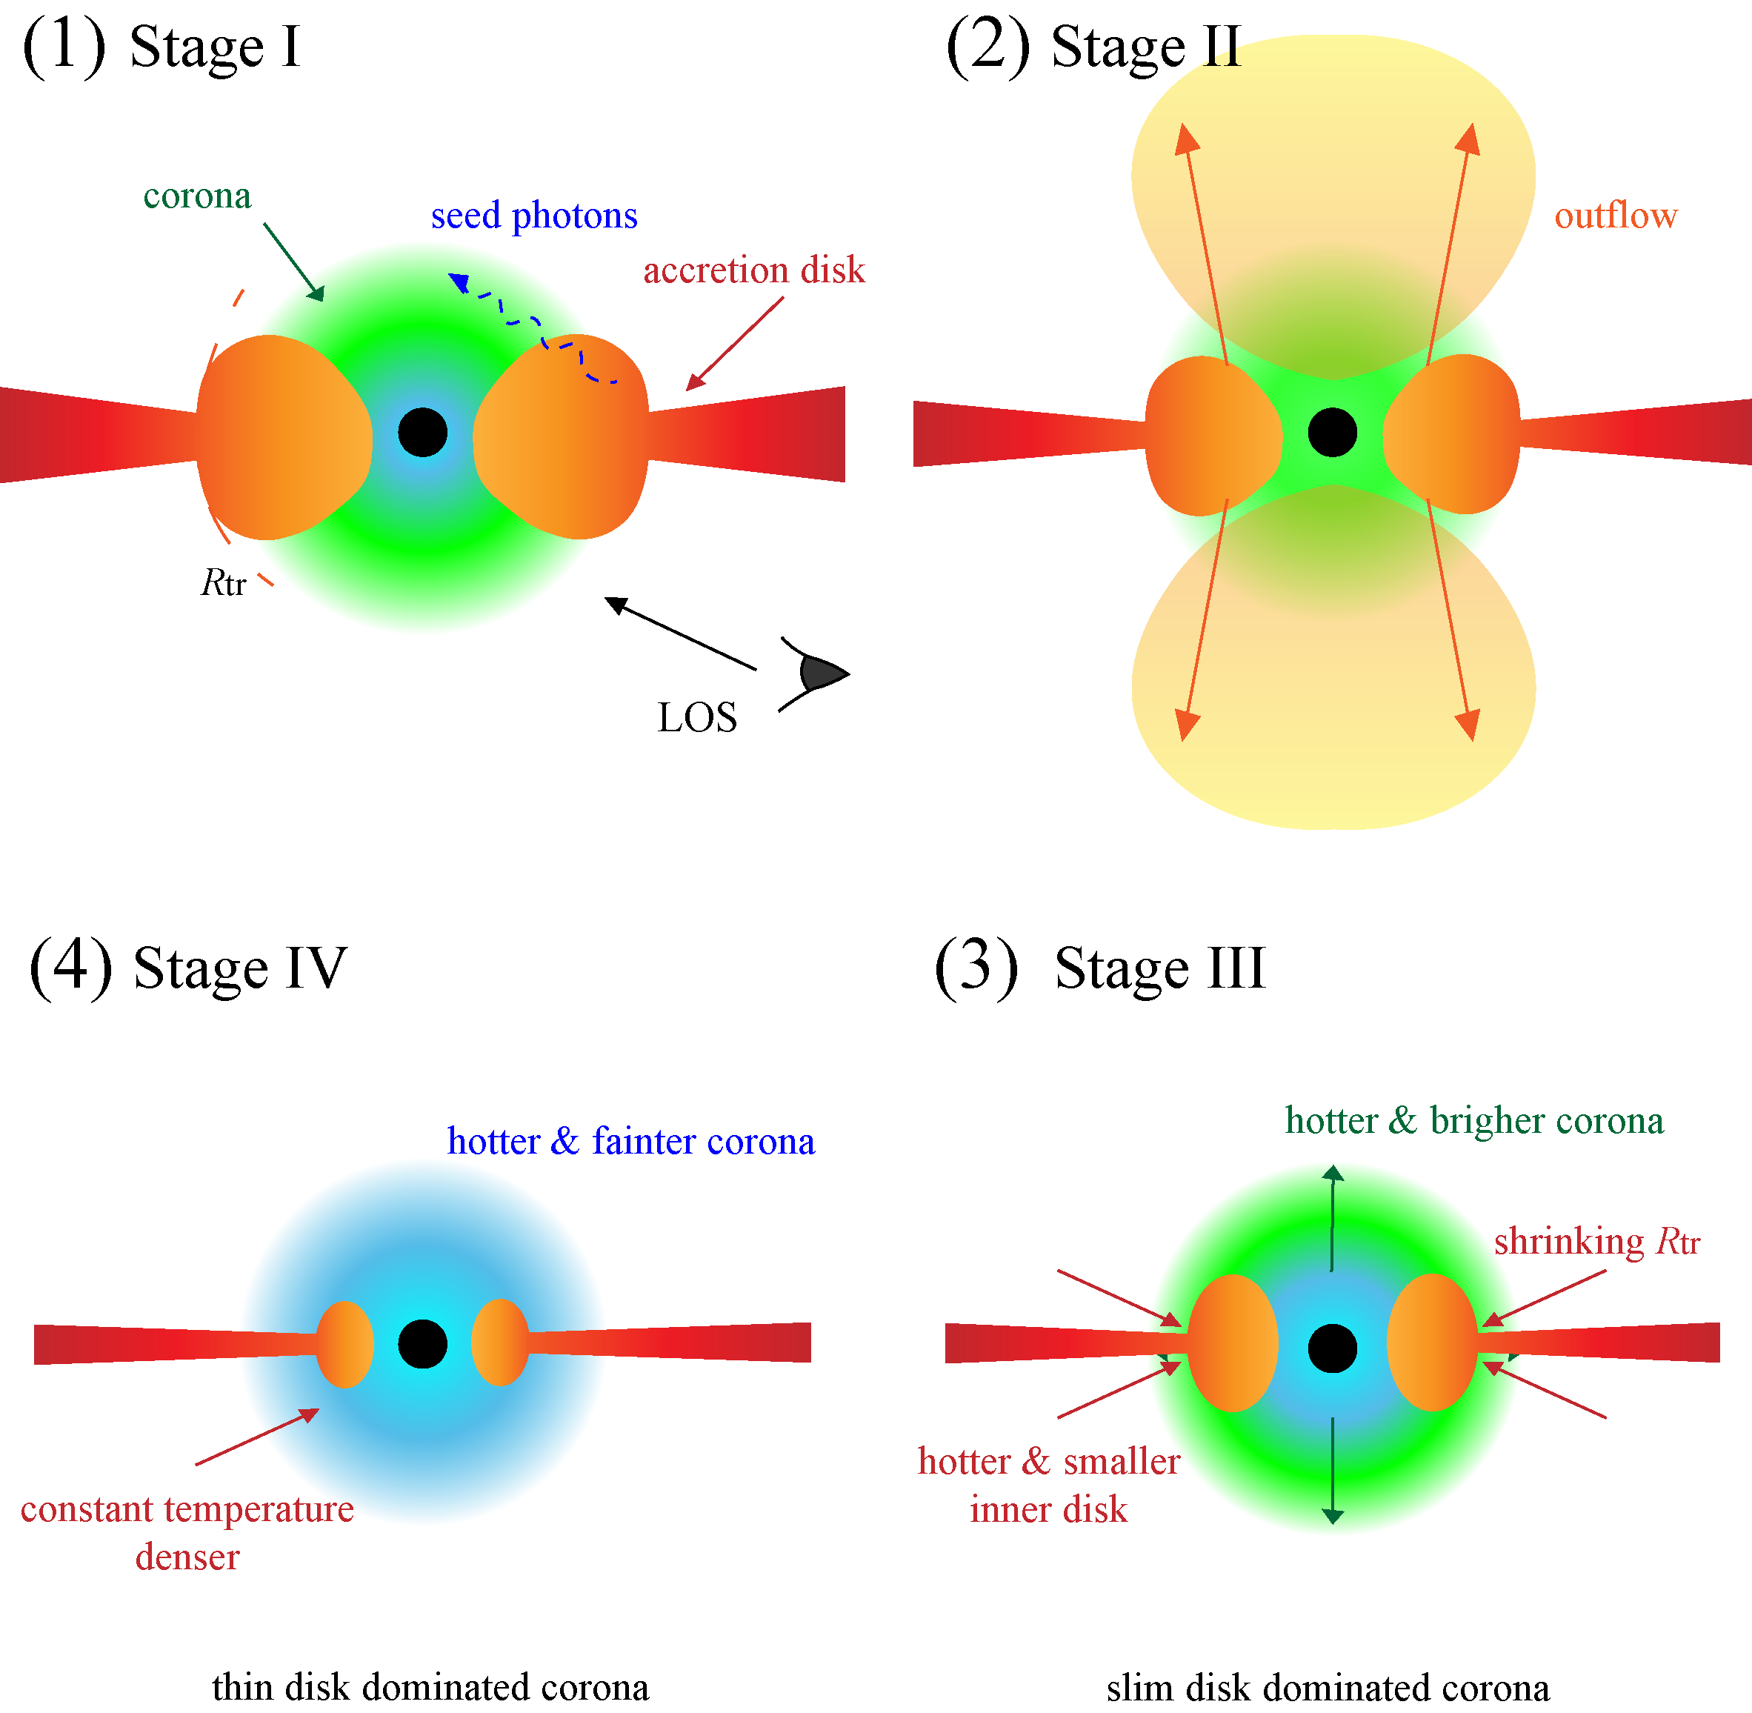
Overall picture
Notes:
Here is time to summarize the 4 stage light curve earlier to the overall physical picture. Initially TDE increase the Mdot of the pre-existing disk significantly, making the inner disk thick. And at the special 200 days, outflow been launched, causing the interesting phenomenon I just show. Then as times goes, mdot decrease, as the truncation radius keep decreasing, disk from a slim disk dominate be a thin disk dominated.

Slide 17

Summary
1. Multi-band observations caught the post-outburst evolution of CLAGN 1ES 1927+654. SED evolution prefer the TDE explanation.
2. The BLR clouds was undergoing dynamical evolution, following a eccentric orbit and varying density. The newly formed BLR was not virialized, overestimating M_{BH}
3. The black hole was accreting super-critically, with t ^{-5/3} declining mass accretion rate, where about 0.55$M_{⨀}$ been accreted
4. The energy distribution shows a clear 2-branch evolution, indicating the existence of a transient slim accretion disk
5. The X-ray disappearance at ~ 200 days can be explanied by a optically thick outflow launched above the slim disk, overcooling the corona & producing reflection feature
Notes:
I want to thank the SOC for giving me the opportunity. Here is the summary, thank you all for listening. I am now ready to take any questions.

