Slide 1
Compact objects around SMBHs: quasi-periodic eruptions, FRBs and EMRIs
Fayin Wang 王发印
Nanjing University
Collaborators: Z.Y. Zhao, R.N.Li, Y.Y.Wang, Y.C.Zou, Z.G.Dai, K.S.Cheng
Astrophysical Black Holes: A Rapidly Moving Field
Hong Kong, June 23-26, 2023

Slide 2
Outline
Introduction
EM counterpart of Extreme Mass Ratio Inspirals (EMRI):
X-ray quasi-periodic eruptions
Fast radio bursts
Summary
Notes:
This is a quick outline of my talk. First, I will give the introduction and background of my talk.
Then I will discuss some topics on GRB cosmology, including dark energy, star formation rate and metal enrichment. Next I will talk about the FRB Cosmology, such as cosmic proper distance and compact dark matter.
The summary will be given in the last.

Slide 3
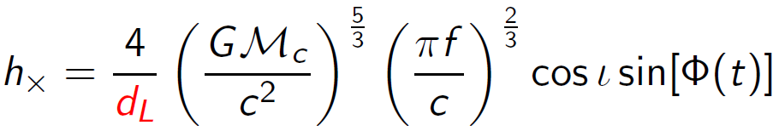
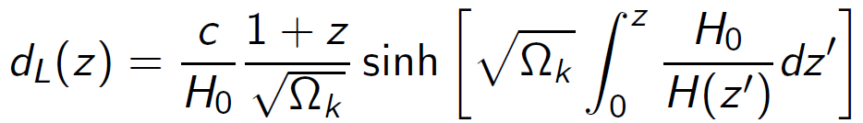
GWs as standard sirens
The luminosity distance can be inferred directly from the measured waveform: GW sources are standard distance indicators
If the redshift of the source is known, then one can fit the distance-redshift relation:
Exactly as SNe Ia -------> standard sirens
Need an EM counterpart!

Slide 4
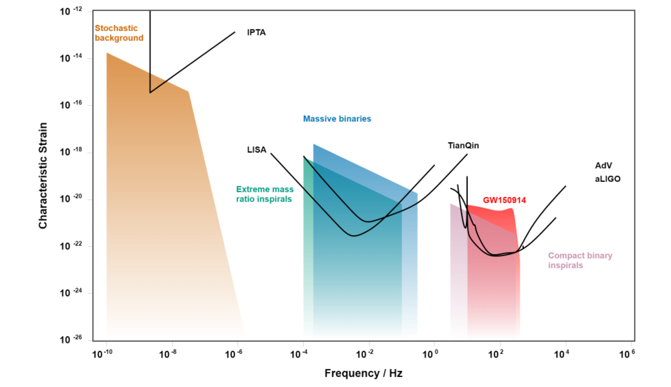
GW spectrum & EM counterparts
GRBs, kilonovae
quasi-periodic eruption?
fast radio bursts?
GWplotter

Slide 5
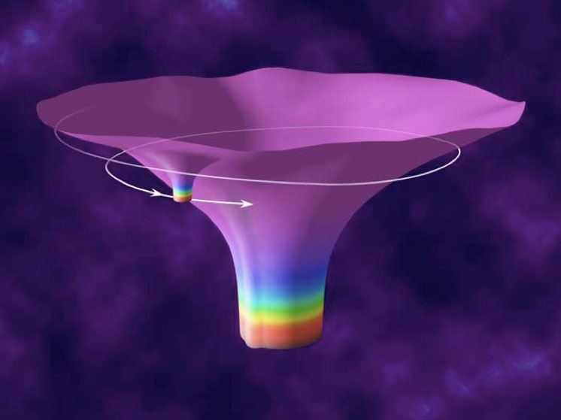
2. EM counterpart of EMRI: quasi-periodic eruptions?
• Extreme-mass-ratio inspiral (EMRI): inspiral of a compact object (a white dwarf, neutron star or black hole) into a massive black hole (MBH). No EM counterpart!
• Standard picture: EMRIs begin with capture of a compact object on a very eccentric orbit by the central black hole.
• For black holes with mass in the range 10⁴-10⁷M⊙, EMRIs will generate gravitational waves detectable by LISA, Tianqin and Taiji.

Slide 6
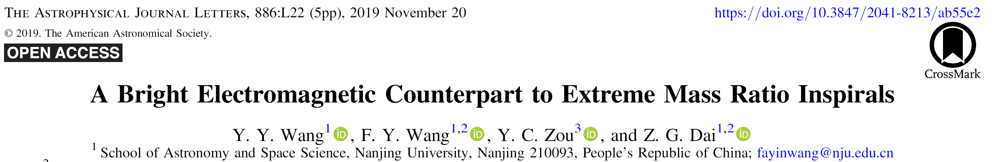
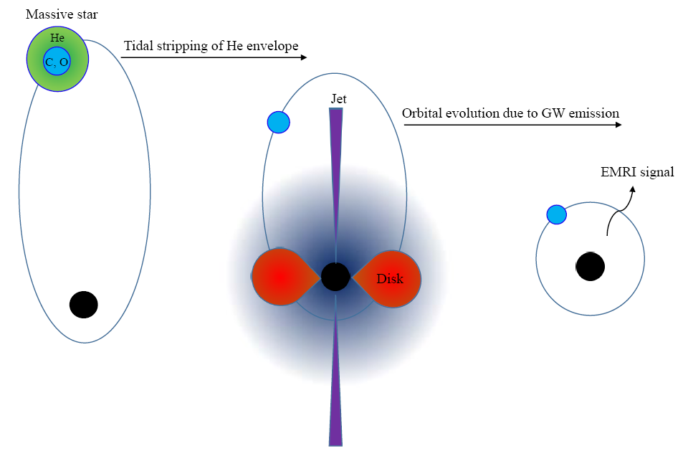
A massive star has lost H envelope during the red supergiant phase. The densities of different layers vary from 10⁰⁻³ g cm⁻³ (He envelope) to 10⁵⁻⁶ g cm⁻³ (C/O core) .
Then the He envelope gets tidally stripped by the SMBH and the C-O core inspirals into the SMBH, producing EMRIs.
A tidal disruption flares prior to EMRI!
Wang, Y. Y., Wang FY*, Zou, Y. C., Dai, Z. G. 2019, ApJL, 886, L22

Slide 7
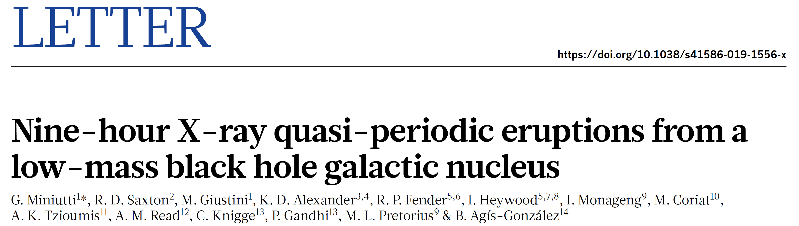
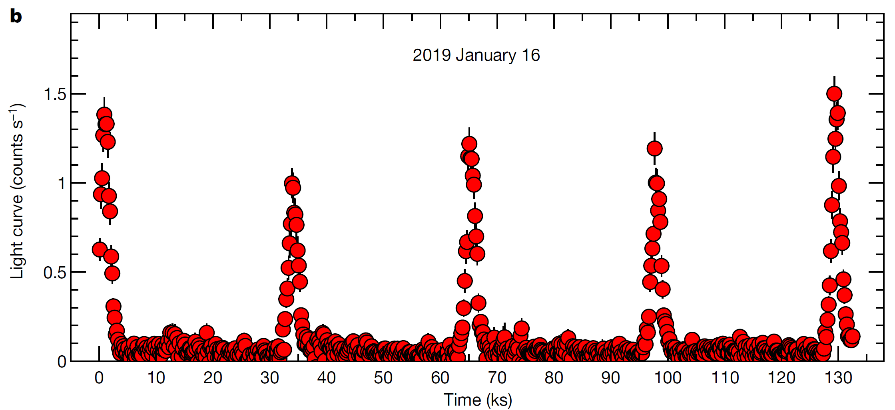
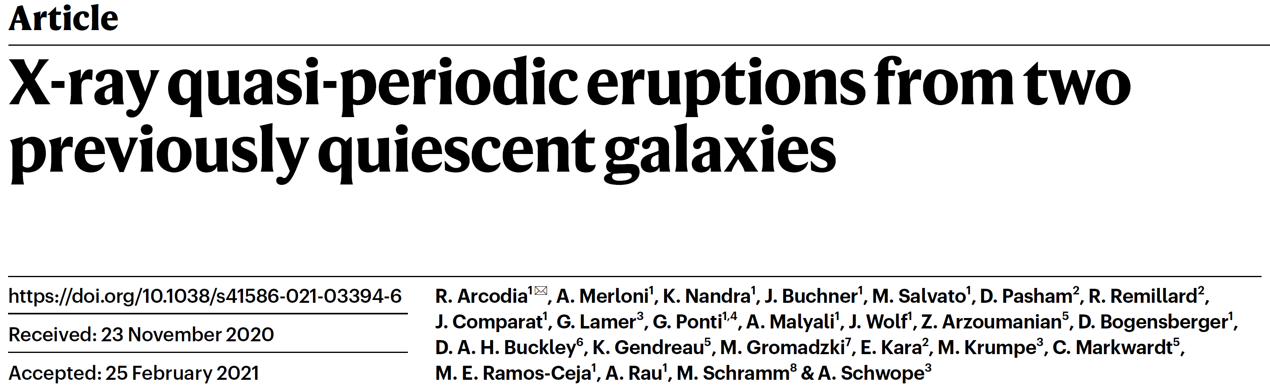
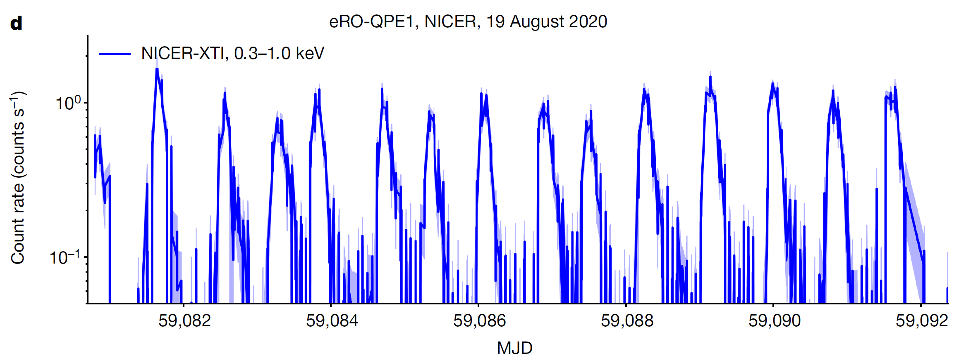
XMM-Newton
2019
GSN 069
very large luminosity; short time-scales: fast rise and slow decay;
Its period may be caused by orbital motion.

Slide 8
Properties of QPEs
Name | redshift | BH mass (M☉) | Duration | Period | Luminosity erg/s | reference
GSN 069 | 0.018 | 4×10⁵ | 1 hr | 9 hr | 5×10⁴² | Miniutti+, 2019
RXJ1301.9+2747 | 0.024 | (1-2.8)×10⁶ | 0.5 hr | 4.2 hr | 10⁴² | Giustini+, 2020
eRO-QPE1 | 0.0505 | 10⁵-10⁶ | 7.6 hr | 18.5 hr | 2×10⁴³ | Arcodia+, 2021
eRO-QPE2 | 0.0175 | 10⁵-10⁶ | 27 min | 2.4 hr | 10⁴² | Arcodia+, 2021
XMMSL1 J024916.6- 041244 (candidate) | 0.0186 | 5×10⁵ | 30 min | 2.5 hr | 10⁴² | Chakraborty+ 2021
2XMM J123103.2 +110648 (candidate) | 0.01 | 10⁵ | 2 hr | 4.1 hr | 10⁴² | Webbe & Young 2023

Slide 9
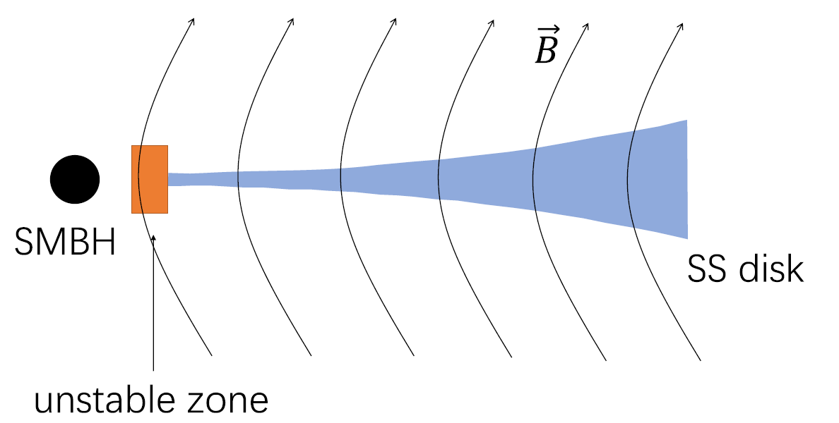
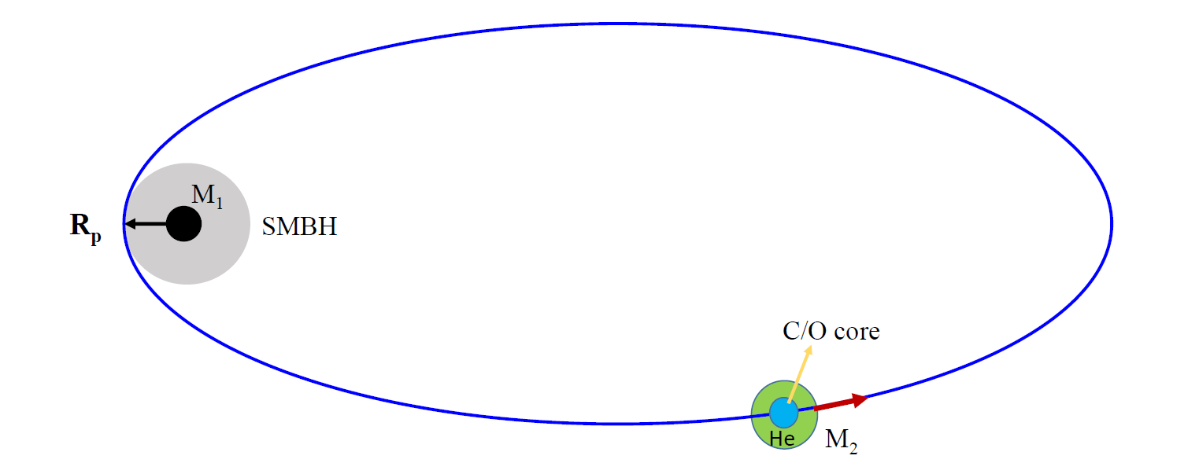
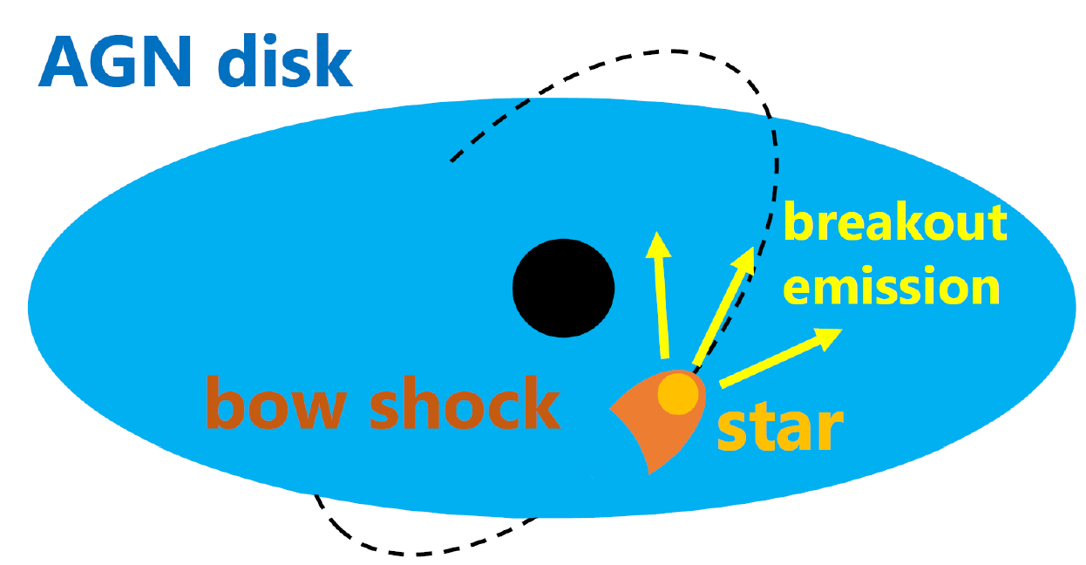
QPE Models
disk instability (Miniutti+ 2019; Sniegowska et al. 2020; Pan+, 2021; 2022, 2023; ...)
mass overflow at pericenter from a star around a SMBH (King 2020, 2022; Zhao+, 2022; Metzger+, 2022; Wang+ 2022; Chen+ 2022; Lu & Quataert 2022; Linial & Sari 2023;…)
shocks from collisions between an AGN disk and a star (Suková et al. 2021; Xian et al. 2021; Tagawa & Haiman 2023; Linial & Metzger 2023; Franchini et al. 2023)

Slide 10
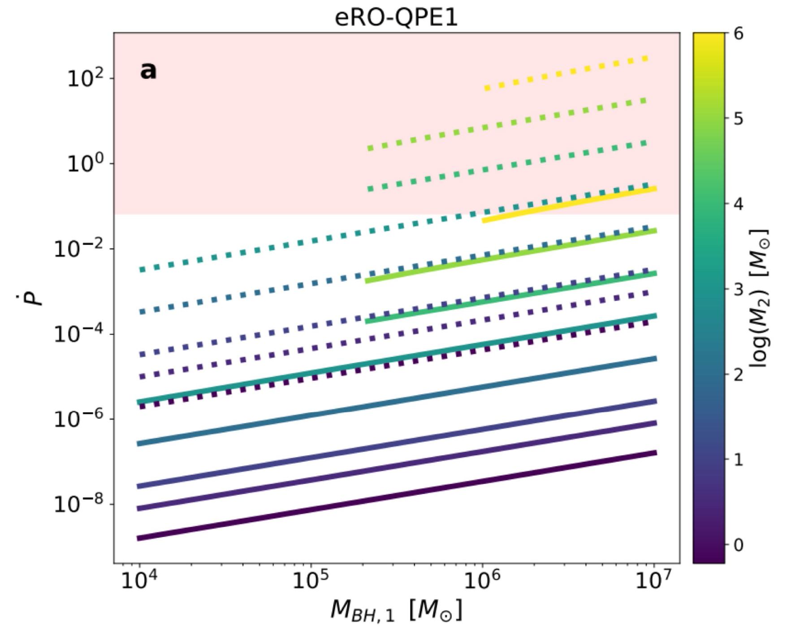
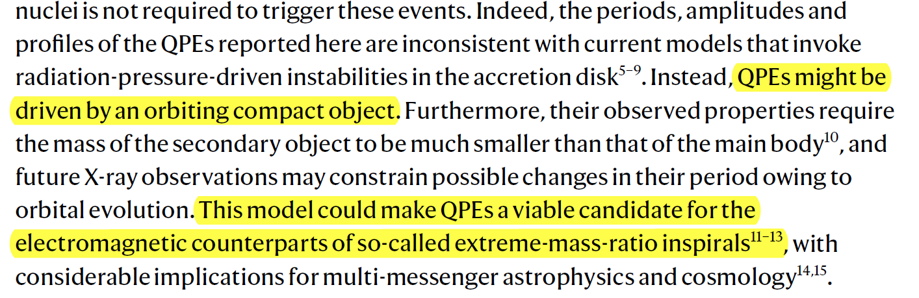
SMBH + compact object: EMRI?
Arcodia+, 2021, Nature
Assuming the period decrease of a compact binary due to emission of gravitational waves, Arcodia+ (2021) found the secondary body mass must be much smaller than the main body, i.e., EMRI.

Slide 11
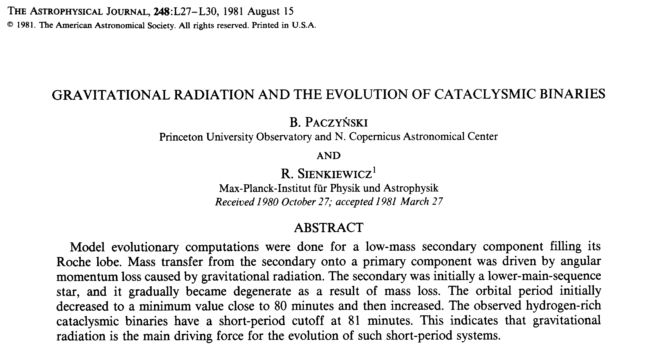
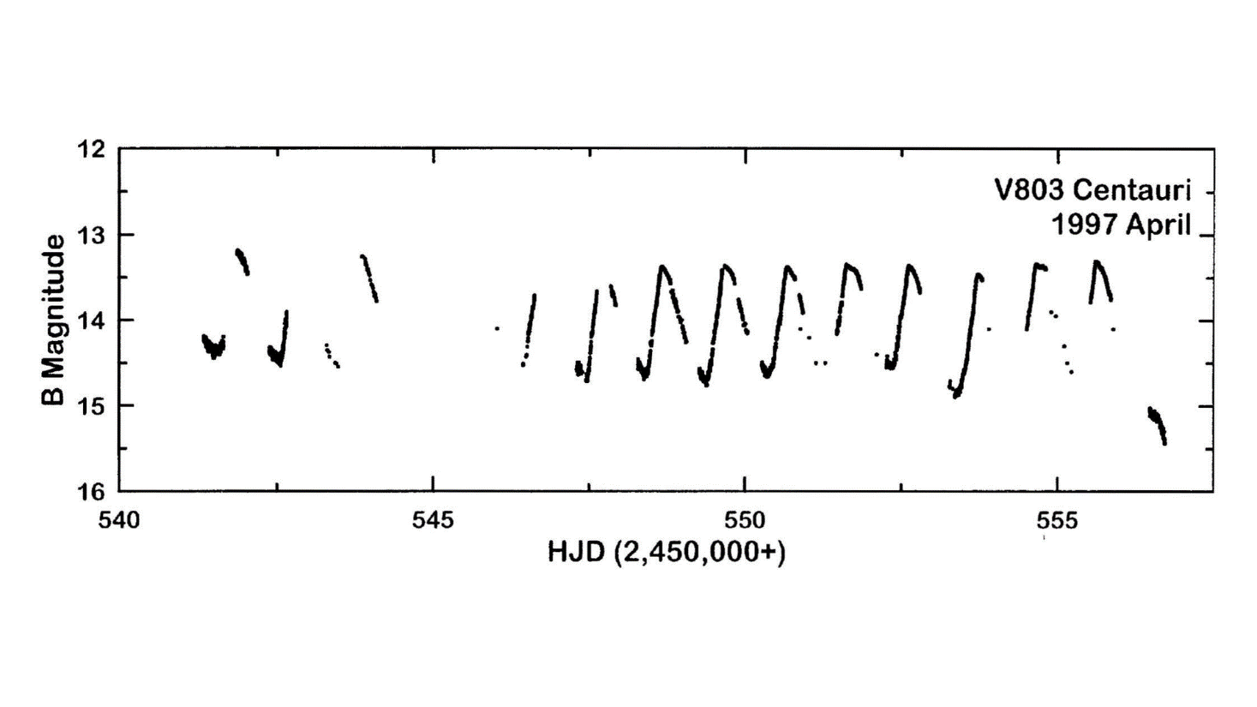
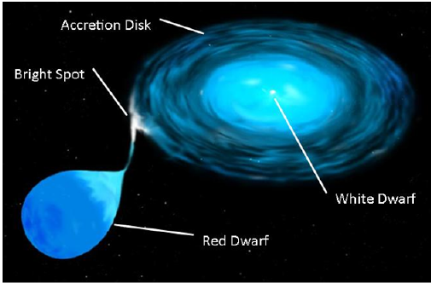
Lessons from CVs

Slide 12
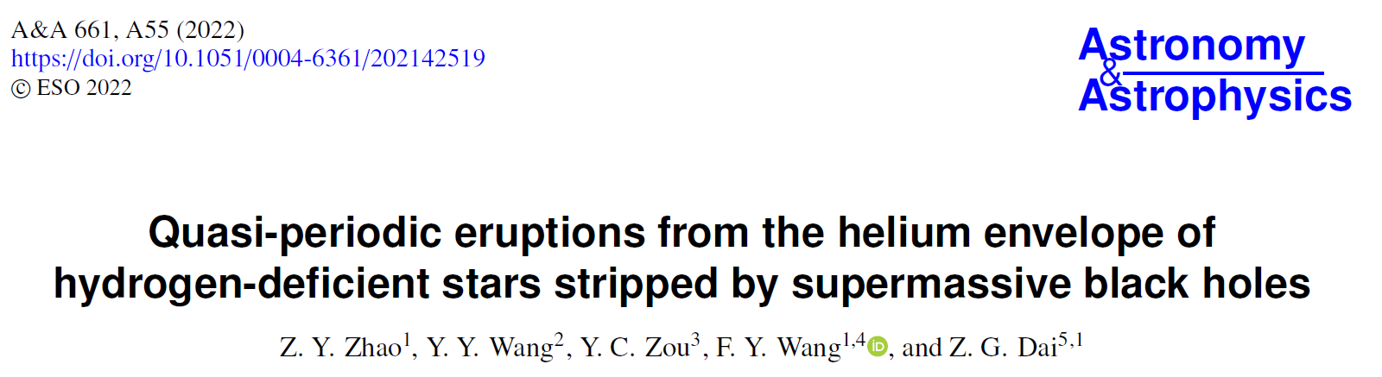
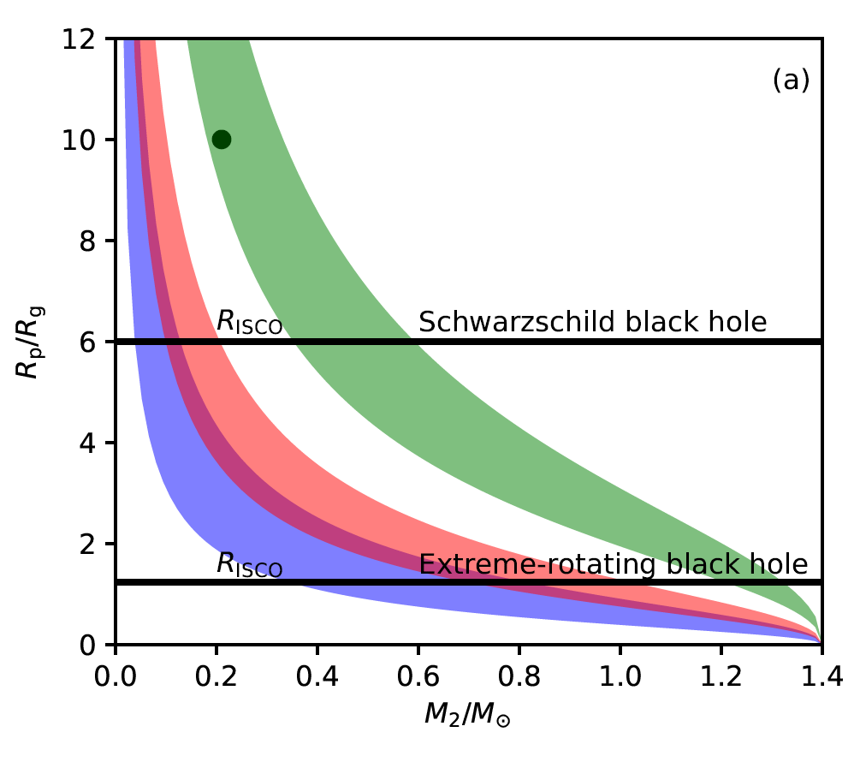
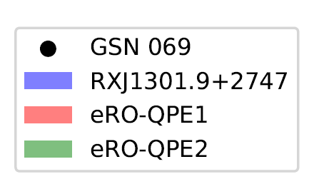
innermost stable circular orbit R_{ISCO}> R_{p}: periastron
Because the BH mass is large (10⁶ solar mass), the donor can not be a white dwarf, only if the mass of the WD companion should be extreme low. A C/O core with a less dense He envelope is possible, which can be produced by an evolving star stripped the H envelope.
R_{g}=GM/c²

Slide 13
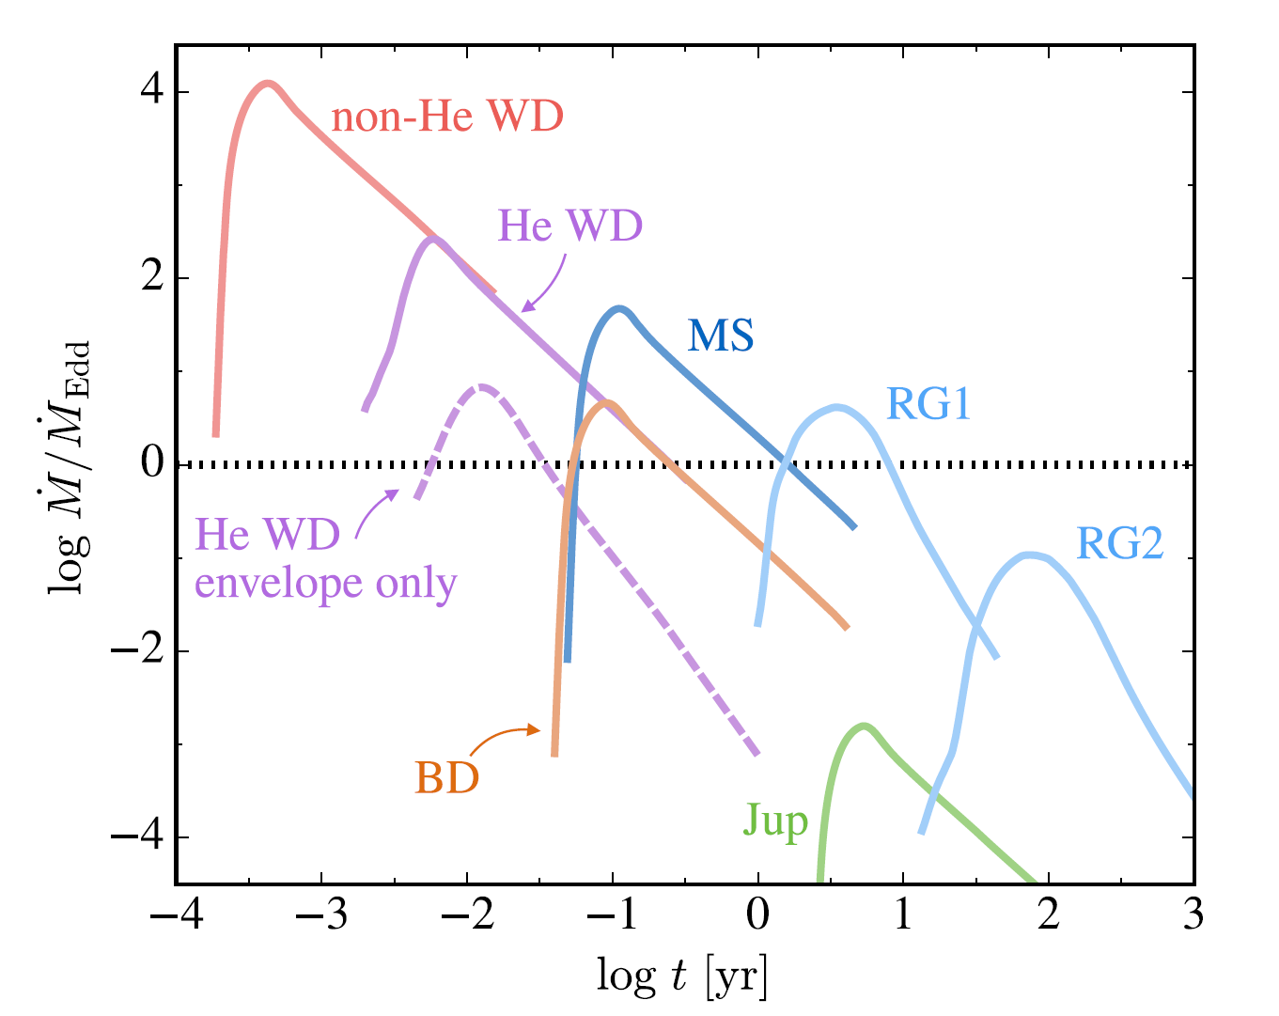
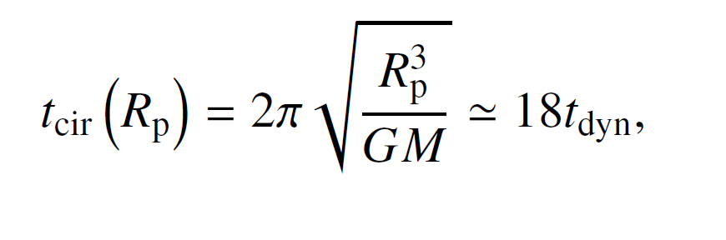
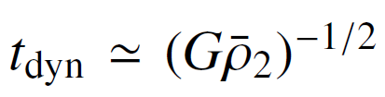
rise time: density of accreted material
Constraints on the companion: rise time
CO WDs: 1 min
He WDs: 0.06 hr
He WD with hydrogen envelope: 2.7 hr
QPEs: rise timescale: 0.2-0.3 hr
52 g cm⁻³ <ρ<2.4×10⁴ g cm⁻³
Law-Smith et al. (2017)

Slide 14
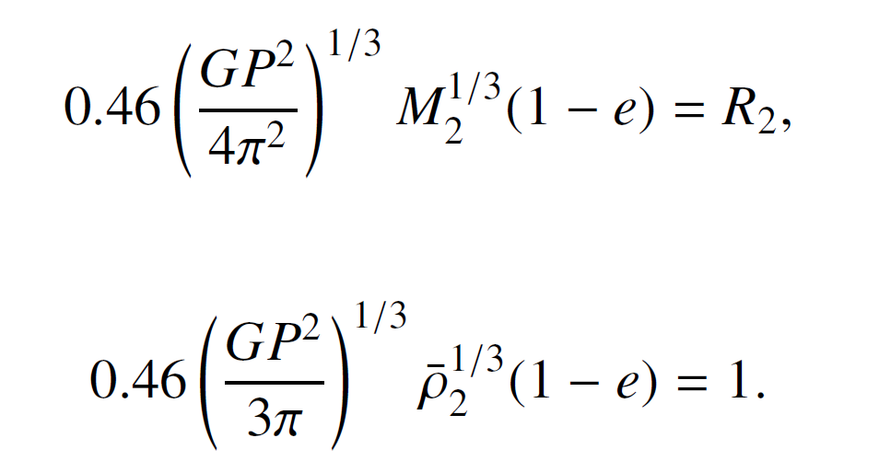
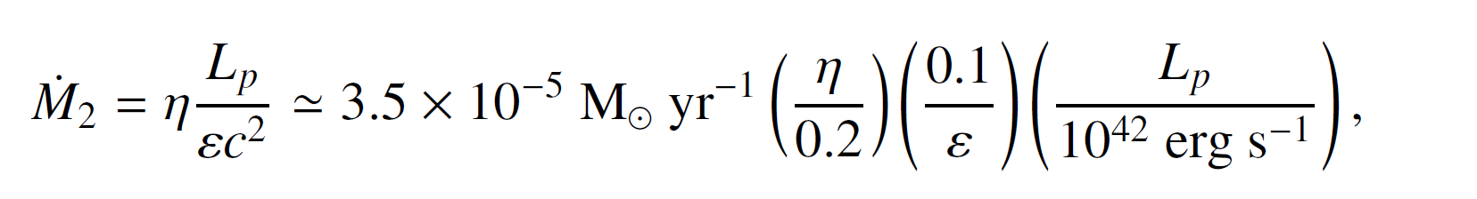
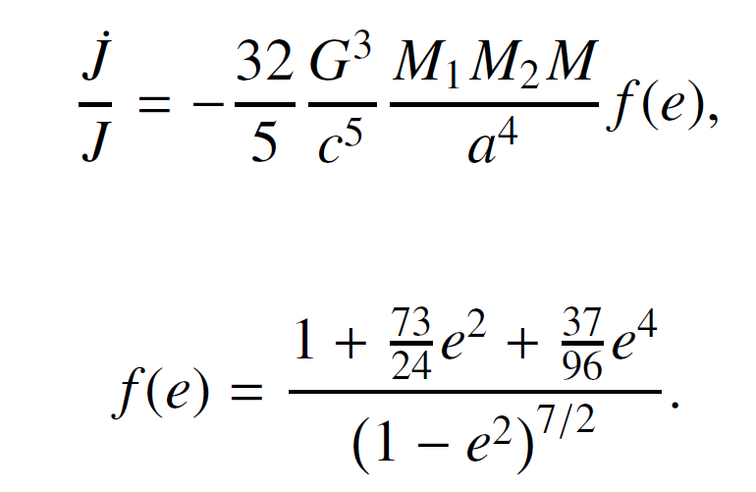
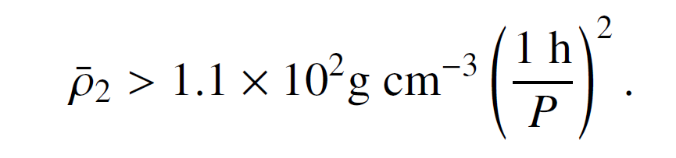
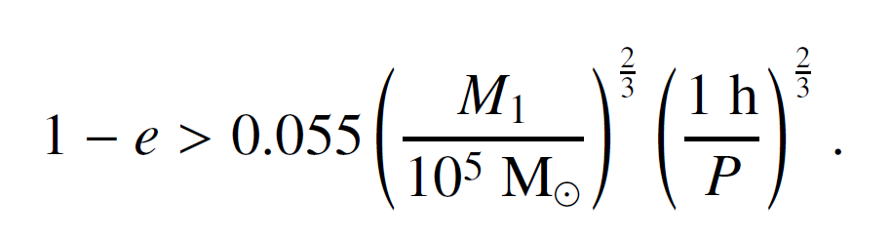
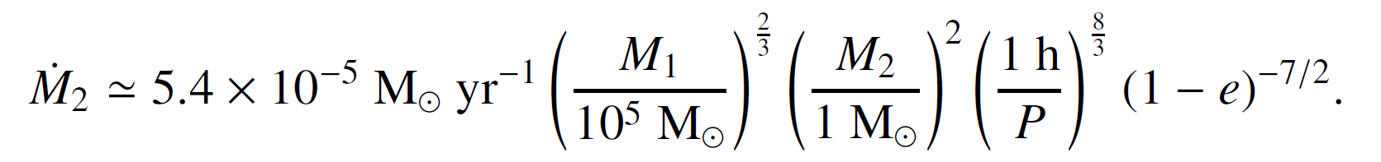
Orbital eccentricity
Mass-transfer rate
The star should fill the Roche lobe at the pericentre
The cycle-average mass-accretion rate is
The gravitational wave radiation is efficient due to the short period and it will drive the mass transfer near the pericentre. The orbital angular momentum lost caused by gravitational radiation is
e > 0：
Rp > R_{ISCO}
Zhao, Z. Y., … Wang FY*, Dai, Z. G. 2022, A&A, 661, A55

Slide 15
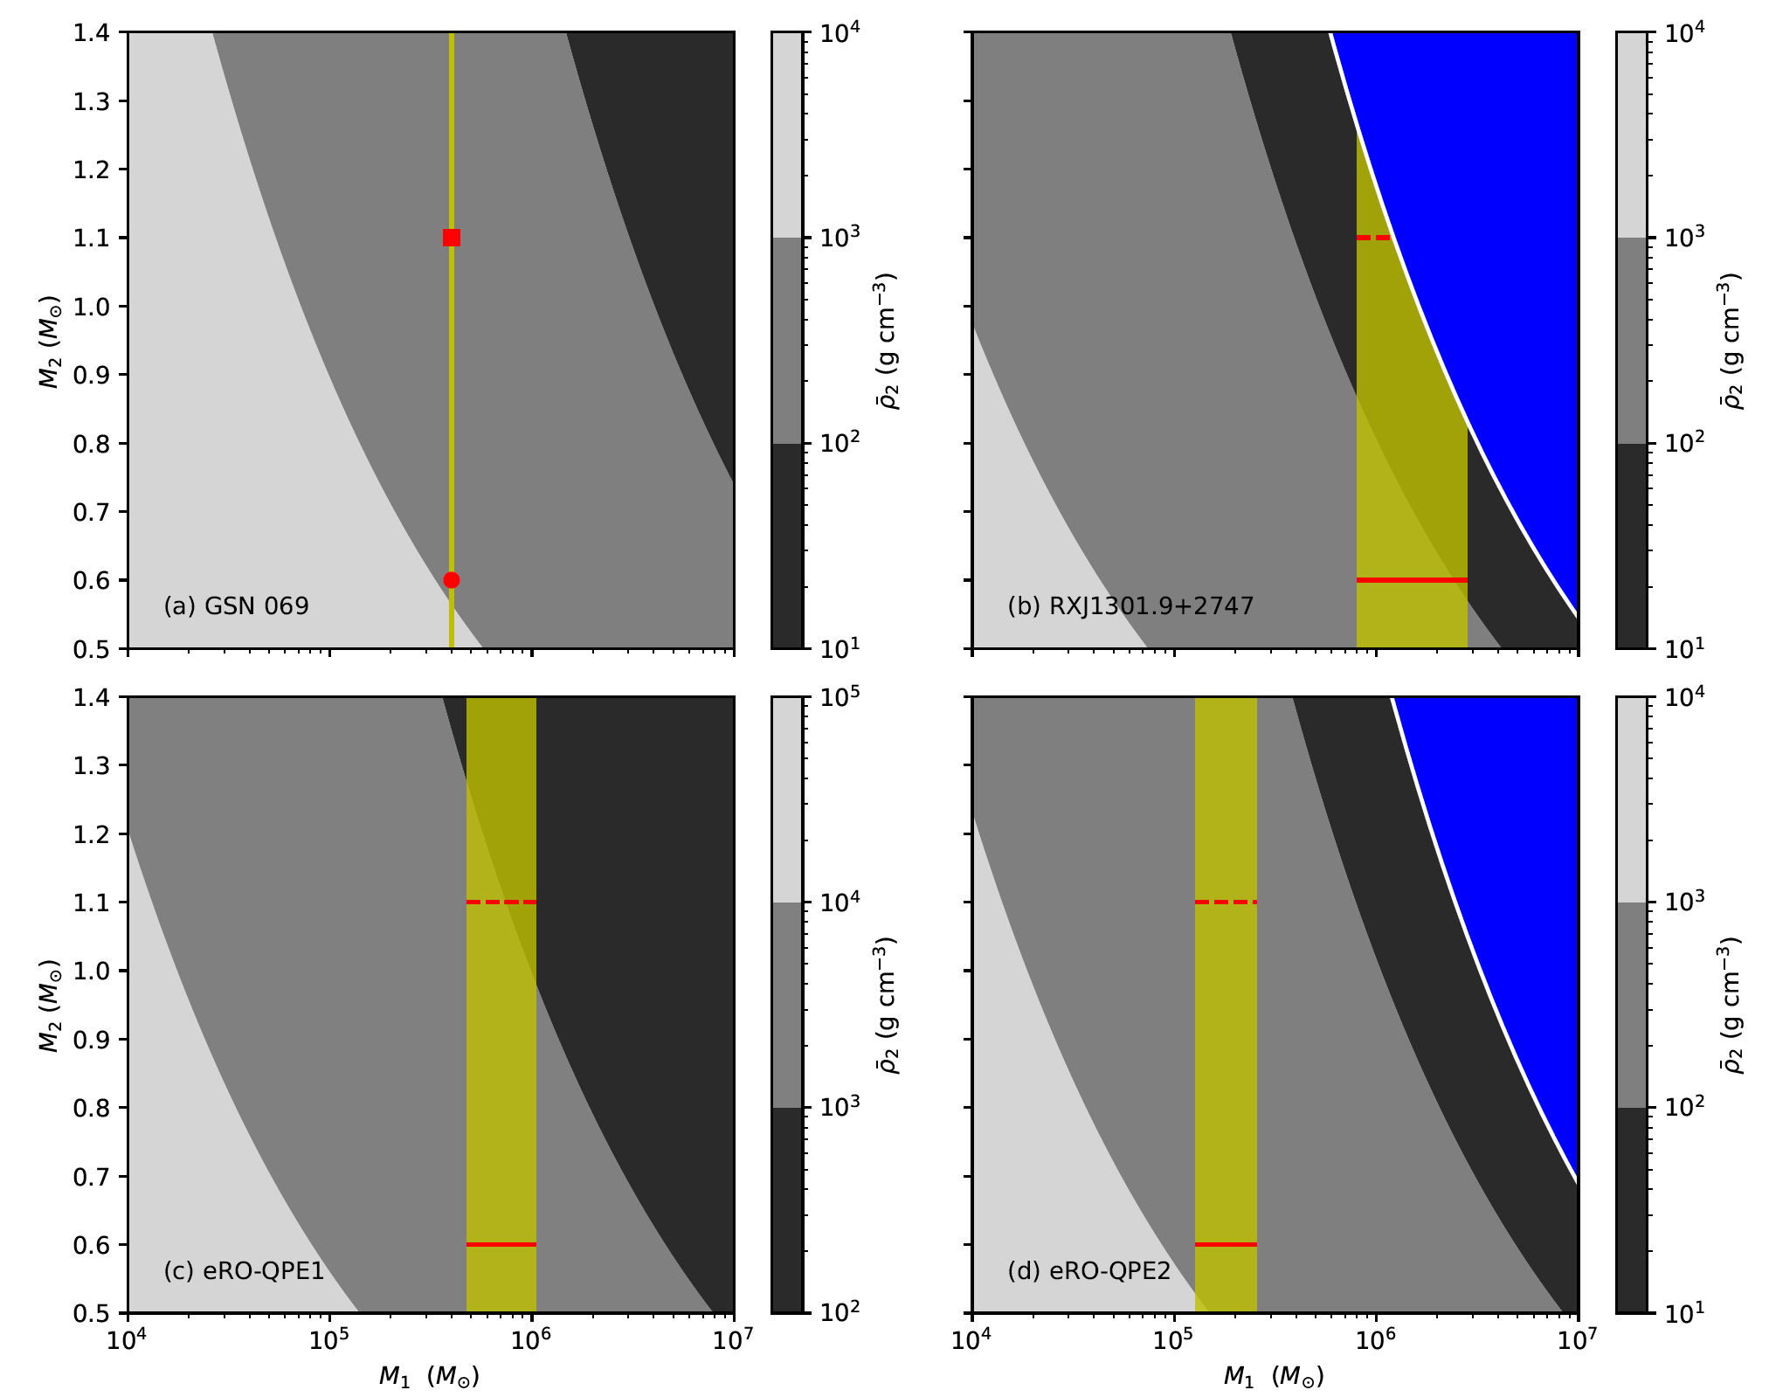
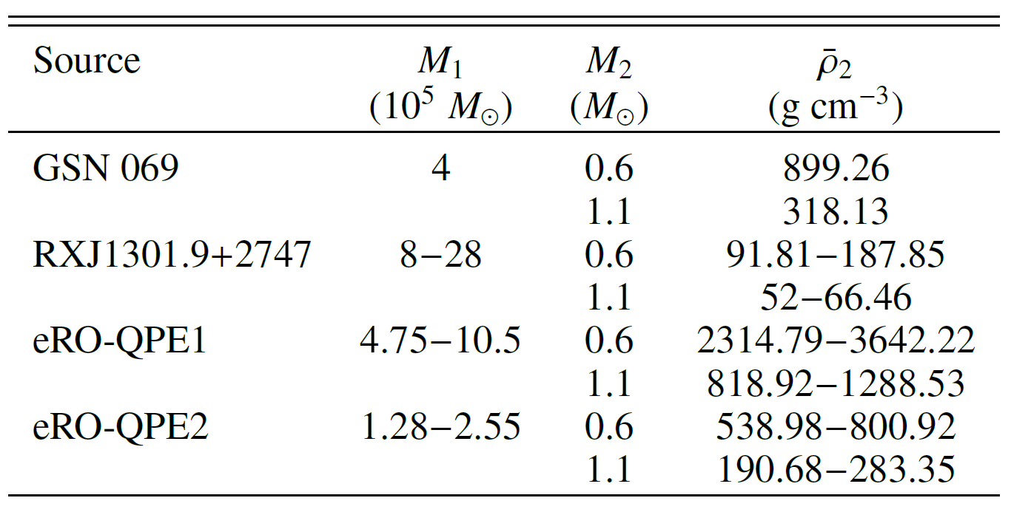
Constraints on the mass and density
The allowed parameter space is shown in yellow, i.e., the mean density of star is about between 100 g cm⁻³ and 10³ g cm⁻³.
Only low and intermediate mass stars (1<M<10 solar mass) which remove their H envelopes in the post-AGB phase can fulfill these requirements.
Zhao, Z. Y., … Wang FY*, Dai, Z. G. 2022, A&A, 661, A55

Slide 16
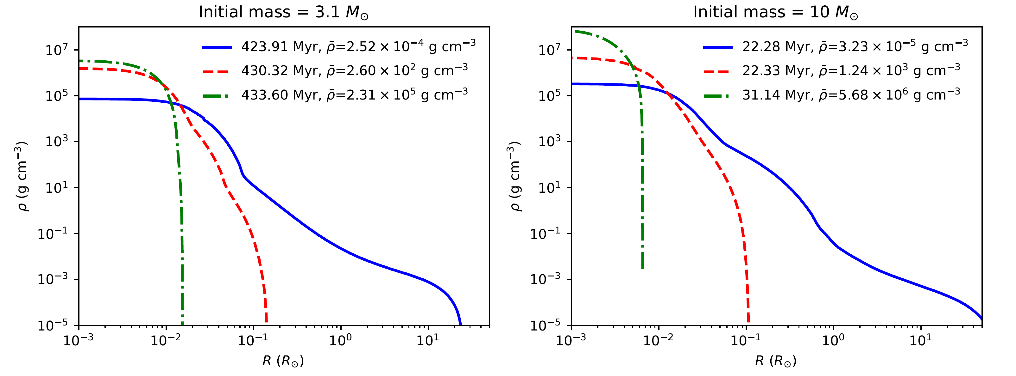
The required stars: post AGB
MESA stellar evolution code
Zhao, Z. Y., … Wang FY*, Dai, Z. G. 2022, A&A, 661, A55

Slide 17
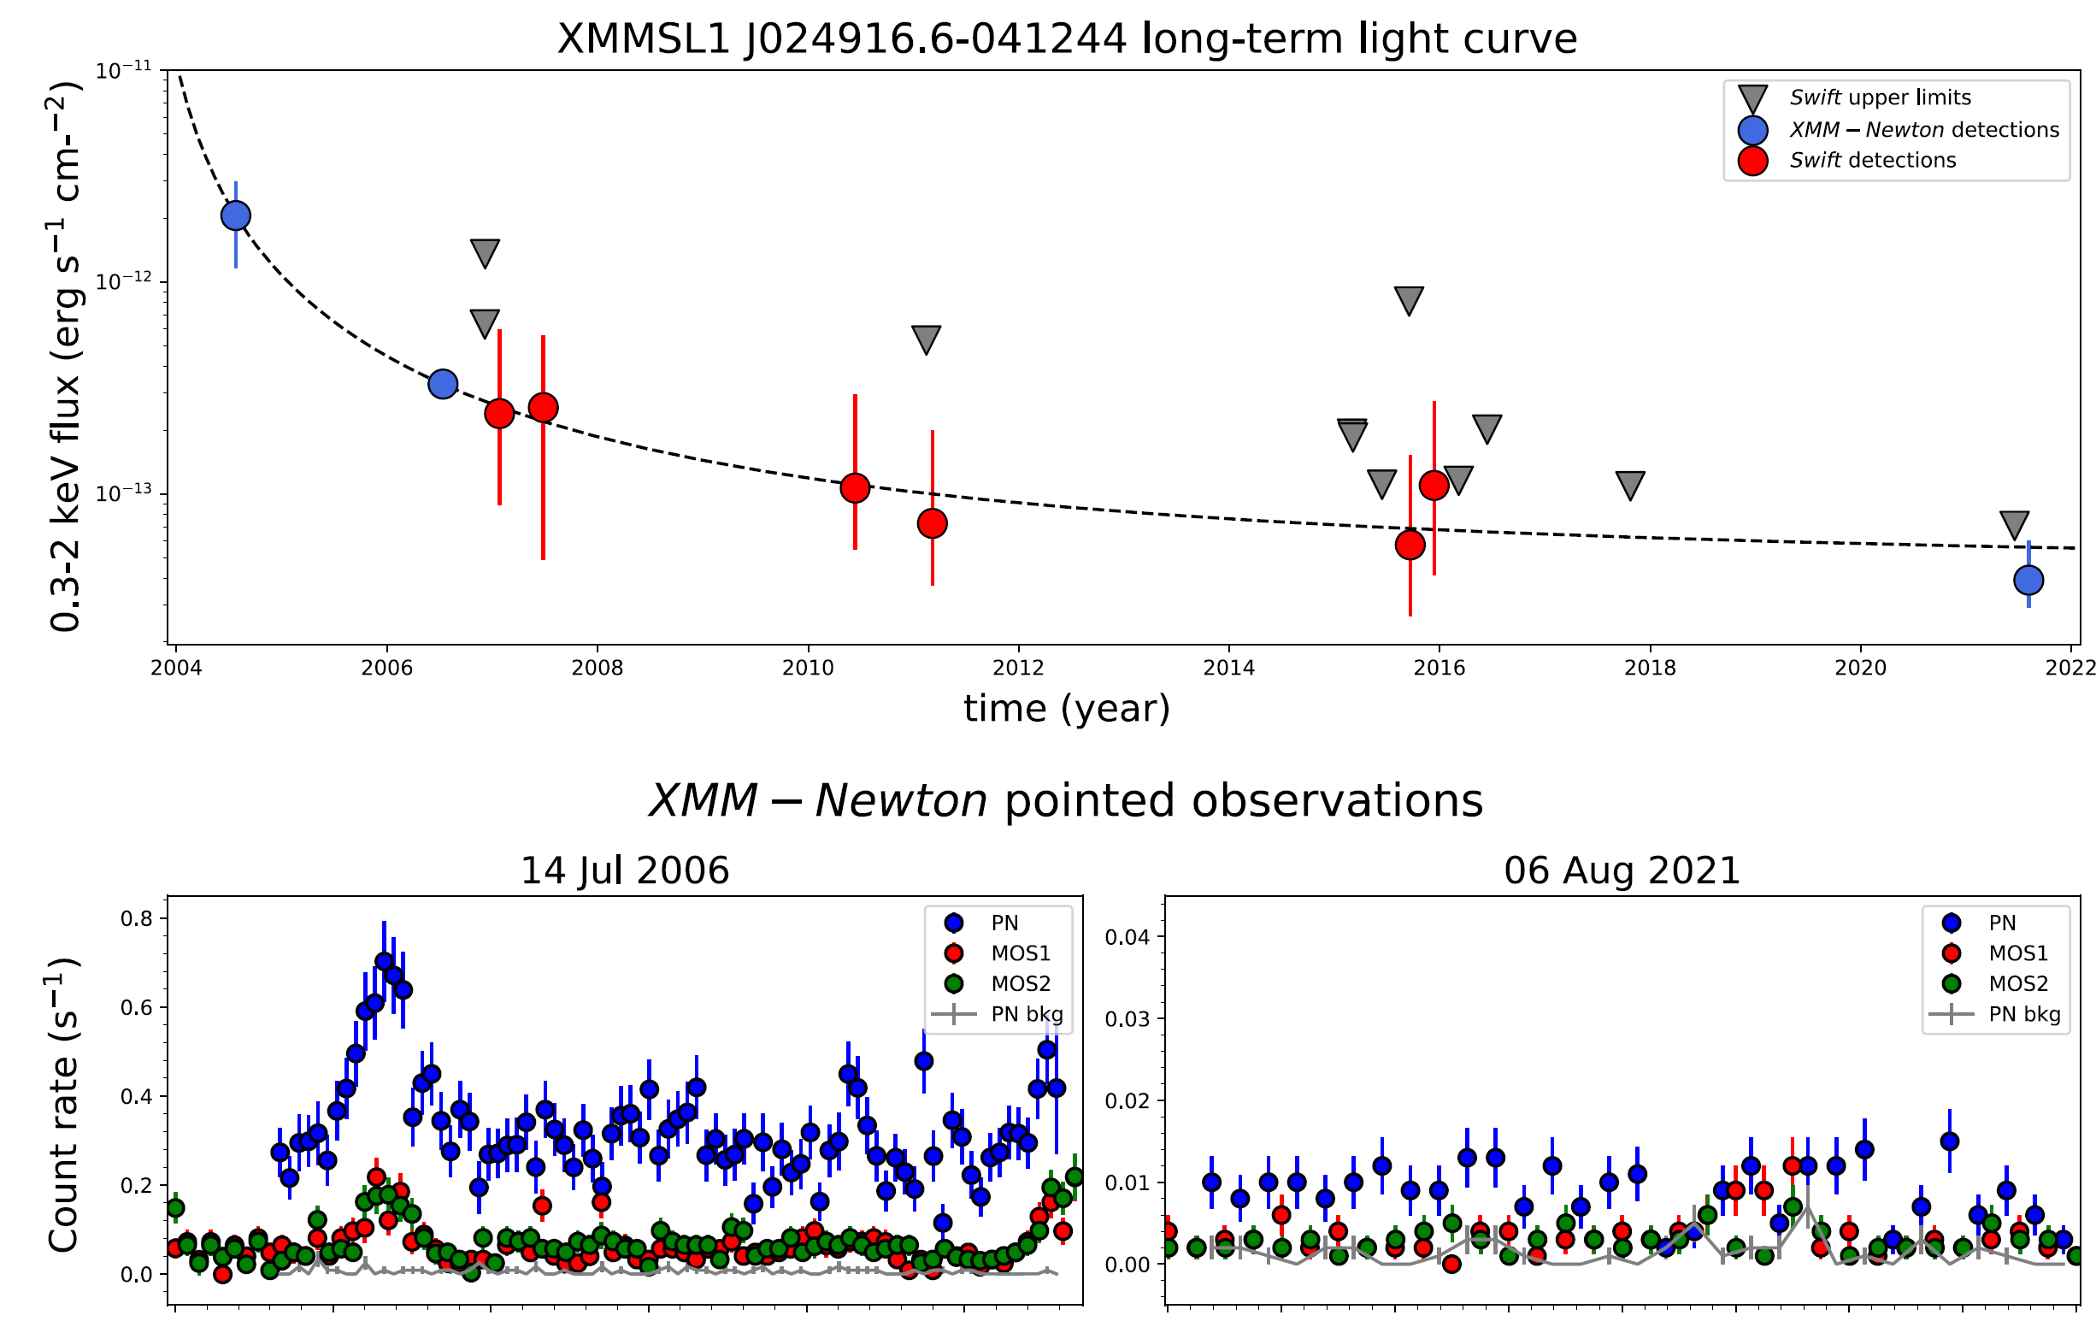
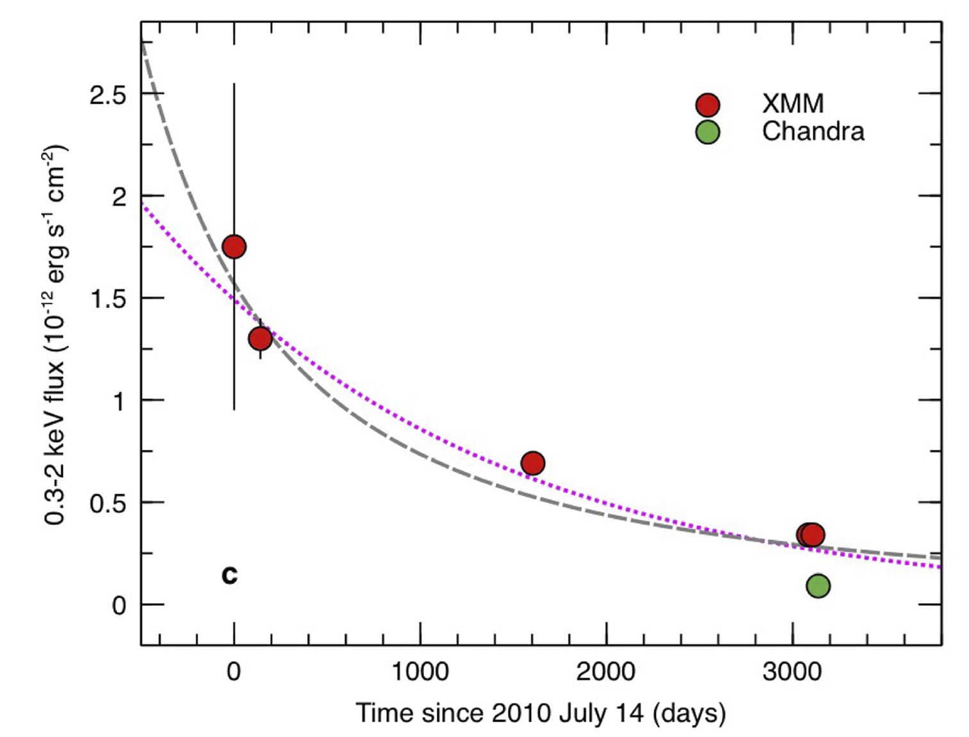
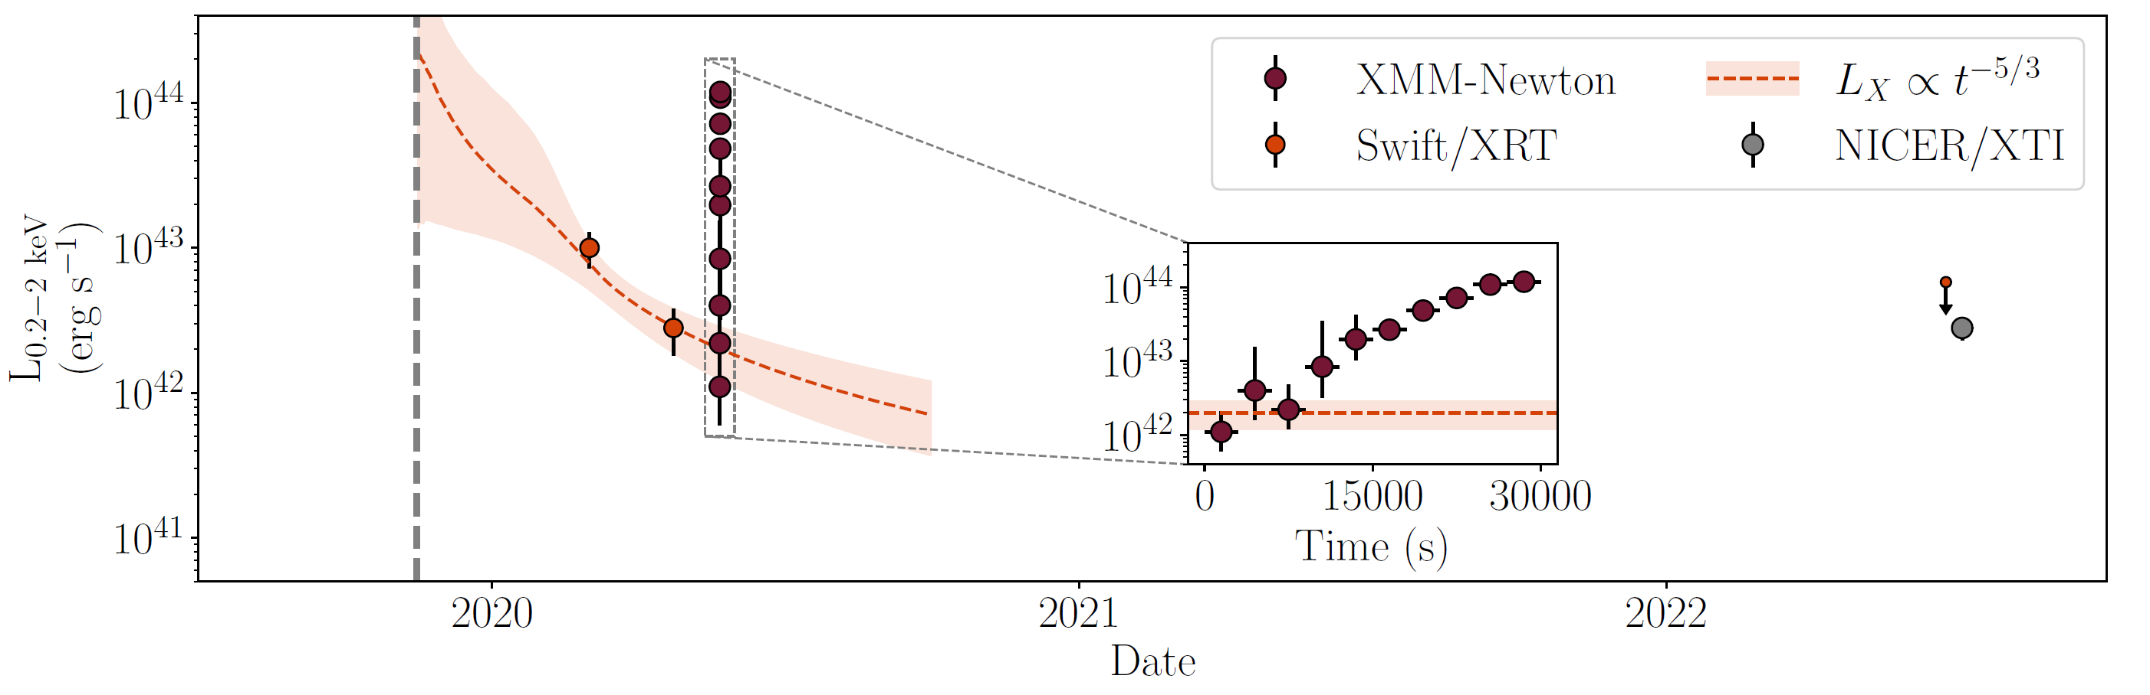
Quasi-periodic Eruptions after a Tidal Disruption Event?
Our model predicts a tidal disruption flares prior to QPEs and EMRIs, which may have been detected!
t^{-5/3}
t^{-5/3}
Chakraborty et al. 2021
GSN 069
Miniutti et al. 2019
Quintin et al. 2023

Slide 18
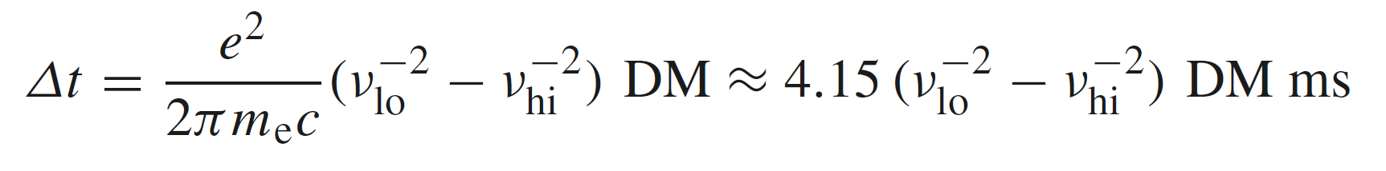
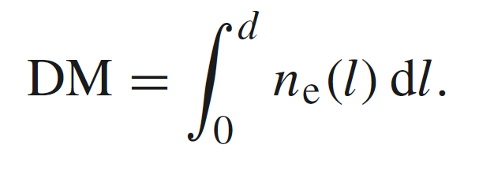
3. Fast radio bursts
Fast radio burst (FRB) was first discovered by Lorimer et al. (2007). FRB 010724;
FRBs are further confirmed with a large sample (Thornton et al. 2013; Spitler et al. 2014; Champion et al. 2015; Spitler et al. 2016…).
Lorimer et al. 2007, Science
DM: dispersion measure

Slide 19
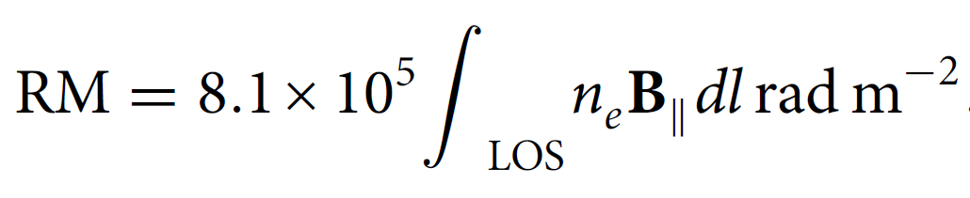

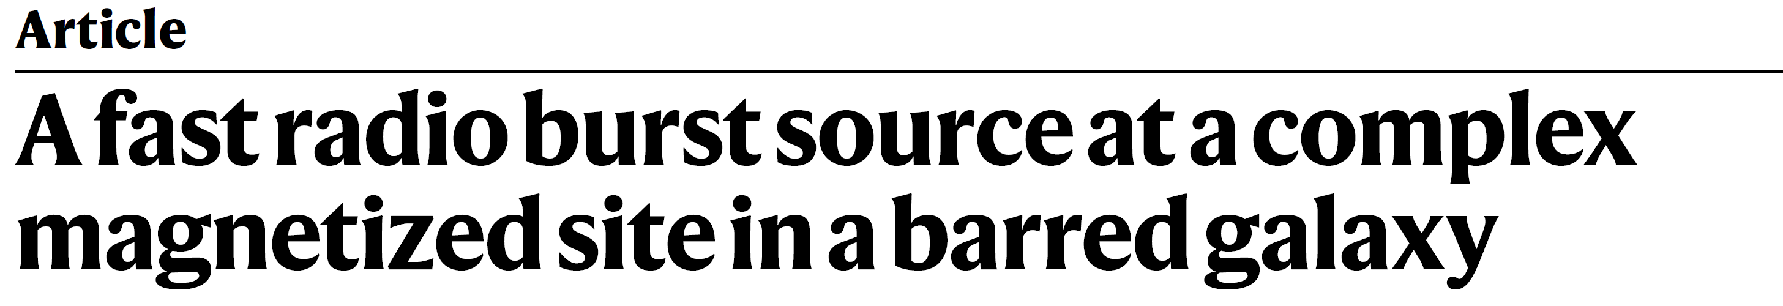
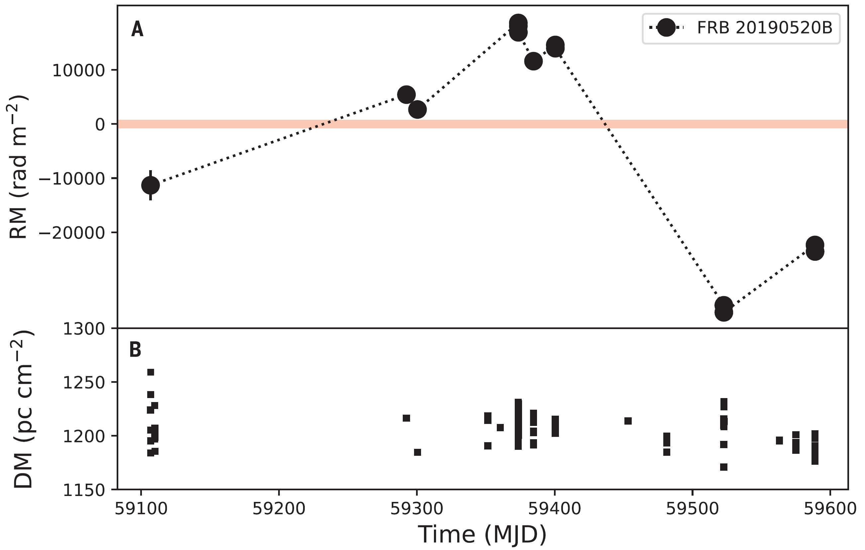
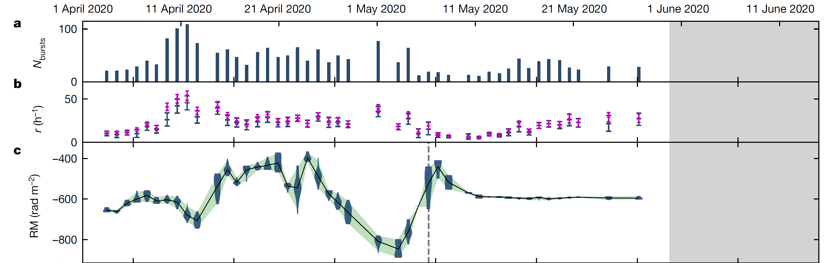
FRBs: rotation measure variations
rotation measure (RM):
FRB 20201124A
FRB 20190520B
The largest RM variation in Universe
Xu+, 2022, Nature
Anna-Thomas+, 2023, Science

Slide 20
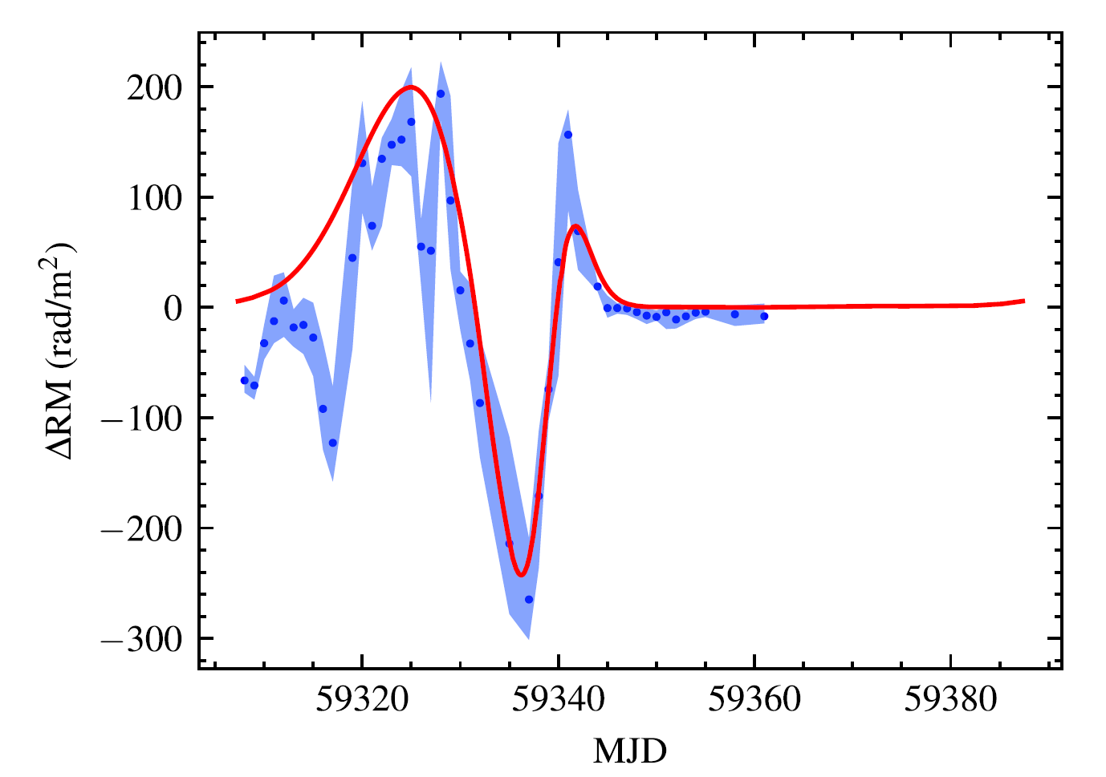
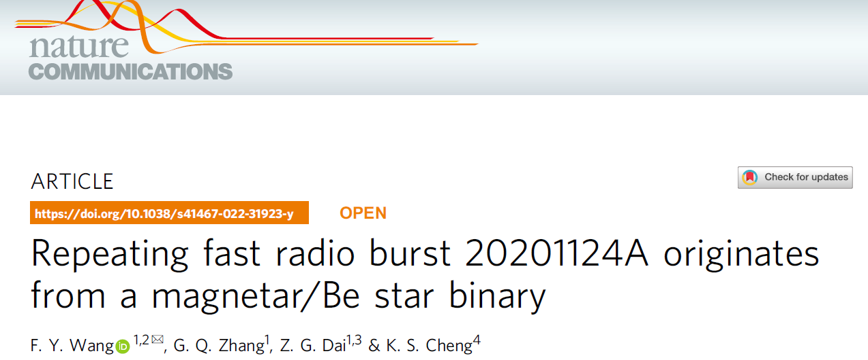
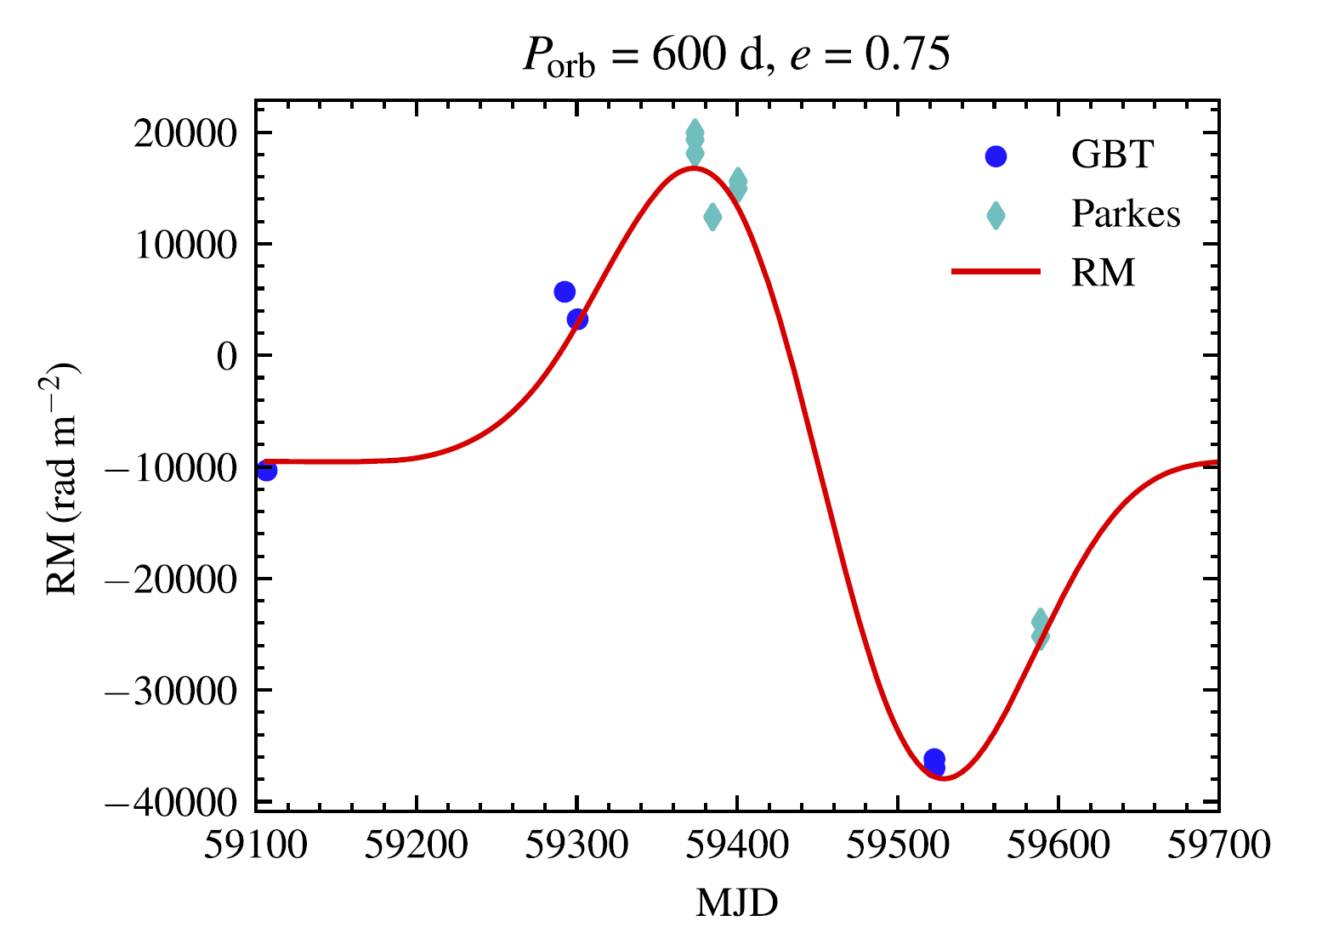
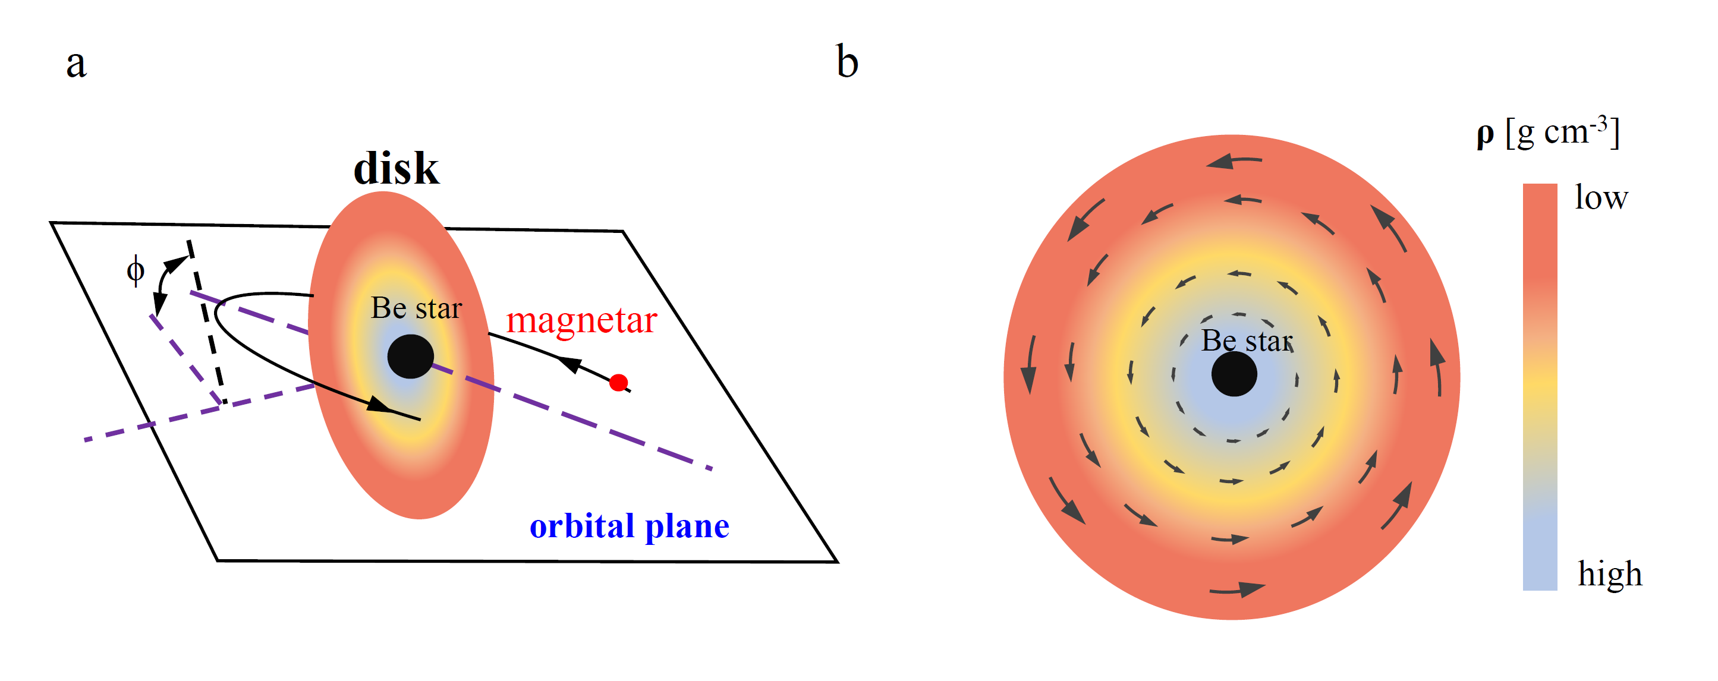
FRBs: RM variations and change sign
FRB 20201124A
FRB 20190520B
Wang FY*, Zhang, G., Dai, Z. G., Cheng, K. S. 2022
Wang FY*, Zhang, G., Dai, Z. G., Cheng, K. S. 2022

Slide 21
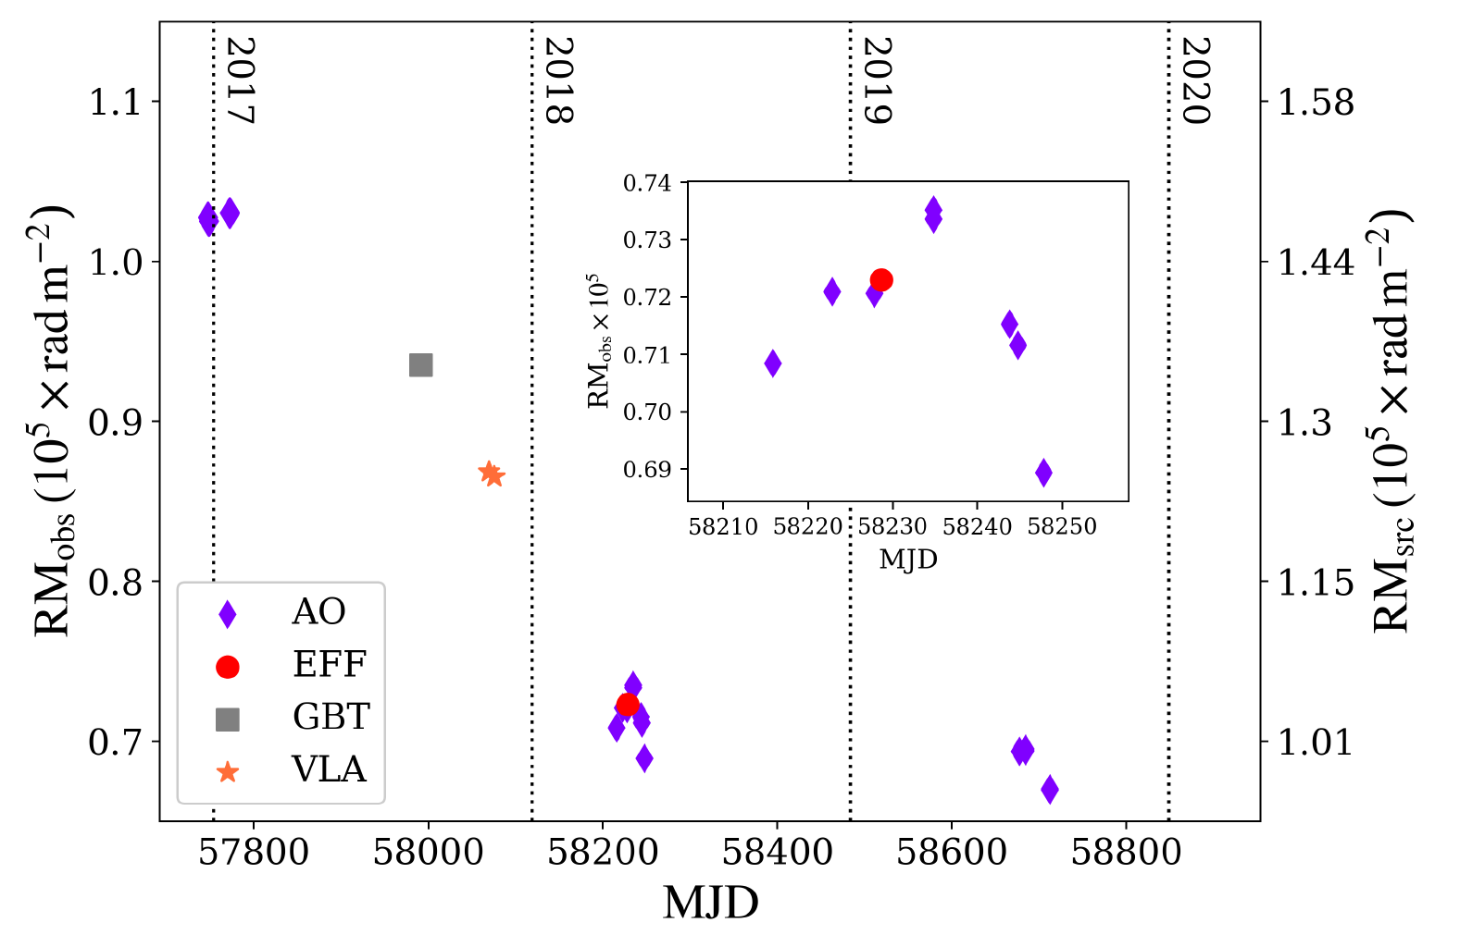
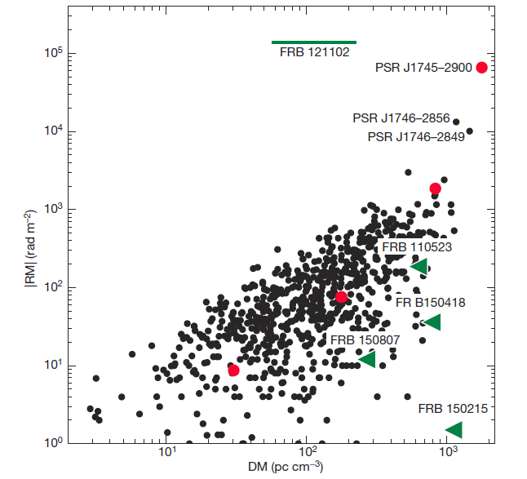
10^5 rad/m²
A magnetar near Sgr A*
Michilli et al. 2018
Hilmarsson+ 2020
rotation measure (RM):
FRB 121102 is in an extreme and dynamic magneto-ionic environment, similar to a magnetar near Sgr A*.

Slide 22
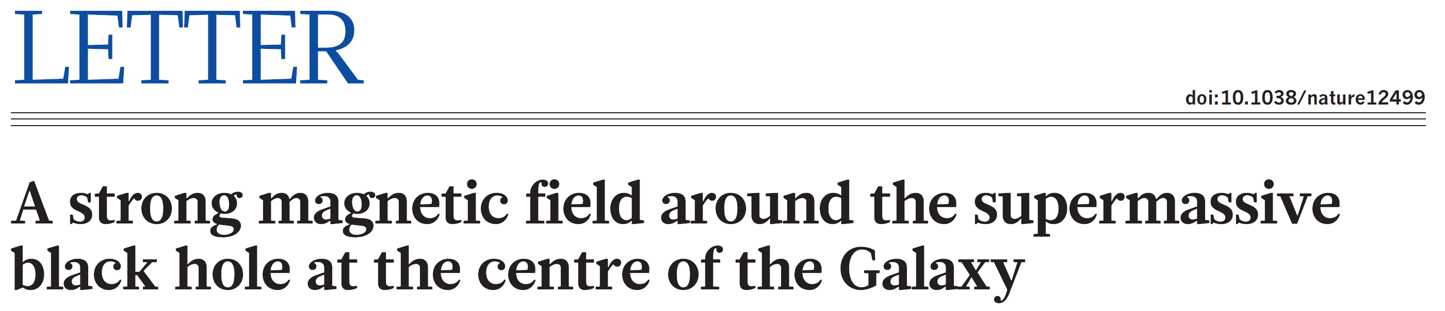
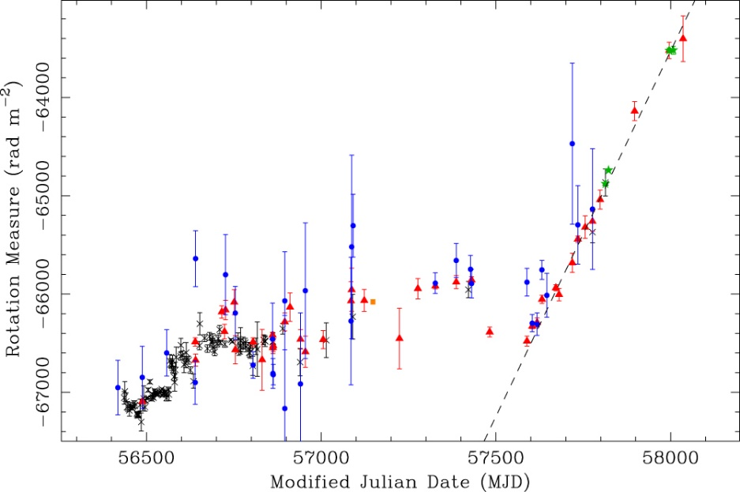
The magnetar PSR J1745-2900, which resides just 0.12 pc from Sgr A ∗ (Eatough et al. 2013), shows a large RM of 10⁴ –10⁵ rad m⁻² with an RM variability of ∼3500 rad m⁻² (Desvignes et al. 2018).
So, it has been suggested that the large RMs observed in some FRB repeaters might be a result that the source is located in the vicinity of a SMBH, i.e., magnetar+SMBH binary.

Slide 23


FRBs: neutron star + SMBH binary
EMRI
Li, R, Zhao, Z., Wang FY, Dai, Z. G., in prep.

Slide 24
Summary
QPEs may be EM counterparts of EMRIs, which can be tested with future space-based detectors.
FRBs could be generated by magnetars orbiting SMBHs.
EM counterparts of GWs are crucial for cosmological applications, i.e., standard sirens.

