Slide 1
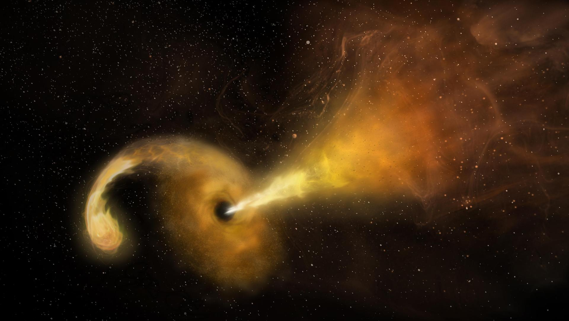
Jetted TDEs: BH spin, jet components and circumneuclear medium
Lei Wei-Hua(雷卫华)
Department of astronomy, Huazhong University of Science & Technology
June, 2023, HKU

Slide 2
Outline
Tidal-disruption Event (TDE)
First On-axis Jetted TDE: Sw J1644+57
BH spin
Two-component jet
First Off-axis Jetted TDE: IGR J 12580+0134
Fourth On-axis Jetted TDE: AT2022cmc
CNM density profile
Summary

Slide 3
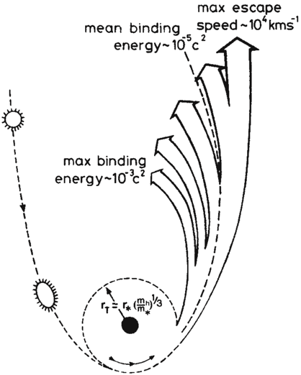
Tidal Disruption Events (TDE)
Tidal disruption radius
(self-gravity force=tidal force):
Notes:
最值得关注的说就是Rees的文章，给出了该理论的细节，其中几乎所有的预言都被观测到

Slide 4
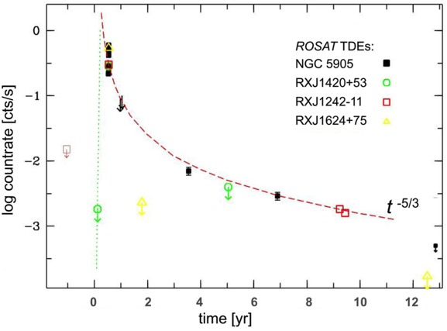
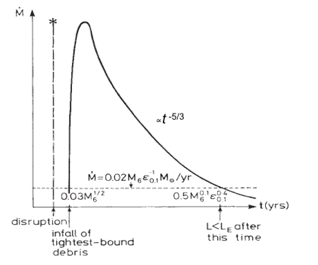
X-ray TDEs
Event rate: 10⁻⁴ ~10⁻⁵ galaxy⁻¹ year⁻¹
Time scale:
Luminosity:
Temperature:
Light curve: L(t) ~ (t-t₀)^{-5/3}
Komossa 2015
SDSS J1201+30
Rees (1988)
Saxton et al. 2012
Notes:
比如t^-5/3，在x和光学，时标天到年

Slide 5
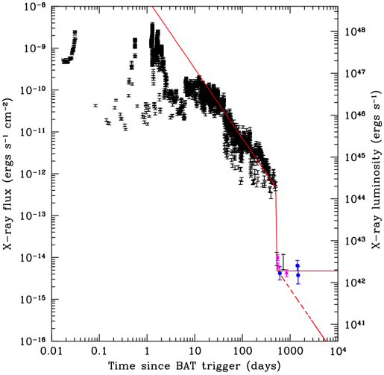
Sw J1644+57：1st on-axis jetted TDE
z = 0.3534
Radio and optical detections of Swift J16444+57. (Zauderer et al. 2011)
Bloom et al. 2011; Burrows et al. 2011; Zauderer et al. 2011; Levan et al. 2011
Notes:
但也有意外之外，比如并没有预言到喷流。我这个时候开始关注TDE

Slide 6
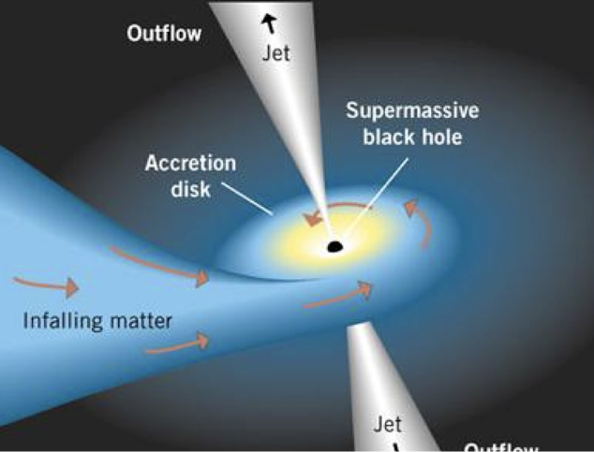
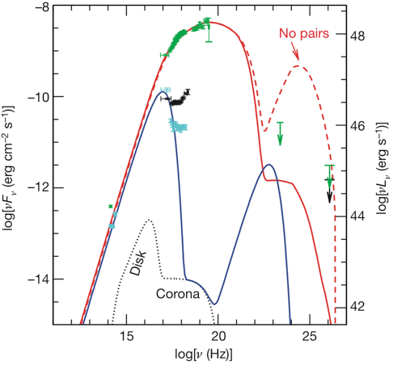
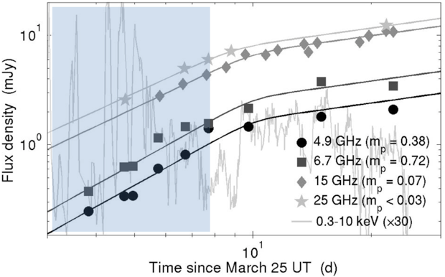
Origin of Emissions: jet
Super-Eddington X-ray luminosity
Blazar jet model fit
Bright radio afterglow: indicate jet with Lorentz factor of few
Burrows et al. 2011
Zauderer et al. 2011

Slide 7
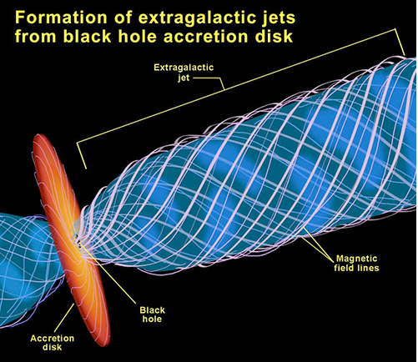
Jet production: Blandford-Znajek Mechanism
Thermal pressure outflow will suffer significant baryon loading (Shao et al. 2011; Gao et al. 2012)
Spectral fit favor Poynting-flux dominated jet model (Burrows et al. 2011)
BZ is a successful model for AGN jets.
NASA
Blandford-Znajek mechanism (Blandford & Znajek 1977)

Slide 8
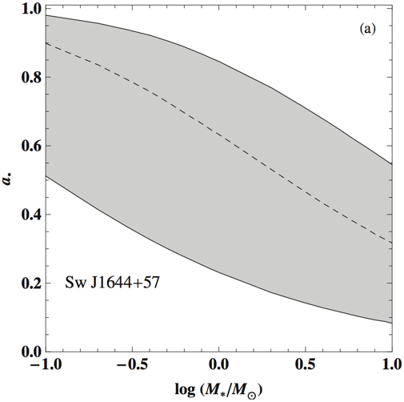
High Black Hole spin
BZ Power
Beaming factor
BH spin: moderate to high spin SMBH (Lei & Zhang 2011; Tchekhovskoy et al. 2014)
Blandford-Znajek process
(Blandford & Znajek 1977)
Zhang & Lei 2011

Slide 9
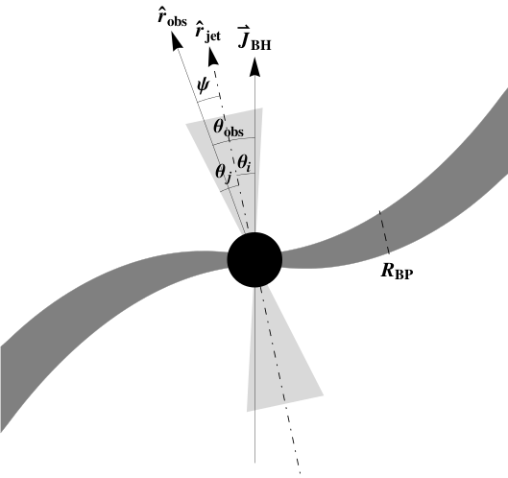
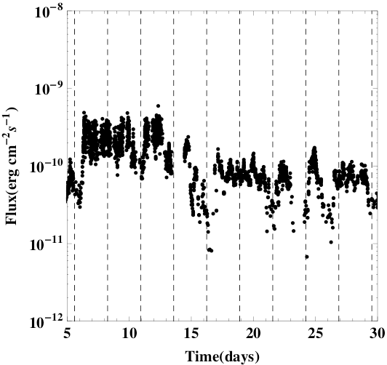
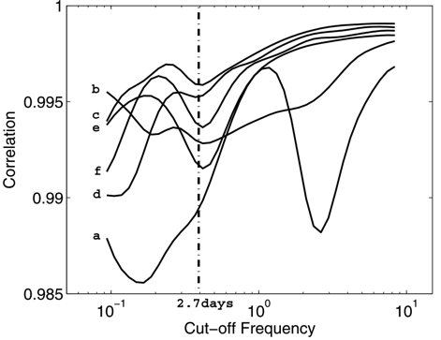
Lense-Thirring Precession
Initial stellar orbit is likely misaligned with the equatorial plane of spinning BH;
Tilted disk is subject to Lense-Thirring torque;
Jet would undergo precession;
2.7d period dips
Lei, Zhang & Gao 2013
Notes:
stepwise filter correlation (SFC) analysis

Slide 10
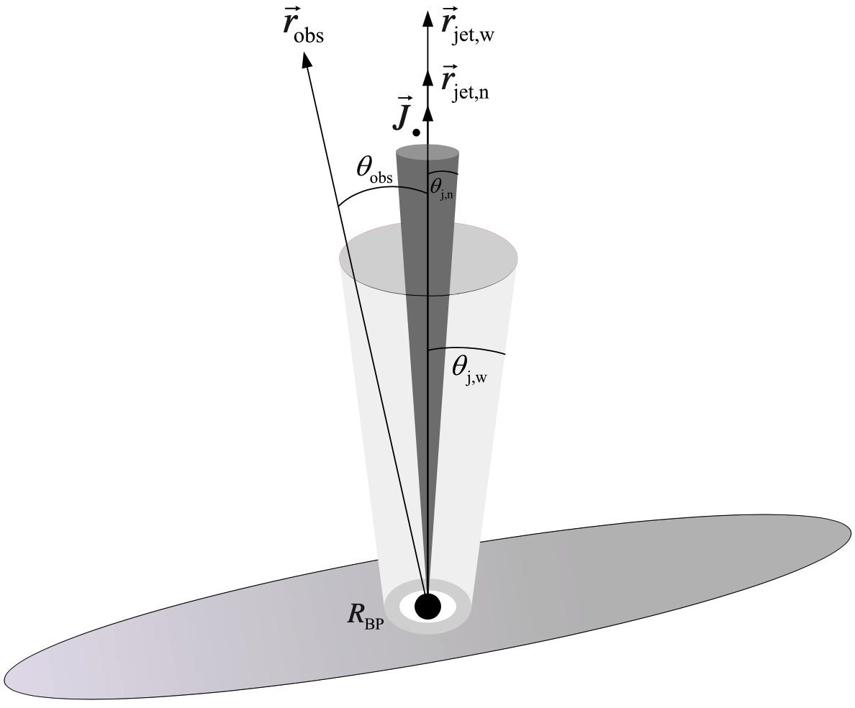
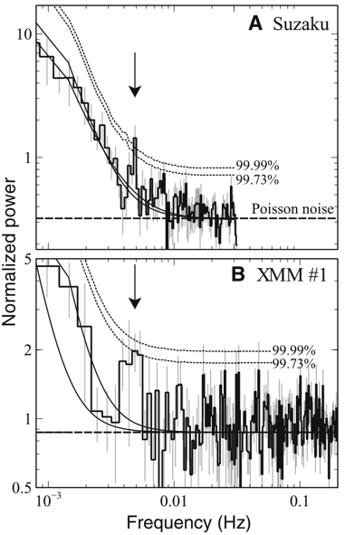
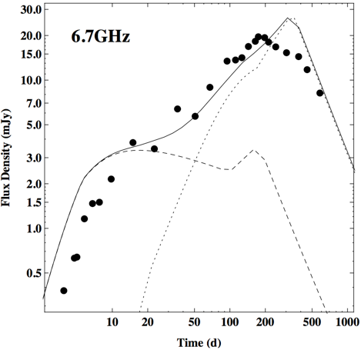
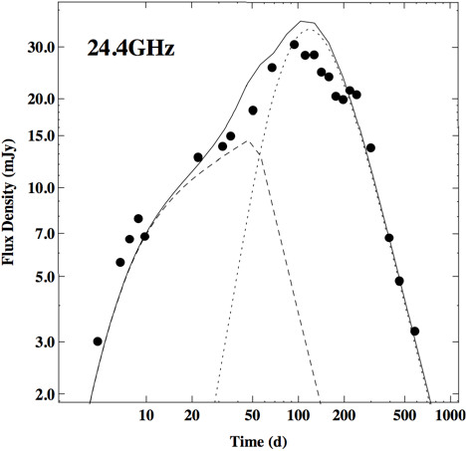
Two-component Jet
200s and 2.7day QPOs in X-ray data
Re-brightening in Radio light curve
Two-component jet model
Reis et al. 2012
Wang et al. 2014

Slide 11
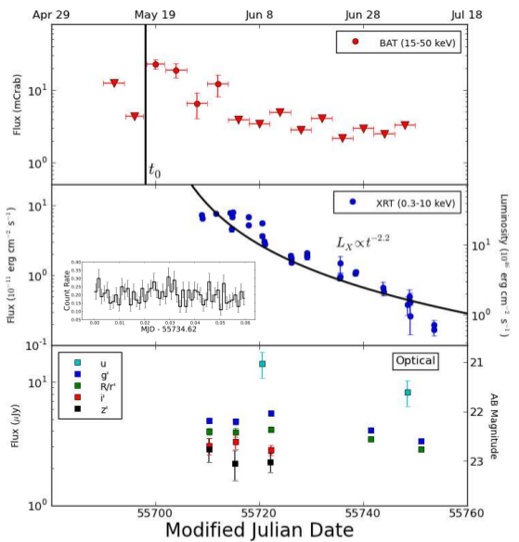
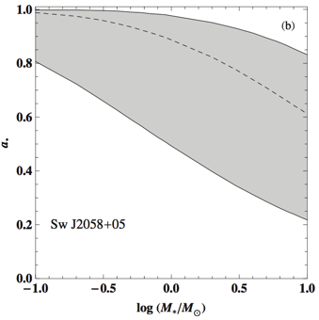
Sw J2058+05: 2nd on-axis jetted TDE
No prior X-ray emission
Duration>months
Variability time scale
Super-Eddington X-ray luminosity
Luminous radio counterpart
BH spin ~0.99:
Cenko et al. 2011
Lei & Zhang 2011

Slide 12
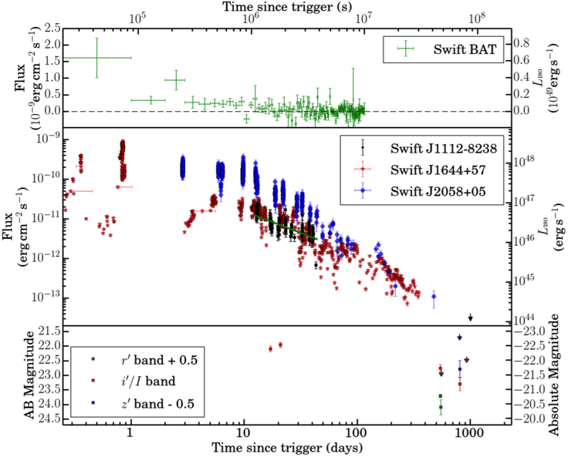
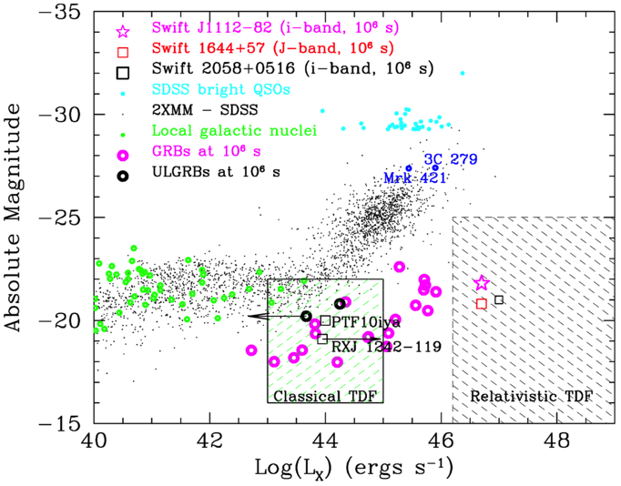
Sw J1112.2-8238: 3rd on-axis jetted TDE
Brown et al. 2015

Slide 13
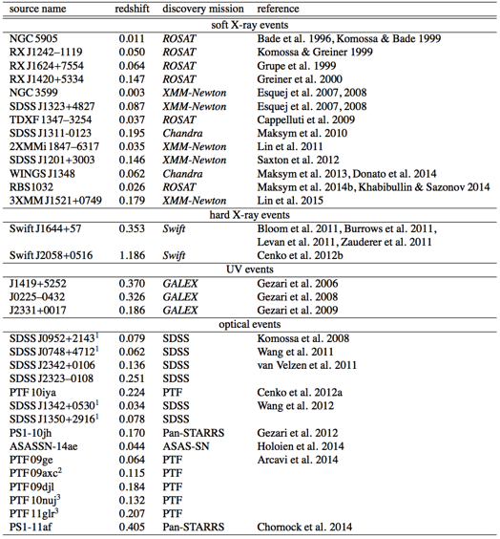
TDE Candidates
TDE with jet
An evolving list of events which have at one point been iden- tified as TDEs can be found at The Open TDE Catalog (https: //tde.space/).
Komossa 2015

Slide 14
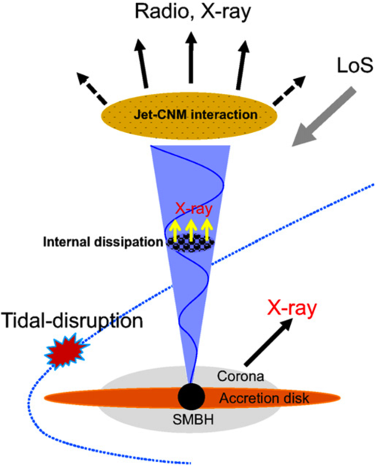
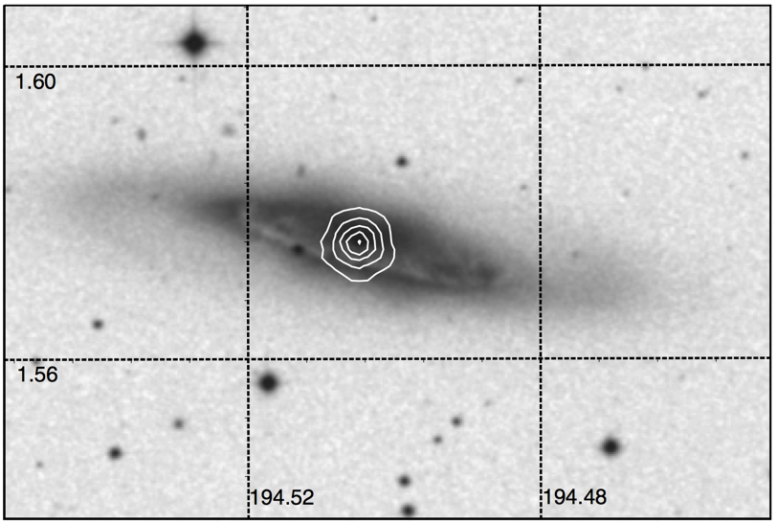
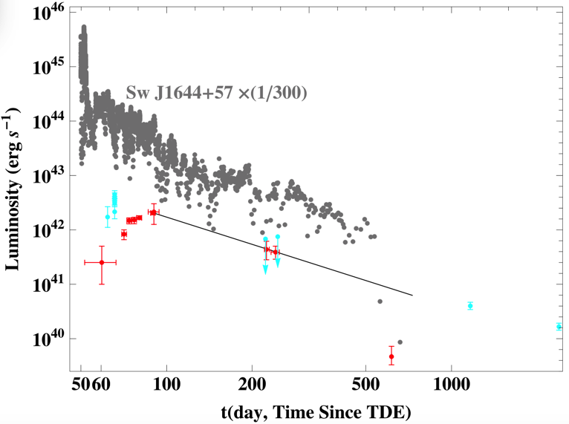
IGR J12580+0134: 1st off-axis jetted TDE
NGC 4845: D=17 Mpc
Optical image of NGC 4845 from STSci-DSS, white solid contours show the XMM-Newton image of IGR J12580+0134 （ Nikolajuk & Walter 2013 ）
Sw J1644+57 (/300)
NGC 5905
NGC 4845
From nearby galaxy NGC 4845: D=17 Mpc
No prior X-ray activity (from 2003-2010)
Duration ~ years
Variability time scale
Sub-Eddington luminosity
Luminous radio counterpart (Irwin et al. 2015)
Lei et al. 2016
Notes:
我们从样本中，发现了第一个这样的事例！

Slide 15
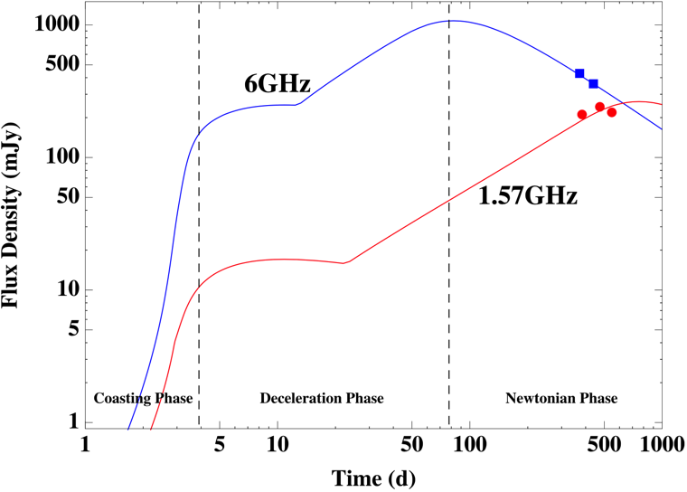
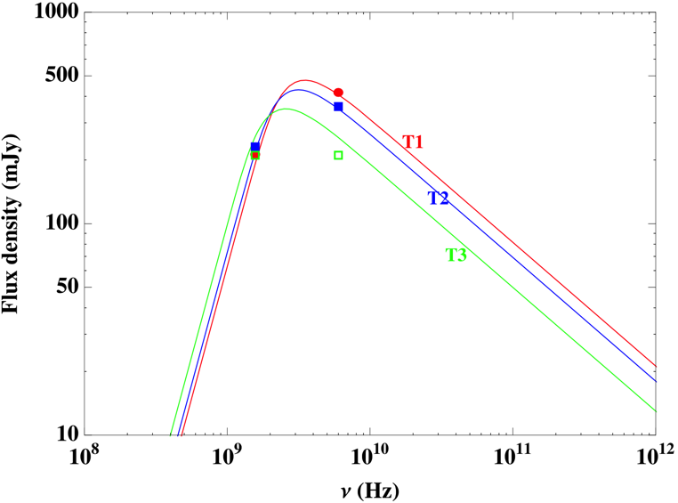
Radio Emission from Jet
Lei et al. 2016

Slide 16
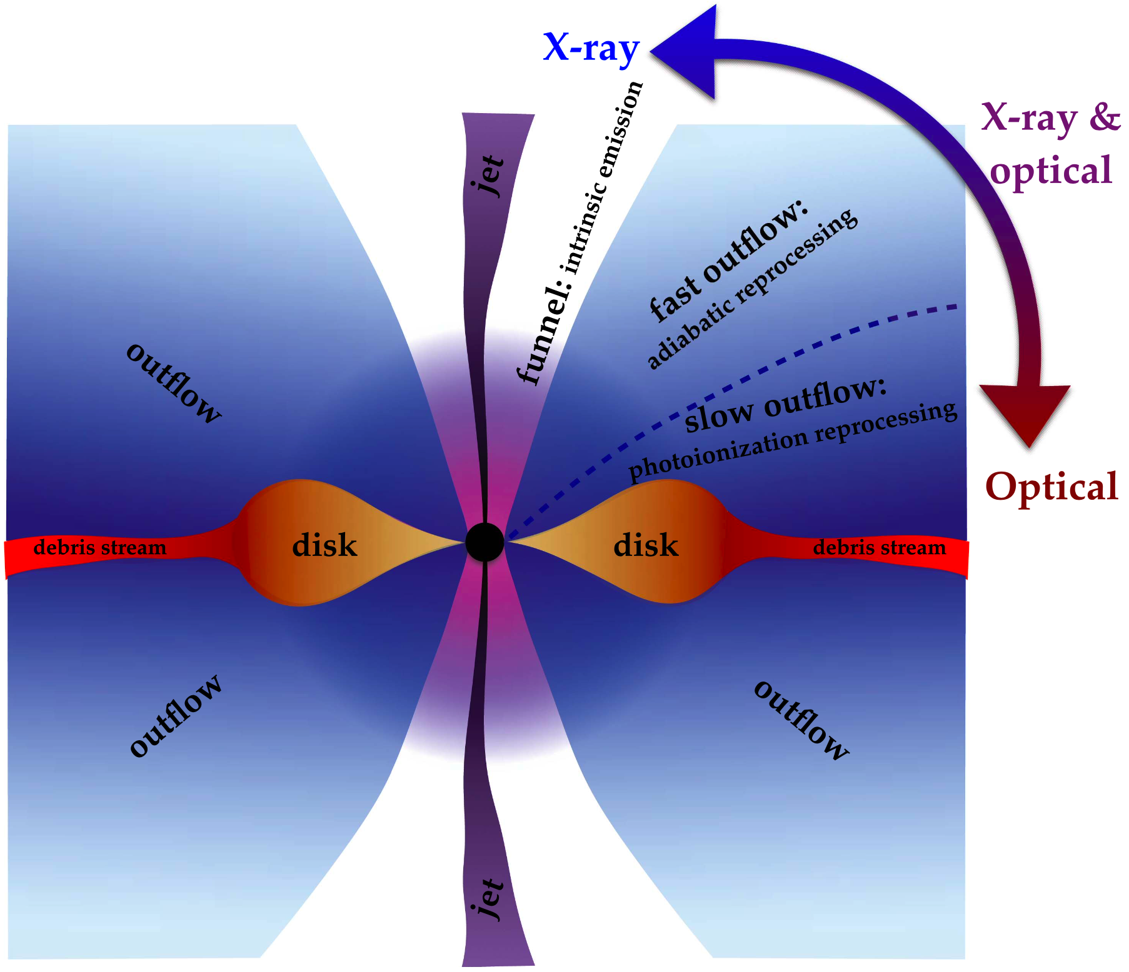
Unified Model for TDEs
Dai et al. 2018
Unified model: X-ray (disk), optical (wind), radio (radio, X-ray…) depends on view angle

Slide 17
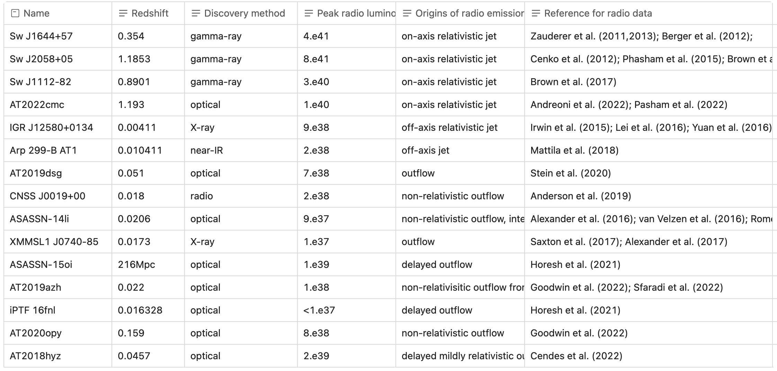
Published Radio TDEs
Origins of radio emission: on-axis jet (4), off-axis jet (2), outflow (9)

Slide 18
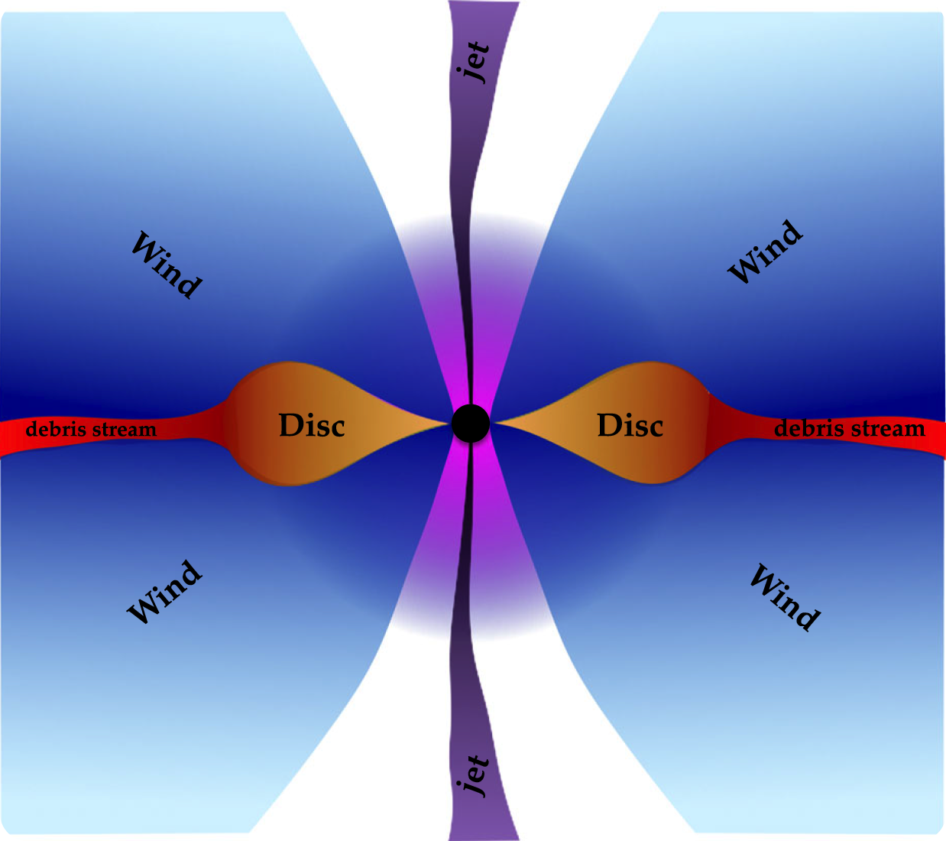
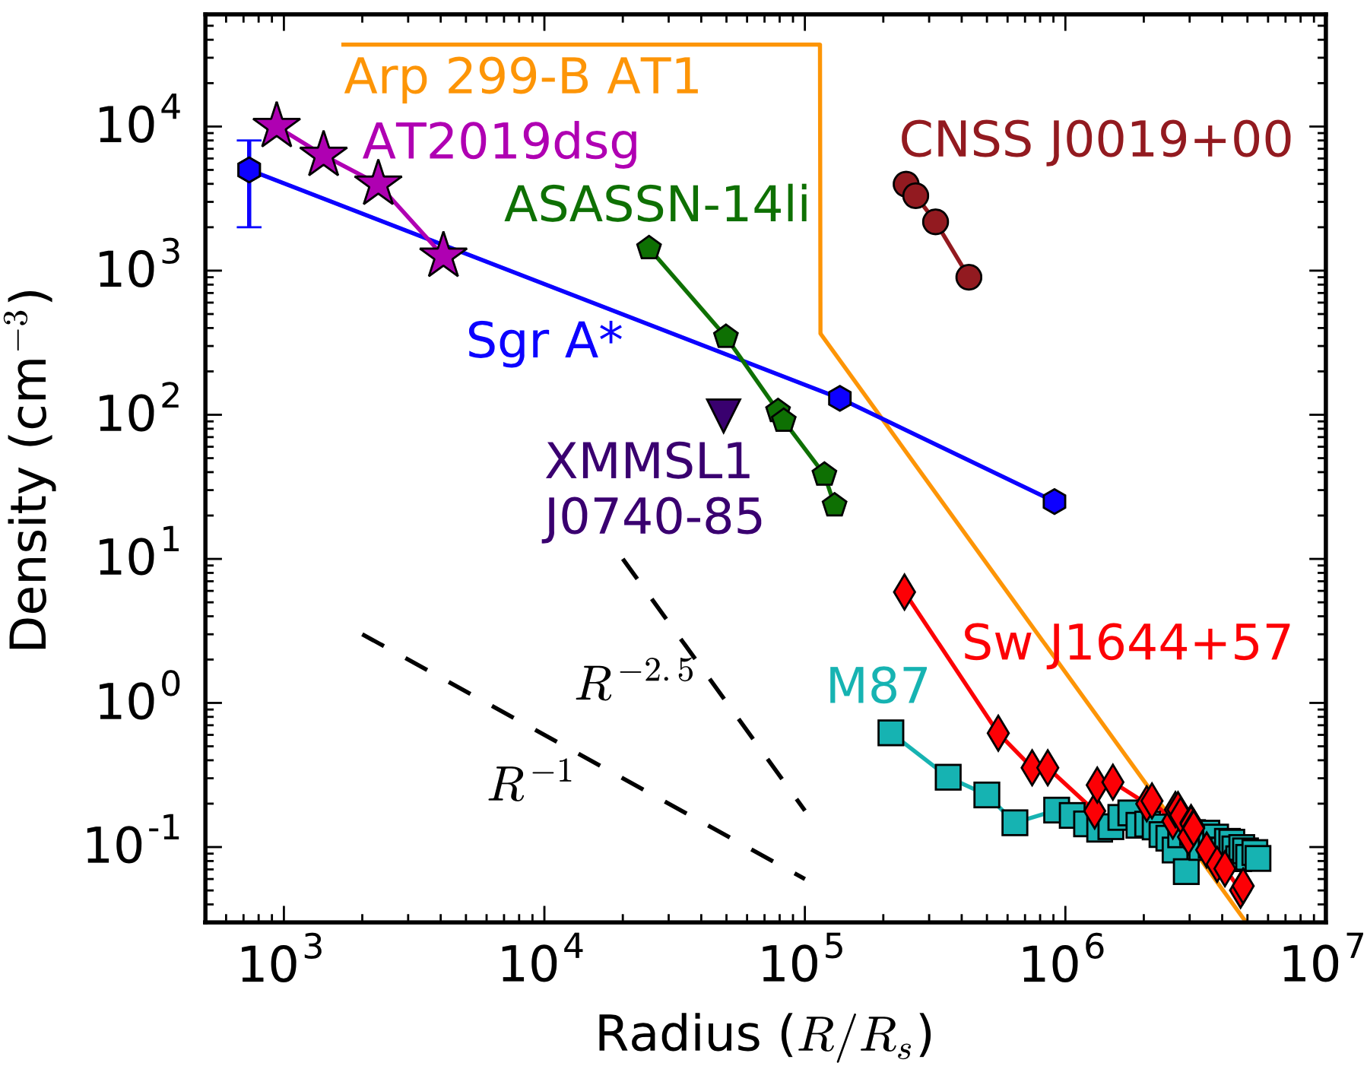
Explore CNM Density Profile
$$ρ_{CNM}∝R^{−k}$$
Circumnuclear medium (CNM) provides key diagnostics of accretion history of SMBH
Synchrotron Emissions (radio) from Outflow-CNM are tools to explore outflow and CNM profile
Bondi-like $ρ∝R^{−3/2}$: Bondi accretion, e.g., Sw J1644
Sgr A*-like $ρ∝R^{−1}$: Bondi accretion+ stellar wind, e.g., AT2019dsg
ZEBRA-like $ρ∝R^{−5/2}$ : super-Eddington accretion, e.g., ASASSN-14li
Alexander et al. 2020

Slide 19
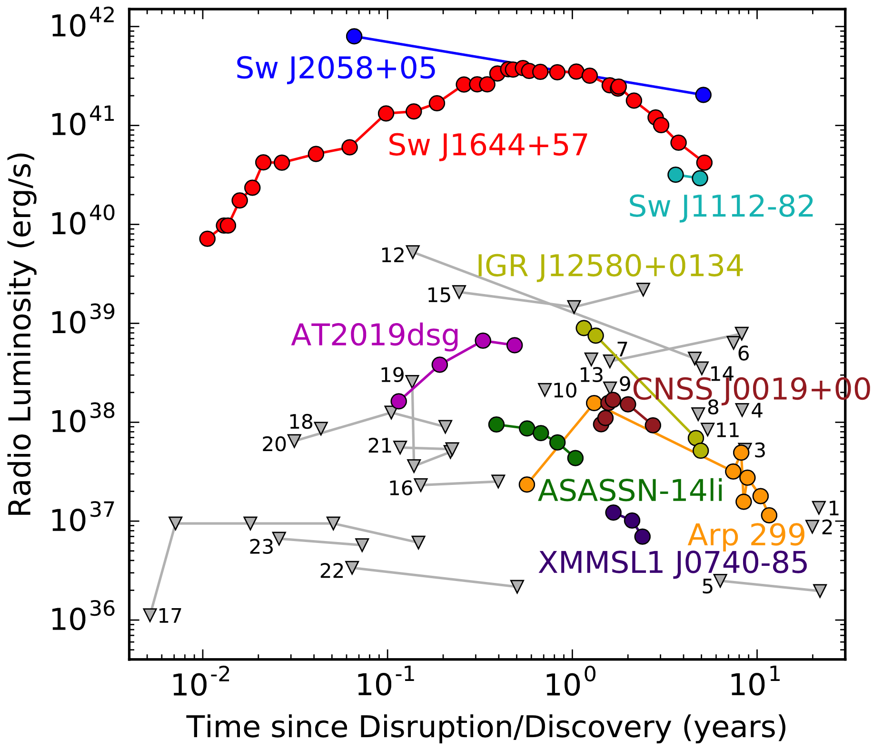
Types of Radio TDEs
Radio loud TDEs: $νL_{ν}>{10}^{40}erg/s$
Radio quiet TDEs: $νL_{ν}<{10}^{40}erg/s$
Alexander et al. 2020

Slide 20
Jetted TDEs: unveiling CNM for z>1
Radio, Optical, X-ray
Synchrotron Emissions from jet-CNM: radio loud
Jetted TDEs have special use in unveiling cosmological quiescent SMBHs and CNM profile at z>1
Sw J1644+57, Sw J2058+05, Sw J1112-82, AT2022cmc (z=1.193)
Jet-CNM interaction
X-ray
Internal dissipation
Tidal-disruption
X-ray
Corona
Accretion disk
SMBH

Slide 21
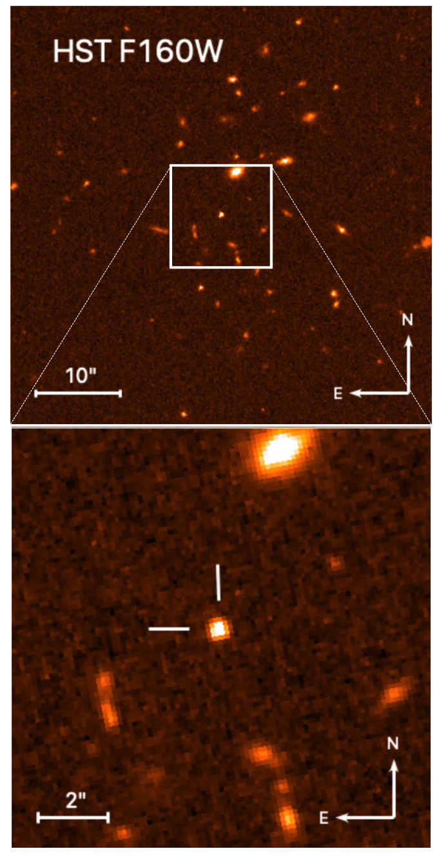
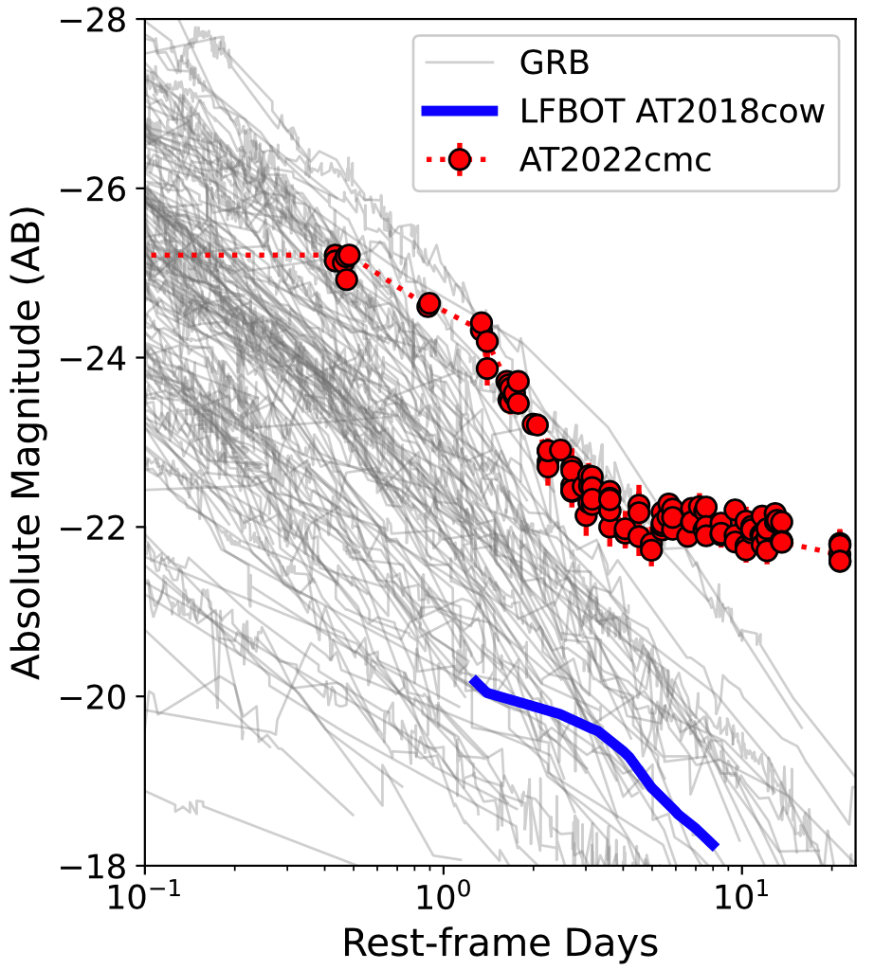
AT2022cmc: optically bright jetted TDEs
AT2022cmc (ZTF, z=1.193): first jetted TDE observed as an optically bright and fast transient
Andreoni et al. 2022

Slide 22
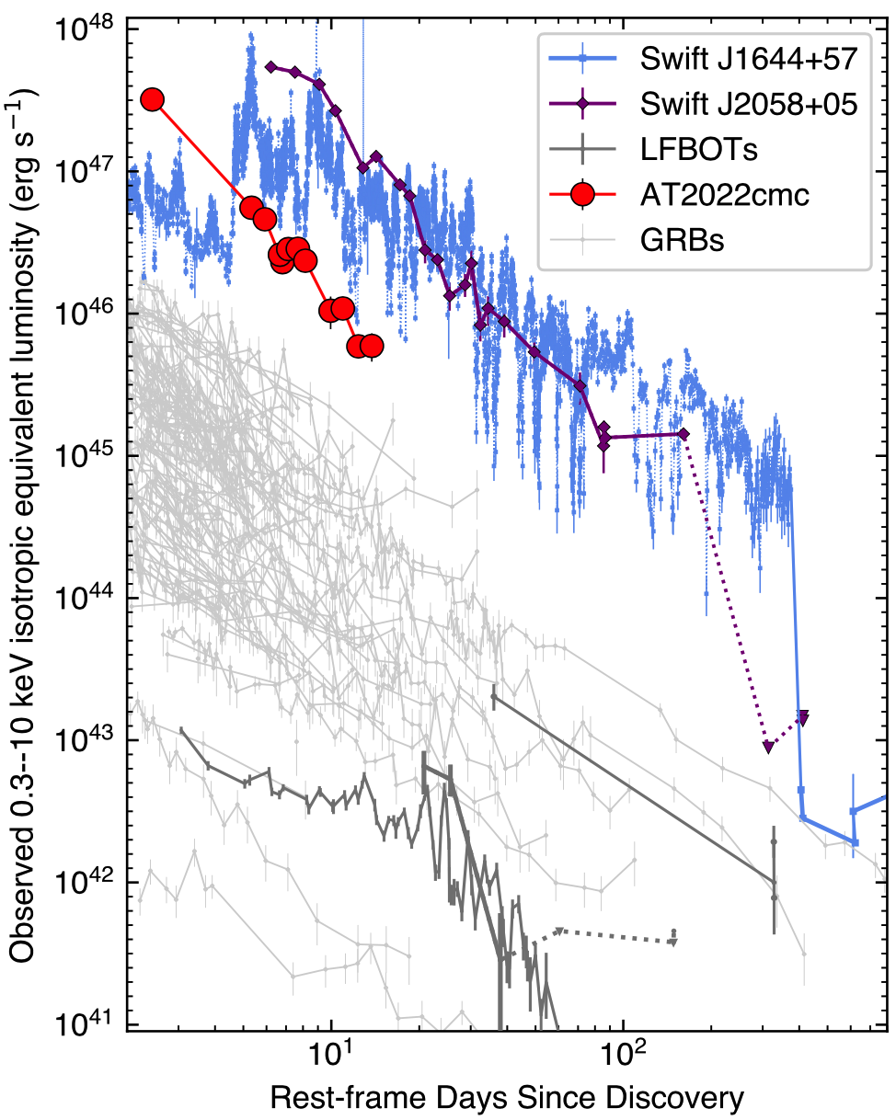
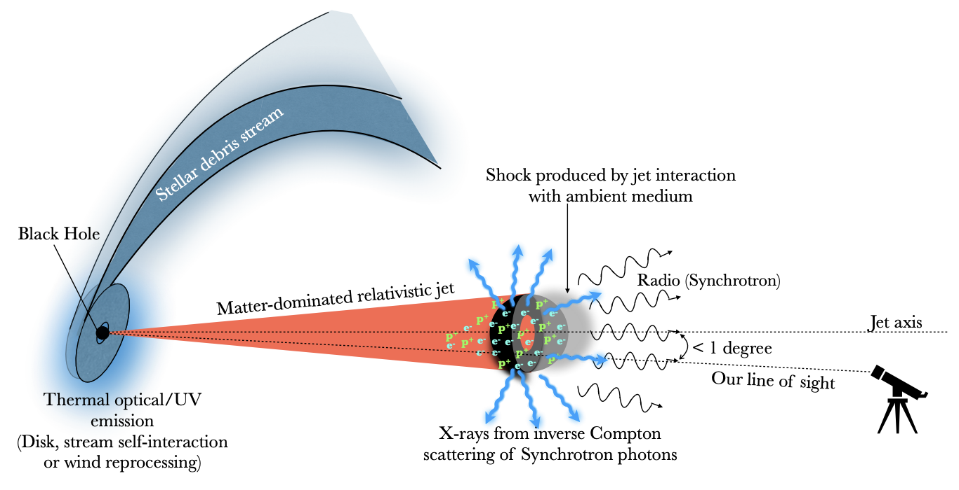
AT2022cmc: 4th on-axis jetted TDEs
Non-thermal X-ray: $L>{10}^{47}erg/s$ , short variability timescales of ~1000s
BH spin >0.3
Andreoni et al. 2022
Pasham et al. 2022

Slide 23
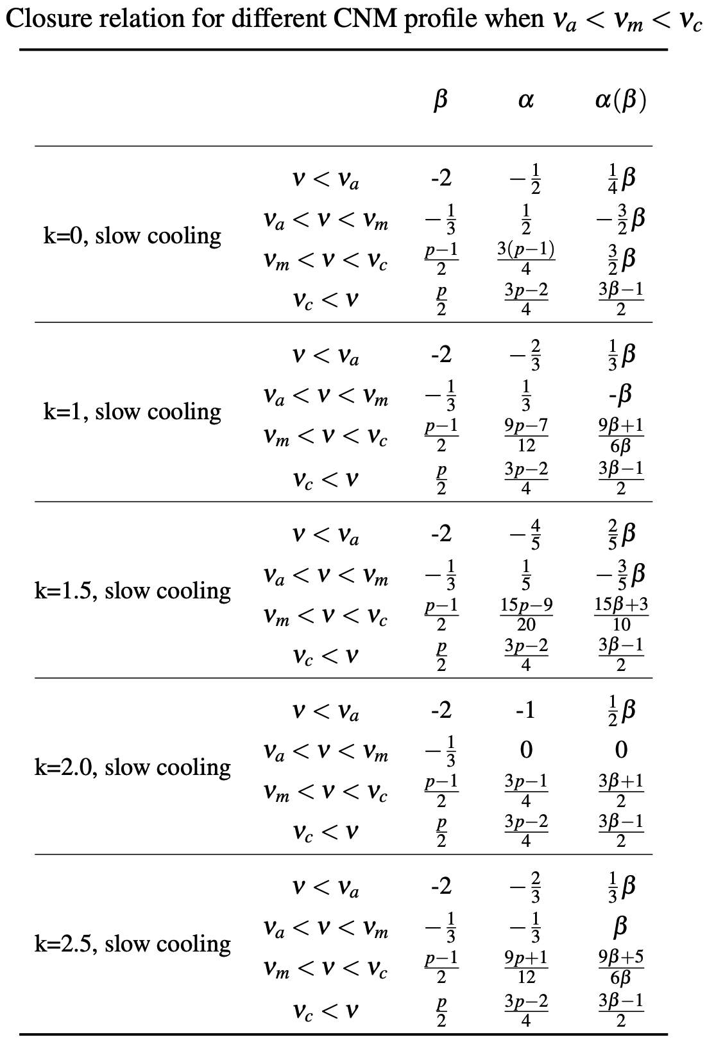
Estimate k with Closure Relations
Jet dynamics is described with Blandford & McKee (1976) self-similar solution for arbitrary k density profile:
Scalings for FS spectra parameters

Slide 24
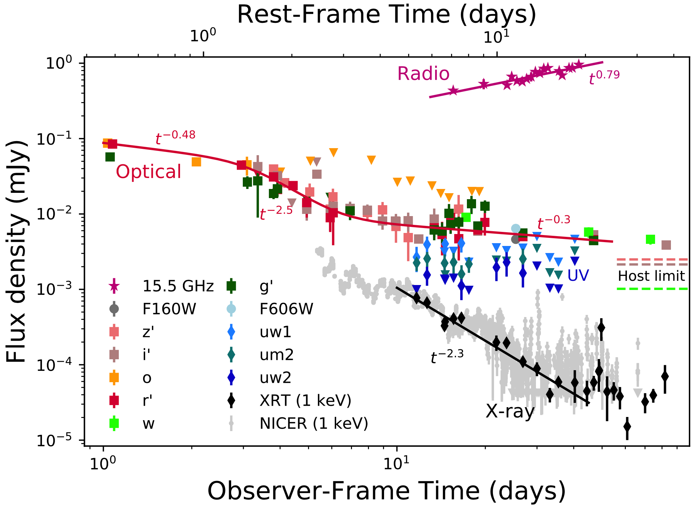
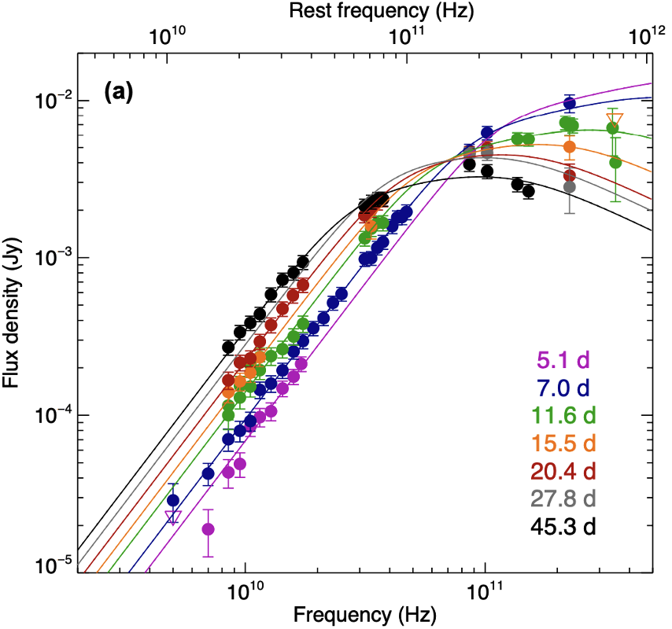
Estimate k with Closure Relations

Slide 25
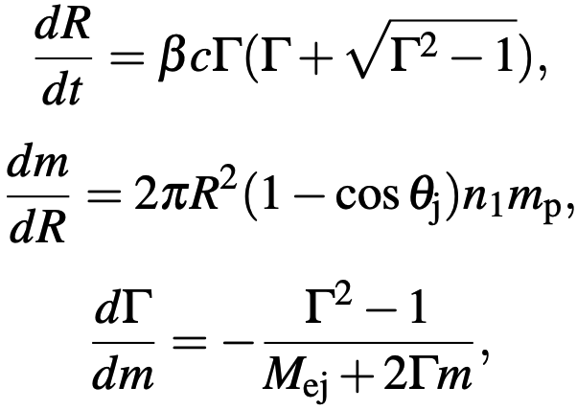
Constrain CNM profile with FSMC
Hydrodynamical equations:
Synchrotron spectrum
Properties of synchrotron emission determined by:1)medium density; 2) jet velocity; 3) electron energy distribution; 4) microphysical parameters: $ε_{e}$, $ε_{B}$
Spectrum: multiple broken power-law separated by $ν_{a}$, $ν_{m}$ and $ν_{c}$
MCMC package emcee is adopted for multiband fitting to constrain the model parameters

Slide 26
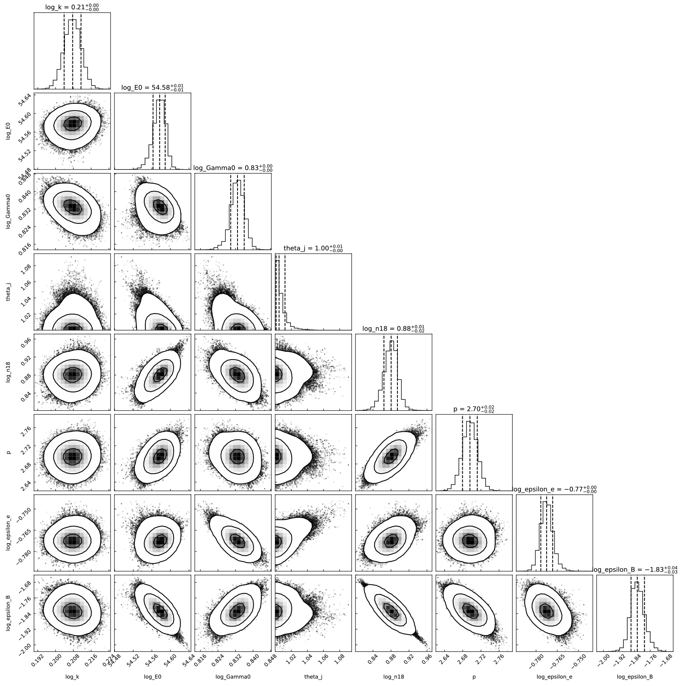
Bondi-like CNM profile
Multiband fitting
$$ρ_{CNM}∝R^{−1.617}$$
accretion history： Bondi accretion

Slide 27
Conclusions
TDE Jet is likely powered by Blandford-Znajek mechanism. BHs in Jetted TDE may carry a moderate to high spin.
Tilted disk surrounding a spinning BH is subject to the Lense-Thirring torque, leading to jet precession.
Multi-band observations enable us to study jet structure, we find a tow-component jet in Sw J1644+57.
Some jetted TDE may beam away from Earth, IGR J12580+0134 is likely an off-axis jetted TDE.
The CNM density profile provides key diagnostics of accretion history of the SMBH. The on-axis jetted TDEs are rare, but have special use in unveiling cosmological quiescent SMBHs and the density profile CNM at z>1.
AT2022cmc is a on-axis jetted TDE with z=1.193. We find that its CNM is Bondi-like.

Slide 28
Thanks!

