Slide 1
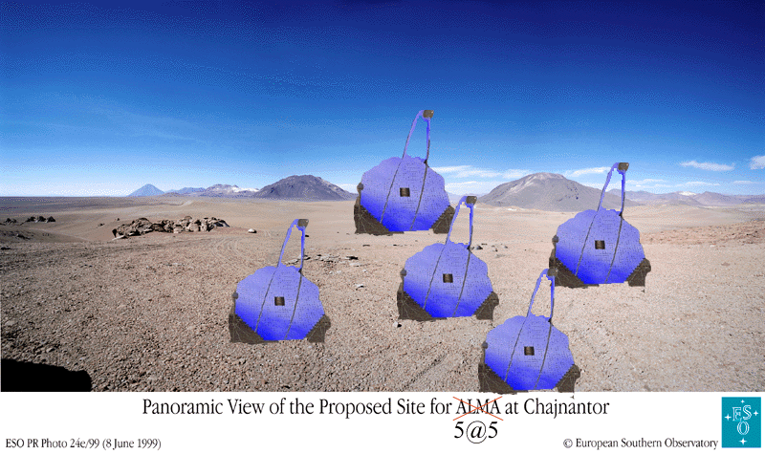
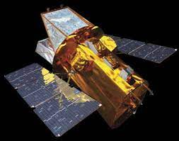
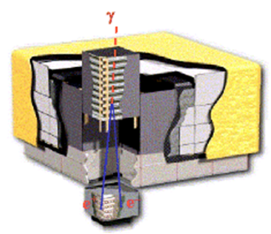
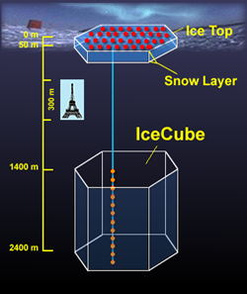
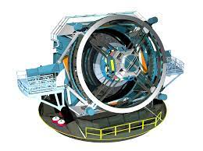
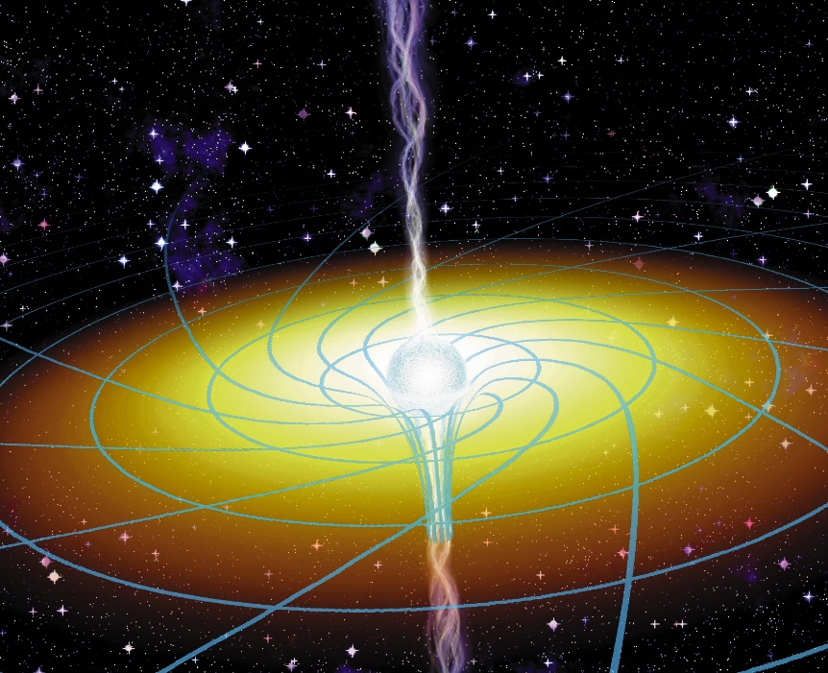
Looking for physics in the weather: gamma-ray blazars
P. Coppi, Yale
[~30 years after the launch of CGRO, have we learned anything?]
??
λλ
Blandford-Znajek vs Blandford-Payne
1. The standard model right after CGRO
2. Some progress = confusion at a higher level
3. Things we need to work on and future prospects

Slide 2
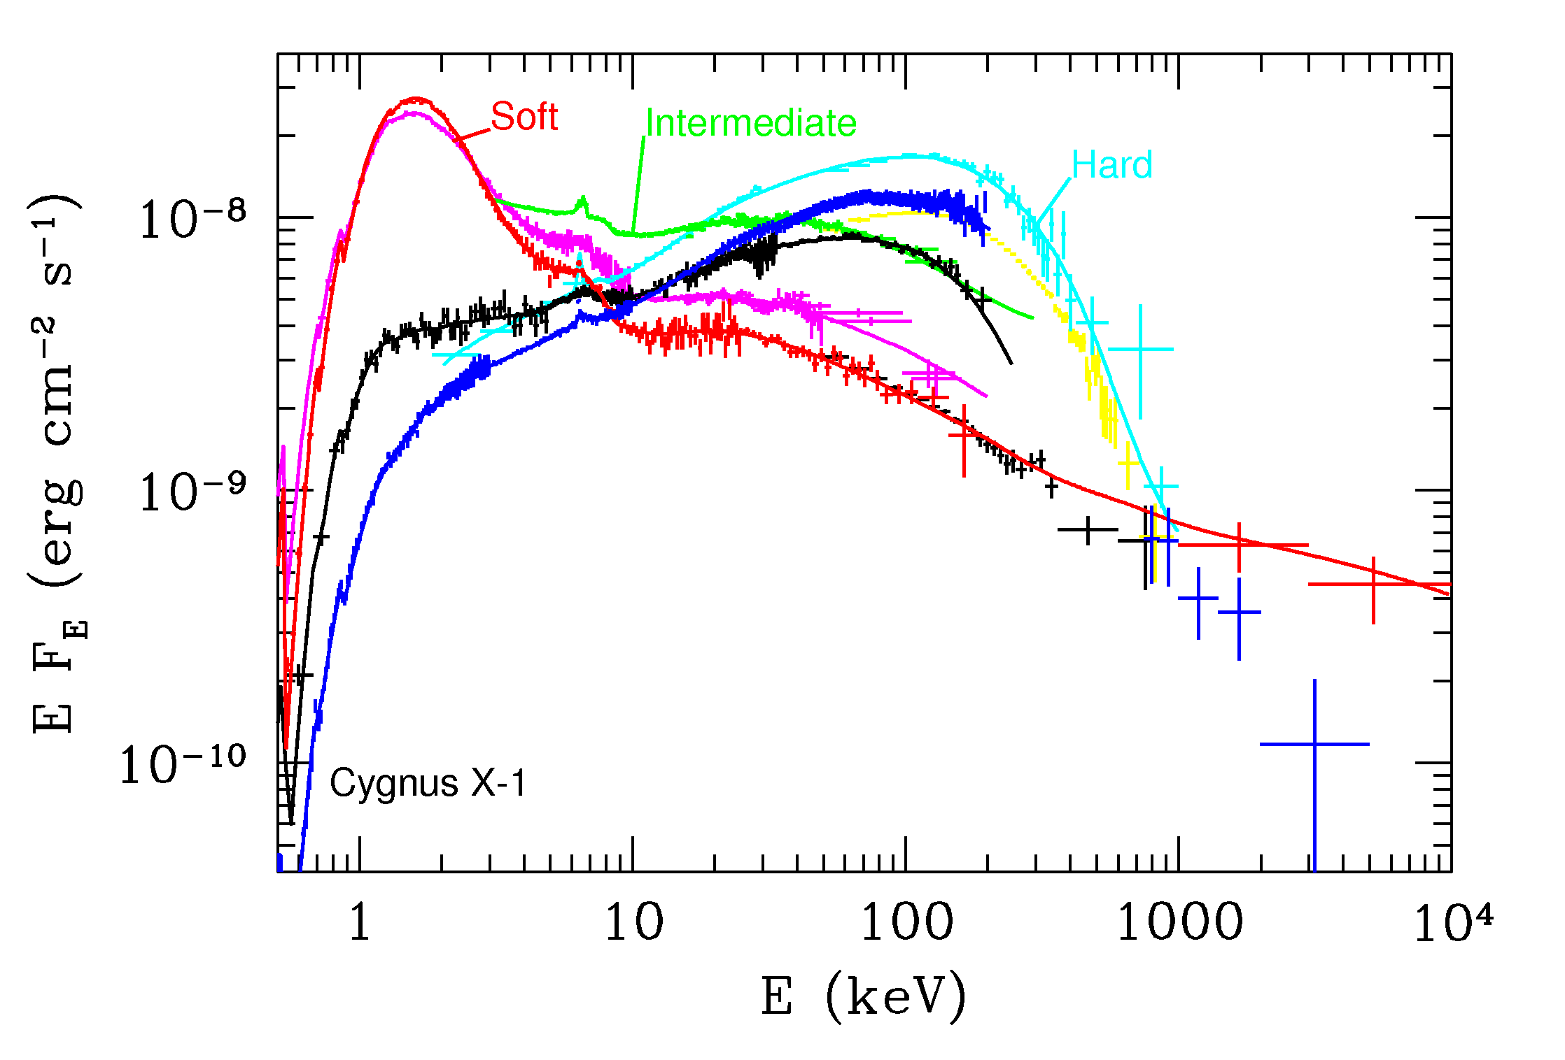
Why (soft) gamma-rays for non-jet AGN? Need broad-band spectra to constrain
physics, reprocessing, measure bolometric luminosity, etc…
X-Ray Binary
Pre- CGRO
Compilation by A. Zdziarski

Slide 3
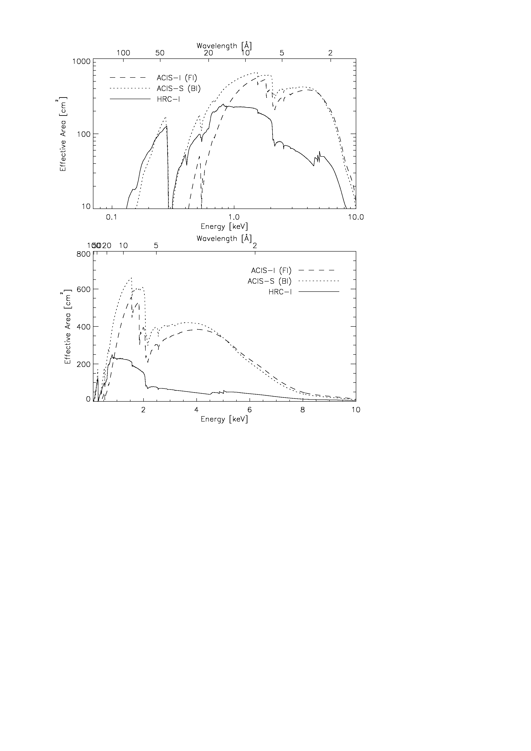
Cygnus X-1 [Spectra of this quality generally do not exist for AGN!]
Chandra
??
[Possible AGN spectral “states” not well-sampled]!

Slide 4
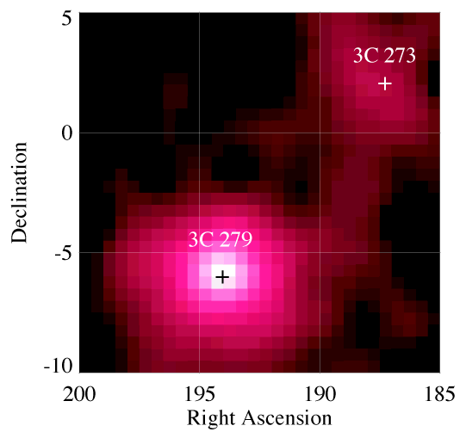
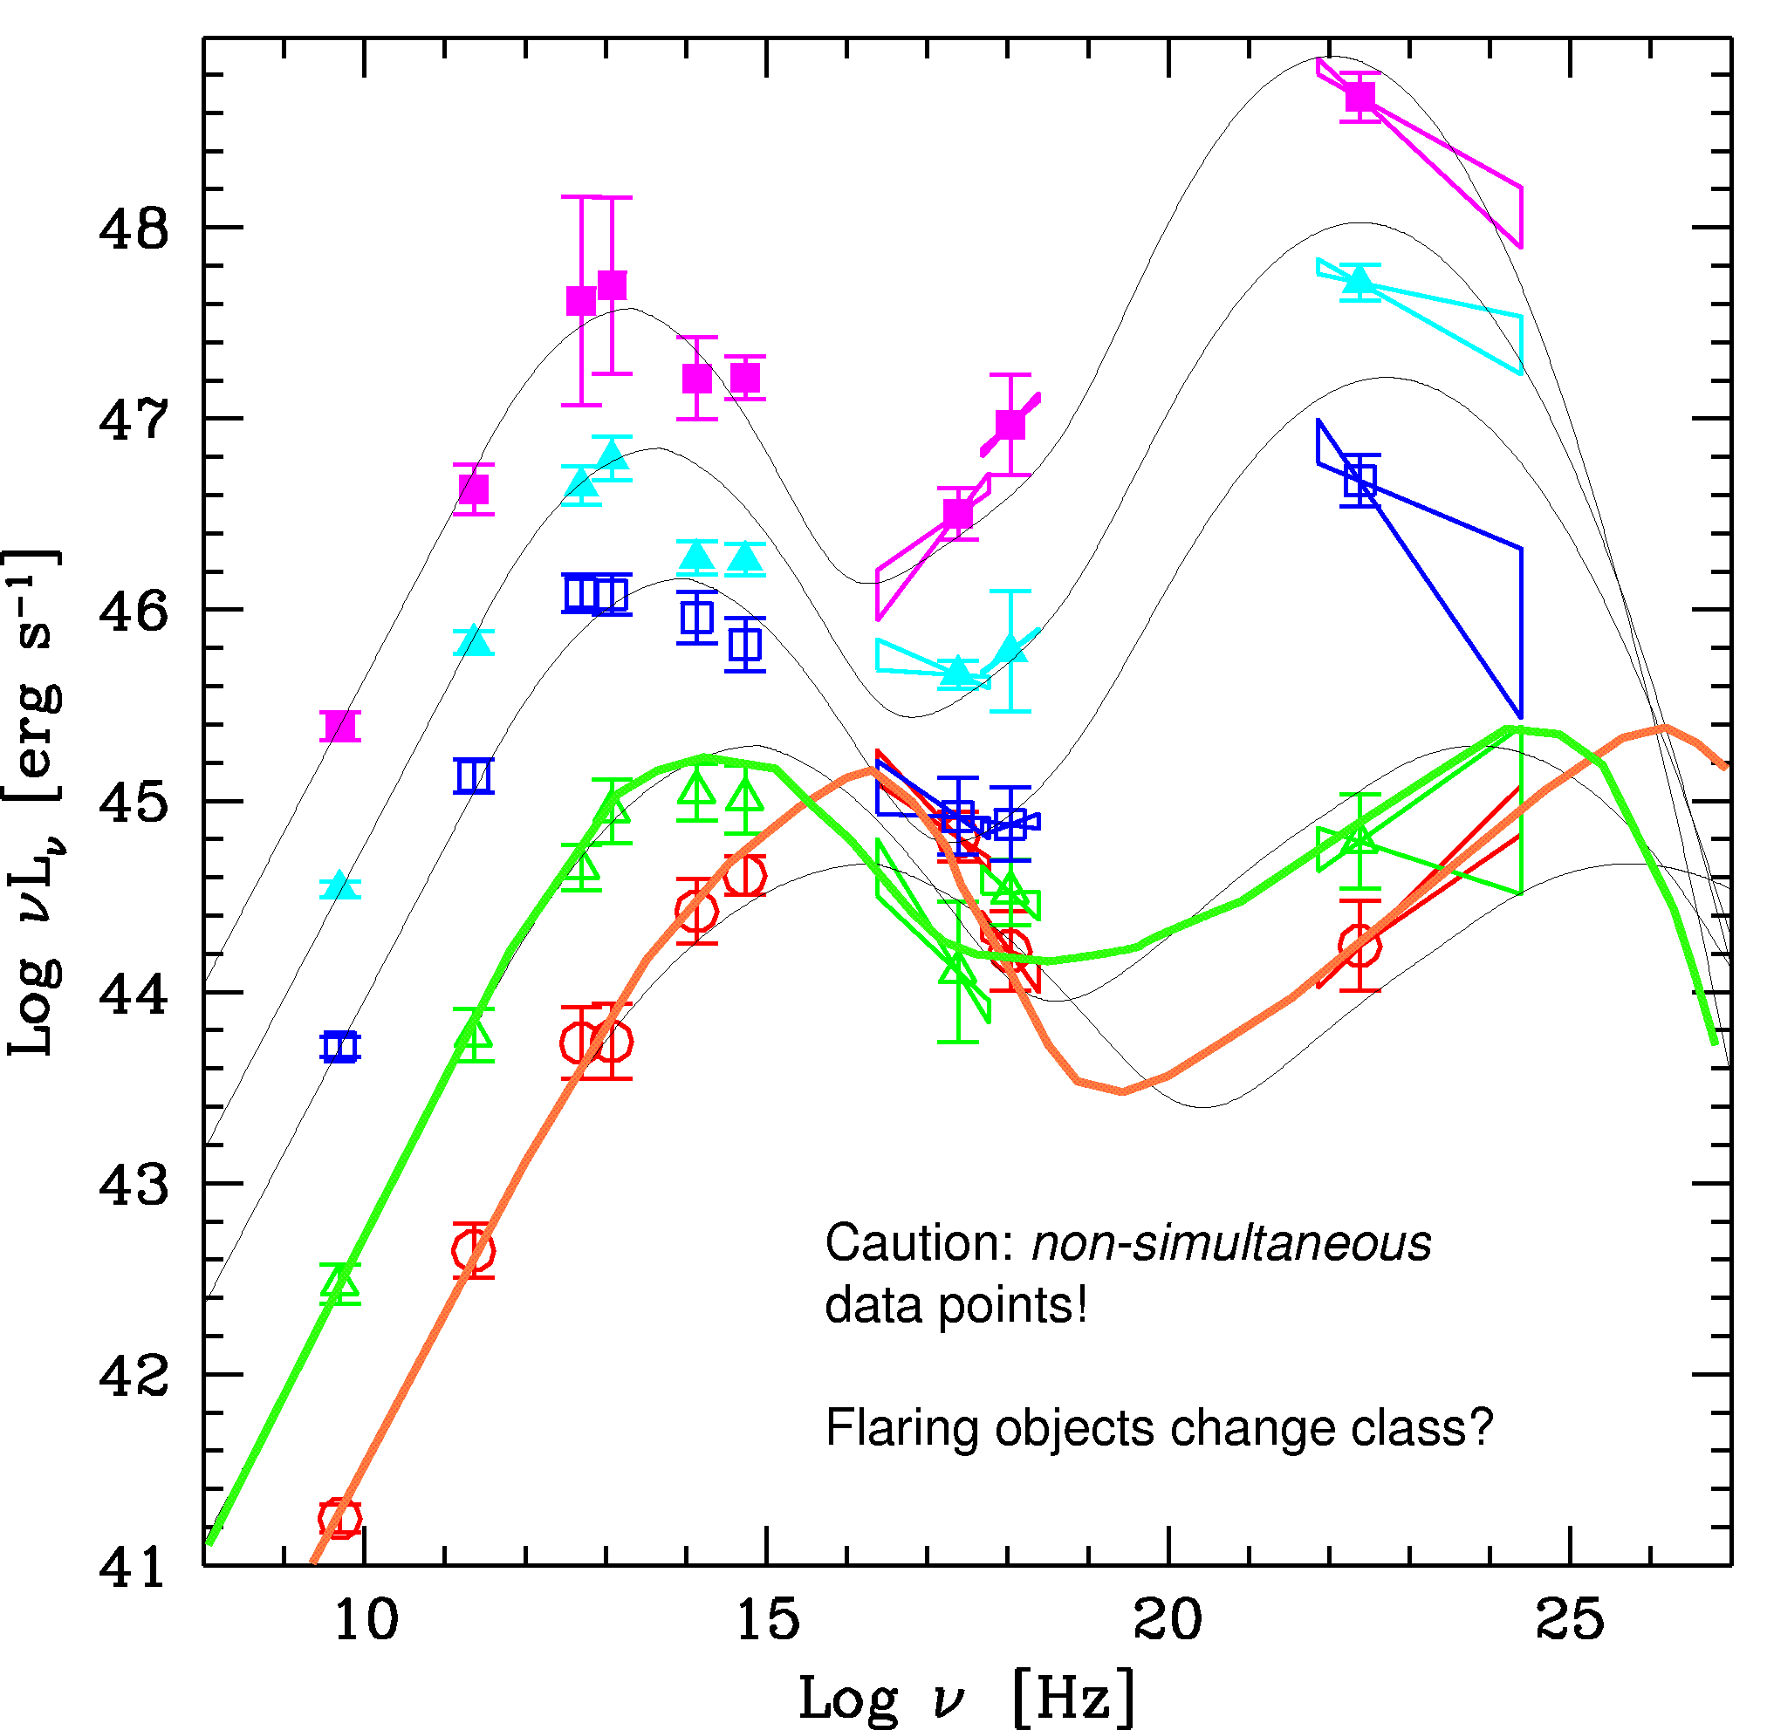
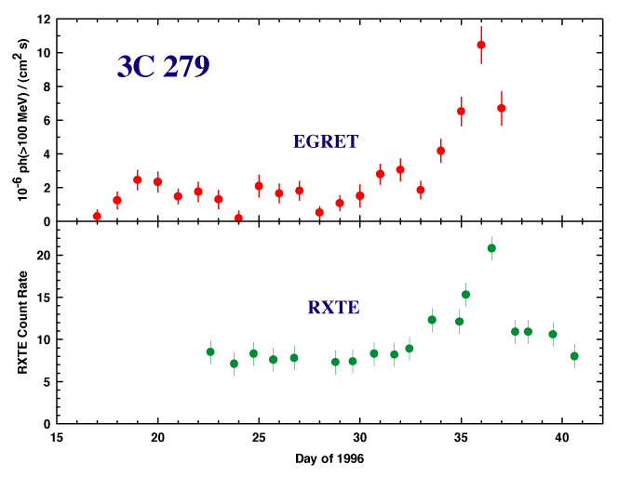
CGRO/EGRET and the “GeV” Blazars- a Compton catastrophe?
[Ghisellini: Biggest mistake since cosmological constant ]
Unified Blazar Scheme?
Fossati?
Donato et al. 2002,
Fossati et al. 1998

Slide 5
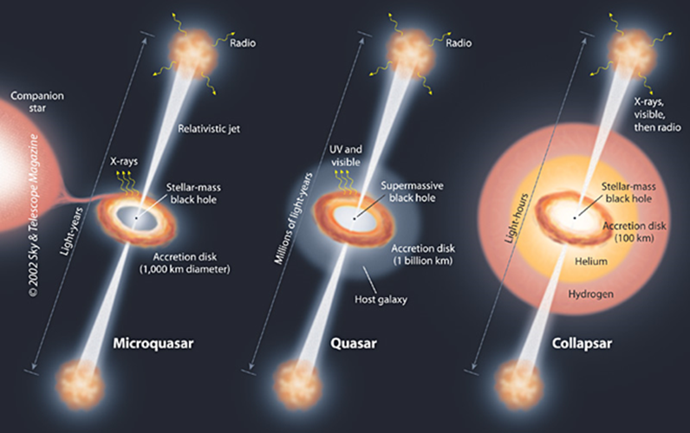
Key Considerations from ~CGRO era
Apparent gamma-ray luminosity large, ~10⁴⁹⁺ erg/sec (>> likely L_{Edd}) => anisotropic emission
Two “bump” emission, optical-X and gamma-ray, vary in correlated manner? Same emission region =>
potential problem because gamma-rays can pair produce off co-spatial photons in lower energy bump.
Rapid variability (hours-day) imply compact emission region => high pair production optical depth => no gamma-rays!? (Compactness problem, same for GRB) => Doppler boosting! + anisotropy = relativistic jet!
Even if emission is boosted by δ⁴ and δ~10, L_{true}~10⁴⁵⁺ erg/sec = non-trivial fraction of jet kinetic power (10⁴⁶ erg/sec) inferred from, e.g., radio lobes. Can’t ignore but also can’t kill jet => zone of avoidance.
Emission is done by energetic particles – need lots of them, jet can’t be empty/pure Poynting flux by time gamma-ray emission starts and probably
by time get to lobes, jet likely baryon loaded/dominated – although by number
jet particle content could dominated by pairs (e.g., Sikora et al. 2006)
[Clue: Andy – particle content of cluster bubbles? k/f ~1 ]

Slide 6
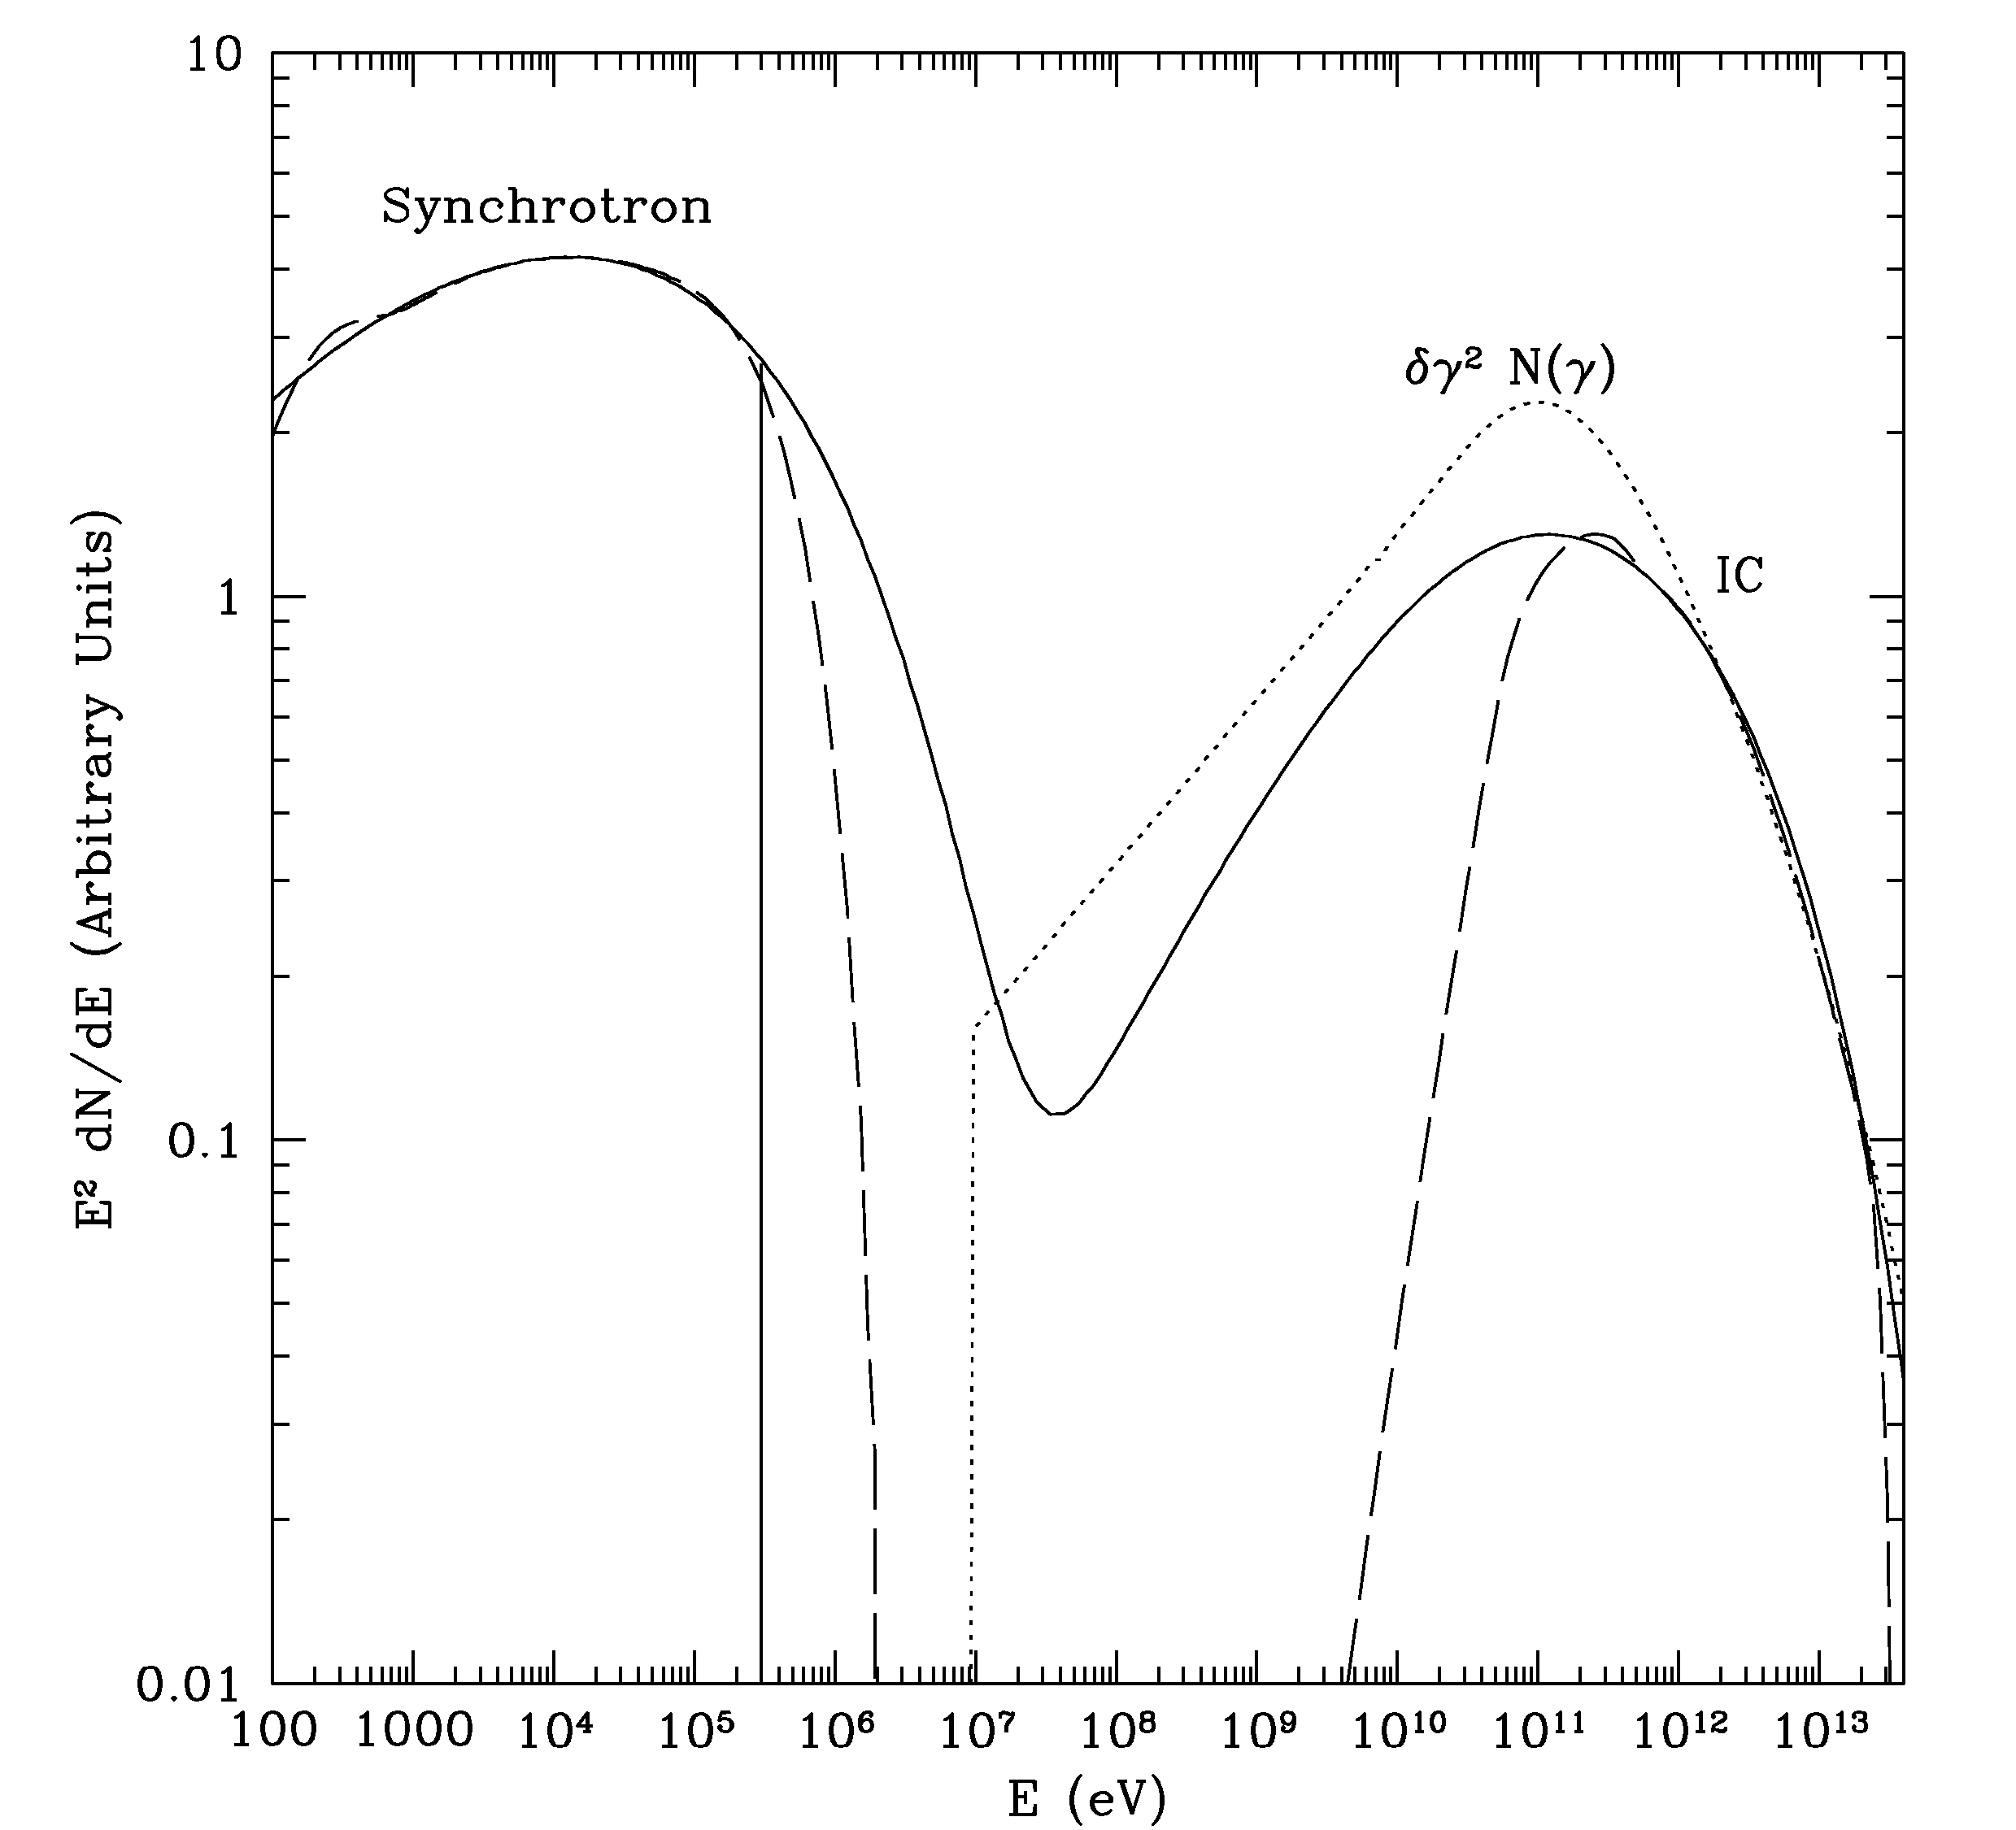


VHE Astrophysics I.
A Generic Source ….
$$ε_{IC}^{peak}∼γ_{peak}^{2}ε_{soft} (\text{Thompson}) \\ ε_{IC}^{peak}∼γ_{peak} (\text{Klein}\text{−}\text{Nishina})$$
Multiwavelength
observations
very powerful/critical!
E.g., if have synchrotron/IC
model L_{IC}/L_{syn}=U_{B}/U_{rad},
constrain B if know U_{rad}.
Also, correlated IC/synch. spectra!
$$ε_{sync}^{peak}∼γ_{peak}^{2}B$$
IC or π₀
_{(or}
_{P-Sync)}
Process(es) directly responsible for observed X-ray/γ-ray emission?
lowest order, most “efficient”

Slide 7
VHE Astrophysics II
O.K. Where do we get required GeV/TeV electrons/pairs/pions?
“leptonic”
models
don’t need to be ultrarelativistic, e.g., SNR
“hadronic”
models
but need large target matter densities
Neutrinos: “smoking gun” for hadronic models
Big advantage of hadronic models: protons easier to accelerate to very high energies
Big disadvantage … : protons harder to extract energy from (INEFFICIENT!)

Slide 8
Theoretical Considerations [Complications] III.
Is the observed high energy cutoff in some objects intrinsic or simply due to
photon-photon pair production (inside source or intergalactic)?
So 3C279
should not be
VHE source,
but it is!!
Costamante, Meyer et al.
No Fermi breaks at > 10
GeV/BLR absorption features!
What is the origin of the spectral breaks seen in X-rays/gamma-rays?
Superposition of different emission components?
Transition from efficient to “inefficient” cooling (particles escape before cooling)?
Acceleration process: E_max or E_min (“quasi-thermal” pool)? => α_{x}~0.5?
Klein-Nishina effects? Cascading [ also => E_{min}]?

Slide 9
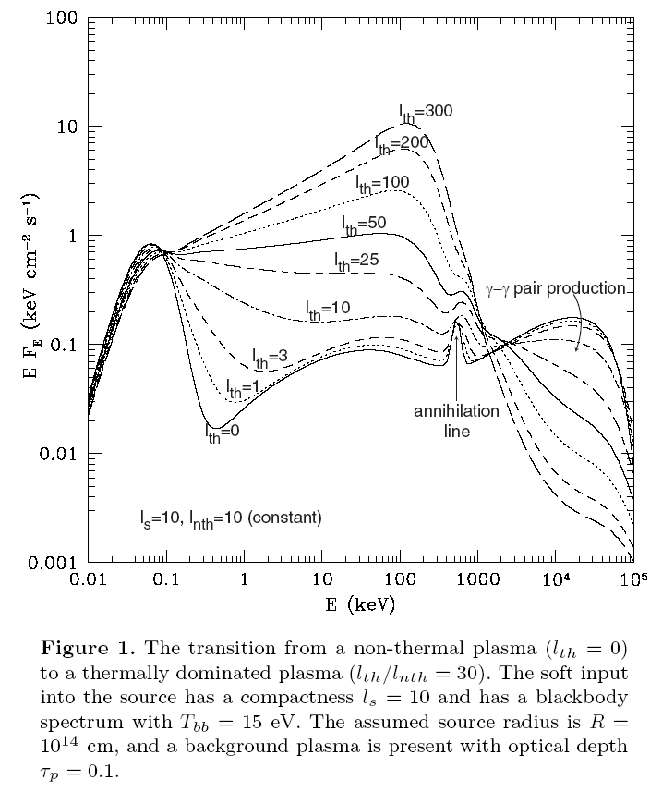
Why ~MeV? A “hidden” 100 MeV source - Cascading
E~511 keV
special energy
for physics:
Klein-Nishina,
pair production,
pair annihilation
Spectral features
expected!
Constraints
if not seen!
Theorem: Black holes have no hair and (obvious)
pairs?

Slide 10
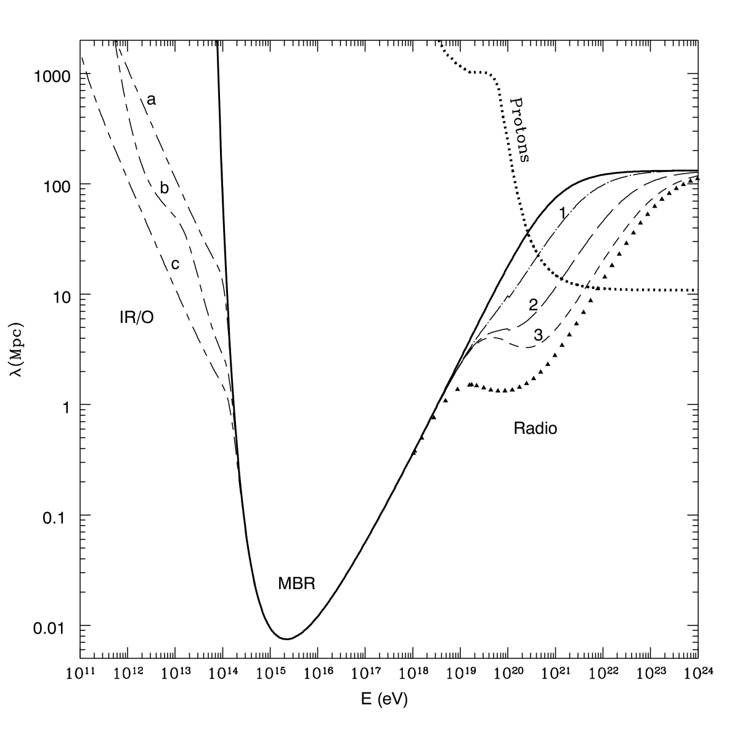
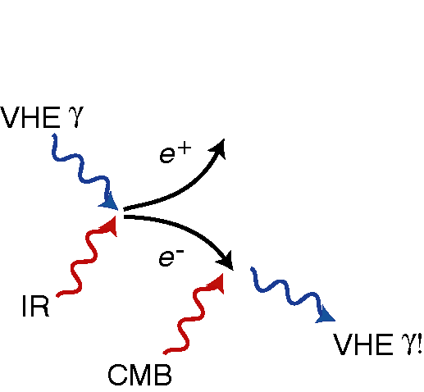
Mean free path
for VHE photons
Absorption
(pair production)
and
Cascading
important for
cosmological
VHE sources.
Coppi & Aharonian 1997

Slide 11
Need ~MeV – GeV instrument
F. Halzen

Slide 12
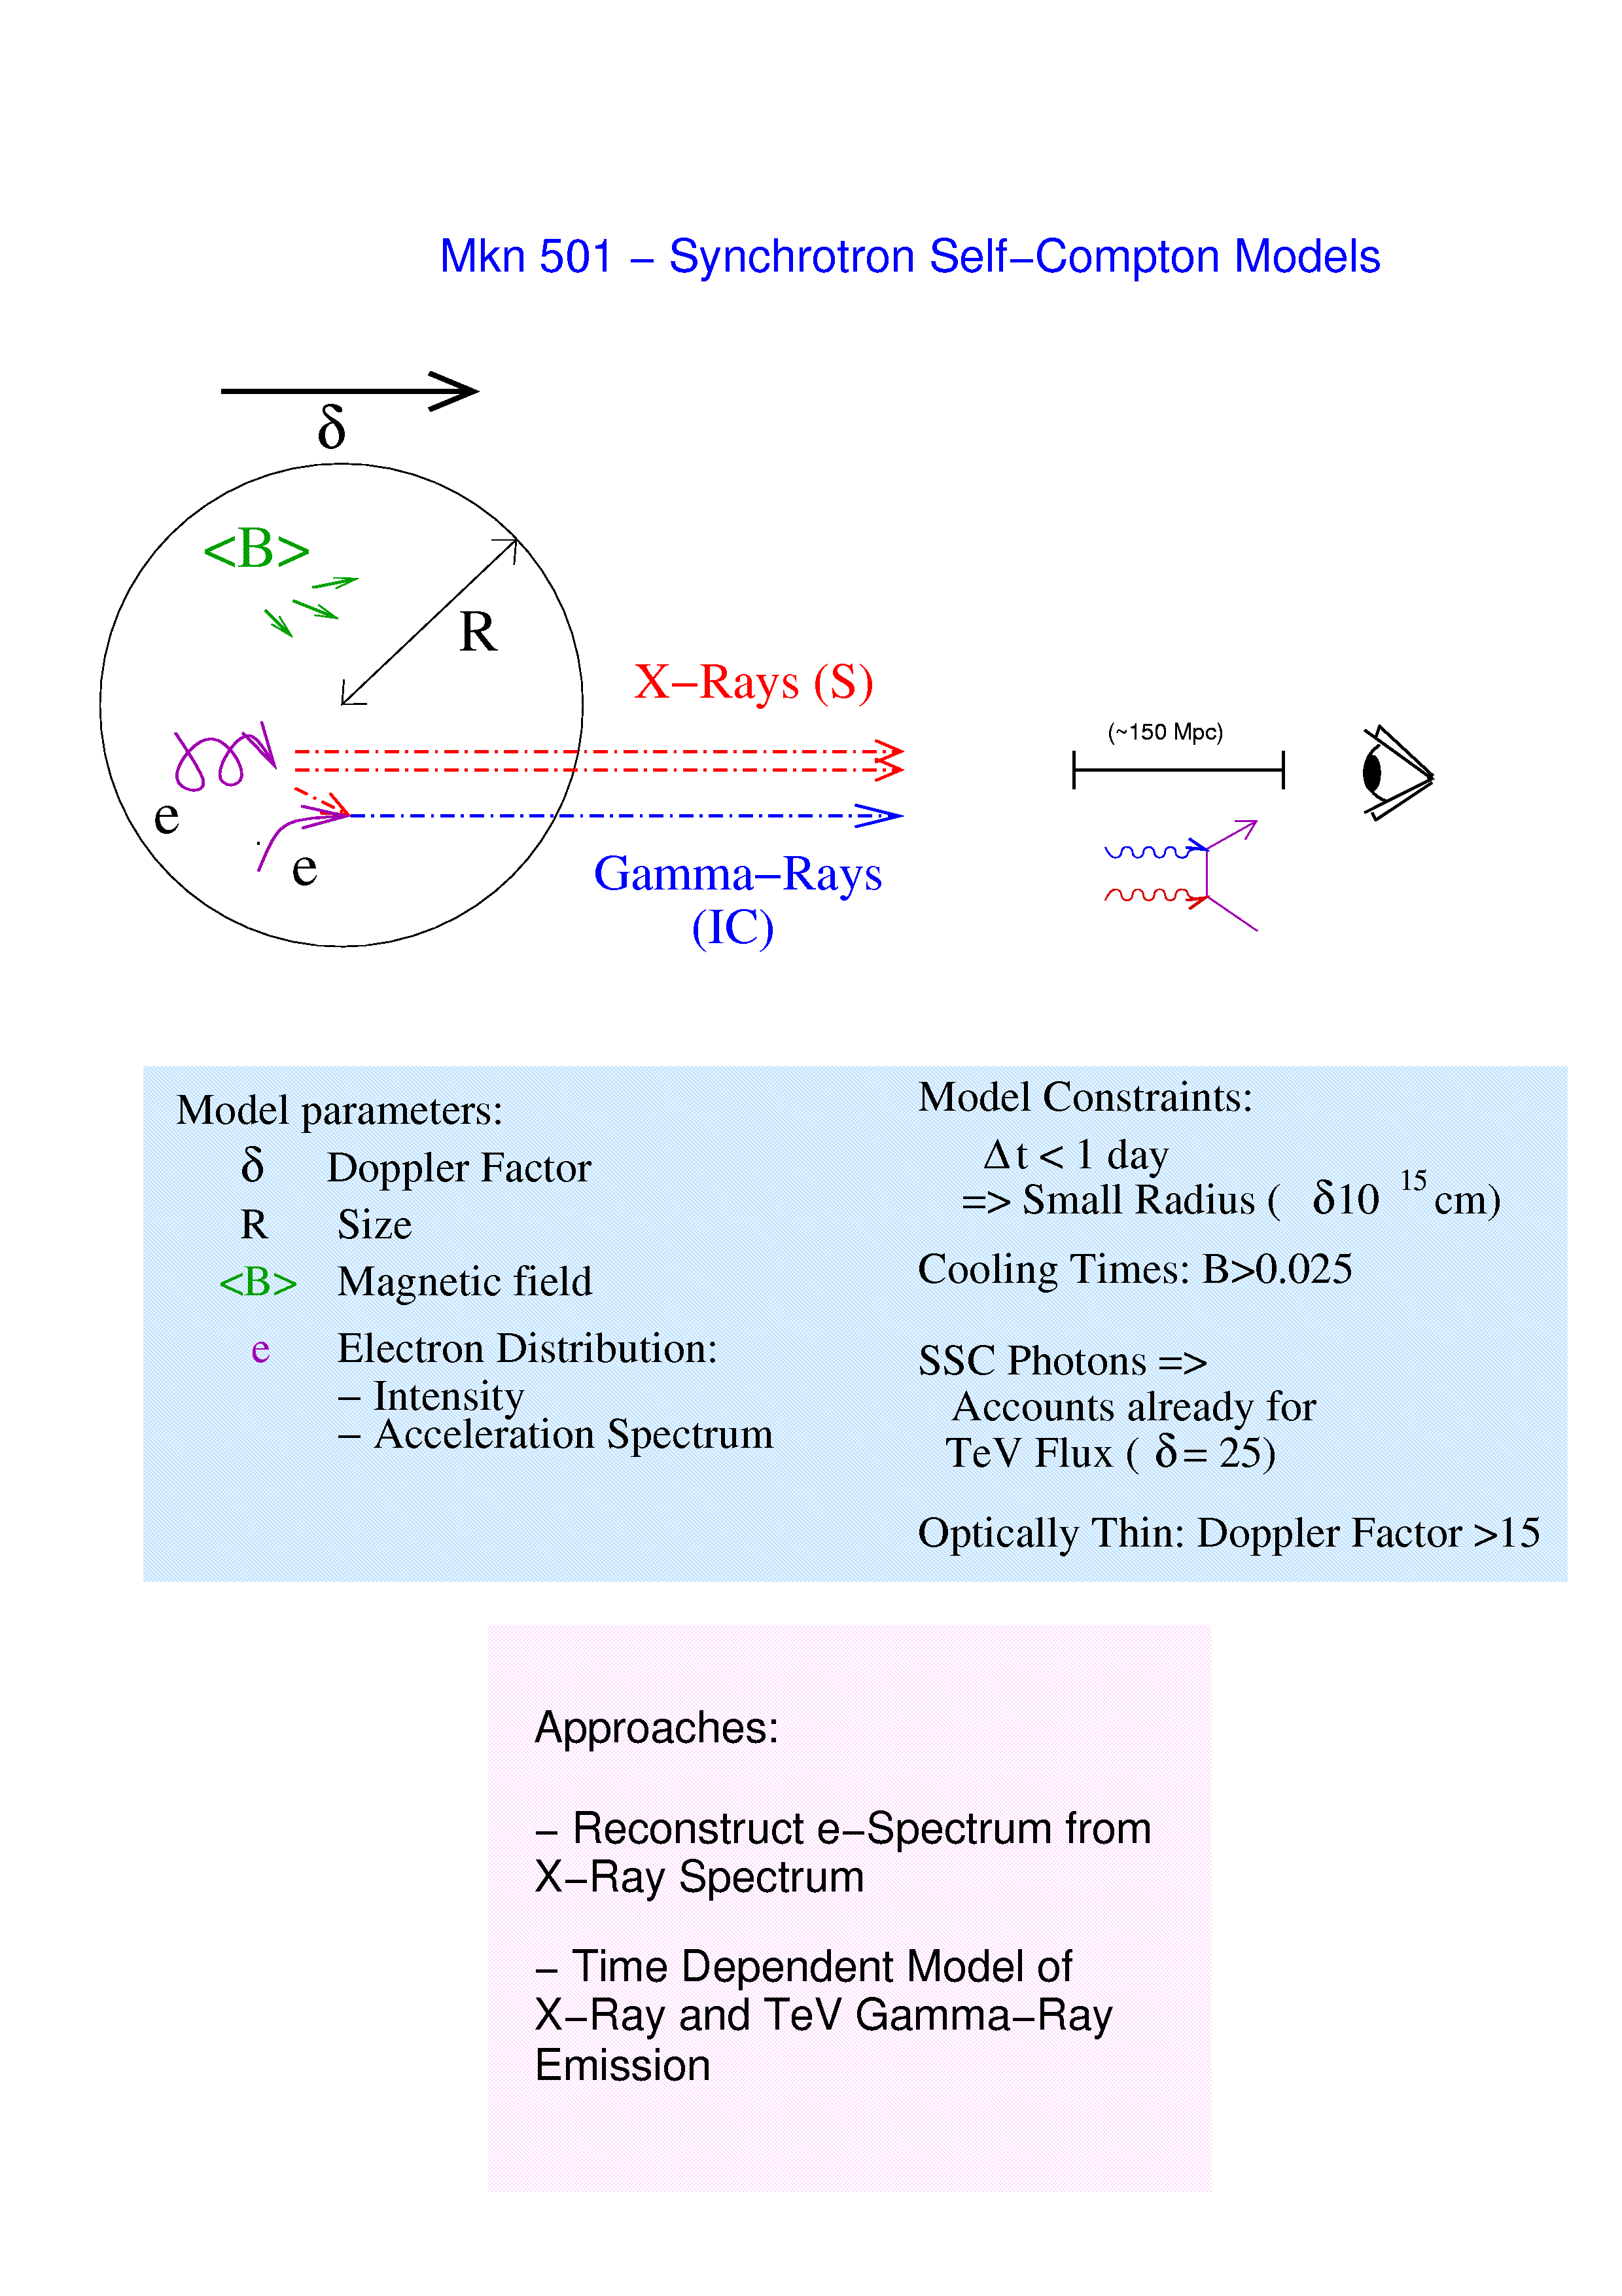
Krawczynski, Coppi, & Aharonian 2002

Slide 13
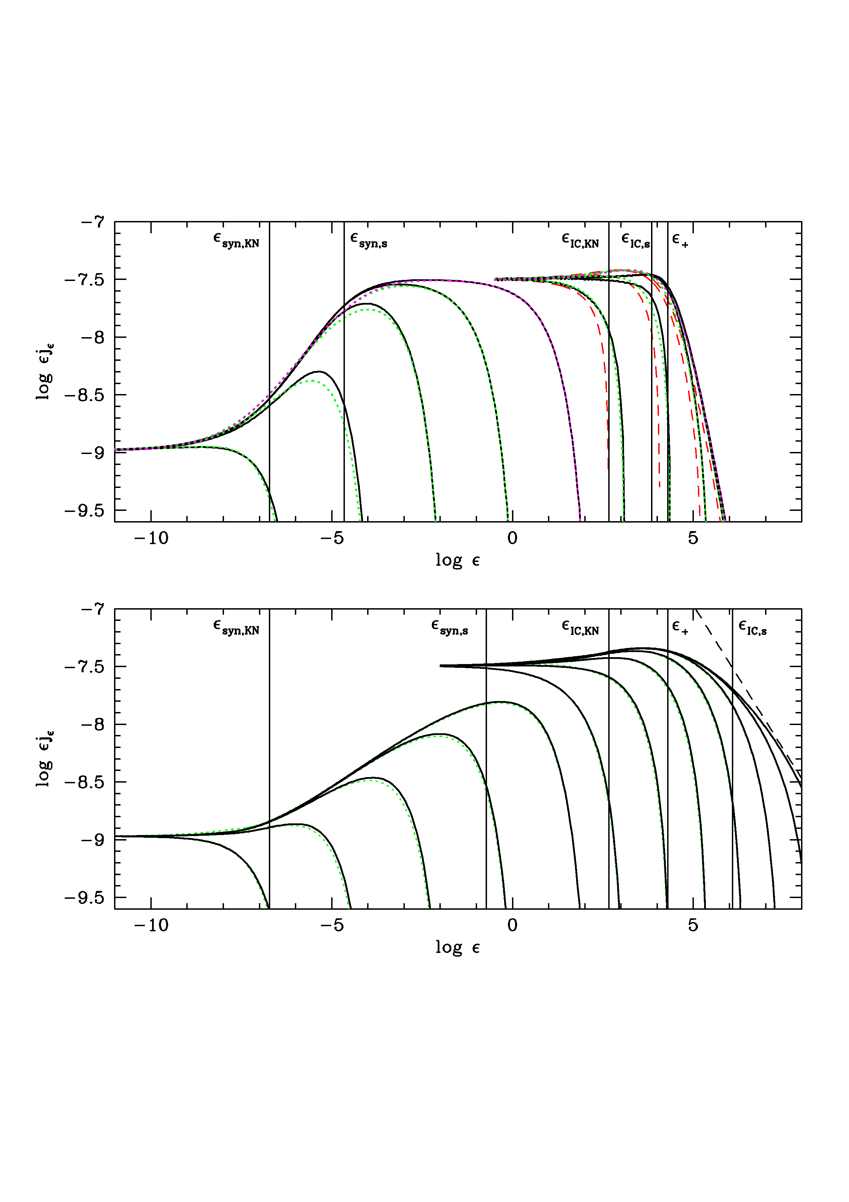
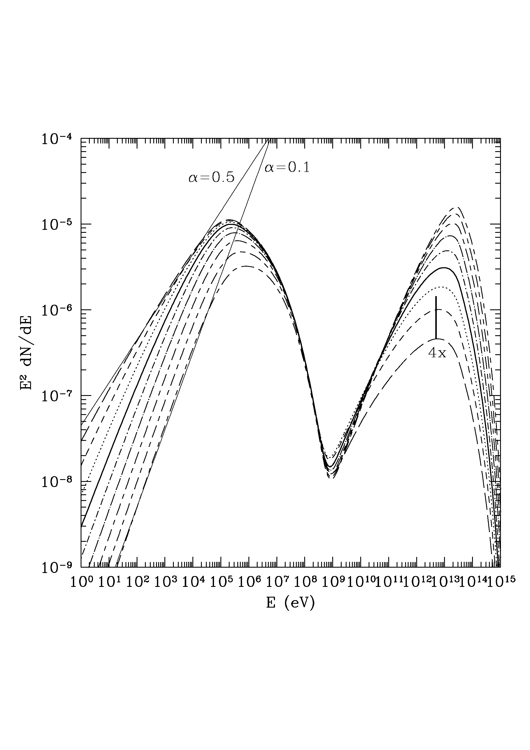

Example
complication…
ERC,
UV blackbody
seeds
$${\dot{γ}}_{sync}≫{\dot{γ}}_{IC}$$
EGRET
blazars?
What happens if
significant fraction
of soft target
photons interact
with scattering
electrons
in Klein-Nishina
limit?
Be careful in
interpreting origin
of spectral features
such as “bumps”
and break energies!
Can get spectral
Index harder
than 0.5!
LEARN ABOUT
TARGET PHOTON
FIELD.
[~MeV]
Moderski et al. 2005
SSC
Mkn 501 model
Get < 4x (N²)
increase in SC flux
Response to repeated 2x
increase in e- luminosity

Slide 14
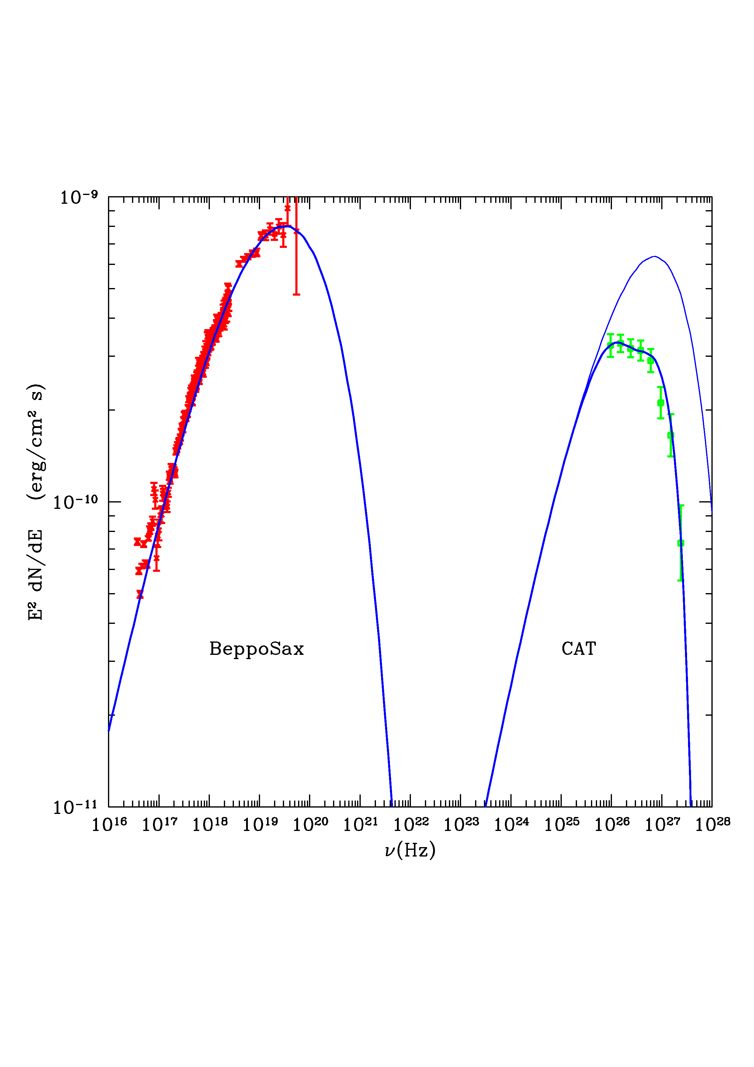
Synchrotron
Simultaneous SSC
fit to BeppoSax and
CAT for Mrk 501
flare of April 16, 1997
using fully
self-consistent model
-- including
Klein-Nishina effects
X-ray spectrum,
harder than 0.5!
[Minor detail – SSC
fit parameters stable
~ 2 months! A single
blob would be far
away by that time]
I.C.

Slide 15
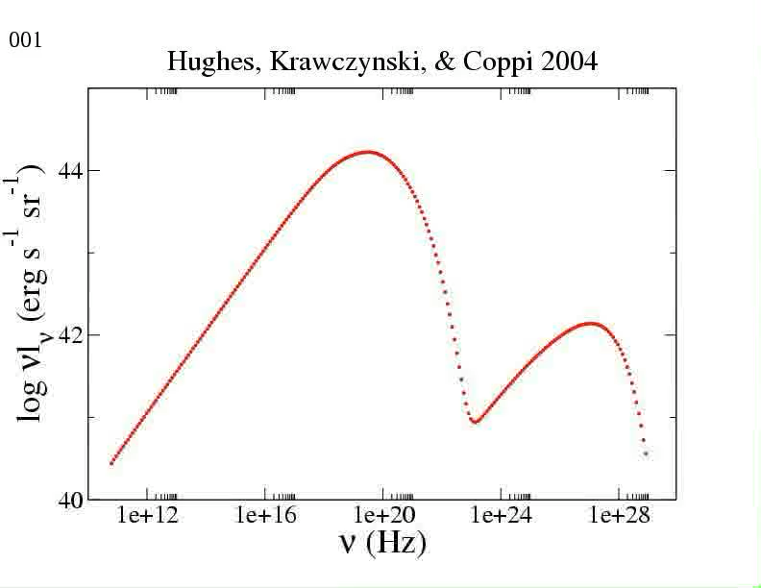

Slide 16
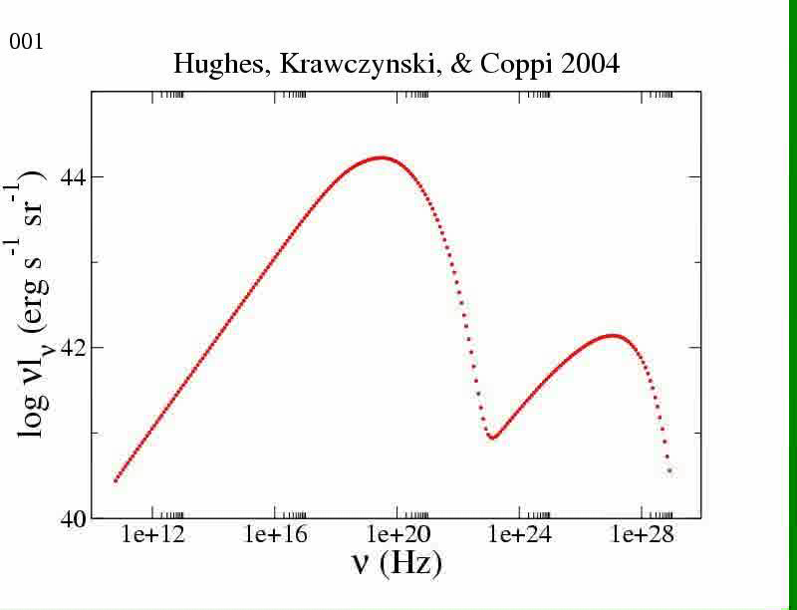
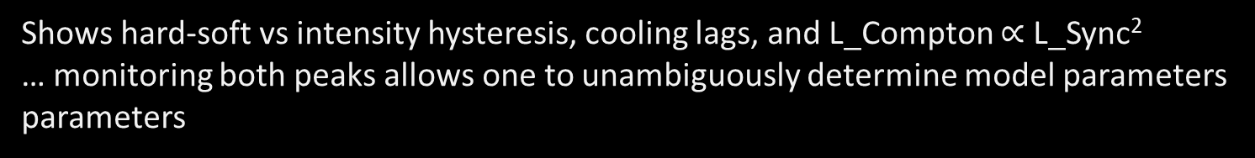
Variability “in principle” very constraining:
simple (?) TeV blazar [one zone SSC, no “external” radiation]
Shows hard-soft vs intensity hysteresis, cooling lags, and L_Compton $∝$ L_Sync²
… monitoring both peaks allows one to unambiguously determine model parameters parameters

Slide 17

Unfortunately, this matches observations only some of the time …
(or never in some objects!)

Slide 18
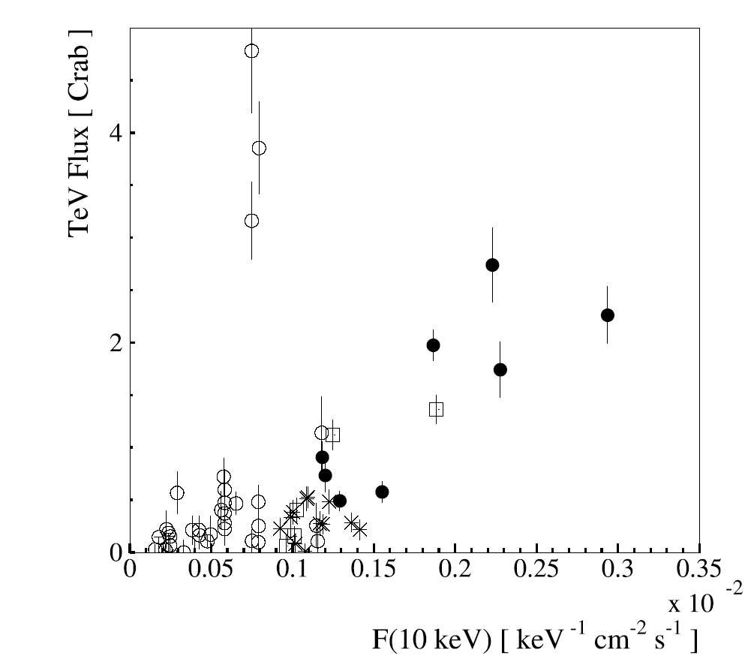
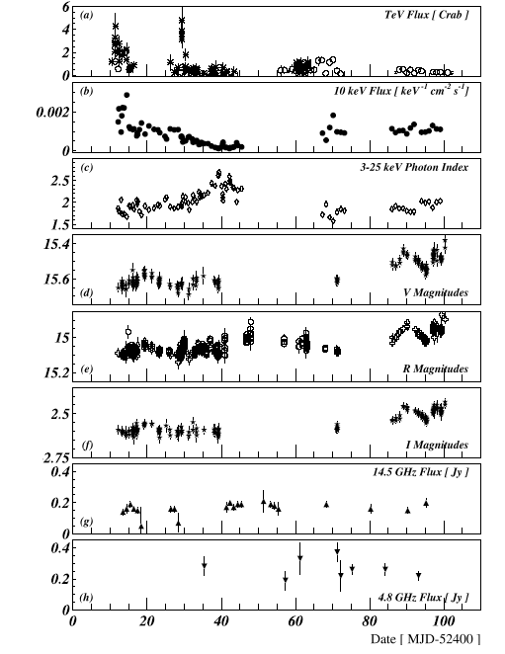
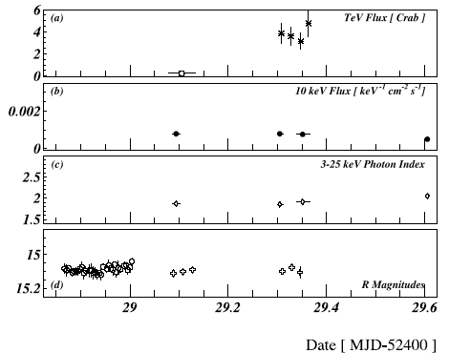
Oops!! -- 1ES1959 May-Aug 2002
Multiple Emission
Components!
Krawczynski et al. 2004

Slide 19
Mrk 501 – extra VHE component? Barely seen by Fermi (Mrk 501 is “boring” Fermi source)
?

Slide 20
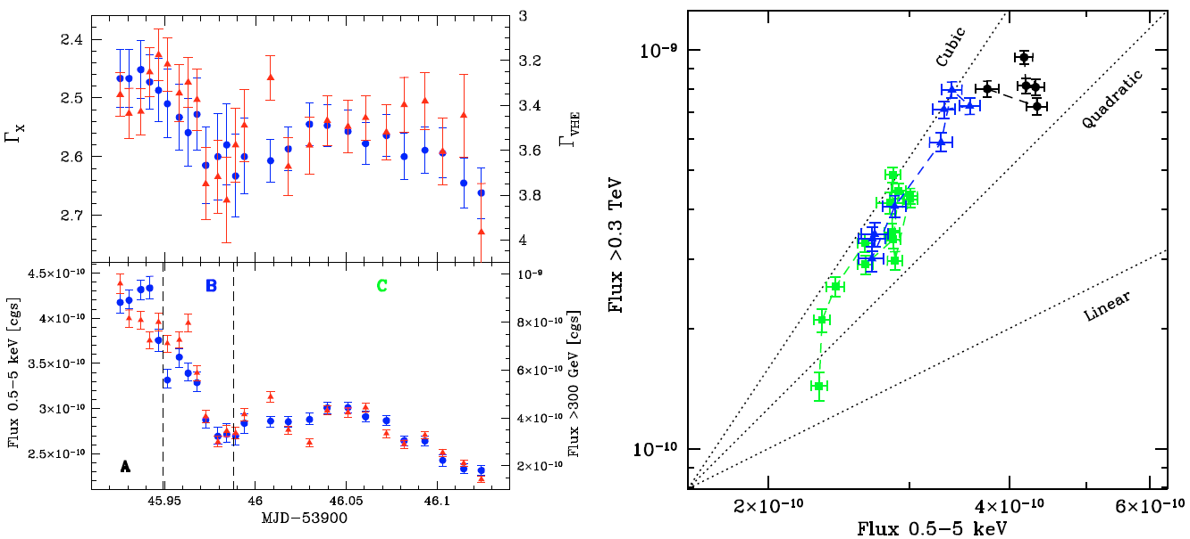
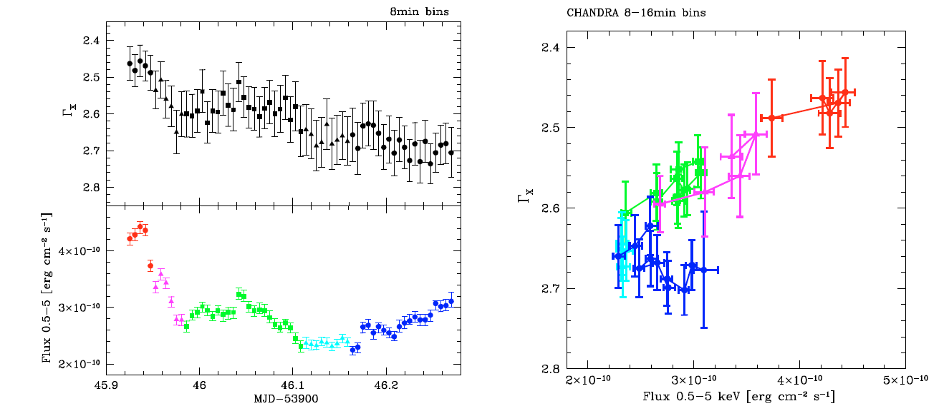
Famous PKS 2155 (HESS) Flare of an “IBL”
Multiple Emission Components – Dilution!?
Very fast (~5min) variability! [N.B. Now also seen in 3C279, FSRQ!]

Slide 21
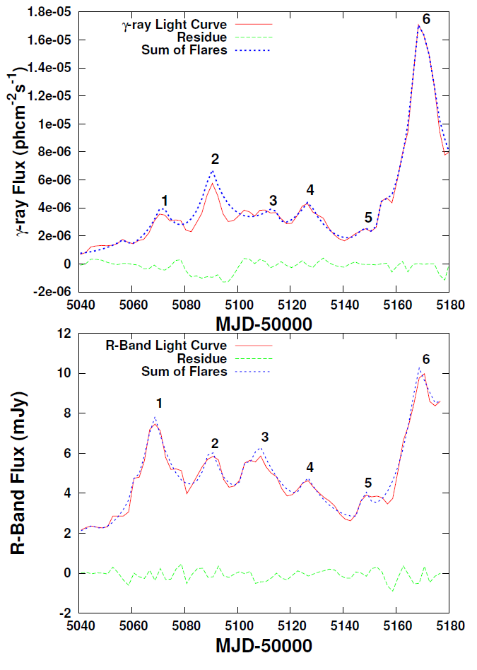
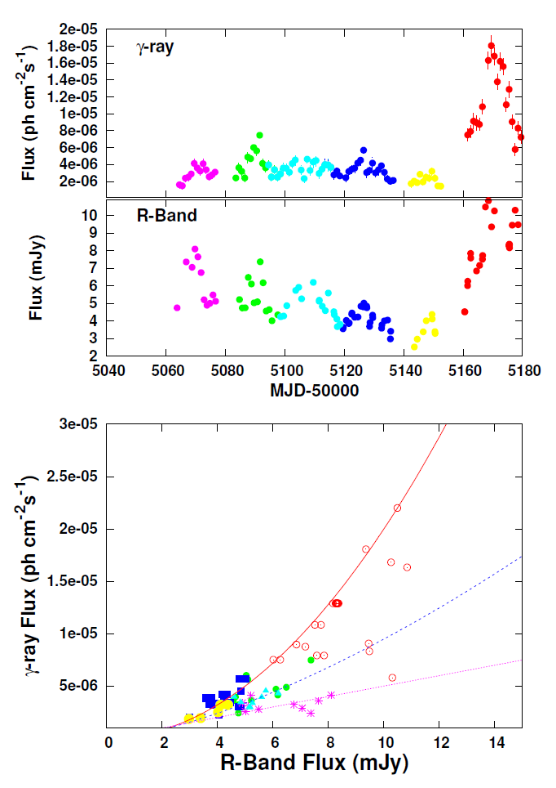
3C 454.3 2009 Flare – SMARTS + Fermi (Chatterjee et al.) - “states”?

Slide 22
??
Best guess answer – sort of, but huge scatter and overlap of classes?
BTW, peak energy in ASTROGAM, not FERMI!
The Fossati (yes) vs.
Giommi-Padovani (no!) controversy:
From talk by Ciprini
In real life, individual objects change peak energy/class! (E.g., 3C454.3, next slide)

Slide 23
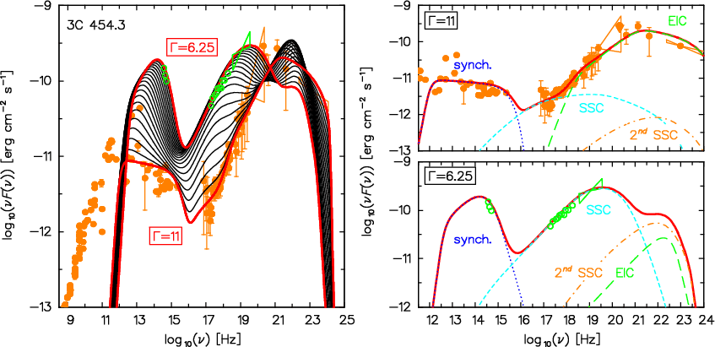
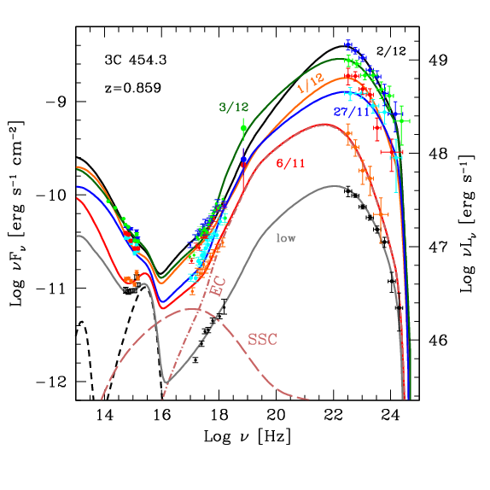
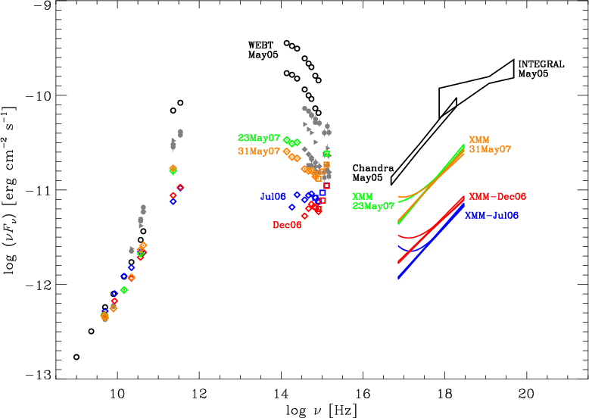
Another example of messy blazar behavior:
Here is well-known (?) MeV blazar, 3C 454 (at least in low state)
Katarzynski & Ghisellini
Tavecchio & Ghisellini
?
??, If spectrum really rolls over as
INTEGRAL suggests,what about
Compton dominance?
(May 05 is huge flare
for synch component… )
Raiteri et al. 2008

Slide 24
(Very) Extreme BL Lacs Exist!
Correct for EBL absorption? Ouch

Slide 25
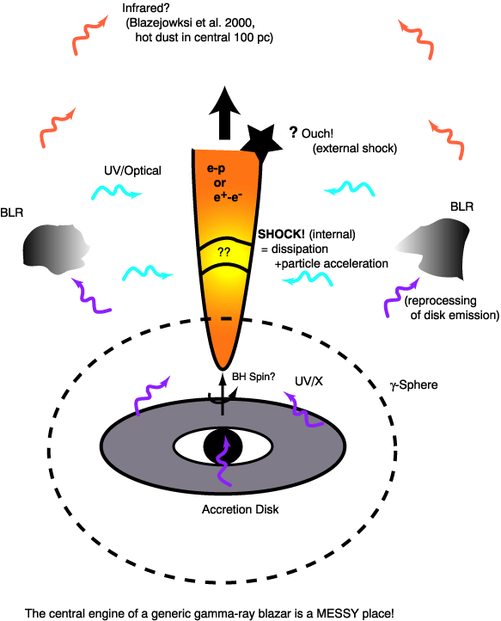
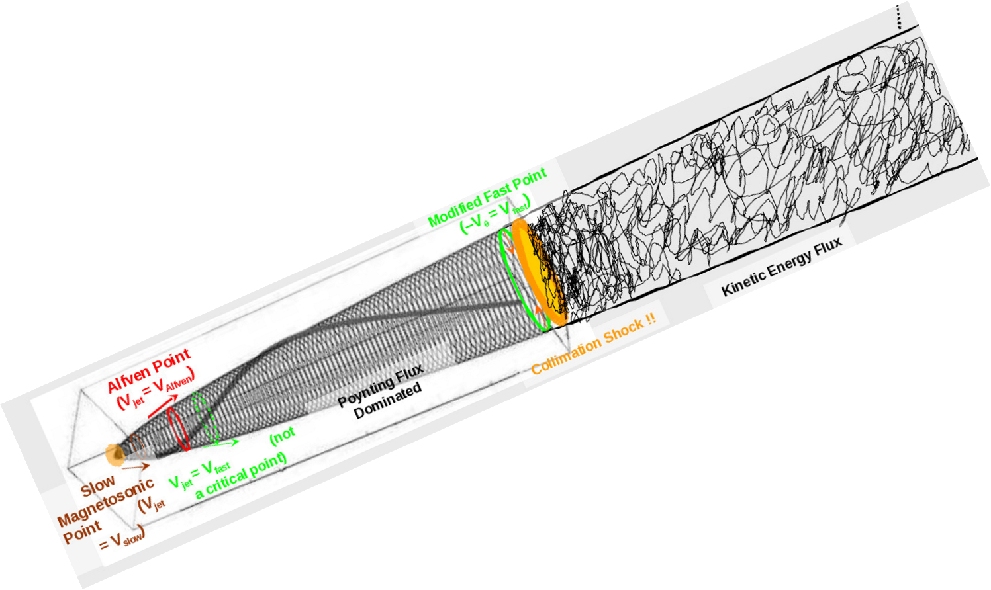
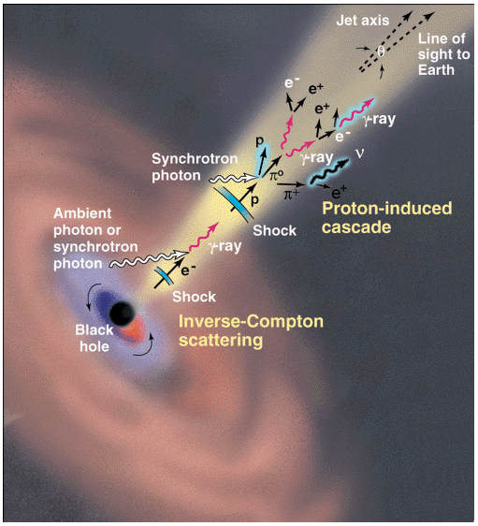
Blazar Emission Mechanisms: Idealized vs. Real Life
(Buckley, Science, 1998)
“Zone of
Avoidance” for
pair jet -- Dark Energy!
What if something did happen here?
Need MeV!

Slide 26
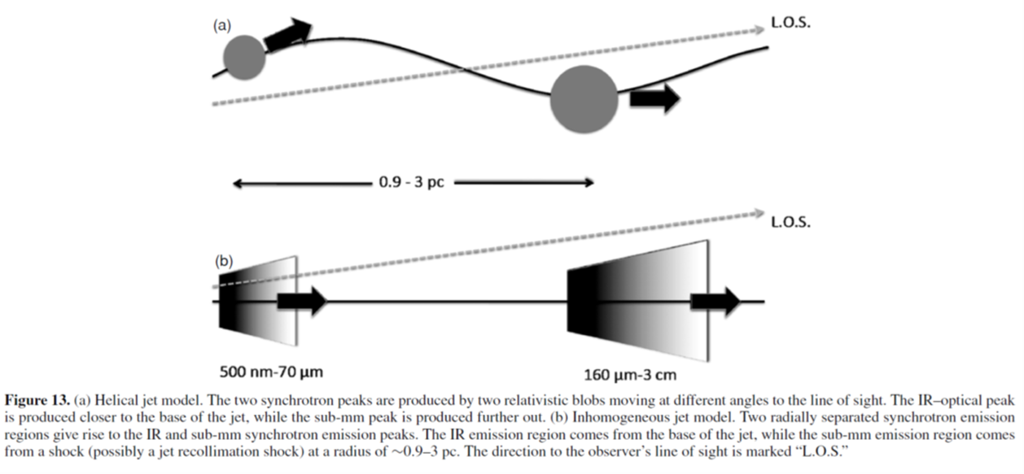
What could happen in a messy
environment? “Compton Mirror”
and “external/internal” (moderately
beamed?) photons from a
jet sheath?
[often see limb brightening in FRI
radio images?]
Acceleration in sheath (boundary,
shear layer)?
``Stratified” jet
w/structure, e.g.,
Γ(Θ)?
Pair sheath?

Slide 27
Vercellone et al. 2011
Gamma-Ray
“Plateau” State
-- NO short-term
variability
“The Flare”
3C 454.3
(Nov. 2010)

Slide 28
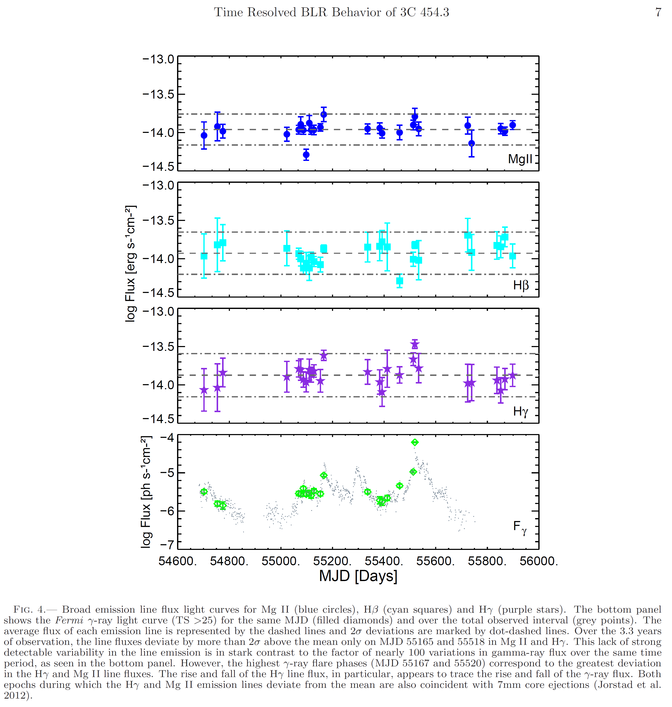
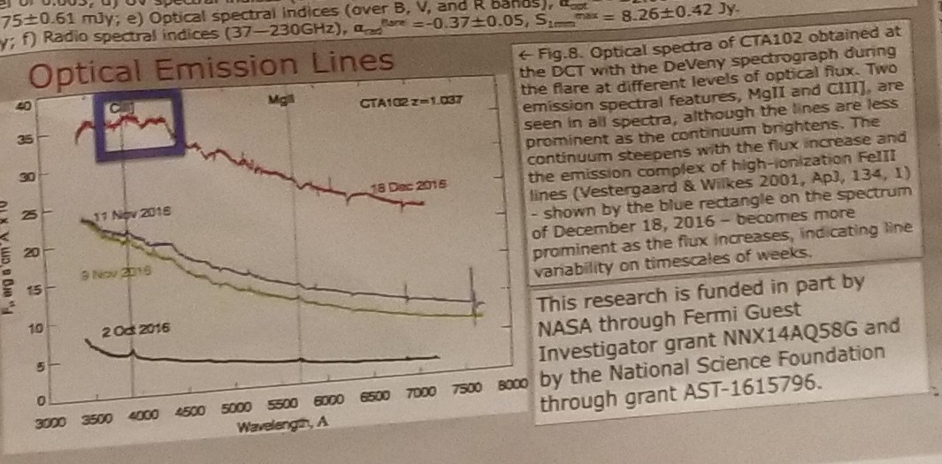
Disk-Jet Connection?
Isler et al. 2013 [see also Leon-Tavares 2013]
Jorstad et al., in prep
Central Engine vs.
Jet?

Slide 29
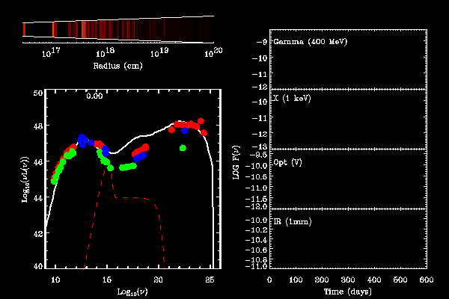
Numerical simulations for 3C 279. Spada et al. 2001
(Internal shock – “Christmas tree”-like model)

Slide 30
Where does jet gamma-ray emission occur? If have enough sensitivity,
probably everywhere … (though not at the same time)

Slide 31
Fractal
Variability?
Cheung et al. 2014

Slide 32
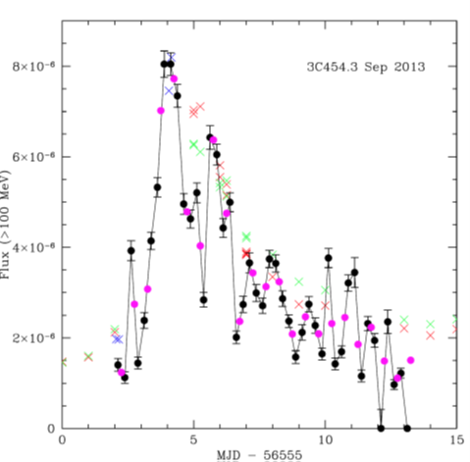
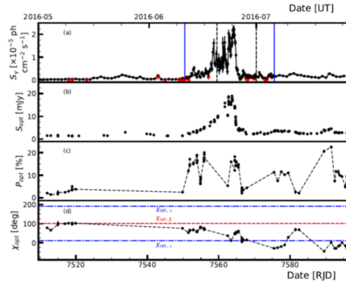
Optical vs. Gamma-Ray Variability: 2013 flare in 3C 454.3
QUEST SNe survey,
2 obs/night, 2hr separation
fake..
Fermi, Daily
SMARTS, 2-3x night
Fermi daily lightcurve – red
QUEST lightcurve, V – blue
SMARTs lightcurve, B - green
If you only had SMARTS and Fermi daily coverage, good luck measuring leads/lags
(e.g., SMARTS missed peak).
On 2hr timescales, QUEST typically sees <10% variability (~15% at flare peak). But if as before
(TBD), gamma-rays will have ~2x(+) variability on that timescale!?
Yet on ~daily timescales, optical and gamma-ray fluxes track well??

Slide 33
Variability Take-Away Points
In the brightest flares, there is strong evidence for
variability on < 3hr timescales, the shortest binning time typically used in Fermi light-curve analysis.
Gamma-ray variability appears fractal. Amplitude increases with decreasing
binning timescale. Day+ flares actually made of many (>2x) subflares…
<30 minutes variability possible, but not so common
Spectral variability is present on these short timescales too.
=> DON’T USE DAILY bins for detailed SED analysis! Can get “unphysical”
time-average SED.
Variability characteristics useful for identifying “states”
Pointed mode Fermi observations + ~continuous multi-wavelength coverage (not one or two snapshots per night) are essential for unraveling what’s going on. THERE is action on < Fermi scanning timescale, e.g., initially missed Crab flares…
Rapid variability is a problem for GeV blazars too…!!
Connection between optical/NIR and GeV not entirely obvious...
BAD optical-gamma correlation on short (< day) timescales for FSRQ.

Slide 34
Some other issues:
Shortest variability timescales decreased over years, inferred Doppler factors increased,
recent papers quote δ~50 with batting an eye. As VLBI frequency (resolution) increased,
also have reports of similar Doppler factors (~30). How do we reconcile this with
Grand Unified Blazar/Radio Galaxy FRI-FRII theory/statistics? [Look at time-averaged
Emission?]
Related: What is gamma-ray emission as f(viewing angle)? Data is there to do better
job but not so clear yet.
High Doppler factors often imply very inefficient emission regions (=> huge bulk
jet power if you’re not careful)?
If rapid variability implies small emission region, have opposite efficiency problem?
How do you get so much power out of such a small region?
Is that really possible via reconnection, jets-in-jets, etc.?
Minute variability for 10⁹ solar mass black hole more extreme than
10 msec variability for few solar mass black hole (GRB)?
Connection to central engine? Will have much better understanding of central engine
variability with LSST. Compare to gamma variability?

Slide 35
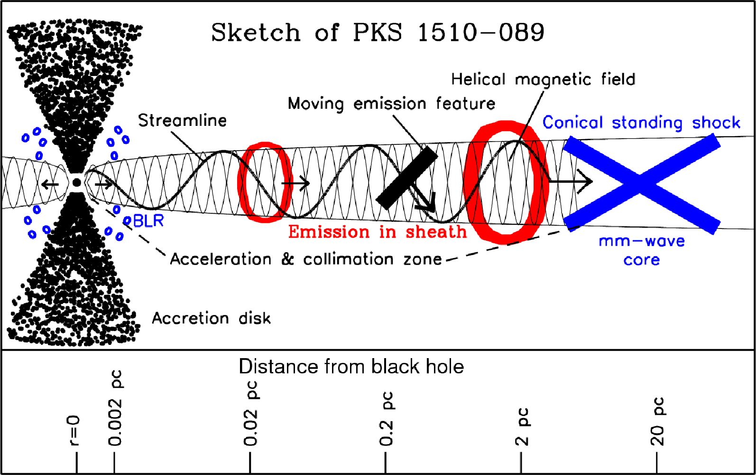
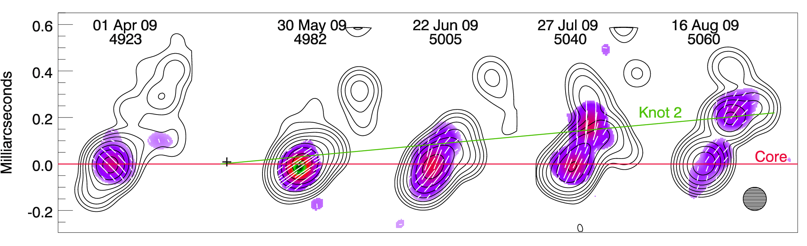
What to do?[A. Marscher]
Many γ-ray flares occur as “blob” passes through or continues downstream of core, a “steady” feature, e.g., standing (recollimation?) shock.
Some flares - include multiple wavebands, others are “orphans” → energy range of power-law distribution of electrons is sometimes broad, sometimes narrow; not all events accelerate electrons to high enough energies or involve enough seed photons to make γ-rays.
It is clear that the multi-waveband emission of blazars is complex, with multiple components possibly active at any given time and some having low duty cycles.
This means: (1) less complete observational programs can give misleading results,
[need large sample + good broad-band variability sampling] , (2) we need to maintain a long-term comprehensive program to sample the range of behavior in order to develop realistic models.

Slide 36
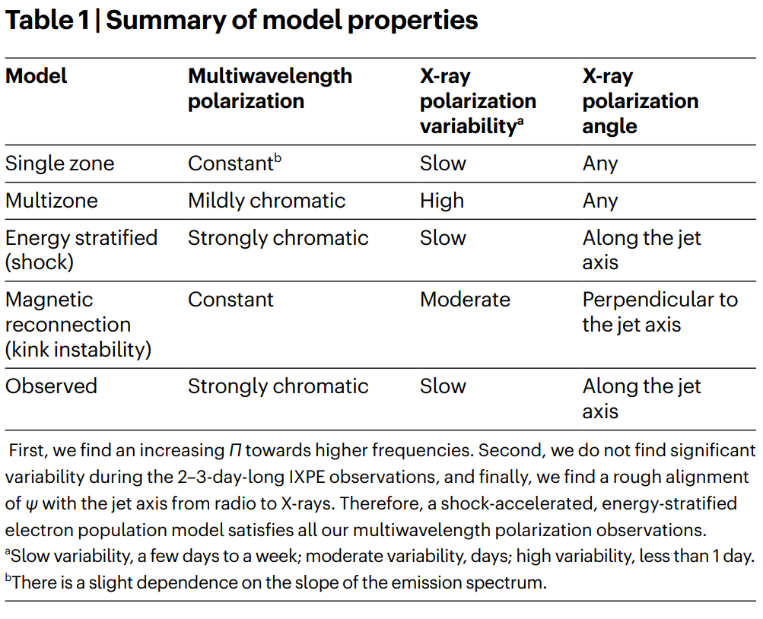
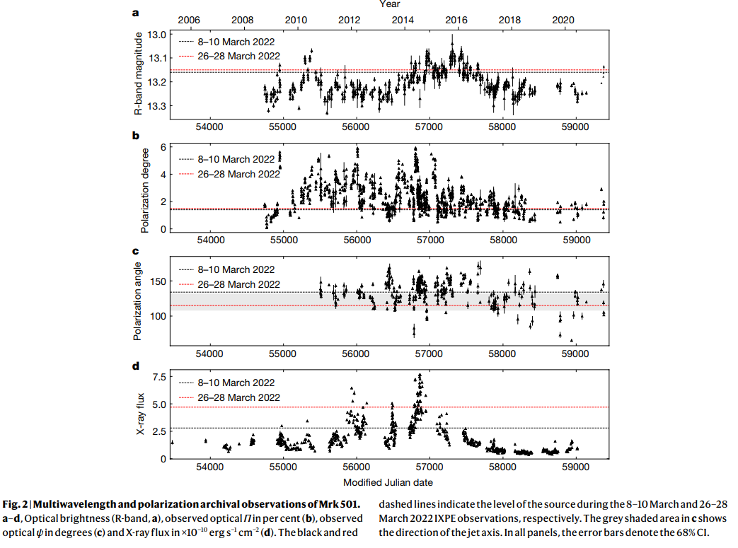
IXPE – finally have X-ray polarization information for Mkn 501 [Liodakis et al. Nature]

Slide 37

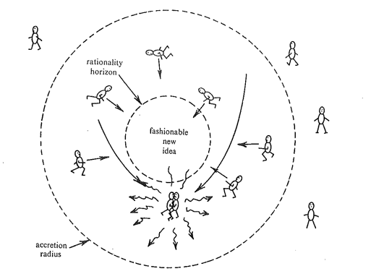
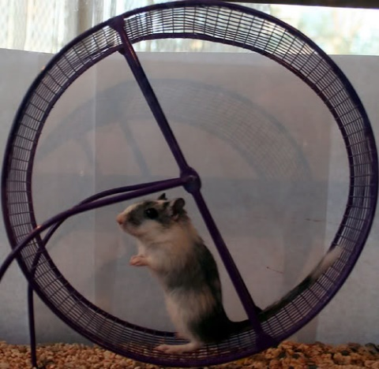
Recent Progress in Understanding Particle Acceleration in Astrophysical Sources?
With apologies to D. McCray + K. Nalewajko

Slide 38
Recent Progress in Understanding Particle Acceleration in Astrophysical Sources:
Better Observations + Bigger Computers = Neither Sources nor
Acceleration Theories Quite What Expected ….
Hey, world is not 1.5D
+ homogenous or toroidal – 3D + Turbulence!?
Convenient Charge Starvation and Current Sheet Topology – Direct Field (LINAC) Acceleration?
2.5D >1.5 but still < 3D
Drift, Kink Mode?
To Guide or Not Guide Field?
Fermi I, II, I.5?
High σ /quasi-perpendicular shocks “Bad”? Kill σ!
Weibel, Weibel, Weibel …
Two beam instability?
PIC
L_{AGN/GRB}~ 40 c/ω_{p} , right?
Injection Problem?
Striped Jets
And Winds?
Tearing Modes
On-Demand, Ultra-Fast Reconnection
(Mini-jets?)
Ion Ring Instability
Wave Resonance & Breaking
But Dad, MHD is so twentieth century …
m_{e} vs. m_{p} still annoying
Radiation Reaction and Feedback/Drag?
With apologies to D. McCray (1979)

Slide 39
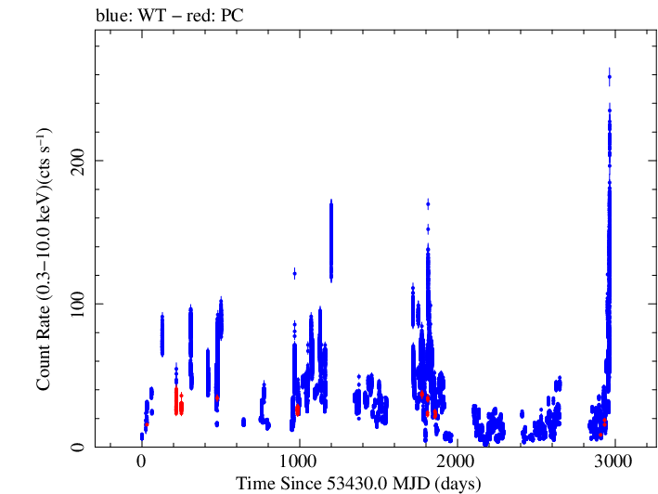
Mkn 421 goes haywire! Multiple Personalities…
Public SWIFT XRT lighcurves (Falcone et al. 2012)

Slide 40
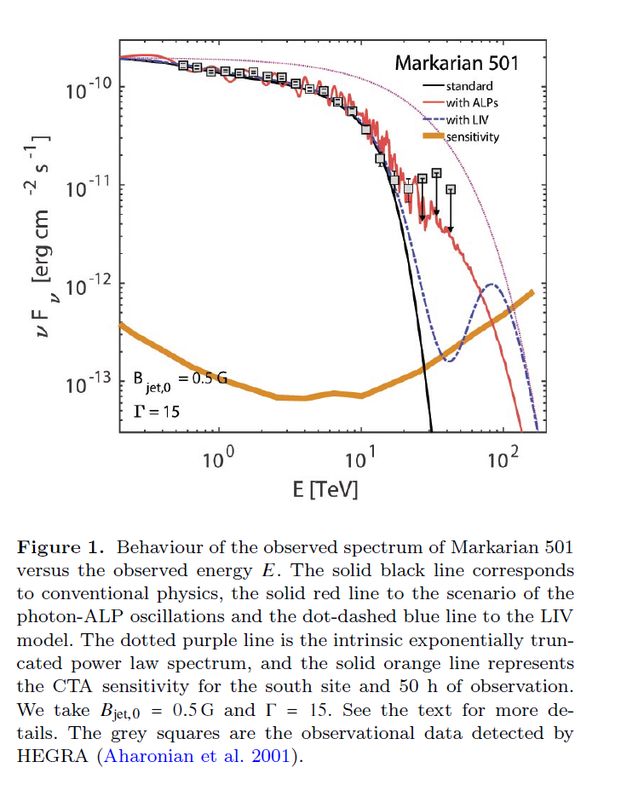
ALP, LIV, and Hadron Beams … ! (Other possible propagation effects)
E.g., Galanti, Tavecchio,
& Landoni 2019

Slide 41
NGC 1068 – ICECUBE!
There are definitely TeV+ energetic particles
associated with a non-jetted black hole !
Complication: neutrino flux ~steady (80 neutrinos over 8 years)
while can corona luminosity usually varies a lot.
F. Halzen, CDY

Slide 42





Extended X-Ray Emission from Jets!! [Parent population of blazars] – Potential GeV/TeV Sources!
Cygnus A - FRII (powerful jet?)
X-RAY
M87 – FRI (weak jet)
X-RAY

Slide 43

O.K. But what does this have to do with LHAASO? NGC 1068 particularly “dirty” environment,
but there may cases that are more Cyg X-1 like and also occasionally have ejections/outflows.
Also:
Most AGN (90%) are not radio loud, i.e., have powerful jets, but many (all?) have outflows
of some kind that may be quite powerful, e.g, UFOs (UltraFast Outflows, Tombesi et al.).
=> Like Galactic colliding winds!? [And outside of “compact” region], see VHE?

Slide 45


Two components!
Optical polarized
Synchrotron
TeV+ electrons!
Uchiyama et al. 2007

Slide 46

Can use M87 [Cen A?] to probe diffuse background at
MIR /FIR wavelengths with E_{γ} > 10 TeV γ-rays!
F. Aharonian

Slide 47
Ajello et al. stacked Fermi data for ~11 AGN
known to have UFOs. Compared to control sample
made to look as much as like UFO sample, except
for lack of UFOs in X-ray spectra.
Stacked UFO AGN show signal!
Stacked control sample doesn’t.

Slide 48

Big complication – even in FSRQ, rapid variability present
at GeV energies on 5 min (3C279) - ~hour timescales!
Bulgarelli et al.,
In prep.
Preliminary aperture photometry analysis of AGILE data for 3C 454.3 flare data,
blue = 3hr binning, red =daily binning … N.B. is continuous, pointed observation!
(Not Fermi scanning.) Now imagine we only had one 3hr observation/day
(not atypical for IACT), i.e., we dropped 7/8 of the blue points … GAPS=BAD!

Slide 49

Spectral Evolution
on Short
Timescales?
[work by S. Saitoh]
Fig. 2: (left panel) Sample light curves from the giant flare of the blazar 3C454.3 in 2010 shown
for four different energy bands. The light curve points are obtained by integrating flux over the
~30 minute exposure windows shown in the bottom graph, properly taking into account the
variation in exposure during the window. Note that there is clear evidence for fast and repeated
variability (greater than factor 2 on ~0.5-1 hour timescales.) (right panels) Discrete correlation
function computed between the 0.1-0.3 and the 0.3-1 GeV energy bands (top) and the 1-3 GeV
(bottom) energy bands as a function of time lag/lead between the bands. Fluxes in the various
bands do not behave identically, i.e., there is spectral evolution during the flare, and
there is a moderate (~2 sigma) detection of a high-to-low energy lag above ~1 GeV.

Slide 50

Fig. 3: Similar to Fig. 2, except the data is for the large 3C454.3 in 2009. Interestingly, the short timescale behavior below ~1 GeV is qualitatively similar, but not above 1 GeV – compare the 0.3-1 vs 1-3 GeV correlation functions in the lower of the two right panels.

Slide 51


Changing look/state AGN(!) – Ricci et al. (2021), 1ES 1927+654
Archival observations
Entire corona disappears
then reappears?
Not supposed to happen
on such short (month-year)
timescales…
Lots more candidates to come
from optical surveys …

Slide 52
Even though LHAASO may not be able to track details of variability, it has one big
advantage over IACT: ~continuous monitoring for most sources.
Besides catching unexpected flares => one can derive much more
easily time-averaged spectra – directly comparable to Fermi 4FGL fluxes. Much
better for determining luminosity functions, average opening angle of emission, connection
to radio power (which usually comes from larger, effectively time-averaged scales).
If one is forced to base conclusions on individual flares,
variable Doppler boosting can be a very very big problem.
Time-averaged flux/luminosity is also the relevant one for cascade background calculations
propagation calculations where IGMF-induced time delays are significant.
As VERITAS discovered recently, low duty cycle of blazar emission means have to go
5-10+ years to get multiple flares. So either observe many, many objects or observe
fewer (hopefully representative) sources for longer time. Can’t use measurements
triggered by MAGIC flare, etc. ☹ Much cleaner and simpler with LHAASO [clean
selection function].
Because of broad and ~uniform sky coverage, LHAASO should be also able to do a lot
with stacking analyses.

Slide 53
How to handle extra-galactic transients
LSST/Rubin operating mode – strengths and weaknesses
  As LSST [a narrow field instrument] tiles the sky every night, individual
  exposures quickly (~minutes-hour) differenced against reference image
  that is periodically updated [how often is subject of ongoing debate]. Transients that
  exceed a 5 sigma variability threshold are sent out in real time on alert stream, along with
  30 days of lightcurve history.
  After that no other data on the transient is publicly available until ~yearly data release that
  contains lightcurves for the previous year. Strategy partly motivated by desire to keep
  alert data flow manageable (10+ million triggers per night).
  Strength: follow-up facilities get access to transients as quickly as LSST can determine
  something happened. Can catch objects that fade quickly.
  Weakness: Interesting classes of objects like ``changing look’’ AGN are missed
  because their variability timescale does not match combination of difference imaging
  timescale and alert threshold. (These objects change by 5 sigma on ~several week-month
  timescales).If have to wait a year to follow-up object, completely miss transitions
  – science is lost forever. Also 30 days of lightcurve history sometimes is not sufficient.

Slide 54
Ideally, LHAASO would have similar alert stream (as real time as possible) and trigger
on range of timescales. Not trivial, but not as hard as for LSST because VHE sky is much
darker less crowded than optical sky.
Note: LSST cannot afford to trigger on multiple timescales across
the whole sky, but individual science collaborations can have ``watch lists’’ (up to ~million
object that are monitored in custom manner – NOT possible via brokers, which only
collect alerts). If LHAASO can’t process fast enough, setup similar watch lists, e.g., for known
X-ray binaries and AGN? Or like RXTE/MAXI, publish daily lightcurves for lists
of “interesting” objects.
Mechanism for equivalent of DDT/TOO [obtaining lightcurve for a random piece of sky
before publication]? E.g., radio and LSST discover transient that
may be “jetted” tidal disruption event. Depending on whether LHAASO sees something,
follow-up strategy for other observatories changes. Could be automated and access restricted
to``partner’’ observatories?
Given known GeV-TeV variability patterns (fractal behavior, “non-linear” fast flares),
don’t repeat initial Fermi mistake and trigger on just daily or weekly fluxes. Lost a lot of
flares. Use Bayesian blocks or simply look for clusters in photon arrival times.
Apologies for stating obvious, but have been in collaborations where lost science because
hadn’t prepared before experiment started. Treat AGN flares like GRBs!

Slide 55



What sources could I put on a watch list?

Slide 56
In stellar mass black hole systems, there is HE/VHE emission (!)
AGILE
Some may be from extendend jet, but some could be from “corona” (base of jet). Cyg X-1 is not really microquasar
(bulk Lorentz factor of jet < 2, no huge
jet outbursts like Cyg X-3, GRS 1915)
Same for AGN? [~3C273 level emission o.k. for EGRB]

Slide 57

Active Galaxy
energy in protons ~
energy in electrons [??]
photon target observed
in lines
>> few events per year km²
Radiation Field:
Ask Astronomers
Produces Cosmic Ray Beam?
F. Halzen, 2004

Slide 58
The trouble with AGN jets and ICECUBE neutrino(s)…
Rieger lecture notes
In delta-function approximation, pion has ~0.1-.2 energy of proton, and neutrino has ~.3 of
energy of pion. ICECUBE sees neutrinos from ~1 TeV – 1 PeV. To make TeV neutrino, need
proton of energy ~20 TeV, or γ~2x10⁴. => need target photon E~3.5 keV [X-rays], and lots of them (for
efficient production)… where do you get these? Compactness (pair production) problem…

Slide 59

What’s up after 10+ years of Fermi/IACT blazar observations??

Slide 60


Slide 61



In case you still thought things
were simple…
Mkn 421 2002 X-ray/TeV campaign
(Dieter Horns, preliminary)
X-ray
Counts
TeV
X-ray hardness ratio (spectrum)

Slide 62
Theoretical Considerations [Complications] III.
If electrons/pairs are primary particles, what is acceleration energy spectrum?
If they are instead secondary particles, similar
considerations for primary protons ….
(relativistic e/p behave in same way for
given energy)

Slide 63
This is what we really need to fit ☺
Saitoh, in prep.
From Ciprini 2014 talk
Need to solve time-dependent equations (+ allow spatial inhomogeneities)!
Fact (??) that rapid [<day] optical variability amplitude in FSRQ
never as great as gamma amplitude
=> (i) dilution of optical? Multi-zone
(ii) Compton dominance of short flares even larger than already
large Compton dominance of time-averaged spectrum
(one zone: rest-frame U_{rad} >> U_{B})
=> Klein-Nishina [cutoff ?] complications [E.g., Moderski et al. 2005]

Slide 64
Now let’s play some with physics expressed in these units…

Slide 67
Numerical simulations for 3C 279. Spada et al. 2001
(Internal shock – “Christmas tree”-like model)

Slide 69
Now have ~10 years of gamma-ray/MW data
on behavior of two humps ….
And the answer is ….. [SMARTS data]!
Uh, oh…
No correlation at ~0 lag except
for 3C454.3!
In fact, no correlations…

Slide 70
Sources change nature!
[= correlation function not
well-defined…]
On shorter timescales, can see
borderline significant correlations in objects
besides 3C454.3 .. But at ~2 weeks…???

Slide 71

One zone fit to 3C 454.3 Dec 2-3 2009, Follow Bonoli et al. 2009…. Except Include
SMARTS
NIR/opt
Need good >broad-band< data!
(must be simultaneous on < hour
timescales too!)
Bonoli et al. 2009 conclusion – source in similar state
on both days, only gamma-ray break energy changed
during flare episode… but…

Slide 72
Keep Basic Model Same –
Fiddle With Bulk Lorentz Factor and High-Energy Electron Cutoff
Is this kind of behavior
ruled out?

Slide 73


If ASTRO-H had been available during big Fermi blazar flares, we would
have significantly better understanding of source like 3C454.
Before ASTRO-H
Fermi
Dec. 3, 2009
Dec. 2, 2009
??
+POLARIZATION!
(MDP ~25 %, 10 ks)
SMARTS
With ASTRO-H
SWIFT
1 hr , 3.6ks exposure
(vs. 12 hr for Fermi)
SGD
HXI
Big change?
Not much going on?
SXI
3C454 on two nights in
December 2009…
Possible breaks due to K-N effects clearly
resolved. And can follow their evolution on
<3hr variability timescale seen by Fermi!

Slide 74
General Conclusions:
AGN, both jetted and non-jetted, are more interesting/extreme than we had thought. EGRET showed us we were only seeing the tip of the iceberg. With 2000+gamma-ray blazars, Fermi has shown a lot more of the iceberg, but there are still only ~30 flare events bright enough to probe the shortest variability timescales at GeV energies… More to discover! [Polarization too?]
Lots more TDE/changing look AGN coming – gamma-rays important to unraveling what is going on… (both in corona + jet)
To address variability issues, need photon bucket. APT? Low-threshold IACT? (in principle could go down to ~10 GeV) STARLINK approach – launch lots of Fermi’s?
Time coverage gaps = bad. For IACT, spread in longitude so can provide CONTINUOUS time coverage?
There is other cool science can do at gamma-rays like nuclear astrophysics, and follow-up of multi-messenger sources (LIGO)
and low-duty cycle AGN flaring => don’t try to do everything
with one mission?!

Slide 75


3C279 Fermi Multi-Wavele ngth
Campaign
(Polarization Swing)
Abdo et al. (Hayashida) 2010
?

Slide 76
A different kind of flare from the “canonical” 3C 454.3….
2019

Slide 77
Yoshida et al., in prep - Use FAVA to look at flares in objects (much more scatter!)
MeV blazar ?

Slide 78
The archetypal EGRET FSRQ violates most standard assumptions…
Complex object,
w/multiple emission
Components,
Peak energy changes,
possible detection even
at TeV… without
ASTROGAM, we will
remain pretty clueless
no matter how many
more multi-wavelength
we carry out!
ASTROGAM!
E.g., how do I connect
blue dots?? Is it MeV blazar?

Slide 79
Numerical simulations for 3C 279. Spada et al. 2001
(Internal shock – “Christmas tree”-like model)

Slide 80
Rapid Gamma-Ray and Optical Variability in Bright Fermi Blazars
P. Coppi, Yale
S. Saito, Rikkyo
L. Stawarz, Jagellonian
Using an “aperture photometry" technique to generate Fermi lightcurves on minute
timescales, we have carried out a Bayesian Block analysis of the brightest blazar flares to search for variability down to ~15 minute timescales. There is moderate evidence for one such
fast flare in PKS 1510-089, but 9 other flare events we examined do not show it, i.e., very
rapid variability as found in TeV blazars is probably not common. However, all flare events do
show evidence strong (factor 2) gamma-ray variability down to ~1 - 2 hour timescales, and
we show evidence in 3C 454.3 for spectral evolution on these short timescales. Using SMARTS
and optical/NIR data, we are searching for correlated rapid optical variability on similar
timescales. While variability on these very short timescales is seen in a few cases,
the optical variability amplitude is typically much smaller than the gamma-ray one.
Interestingly, on ~1-3 day timescales the optical and gamma-ray variability are instead
well-correlated and of similar amplitude.

Slide 81

Rapid Variability Example: PKS 1510-089
Using standard daily time bins doesn’t tell the whole story …

Slide 82



N.B. Amplitudes of flares increases as go to shorter time binning.
There are >2x flares on even three hour timescales … !
=> DON’T USE DAILY LIGHTCURVES

Slide 83

Bayesian block analysis inside individual Fermi exposure windows,
example for PKS 1510-089.

Slide 84

3C 279 in 2015, Fermi, arXiv:1605.05324, Ackerman et al. 2016

Slide 85


Slide 86

G. Senturk et al. 2011

Slide 87


Lesson: PKS 2155, X-ray-optical-gamma-ray correlations?

Slide 88


Slide 89


Marshall et al. 2010 Pictor A rapid X-ray Variability?
Centaurus A - Chandra

Slide 90

Another “boring”
nearby elliptical …
Cen A (radio + optical
+ Fermi)

Slide 91


So, why do “low energy” astrophysicists care about VHE astronomy?
Starlight
BIG zodiacal
light foreground
Dust

Slide 92


Slide 93


Slide 94


Slide 95


Slide 96


Slide 97


Slide 98


Slide 99


Slide 100


Slide 101


Slide 102
G. Senturk et al. 2011

Slide 104
One zone fit to 3C 454.3 Dec 2-3 2009, Bonoli et al. X-gamma + SMARTS NIR/opt

Slide 106
Isler et al. 2013, submitted [see also Leon-Tavares 2013]

Slide 108
Personality states trigger stare don’t have one instrument do all if could simultaneously whole spectrum including break, can start to constrain, but still often several model degeneracies, really start to constrain if measure simultaneously take advantage of big flares, single component
FRB example plug into various brokers dedicated follow-up facilities pair cascade swift ng decadal

Slide 109


(Nature 2007)

Slide 110

From P. Blasi,
Brasil lectures
HADRONIC
RXJ1713
RXJ1713
LEPTONIC
Morlino, Amato & PB 2009

Slide 111
How to effectively probe the Universe: use the right messenger particles!
[Ideally use as many different kinds and at different energies as possible.]
Optical/UV: characteristic (z=0) stellar energy, worst in terms of obscuration, but do see lots of useful atomic features [your eyes]
Radio: mainly non-thermal, relatively good at penetrating intervening matter [currently highest spatial resolution, e.g., VLBA interferometry ].
Infrared: see energy absorbed and re-emitted by dust [Spitzer, ALMA].
Soft X-Ray: hot gas, atomic features still available but not completely understood, still easily obscured.
Hard X-ray (>10 keV): very little gas/stellar contamination, very penetrating, lose atomic features, hard to focus – sensitivity starts to plummet.
Soft Gamma-Ray (>500 keV): pair annihilation line, nuclear lines, but subject obscuration again due to photon-photon pair production, even harder to stop in detector and image, lots of background.
VHE Gamma-Ray (>GeV): obscuration in source/during propagation big worry (double-edged sword), but clearly indicates presence of very energetic particles and “extreme” processes and physical conditions (and new physics?)!
All, straight line propagation from source!

Slide 112

Messenger particles II.
Protons, Electrons (cosmic rays): subject to energy losses, deflection by magnetic field.
Neutrinos: straight line propagation, usually impossible to stop in source and almost equally impossible to detect ☺, smoking gun probe for hadronic processes. [ICECUBE, right sensitivity level to finally start seeing something besides nearby supernova]
Gravitons (gravity waves): straight line propagation, need only to detect strain (amplitude not power) => can see to high redshift, but expected strains miniscule, no convincing detections yet [LIGO, LISA]
When you look in new ways …
??

Slide 113



A “boring” object in the sky: the nearby elliptical galaxy M87
Optical
Radio

Slide 114

Bayesian Block Analysis – PKS 1510-089, Flare 5 shows 3.5 sigma excess of orbits where saw possible flux change (vs. expected number of false positives, solid line in right panels)
Red interval – Bayesian blocks favors 2+ intensity levels during orbit
Solid line =
Number of
expected
false positives
Light curve points shown are averaged over each Fermi exposure window (~30 min long).

Slide 115



Time Domain Studies of AGN: How to Use Gamma-Rays
Properly(?)
λλ
Ground-Based γ-Ray Detectors
P. Coppi,Yale
?
Space-Based γ-Ray Detectors
Why Gamma-Rays for AGN?
The Problem: (Extreme) Variability,
Low Duty Cycle – Where Things Stand
III. Future Prospects & Suggestions
Fermi
?? neutrinos

Slide 116



The high-energy break in the hard state of Cyg X-1: Another example of how the SGD/ASTRO-H comes into its own for brighter sources (>10⁻¹⁰ erg cm² s⁻¹), e.g., enabling science that cannot be done by NuSTAR alone.
Cyg X-1, 30ksec, EQPAIR+ 511 keV
line
SGD
Temperature determined to < 10%,
line clearly detected.
Cyg X-1, 100ksec, EQPAIR+ 511 keV
line
SGD
Even with sensitivity to ~60 keV, i.e., past the peak
of the Compton reflection hump, modeling degeneracies
remain for NuSTAR/HXI alone. Above, the temperature
of the Comptonizing electrons cannot be constrained
to better than a factor 2.
Now line width accurately measured!
Standard PEXRAV models ruled out
because of wrong cutoff shape.

Slide 117



Gamma-Ray Emitting AGN
P. Coppi, Yale
Blandford-Znajek vs Blandford-Payne
?

Slide 118



Is there a blazar sequence??
Lee et al., U Wash.
No…?

Slide 119
Code units for leptonic source, recap
Good choice allows us to scale code to many environments,
keep variables ~ unity (helps with numerical precision), and
often let’s us quickly do order of magnitude estimates.
Compactness

Slide 120
Given previous SEDs, and high compactness of coronal region, one might think Cyg X-1
could never be significant TeV source… but
Albert et al 2007

