Slide 1
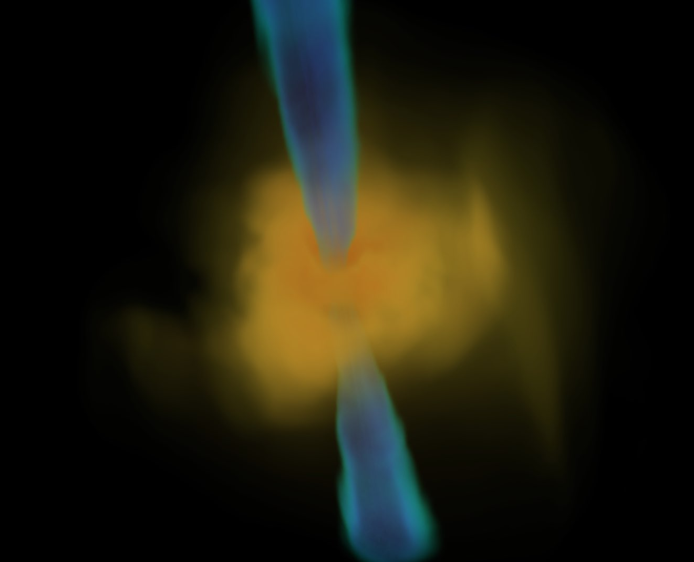
Simulating Bondi-Like Accretion Flows Around Black Holes
Tom Man Kwan
The University of Hong Kong
+ Jane Dai, Sasha Tchekhovskoy
Astrophysical Black Holes: A Rapidly Moving Field
24 June 2023
www.tomkm.com

Slide 2
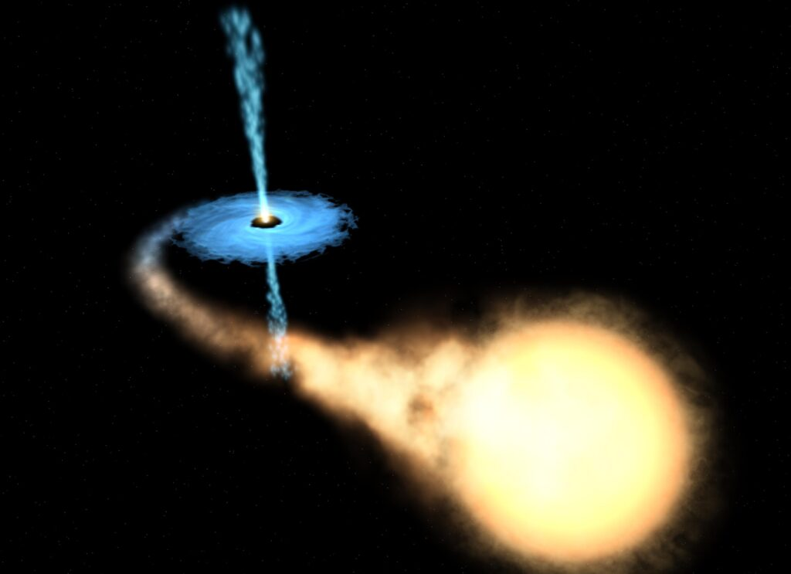
Black Holes and Accretion Disks
Gas accreting onto black hole carries angular momentum and forms a disk
Disk viscous process allows the gas accrete and powers luminous emission
Sometimes a relativistic jet is produced!
Credit: ESA/NASA/Felix Mirabel

Slide 3
Relativistic Jets launched from Black Holes
$$P_{Jet}$$
Blandford-Znajek Mechamism (1977)
$P_{jet}∝φ^{2}a^{2}$
Jet Power
Magnetic flux
Black hole spin

Slide 4
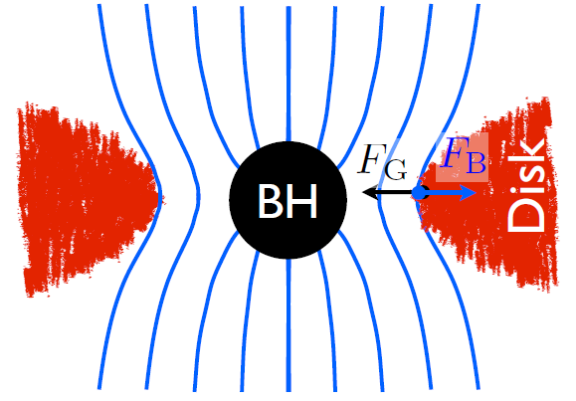
Magnetically Arrested Disk
Magnetically Arrested Disk (MAD) is formed when the inflow carries strong, ordered magnetic flux near the BH
Dimensionless magnetic flux at horizon (MAD parameter) $φ_{H}=\frac{Φ_{H}}{\sqrt{\overset{·}{M_{H}}}}≳40$
A powerful jet can be launched
Disk carries large angular momentum
Tchekhovskoy+ 2011; McKinney+ 2012

Slide 5
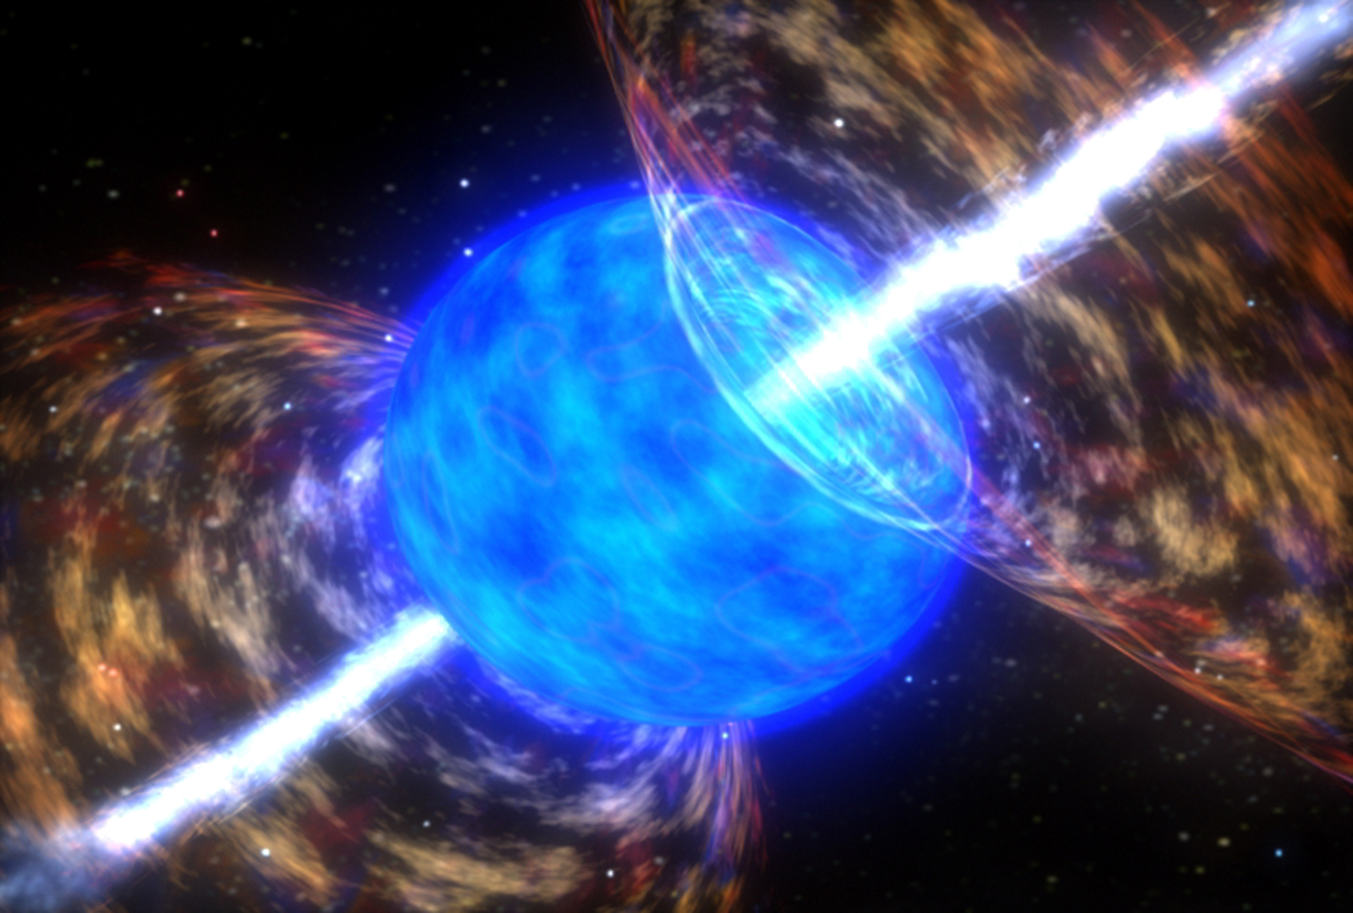
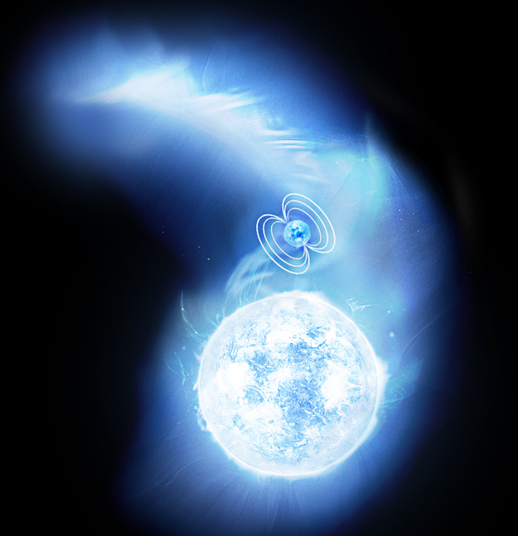
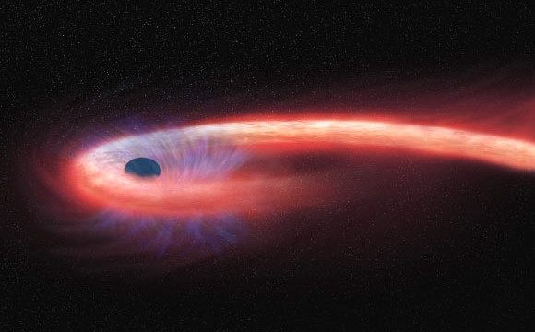
What if the accretion flow carries low angular momentum?
Long Gamma Ray Bursts
(Credit: NASA / SkyWorks Digital)
BH High-mass X-ray Binary
(Credit: ESA)
Tidal Disruption Events
(Credit: NASA/ CXC / M. Weiss)
Sgr A*
(Credit: EHT)

Slide 6
Bondi & Bondi-like Accretion
Zero angular momentum: Bondi model
A thick torus structure can form when gas has low angular momentum (e.g. Proga & Begelman 2003; Lee & Ramirez 2006; Sukova 2015)
Bondi 1952

Slide 7
Bondi & Bondi-like Accretion
Zero angular momentum: Bondi model
A thick torus structure can form when gas has low angular momentum (e.g. Proga & Begelman 2003; Lee & Ramirez 2006; Sukova 2015)
The effect of magnetic field, GR & BH spin?
Bondi 1952

Slide 8
Simulation Code: HARM
3D general relativistic magnetohydrodynamics (GRMHD) code HARM (Gammie+ 2003, Noble+ 2006, McKinney+ 2012)
Continuity equation
Conservation of Energy-Momentum
Conservation of Magnetic flux
$$∇_{μ}\left(nu^{μ}\right)=0$$
$$T_{ν}^{μ}={T^{MA}}_{ν}^{μ}+{T^{EM}}_{ν}^{μ}$$
$$∇_{μ}T_{ν}^{μ}=0$$
$$∂_{t}\left(\sqrt{−g}B^{i}\right)=−∂\left[\sqrt{−g}\left(b^{j}u^{i}−b^{i}u^{j}\right)\right]$$

Slide 9
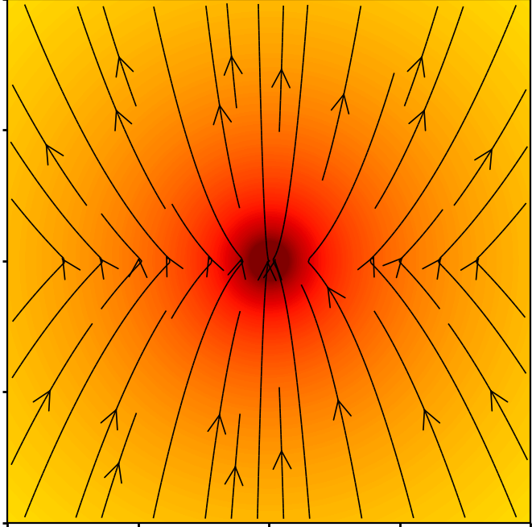
GRMHD Simulations Setup
Three simulations with zero or very small specific angular momentum
Black hole spin: 0.9
Spherically symmetric gas density
Circularization radius $R_{c}=0$, $10$, $50 r_{g}$ (BH gravitational radius)
Poloidal magnetic field in the gas
Simulation box: ${10}^{5}r_{g}$

Slide 10
$$R_{c}=0 r_{g}$$
Gas Density
Dense
Dilute
Edge-on view
Face-on view

Slide 11
$$R_{c}=50 r_{g}$$
Gas Density
Dense
Dilute
Edge-on view
Face-on view

Slide 12
MAD Formation
MAD condition
Kwan et al. 2022 In prep
Kwan et al. 2023
0 | 27.4
10 | 23.4
50 | 45.6
$R_{c}=0,10r_{g}$: form MAD initially but later fail to maintain MAD
$R_{c}=50$ $r_{g}$ : build up slowly but maintain MAD
$$R_{c}$$
$$φ_{H}$$

Slide 13
Jet Power
Kwan et al. 2023
0 | 27.4 | 18.6
10 | 23.4 | 10.1
50 | 45.6 | 61.4
$R_{c}=50 r_{g}$: powerful jets with high jet efficiency
$R_{c}=0,10r_{g}$: weaker jets with jet efficiency$∼10\%$
$$R_{c}$$
$$φ_{H}$$
$$η_{jet}(\%)$$

Slide 14
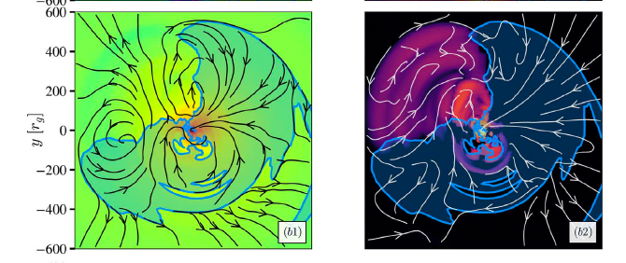
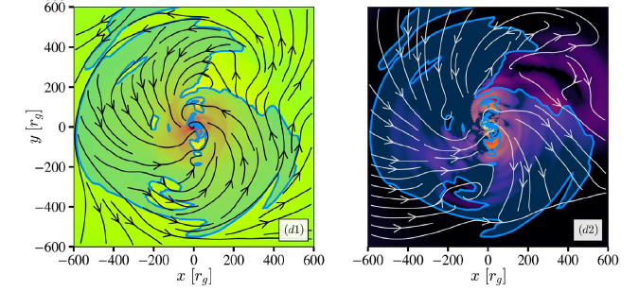
Dissipation of magnetic flux
Gas density
EM energy flux
$$R_{c}=0$$
$$R_{c}=50r_{g}$$

Slide 15
Is a “disk” produced?
$R_{c}=0,10r_{g}$ :
Gas rotating in different directions at different latitude
Outflow in some 𝜙-directions even along mid-plane
Kwan et al. 2023

Slide 16
Jet Power
Kwan et al. 2023
0 | 27.4 | 18.6
10 | 23.4 | 10.1
50 | 45.6 | 61.4
$R_{c}=50 r_{g}$: powerful jets with high jet efficiency
$R_{c}=0,10r_{g}$: weaker jets with jet efficiency$∼10\%$
$$R_{c}$$
$$φ_{H}$$
$$η_{jet}(\%)$$

Slide 17
Relativistic Jets launched from Black Holes
$$P_{Jet}$$
Blandford-Znajek Mechamism (1977)
$P_{jet}∝φ^{2}a^{2}$
Jet Power
Magnetic flux
Black hole spin

Slide 18
Key messages
A disk is not needed to produce a jet
Zero gas angular momentum accretion flow around a spinning black hole can still launch a jet through BZ process
A small specific angular momentum threshold is needed for the accreting gas to sustain MAD and launch very powerful jets
The interplay between gas angular momentum and magnetic flux is important!
Kwan, T. M., Dai, L., Tchekhovskoy, A, 2023, ApJL, 946, L42

